Slide 1
PHYS4260 Quantum Mechanics II Spring 2025
Path Integral in QM

Slide 2
Outline
Perturbation theory and the S-Matrix
Born Series
Green’s functions

Slide 3
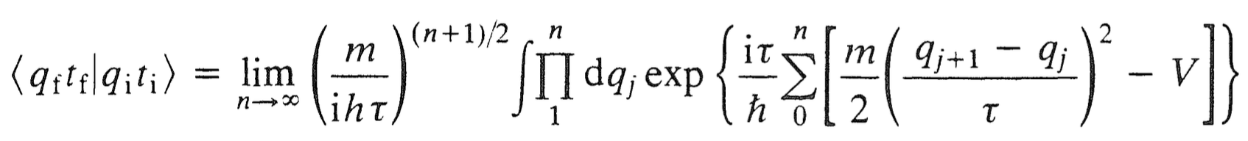
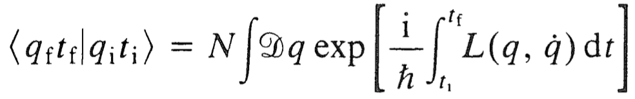

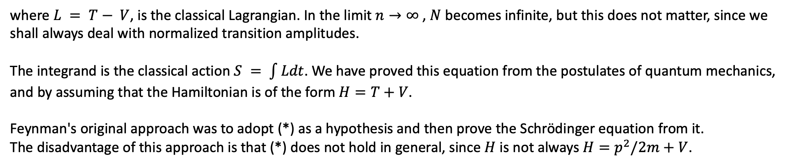

Re: $p_{j}$-integration
Doing the integration over $p_{j}$ one arrives at
and hence, in the continuum limit, one obtains
(*)
where $L = T− V$, is the classical Lagrangian. In the limit $n→∞$ , $N$ becomes infinite, but this does not matter, since we
shall always deal with normalized transition amplitudes.
The integrand is the classical action $S = \int{Ldt}$. We have proved this equation from the postulates of quantum mechanics, and by assuming that the Hamiltonian is of the form $H=T+V$.
Feynman's original approach was to adopt (*) as a hypothesis and then prove the Schrödinger equation from it.
The disadvantage of this approach is that (*) does not hold in general, since $H$ is not always $H=p^{2}/2m$ $+ V$.

Slide 4
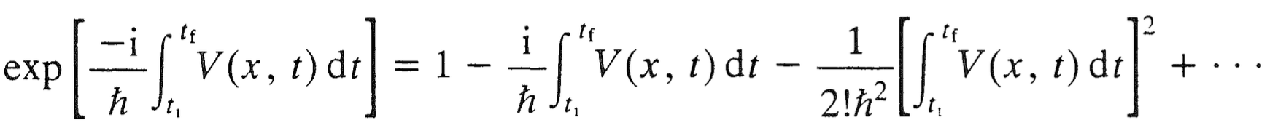
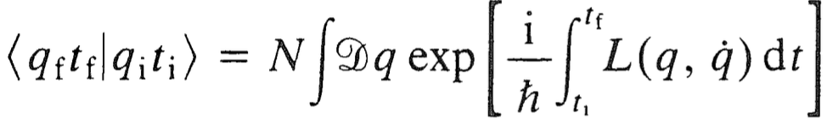
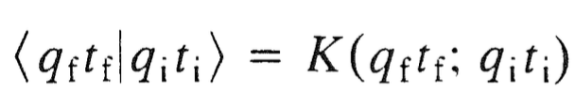

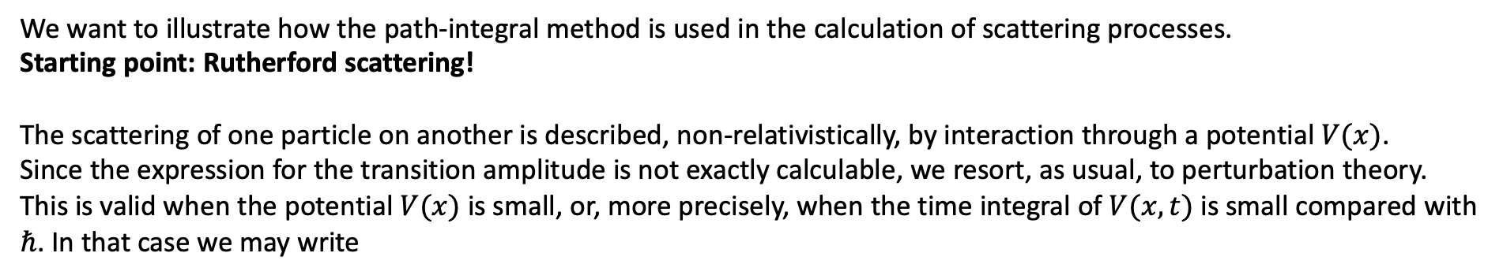
Perturbation theory and the S matrix
We want to illustrate how the path-integral method is used in the calculation of scattering processes.
Starting point: Rutherford scattering!
The scattering of one particle on another is described, non-relativistically, by interaction through a potential $V(x)$.
Since the expression for the transition amplitude is not exactly calculable, we resort, as usual, to perturbation theory. This is valid when the potential $V(x)$ is small, or, more precisely, when the time integral of $V(x, t)$ is small compared with $ℏ$. In that case we may write
This is the perturbation expansion. When substituted into the expression for the propagator
remember that

Slide 5

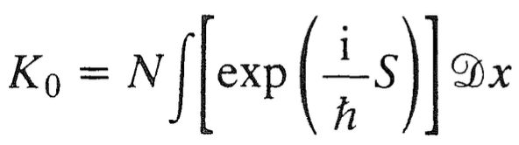
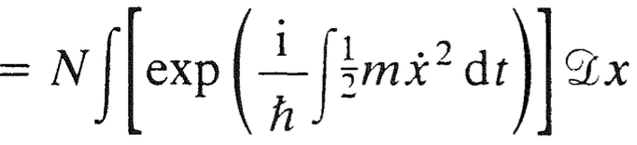
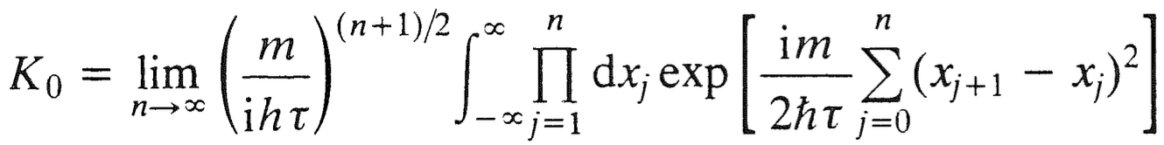
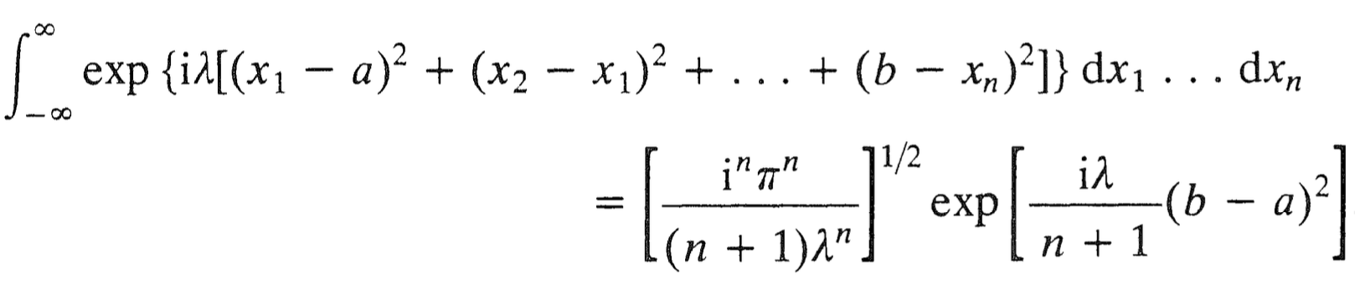
Perturbation theory and the S matrix
we get a series expansion
If $L=L(x,\dot{x})$, the first term of which is the free propagator $K_{0}$
To evaluate this, we write it in its discrete form
and using the identity

Slide 6
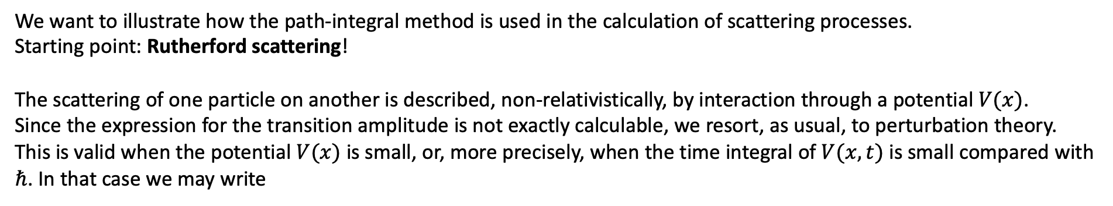
Recap: Perturbation theory and the S matrix
We want to illustrate how the path-integral method is used in the calculation of scattering processes.
Starting point: Rutherford scattering!
The scattering of one particle on another is described, non-relativistically, by interaction through a potential $V(x)$.
Since the expression for the transition amplitude is not exactly calculable, we resort, as usual, to perturbation theory. This is valid when the potential $V(x)$ is small, or, more precisely, when the time integral of $V(x, t)$ is small compared with $ℏ$. In that case we may write
This is the perturbation expansion. When substituted into the expression for the propagator
and remember that the whole point is the identification below

Slide 7
Recap: Perturbation theory and the S matrix
we get a series expansion
the first term of which is the free propagator $K_{0}$
To evaluate this, we write it in the discrete form
And using the identity

Slide 8
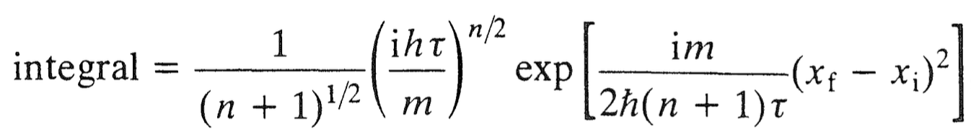

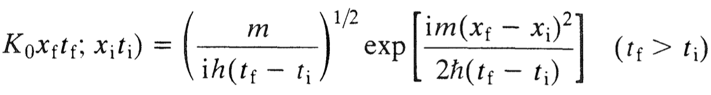
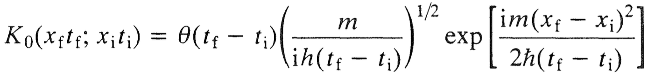


Perturbation theory and the S matrix
we obtain
Therefore, since we divided the $t_{f}−t_{i}$ interval in $n+1$ equal parts, we can rewrite
We obtain the propagator for the free particle
$$($$
$$($$
The condition $t_{f}>t_{i}$ is clearly crucial for the propagator, since it vanishes, by causality, if $t_{i}>t_{f}$, so we may properly put
Heaviside theta function

Slide 9
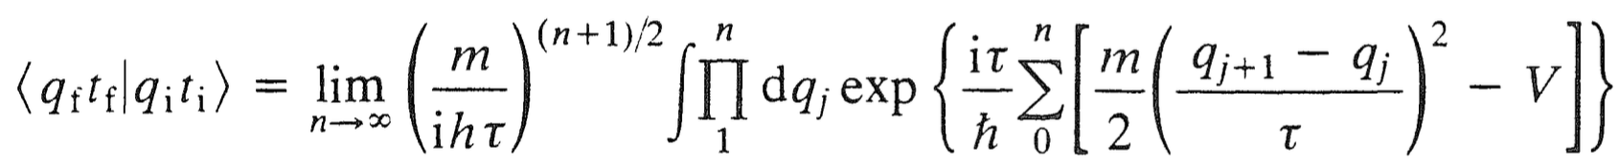
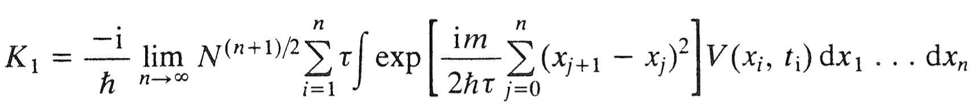

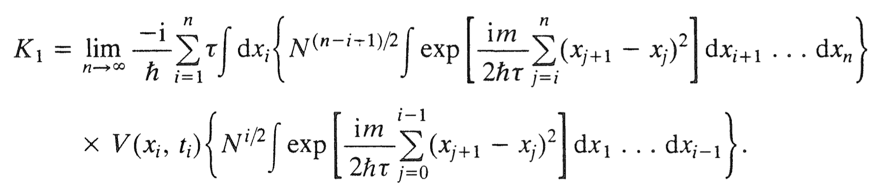

Perturbation theory and the S matrix
Let us now calculate the other contributions in the series, starting from $K_{1}$ . Using
($q→ x$ here)
and
We obtain
where and we have replaced integration over $t$ by summation over $t_{i}$. Noting that $V$depends on $x_{i}$ we
now split up the sum in the exponent into two, one going from $j = 0$to $j = i − 1$, and the other from $j = i$to $j = n$.
We also separate out the integration over $x_{i}$ and get
+

Slide 10



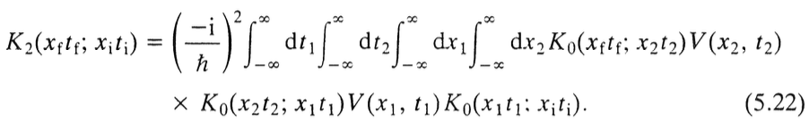

Perturbation theory and the S matrix
The two terms in curly brackets are $K_{0}(x_{f} t_{f};x t)$ and $K_{0}({x t; x}_{i} t_{i})$ and replacing we obtain
Now, $K_{0}(x_{f} t_{f};x t)$ vanishes if $t>t_{f}$ and $K_{0}({x t; x}_{i} t_{i})$ vanishes if $t<t_{i}$ and therefore the integration may be taken over
all values of $t$:
This is the first order correction to the free propagator. In a similar way, we may prove that the second order correction is

Slide 11
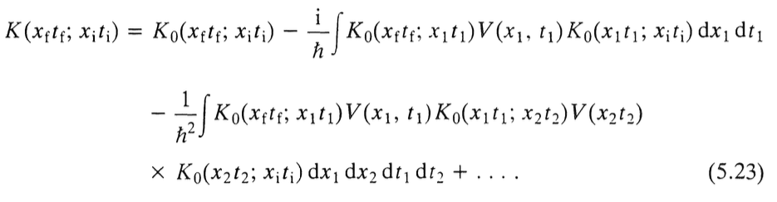

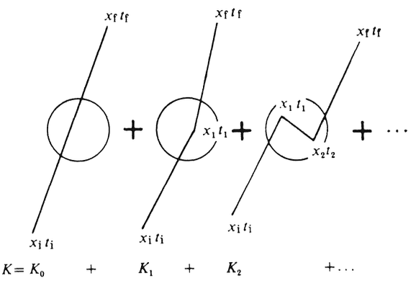
Born Series (again…)
Analogous expressions hold for all $K_{n}$, in the expansion, so we write
This is the solution to the perturbation series in $K$ and is called the Born series which we have seen in the context of scattering theory.

Slide 12
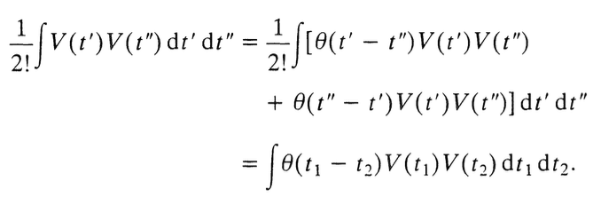
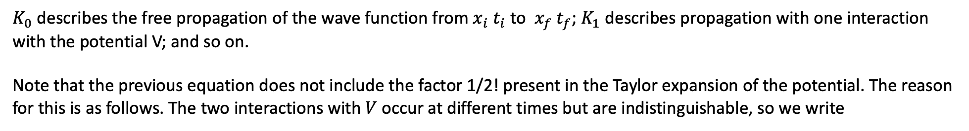
Born Series (again…)
$K_{0}$ describes the free propagation of the wave function from $x_{i} t_{i}$ to $x_{f} t_{f}$; $K_{1}$ describes propagation with one interaction with the potential V; and so on.
Note that the previous equation does not include the factor 1/2! present in the Taylor expansion of the potential. The reason for this is as follows. The two interactions with $V$ occur at different times but are indistinguishable, so we write
In a similar way, there is no factor $1/n!$in the expression for $K_{n}$.

Slide 13

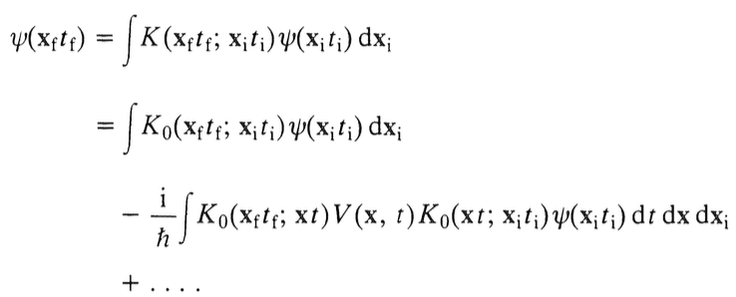
Green’s functions
Now we shall show that the free propagator $K_{0}$ is simply the Green’s function for the Schrödinger equation. To see this,
we substitute the Born series in
and obtain (note that we are using the vector position $x$ now instead of $q_{i}$)
and we have also changed from one space dimension to three.

Slide 14


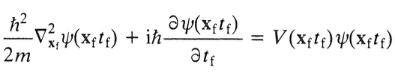

Green’s functions
Assuming the series above converges, the effect of the unwritten terms is to modify the last $K_{0}$ to the full propagator $K$, so that
This equation is exact and is an integral equation for $ψ$. Now assume that in the distant past, $t_{i}→−∞$, $ψ$ becomes free that is, a plane wave $φ$. Then, the first term on the right-hand side of is also a plane wave, since it results from the free propagation of $ψ(x_{i},t_{i})$ and we may write
Now $ψ\left(x_{f} t_{f}\right)$ obeys the Schrödinger equation

Slide 15

Green’s functions
Since $ϕ\left(x_{f},t_{f}\right)$ obeys the free-particle equation (with $V=0$), then $K_{0}$ must obey
which is the equation for the Green's function of the Schrödinger equation. Note that the presence of the $δ(t_{f}−t)$ is to be expected from the $θ(t_{f}−t)$ occurring in the definition of $K_{0}$. The propagator $K_{0}$ is then simply the Green's function of the Schrödinger equation, as claimed.

Slide 16

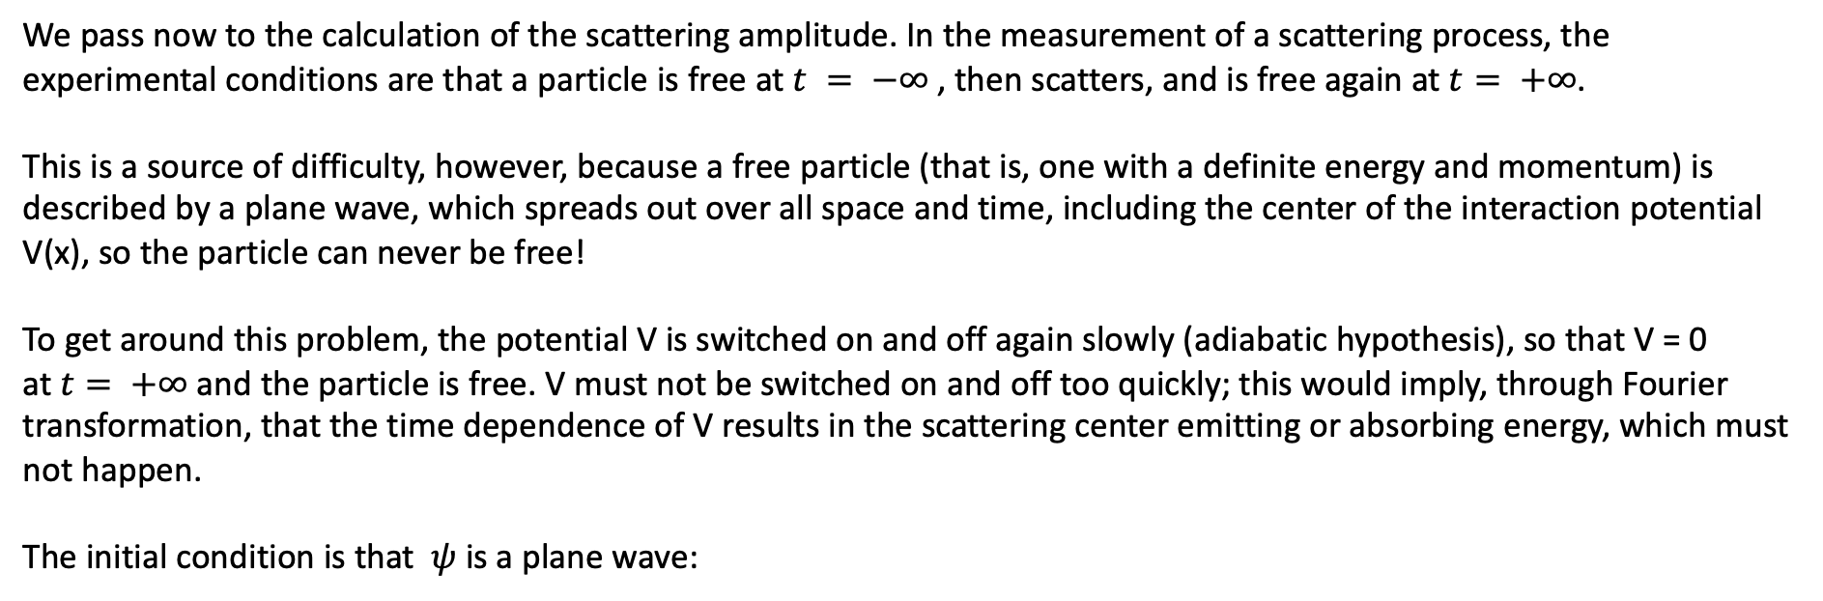
S-matrix
We pass now to the calculation of the scattering amplitude. In the measurement of a scattering process, the experimental conditions are that a particle is free at $t = −∞$, then scatters, and is free again at $t= +∞$.
This is a source of difficulty, however, because a free particle (that is, one with a definite energy and momentum) is described by a plane wave, which spreads out over all space and time, including the center of the interaction potential V(x), so the particle can never be free!
To get around this problem, the potential V is switched on and off again slowly (adiabatic hypothesis), so that V = 0
at $t= +∞$and the particle is free. V must not be switched on and off too quickly; this would imply, through Fourier transformation, that the time dependence of V results in the scattering center emitting or absorbing energy, which must not happen.
The initial condition is that $ψ$ is a plane wave:

Slide 17
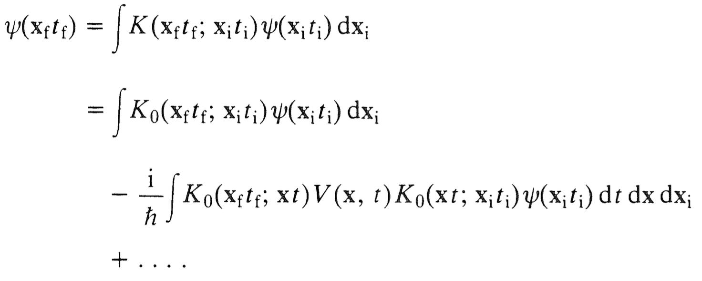
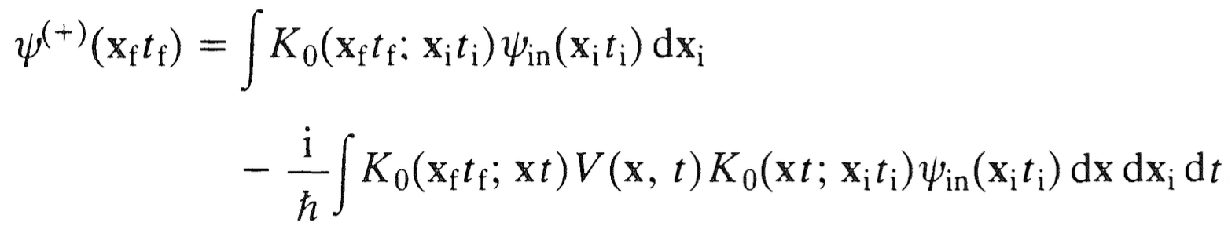
S-matrix
We assume that V → 0 for large negative $t$ and that $t_{i}$ is even further in the past. Taking the first Born approximation in
gives

Slide 18
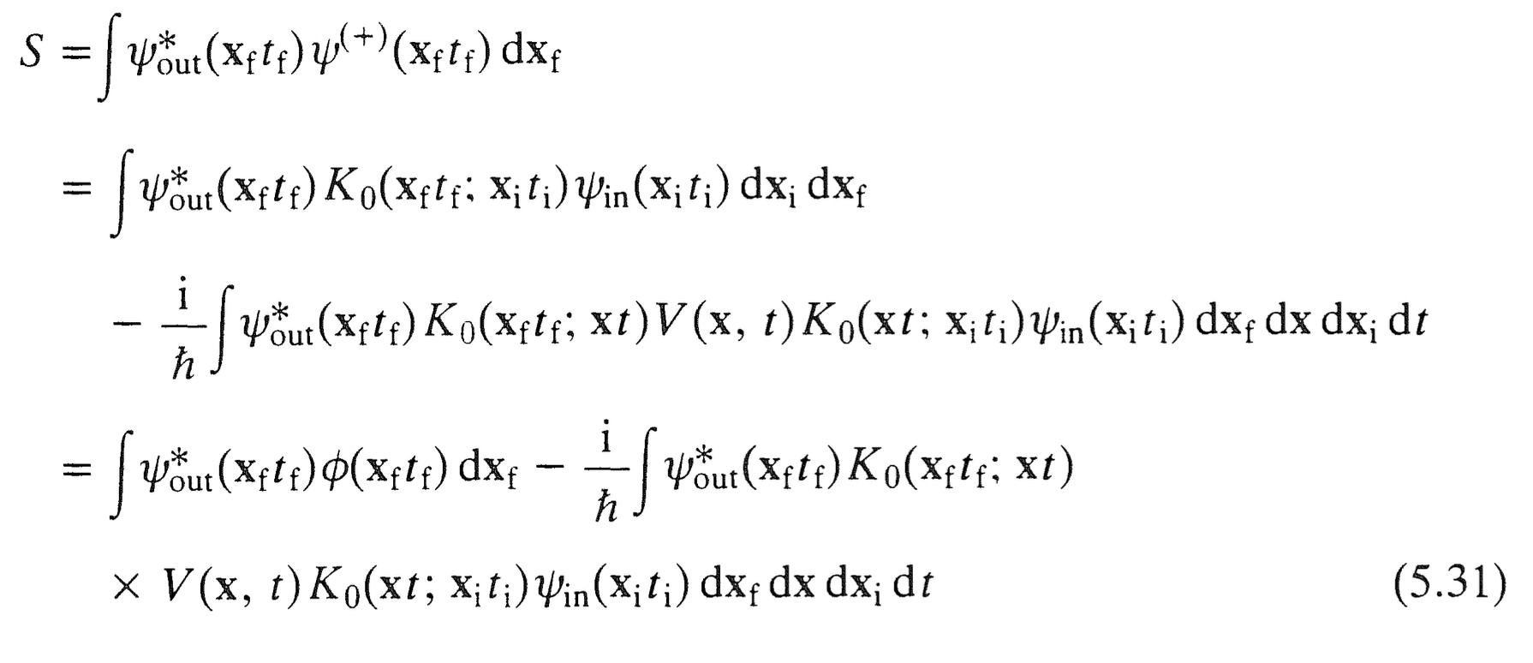

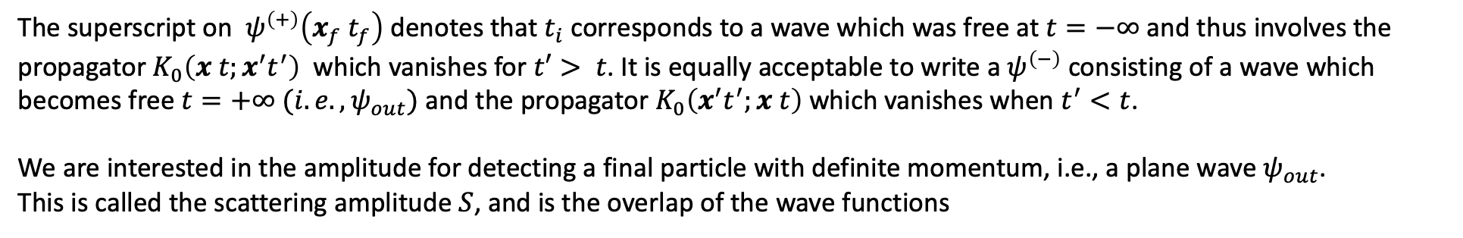
S-matrix
The superscript on $ψ^{\left(+\right)}\left(x_{f} t_{f}\right)$ denotes that $t_{i}$ corresponds to a wave which was free at $t=−∞$and thus involves the propagator $K_{0}\left(x t;x^{′}t^{′}\right)$ which vanishes for $t′> t$. It is equally acceptable to write a $ψ^{\left(−\right)}$ consisting of a wave which becomes free $t=+∞ (i.e., ψ_{out})$and the propagator $K_{0}\left(x^{′}t^{′};x t\right)$which vanishes when $t^{′}<t$.
We are interested in the amplitude for detecting a final particle with definite momentum, i.e., a plane wave $ψ_{out}$.
This is called the scattering amplitude $S$, and is the overlap of the wave functions

Slide 19
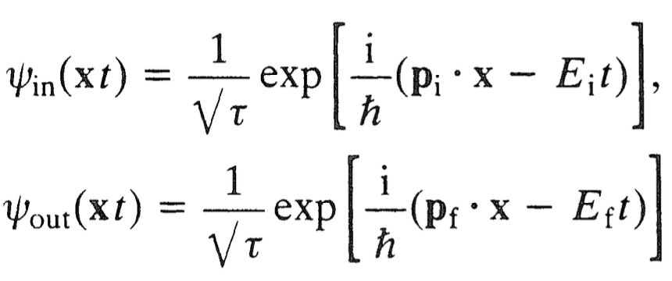
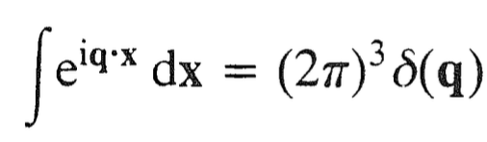

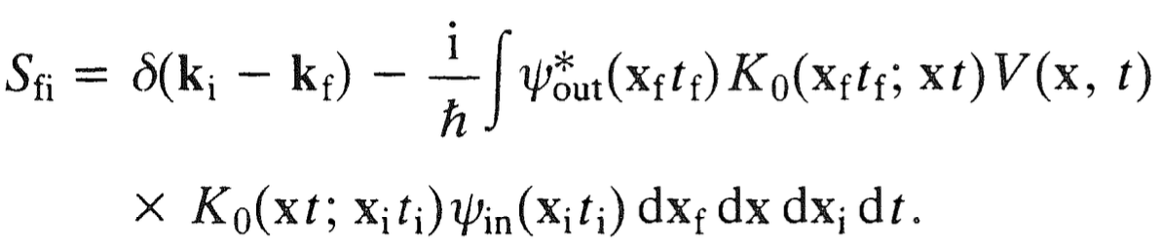
S-matrix
where the $φ\left(x_{f} t_{f}\right)$, just like the $ψ_{in} \left(x_{i} t_{i}\right)$ si a plane wave. If the initial and final momenta are $p_{i}=ℏk_{i}$ and $p_{f}=ℏk_{f}$
we have, with box normalization,
where $E = p^{2}/2m$ and $τ$ is the volume of the box, which of course is arbitrary. Substituting into the first term of the previous equation using
and
We obtain

