Slide 1
PHYS4260
Sample problems - Preparation for TEST 2

Slide 2
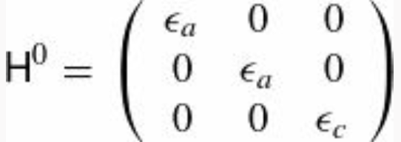
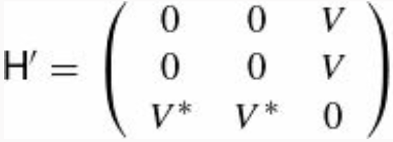
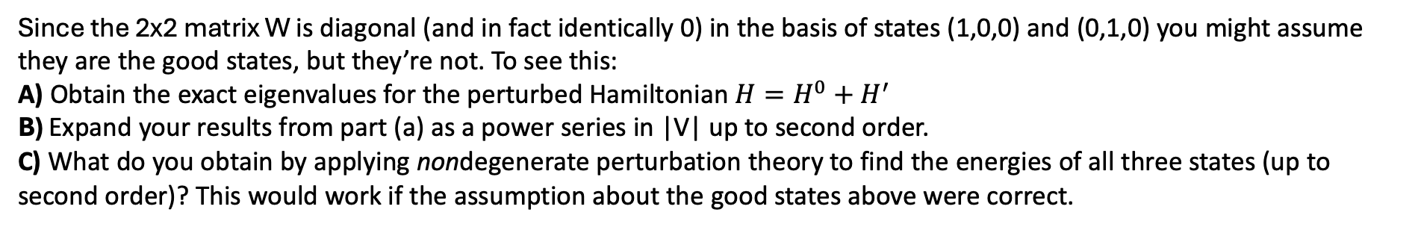
Problem 1. Perturbation Theory Recap
Consider a three-level system with the unperturbed Hamiltonian
with $ε_{a}>ε_{c}$ and the perturbation
Since the 2x2 matrix W is diagonal (and in fact identically 0) in the basis of states (1,0,0) and (0,1,0) you might assume they are the good states, but they’re not. To see this:
A) Obtain the exact eigenvalues for the perturbed Hamiltonian ${H=H}^{0}+H^{′}$
B) Expand your results from part (a) as a power series in |V| up to second order.
C) What do you obtain by applying nondegenerate perturbation theory to find the energies of all three states (up to second order)? This would work if the assumption about the good states above were correct.

Slide 3
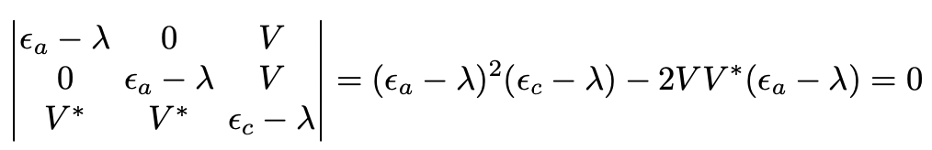
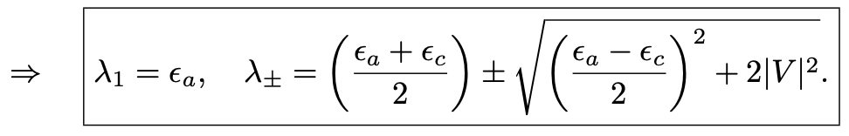
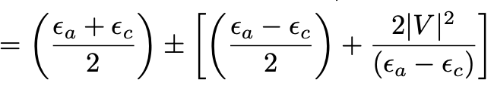
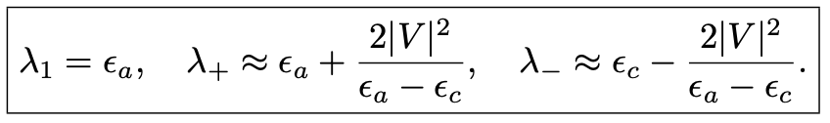
Solution to Problem 1.
A) The energies of the system are the eigenvalues of ${H=H}^{0}+H^{′}$ determined by solving the characteristic Eqn
B) Taylor expanding these eigenvalues in $|V|$ one gets
Then, we find

Slide 4

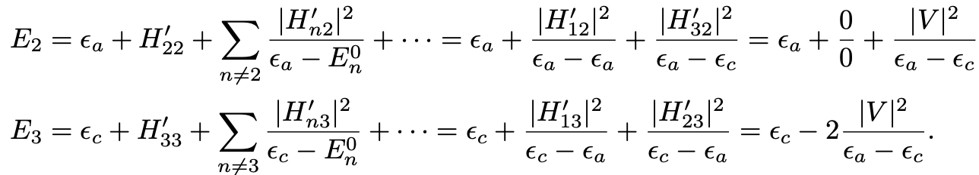

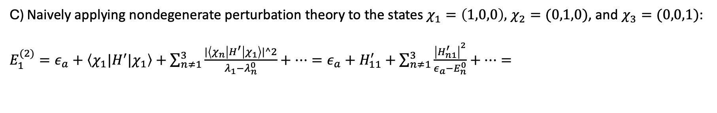
Solution to Problem 1.
C) Naively applying nondegenerate perturbation theory to the states $χ_{1}=\left(1,0,0\right),$ $χ_{2}=(0,1,0)$, and $χ_{3}=(0,0,1)$:
$E_{1}^{(2)}=ε_{a}+\left\langle χ_{1}|H^{′}|χ_{1}\right\rangle +\sum_{n≠1}^{3}{\frac{|\left\langle χ_{n}\left|H^{′}\right|χ_{1}\right\rangle |^2}{λ_{1}−λ_{n}^{0}}}+…=ε_{a}+H_{11}^{′}+$ $\sum_{n≠1}^{3}{\frac{{\left|H_{n1}^{′}\right|}^{2}}{ε_{a}−E_{n}^{0}}}+…=$
where we used the fact that $λ_{1}=E_{1}^{0}=ε_{a}$; $λ_{+}= E_{2}^{0}=ε_{a}$; $λ_{−}=E_{3}^{0}=ε_{c}$. By the same token
The nondegenerate state comes out right ($λ_{−}=E_{3}^{0}$), but the other two are at best ambiguous (the 0/0 terms warning us, perhaps, that something is missing).

Slide 5

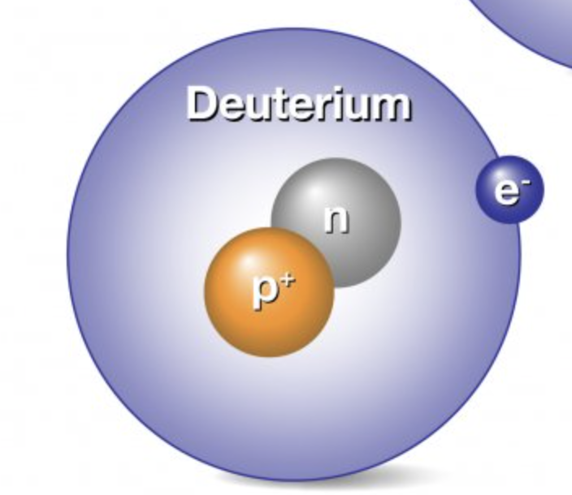
Problem 2. Hyperfine structure recap
Calculate the wavelength, in centimeters, of the photon emitted under a hyperfine transition in the ground state ($n=1$) of deuterium. Deuterium is “heavy” hydrogen, with an extra neutron in the nucleus; the proton and neutron bind together to form a deuteron, with spin 1 and magnetic moment given by
the deuteron g_{d}-factor is 1.71.

Slide 6
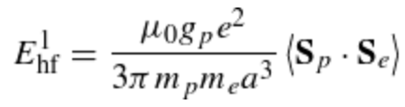
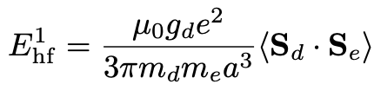





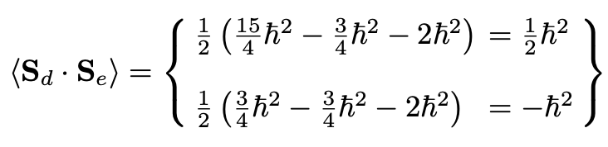

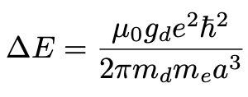


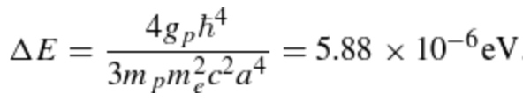
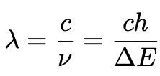




Solution to Problem 2.
and we write
The electron has spin ½ and $S_{e}^{2}=ℏ^{2}s(s+1)$
The deuteron has spin 1
The total spin can be 3/2, in which case , or ½, in which case . Therefore,
The difference between the two states is
hydrogen
And since $m_{d}=2m_{p}$

Slide 7
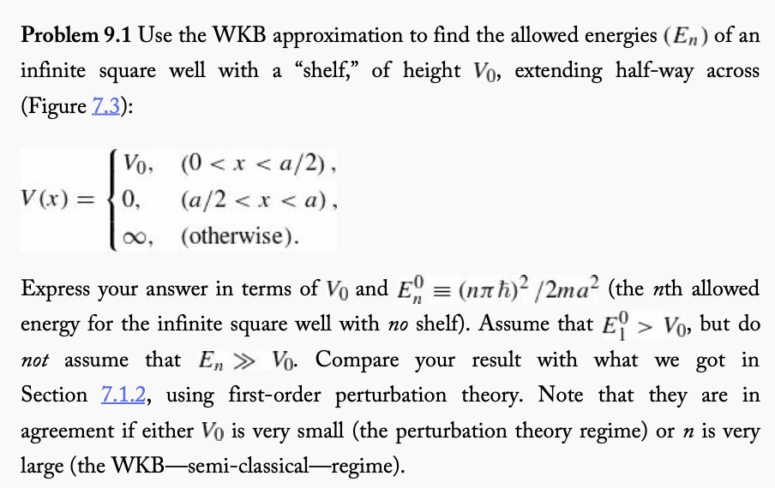
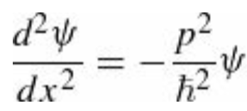


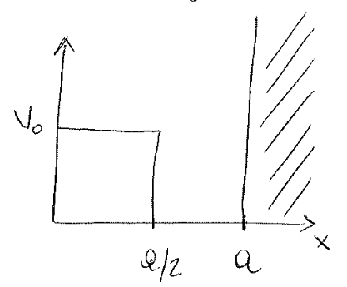
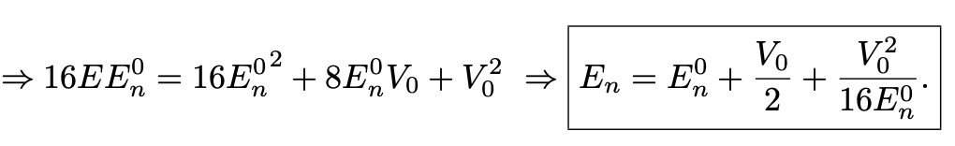
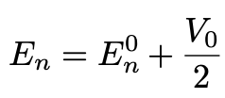



Problem 3. WKB approximation
$$E>V$$
For $E>V(x)$ the approx. solution is
where
The boundary conditions give
Squaring left-hand side and right-hand side of the last equation above gives
The result from perturbation theory is
which agrees with our previous result only in the case of small perturbations, i.e., very small V₀ term or for large n.
The extra term goes to zero t large n because

