Slide 1
PHYS4260
Sample problems - Preparation for TEST 3

Slide 2
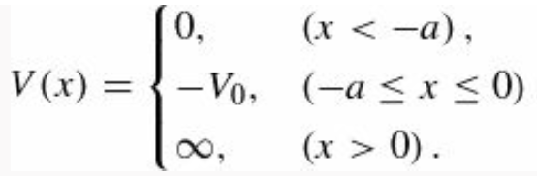








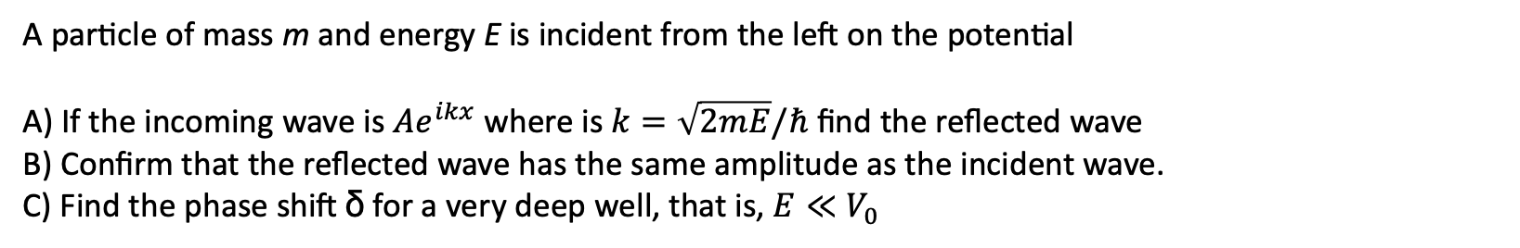
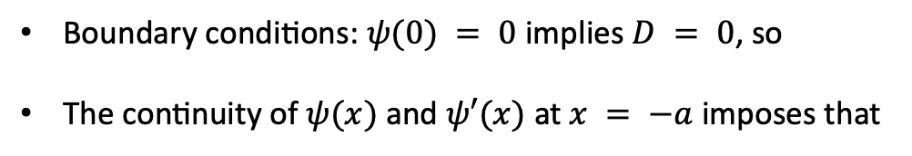




Example: Problem 10.5 – Phase Shifts
A particle of mass m and energy E is incident from the left on the potential
A) If the incoming wave is $Ae^{ikx}$ where is $k=\sqrt{2mE}/ℏ$ find the reflected wave
B) Confirm that the reflected wave has the same amplitude as the incident wave.
C) Find the phase shift δ for a very deep well, that is, $E≪V_{0}$
A)
In the $−a<x<0$ region the TISE gives
$$−a$$
$$−$$
LHS:
0
x
with
$$+$$
$$−V_{0}$$
The general solution is:
Boundary conditions: $ψ(0) = 0$ implies $D = 0$, so
The continuity of $ψ(x)$and $ψ′(x)$ at $x = −a$ imposes that
LHS
RHS

Slide 3
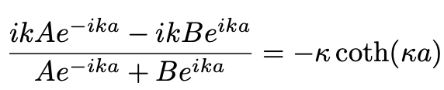
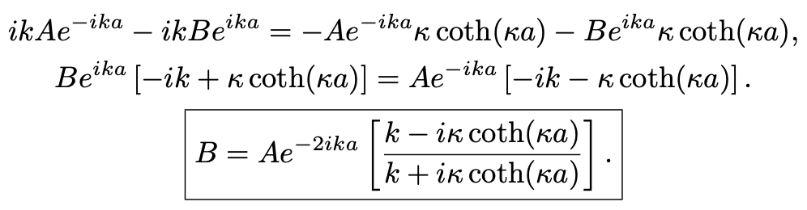
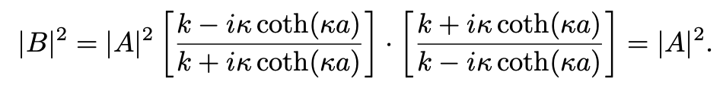
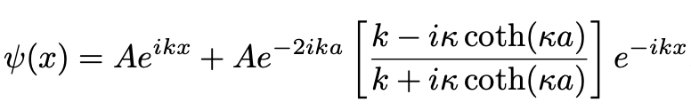


Example: Problem 10.5 – Phase Shifts
If we divide the two equations, then we can solve for B
B) Now that we know the coefficient B, we can determine
C) From part A), the wave function for $x < −a$ is
But by definition of the phase shift

Slide 4
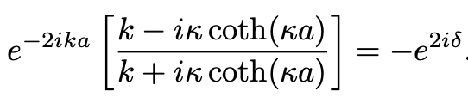
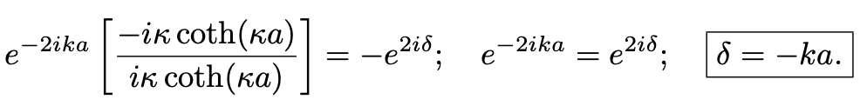

Example: Problem 10.5 – Phase Shifts
Therefore, equating the two terms we obtain
Exact result!
For a very high barrier
$$+$$
Therefore, we can approximate the exact relation as

Slide 5
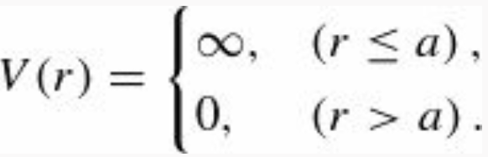
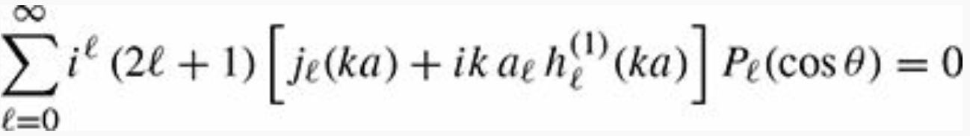

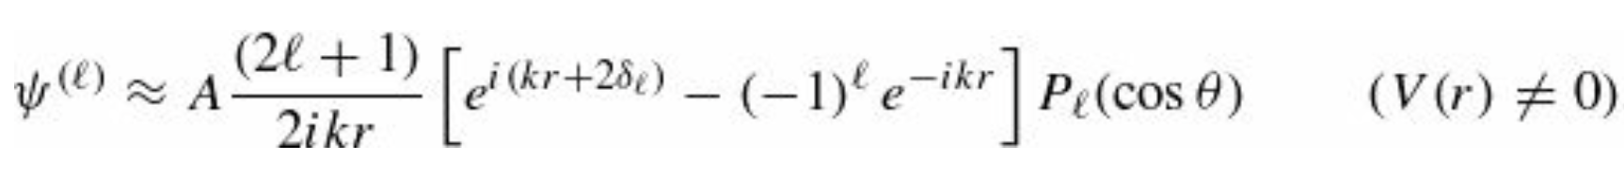
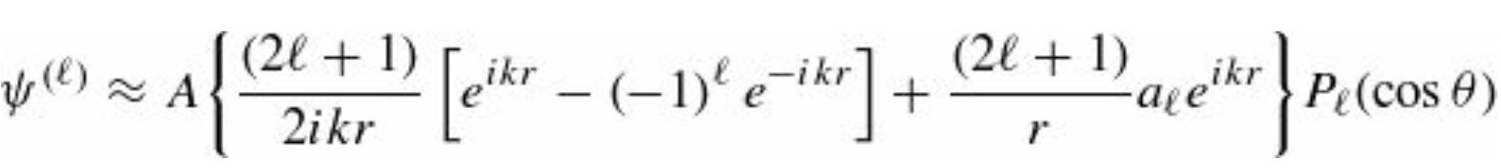





Example: Problem 10.6
Quantum hard sphere scattering: What are the partial wave phase shifts $δ_{l}$ for hard-sphere scattering in the
quantum case?
From Example 10.3, we learned that the boundary condition $ψ\left(a,θ\right)=0$ gives
and using orthogonality it follows that
In addition, comparing the two asymptotic forms of the wave function $ψ(r,θ)$
and
we obtain . Putting things together, we obtain that
From the definition of the Henkel functions
where:
=
(shortcut notation)

Slide 6



Example: Problem 10.6
At this point, we equate Real and Imaginary parts in the resulting equation which we rewrite below for completeness
This gives
Dividing the two equations

Slide 7
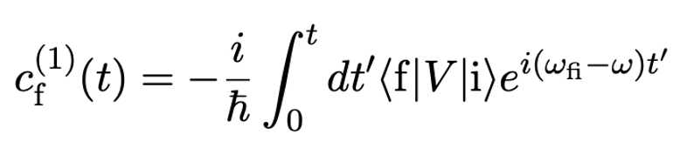
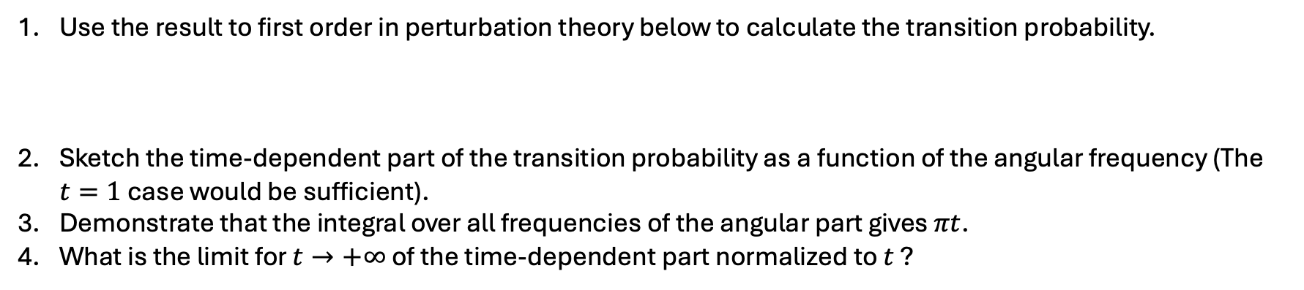
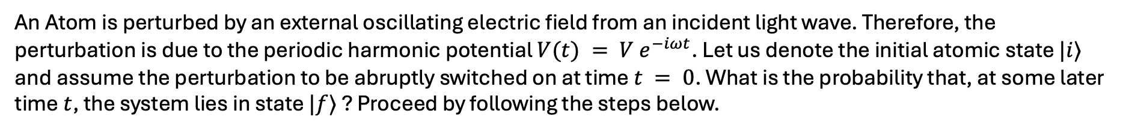
Problem 3: from the lecture notes
An Atom is perturbed by an external oscillating electric field from an incident light wave. Therefore, the perturbation is due to the periodic harmonic potential $V(t) = V e^{−iωt}$. Let us denote the initial atomic state $|i⟩$ and assume the perturbation to be abruptly switched on at time $t = 0$. What is the probability that, at some later time $t$, the system lies in state $|f⟩$ ? Proceed by following the steps below.
Use the result to first order in perturbation theory below to calculate the transition probability.
Sketch the time-dependent part of the transition probability as a function of the angular frequency (The $t=1$ case would be sufficient).
Demonstrate that the integral over all frequencies of the angular part gives $πt$.
What is the limit for $t→+∞$ of the time-dependent part normalized to $t$ ?

Slide 8
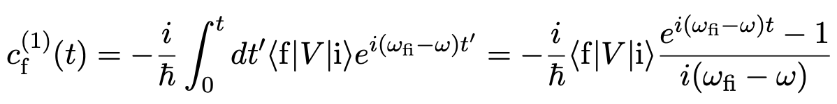
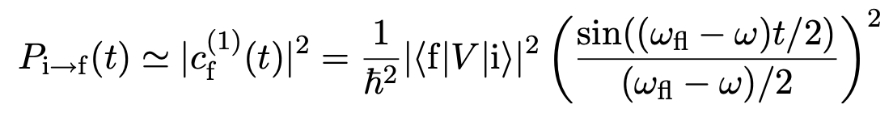

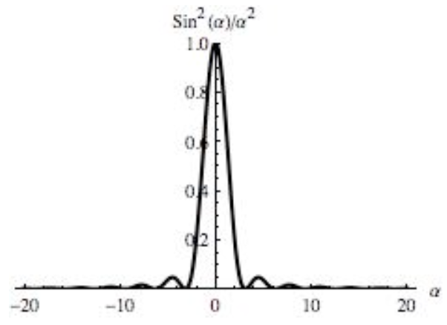
Problem 3: from the lecture notes
1. We found that to first order in perturbation theory, we have
The probability for the transition after a time $t$ is therefore given by
2. The sketch of the time-dependent part

Slide 9




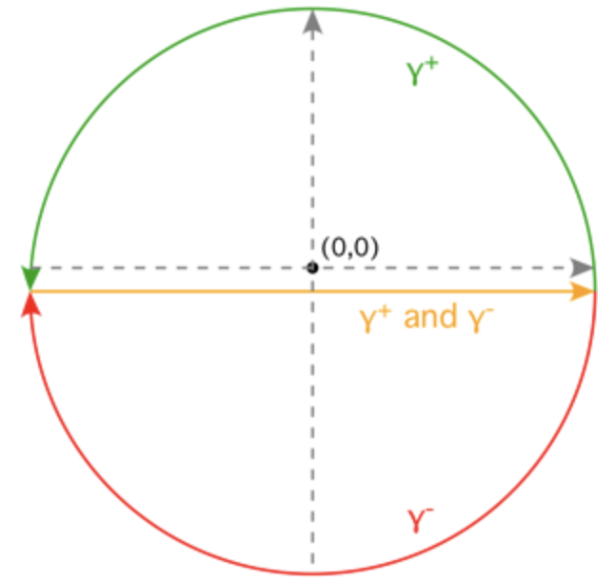
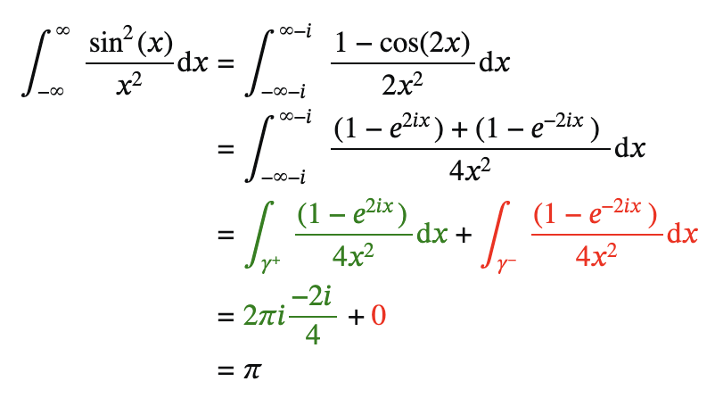

Problem 3: from the lecture notes
3. Prove that
It is easy to see this by using the residue theorem. We observe that using the complex representation for sin(x)
To avoid the double pole at 𝑥=0, drop the path of integration a bit below the real line (this function has no poles, and it
vanishes at infinity, so this is okay).
Note that 𝛾+ circles the double pole at 𝑥=0 of
and 𝛾− misses the pole at 𝑥=0 of
The residue theorem gives $→$

Slide 10

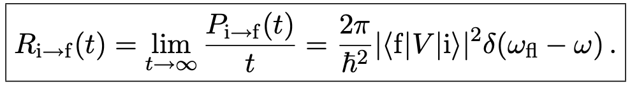

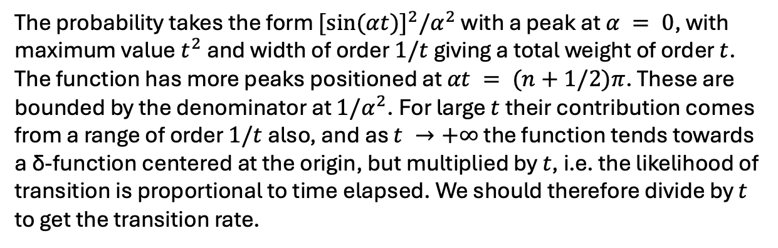

Problem 3: from the lecture notes
${[sin(αt)]}^{2}⁡/α^{2}$
The probability takes the form ${[sin(αt)]}^{2}⁡/α^{2}$ with a peak at $α = 0$, with maximum value $t^{2}$ and width of order $1/t$ giving a total weight of order $t$. The function has more peaks positioned at $αt = (n+1/2)π$. These are bounded by the denominator at $1/α^{2}$. For large $t$ their contribution comes from a range of order $1/t$ also, and as $t →+∞$ the function tends towards a δ-function centered at the origin, but multiplied by $t$, i.e. the likelihood of transition is proportional to time elapsed. We should therefore divide by $t$ to get the transition rate.
$$t=1$$
4. Using the result
the limit of the time-dependent part normalized to t gives
Finally, the expression for the transition rate is

