Slide 1
PHYS4260 Quantum Mechanics II Spring 2025
Time-Independent Perturbation Theory

Slide 2
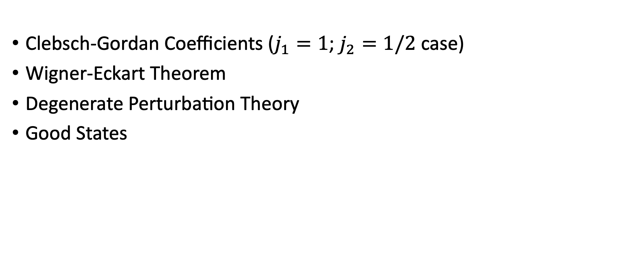
Outline
Clebsch-Gordan Coefficients ($j_{1}=1$; $j_{2}=1/2$ case)
Wigner-Eckart Theorem
Degenerate Perturbation Theory
Good States

Slide 3
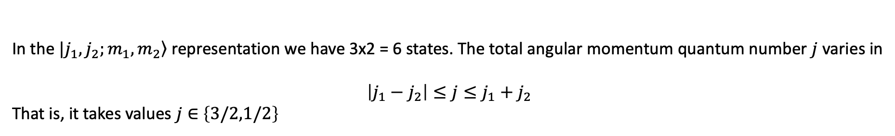

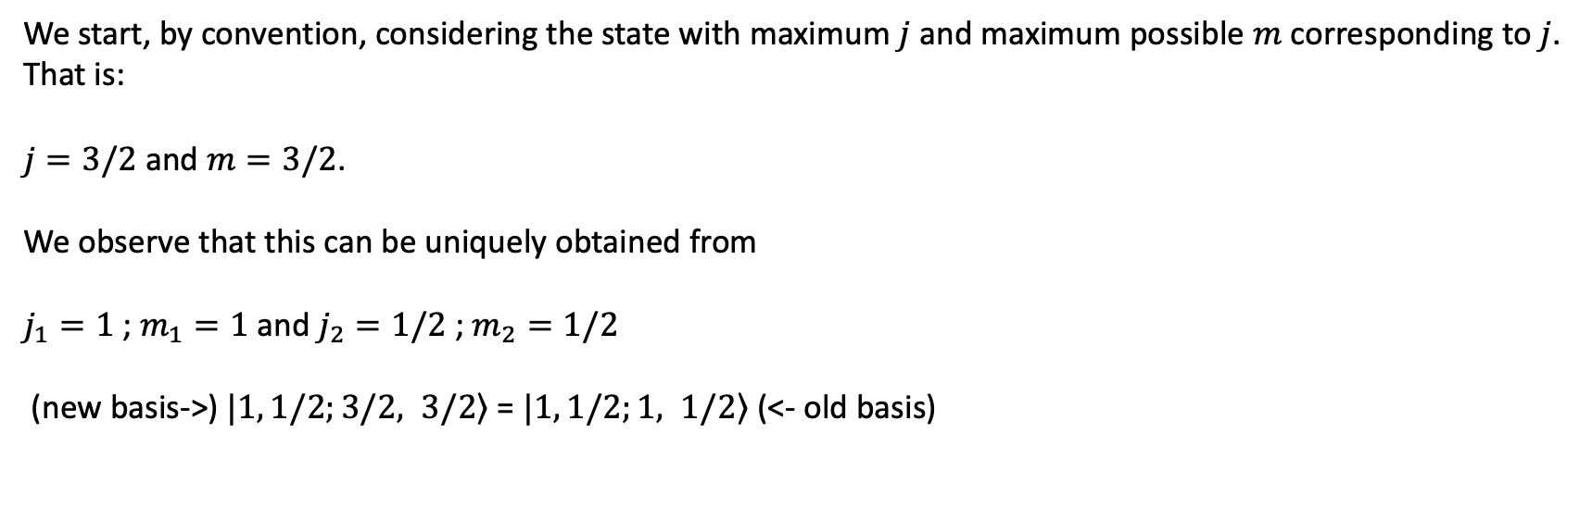
Clebsch-Gordan Coefficients $j_{1}=1$; $j_{2}=1/2$
In the $|\left.j_{1},j_{2};m_{1},m_{2}\right\rangle$ representation we have 3x2 = 6 states. The total angular momentum quantum number $j$ varies in
$$\left|j_{1}−j_{2}\right|≤j≤j_{1}+j_{2}$$
That is, it takes values $j∈$ $\left\{3/2,1/2\right\}$
We start, by convention, considering the state with maximum $j$ and maximum possible $m$ corresponding to $j$.
That is:
$j=3/2$ and $m=3/2$.
We observe that this can be uniquely obtained from
$j_{1}=1$ ; $m_{1}=1$ and $j_{2}=1/2$ ; $m_{2}=1/2$
(new basis->) $|\left.1, 1/2;3/2, 3/2\right\rangle$ = $|\left.1, 1/2;1, 1/2\right\rangle$ (<- old basis)

Slide 4
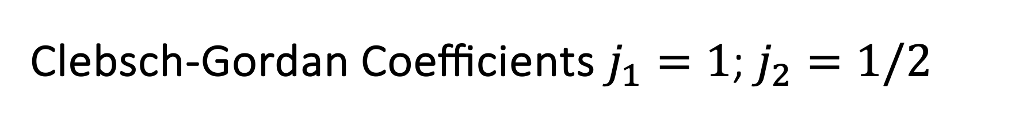

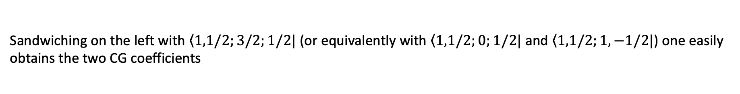
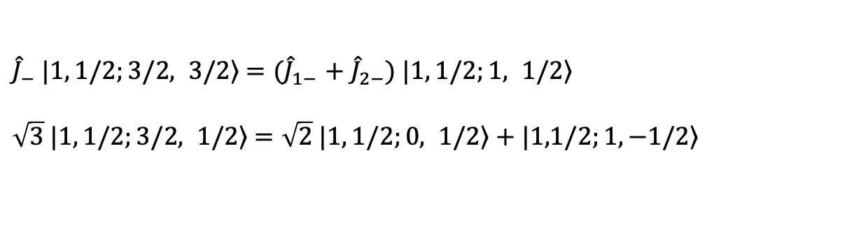
Clebsch-Gordan Coefficients $j_{1}=1$; $j_{2}=1/2$
We apply the descending ladder operator ${\hat{J}}_{−}$ on the left, and use the identity ${\hat{J}}_{−}={\hat{J}}_{1−}+{\hat{J}}_{2−}$ on the right
${\hat{J}}_{−} |\left.1, 1/2;3/2, 3/2\right\rangle$ ${=(\hat{J}}_{1−}+ {\hat{J}}_{2−})$ $|\left.1, 1/2;1, 1/2\right\rangle$
$\sqrt{3} |\left.1, 1/2;3/2, 1/2\right\rangle$ $=\sqrt{2} |\left.1, 1/2;0, 1/2\right\rangle$ $+ |\left.1,1/2;1, −1/2\right\rangle$
Sandwiching on the left with $\left\langle 1,1/2;3/2;1/2\right.|$ (or equivalently with $\left\langle 1,1/2;0;1/2\right.|$and $\left\langle 1,1/2;1,−1/2\right.|$) one easily
obtains the two CG coefficients
$\left\langle 1,1/2;3/2;1/2\right.|\left.1, 1/2;0, 1/2\right\rangle$ $=\sqrt{\frac{2}{3}=}$ $\left\langle 1,1/2;0;1/2\right.|\left.1, 1/2;3/2, 1/2\right\rangle$
$\left\langle 1,1/2;3/2;1/2\right.|\left.1,1/2;1, −1/2\right\rangle$ $=\sqrt{\frac{1}{3}}=$ $\left\langle 1,1/2;1;−1/2\right.|\left.1, 1/2;3/2, 1/2\right\rangle$
The remaining coefficients with negative $m$, e.g., $j_{2}=3/2$ and $m=−3/2$ obtained from $j_{1}=1$ and $m_{1}=−1$ and
$j_{2}=1/2$ and $m_{2}=−1/2$, can be obtained by symmetry or using an analogous strategy.

Slide 5

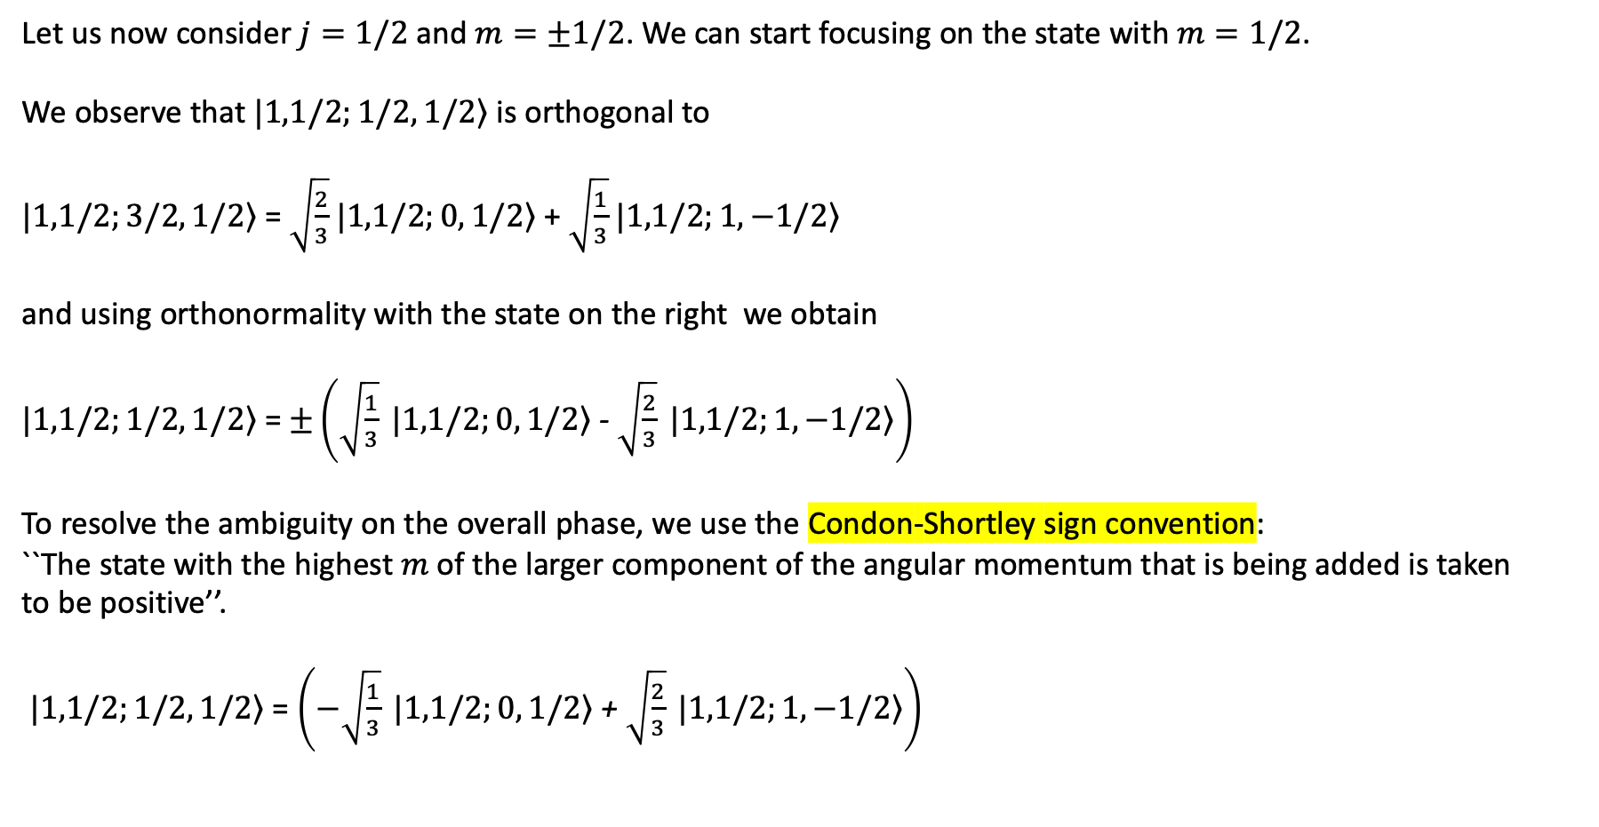






Clebsch-Gordan Coefficients $j_{1}=1$; $j_{2}=1/2$
Let us now consider $j=1/2$ and $m=±1/2$. We can start focusing on the state with $m=1/2$.
We observe that $|\left.1,1/2;1/2, 1/2\right\rangle$ is orthogonal to
$|\left.1,1/2;3/2, 1/2\right\rangle$ = $\sqrt{\frac{2}{3}}$ $|\left.1,1/2;0, 1/2\right\rangle$ + $\sqrt{\frac{1}{3}}$ $|\left.1,1/2;1, −1/2\right\rangle$
and using orthonormality with the state on the right we obtain
$|\left.1,1/2;1/2, 1/2\right\rangle$ = $±\left(\sqrt{\frac{1}{3}} |\left.1,1/2;0, 1/2\right\rangle \text{- }\sqrt{\frac{2}{3}} |\left.1,1/2;1, −1/2\right\rangle \right)$
To resolve the ambiguity on the overall phase, we use the Condon-Shortley sign convention:
``The state with the highest $m$ of the larger component of the angular momentum that is being added is taken
to be positive’’.
$|\left.1,1/2;1/2, 1/2\right\rangle$ = $\left(−\sqrt{\frac{1}{3}} |\left.1,1/2;0, 1/2\right\rangle \text{+} \sqrt{\frac{2}{3}} |\left.1,1/2;1, −1/2\right\rangle \right)$
$$j$$
$$m$$
$$m_{1}$$
$$m_{2}$$
$$j_{1}$$
$$j_{2}$$

Slide 6
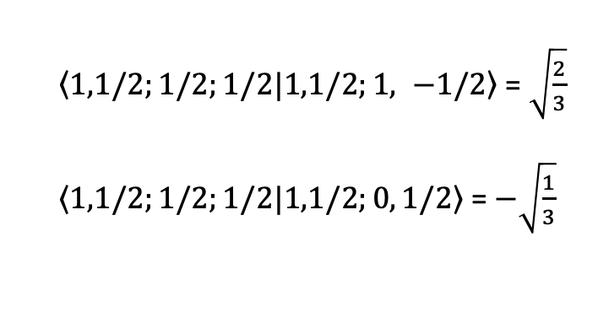
Clebsch-Gordan Coefficients $j_{1}=1$; $j_{2}=1/2$
This gives the other two CG coefficients as follows
$\left\langle 1,1/2;1/2;1/2\right.|\left.1,1/2;1, −1/2\right\rangle$ = $\sqrt{\frac{2}{3}}$
$\left\langle 1,1/2;1/2;1/2\right.|\left.1,1/2;0, 1/2\right\rangle$ = $−\sqrt{\frac{1}{3}}$

Slide 7
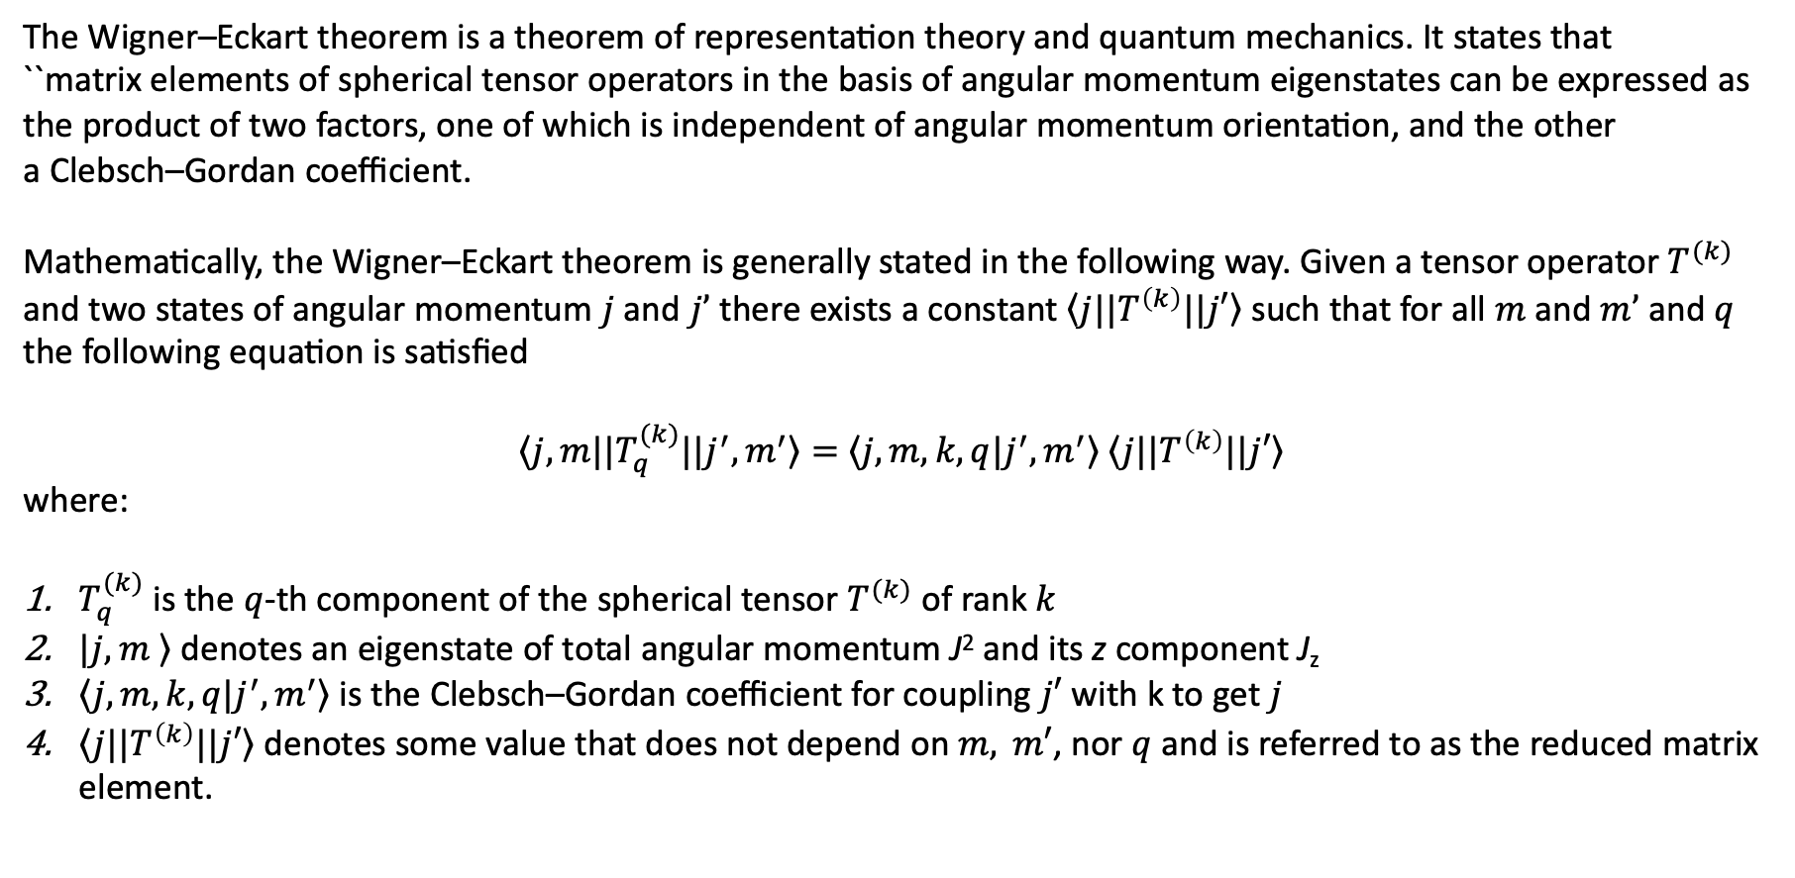
The Wigner-Eckart theorem
The Wigner–Eckart theorem is a theorem of representation theory and quantum mechanics. It states that
``matrix elements of spherical tensor operators in the basis of angular momentum eigenstates can be expressed as the product of two factors, one of which is independent of angular momentum orientation, and the other a Clebsch–Gordan coefficient.
Mathematically, the Wigner–Eckart theorem is generally stated in the following way. Given a tensor operator $T^{(k)}$ and two states of angular momentum $j$ and $j’$ there exists a constant $\left\langle j\right.|{|T}^{\left(k\right)}||\left.j′\right\rangle$ such that for all $m$ and $m’$ and $q$ the following equation is satisfied
$\left\langle j,m||\right.T_{q}^{(k)}||\left.j^{′},m^{′}\right\rangle =$ $\left\langle j,m,k,q|\right.\left.j^{′},m^{′}\right\rangle \left\langle j\right.|{|T}^{\left(k\right)}||\left.j′\right\rangle$
where:
$T_{q}^{(k)}$ is the $q$-th component of the spherical tensor $T^{(k)}$ of rank $k$
$|\left.j,m \right\rangle$ denotes an eigenstate of total angular momentum J² and its z component J_{z}
$\left\langle j,m,k,q|\right.\left.j^{′},m^{′}\right\rangle$ is the Clebsch–Gordan coefficient for coupling $j′$ with k to get $j$
$\left\langle j\right.|{|T}^{\left(k\right)}||\left.j′\right\rangle$ denotes some value that does not depend on $m, m′$, nor $q$ and is referred to as the reduced matrix element.

Slide 8

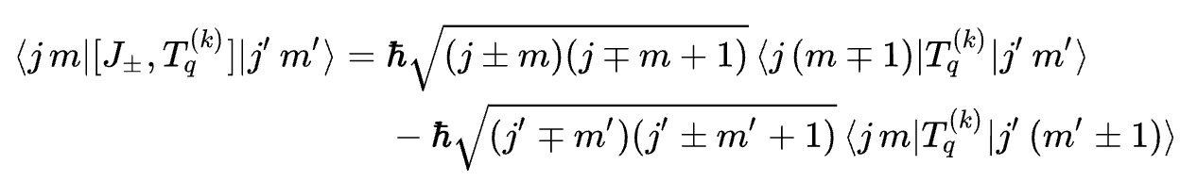
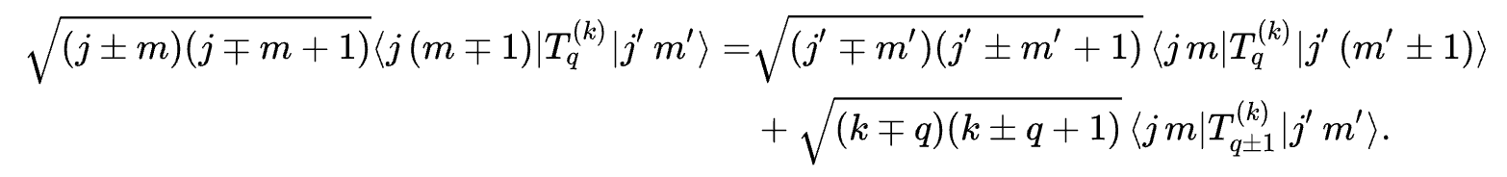
Proof
Starting with the definition of a spherical tensor operator, we have
which we use to then calculate
If we expand the commutator on the LHS by calculating the action of the $J_{±}$ on the bra and ket, then we get
We may combine these two results to get
This recursion relation for the matrix elements closely resembles that of the Clebsch–Gordan coefficient!

Slide 9
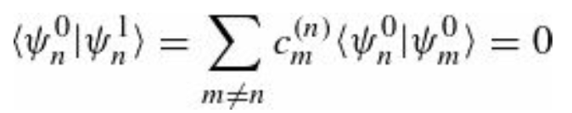
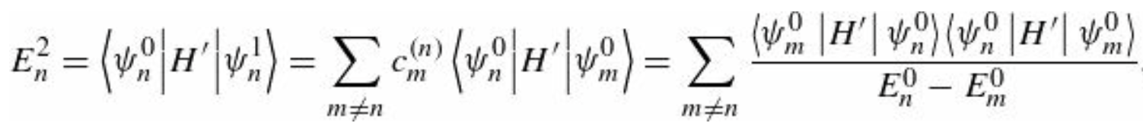
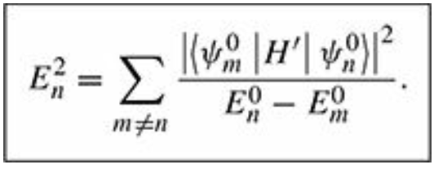
Recap: Second-Order Energies
We also know from before that
And this implies that
This is the fundamental result of second-order perturbation theory. One can continue with this method and generate higher-order corrections to the wave functions and energy. But after the third order things get involved and one needs more powerful methods (e.g., Dalgarno-Lewis method, or the “logarithmic” perturbation theory)

Slide 10
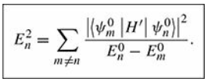


Degenerate Perturbation Theory
If the unperturbed states are degenerate—that is, if two (or more) distinct states e.g., $ψ_{n}^{0}$ and $ψ_{m}^{0}$, that share the same energy, then ordinary perturbation theory fails
$$∞$$
$$∞$$
unless the numerator itself goes to zero.
As we have anticipated, this is a typical case in which degeneracy induces infinities in the theory, and therefore, the theory must be amended to deal with degeneracy.
In the degenerate case, there is no reason to trust even the first-order correction to the energy, and we must look for some other way to handle the problem.
Note that this is not a minor problem; almost all applications of perturbation theory involve degeneracy.

Slide 11



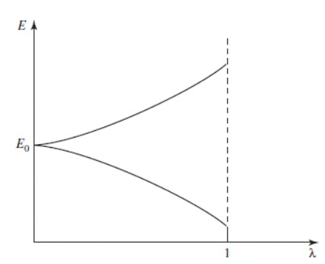
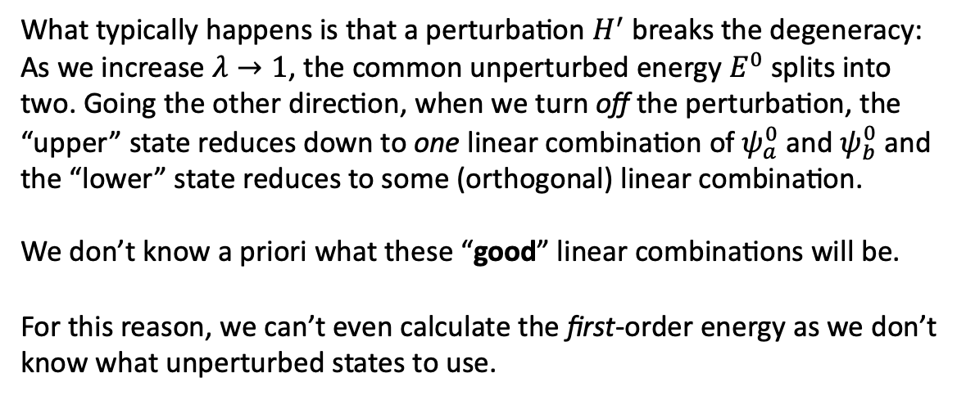
Two-Fold Degeneracy
Let’s assume that we have a system for which
and that $ψ_{a}^{0}$ and $ψ_{b}^{0}$ are normalized. Note that any linear combination of these states, is still eigenstate of $H^{0}$
What typically happens is that a perturbation $H^{′}$ breaks the degeneracy: As we increase $λ→1$, the common unperturbed energy $E^{0}$ splits into two. Going the other direction, when we turn off the perturbation, the “upper” state reduces down to one linear combination of $ψ_{a}^{0}$ and $ψ_{b}^{0}$ and the “lower” state reduces to some (orthogonal) linear combination.
We don’t know a priori what these “good” linear combinations will be.
For this reason, we can’t even calculate the first-order energy as we don’t know what unperturbed states to use.

Slide 12


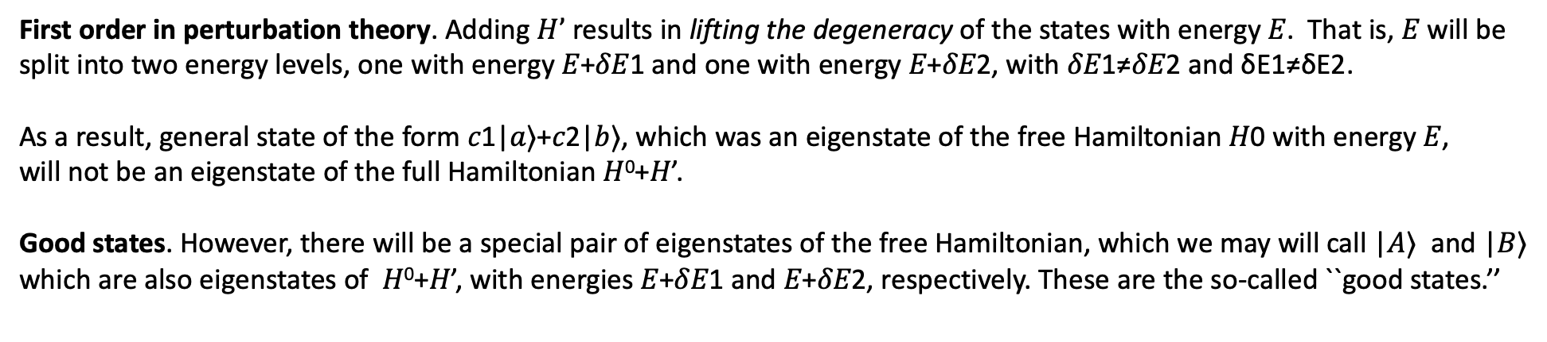
Two-Fold Degeneracy: problem statement
Zero order in perturbation theory. Suppose at energy 𝐸, there is a 2-dimensional degenerate subspace. Let's say that |𝑎⟩ and |𝑏⟩ form a basis for this subspace. Then, there are an infinite number of states that have energy 𝐸, of the form 𝑐1|𝑎⟩+𝑐2|𝑏⟩, where
More concretely, for all pairs of complex numbers 𝑐1 and 𝑐2 obeying the normalization condition, we have
First order in perturbation theory. Adding $H’$ results in lifting the degeneracy of the states with energy 𝐸. That is, 𝐸 will be split into two energy levels, one with energy 𝐸+𝛿𝐸1 and one with energy 𝐸+𝛿𝐸2, with 𝛿𝐸1≠𝛿𝐸2 and δE1≠δE2.
As a result, general state of the form 𝑐1|𝑎⟩+𝑐2|𝑏⟩, which was an eigenstate of the free Hamiltonian 𝐻0 with energy 𝐸, will not be an eigenstate of the full Hamiltonian 𝐻⁰+𝐻’.
Good states. However, there will be a special pair of eigenstates of the free Hamiltonian, which we may will call |𝐴⟩ and |𝐵⟩ which are also eigenstates of 𝐻⁰+𝐻’, with energies 𝐸+𝛿𝐸1 and 𝐸+𝛿𝐸2, respectively. These are the so-called ``good states.’’

Slide 13


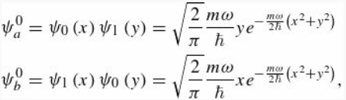
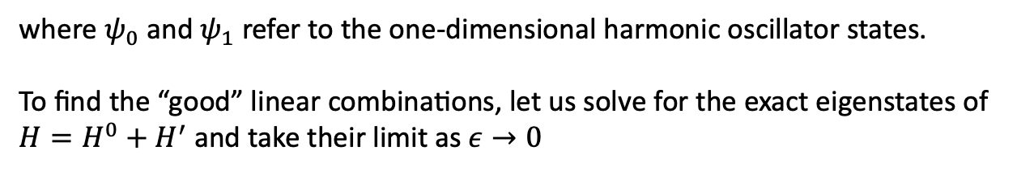
Two-Fold Degeneracy: Example (ideal case)
The “good” states are defined as the limit of the true eigenstates as the perturbation is switched off $λ→0$. But that isn’t how we find them in realistic situations (if we knew the exact eigenstates, we wouldn’t need perturbation theory).
Before showing the practical techniques for calculating them, we’ll look at an example where we can take the $λ→0$ limit.
Consider a particle of mass m in a two-dimensional oscillator potential.
to which is added a perturbation $H’$. Using the separation of variables, we obtain that the unperturbed first-excited state
(with $E^{0}=2ℏω$) is two-fold degenerate
where $ψ_{0}$ and $ψ_{1}$ refer to the one-dimensional harmonic oscillator states.
To find the “good” linear combinations, let us solve for the exact eigenstates of
${H=H}^{0}+H^{′}$ and take their limit as $ε→0$

Slide 14


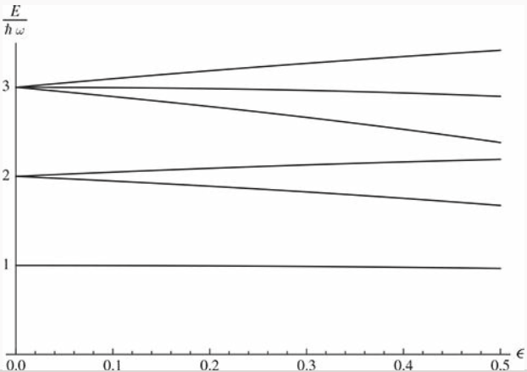

Two-Fold Degeneracy: Example (ideal case)
The problem can be simplified by rotating the coordinates
In fact, in this case the potential becomes additive in $x’$ and $y’.$ That is, $H$ is that of two independent 1-dim oscillators
Exact solutions representing oscillatory states with frequencies
The first few exact energies, are
Exact energy levels as a function of ε

Slide 15
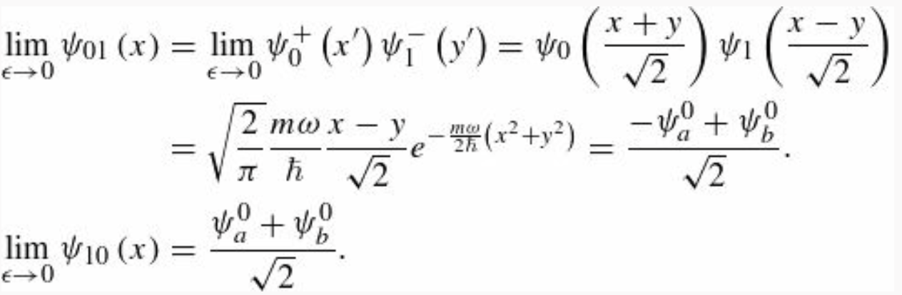
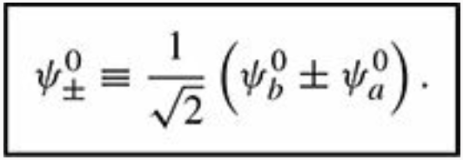
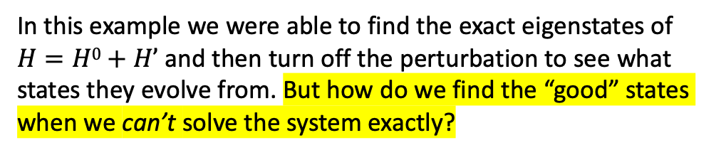
Two-Fold Degeneracy: Example (ideal case)
The two states which grow out of the degenerate first-excited states as $ε$ is increased have $m=0,n=1$ and $m=1,n=0$
If we track these states back to $ε=0$ (and in that limit $ω_{±}→ω$)
Therefore the “good” states for this problem are:
Exact energy levels as a function of ε
In this example we were able to find the exact eigenstates of $H=H0+H’$and then turn off the perturbation to see what states they evolve from. But how do we find the “good” states when we can’t solve the system exactly?

Slide 16




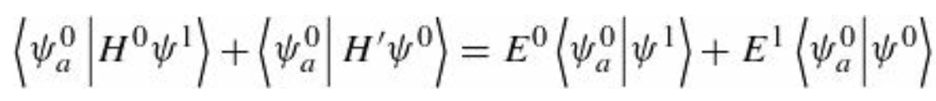
Two-Fold Degeneracy: finding the good states
For the moment let’s just write the “good” unperturbed states in generic form keeping $α$ and $β$ adjustable. We want to solve the Schrödinger equation,
with and
Plugging these into the above Equation, and collecting powers of $λ$ (as before) we find
the first terms cancel; at order $λ^{1}$ we obtain
Taking the inner product with $ψ_{a}^{0}$ on the left, we get

Slide 17
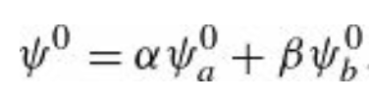
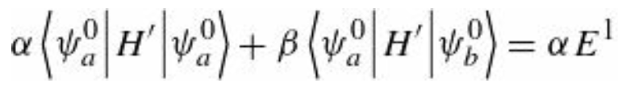

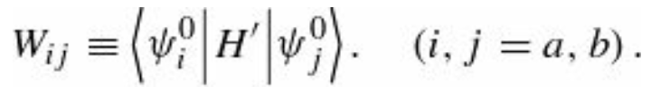


Two-Fold Degeneracy: finding the good states
Because $H^{0}$is Hermitian, the first term on the left cancels the first term on the right. Putting in the Equation
and exploiting the eigenvalue equations plus the orthonormality condition
we obtain
Or more compactly
Similarly, the inner product with $ψ_{b}^{0}$ gives
and we have a system of equations.

Slide 18
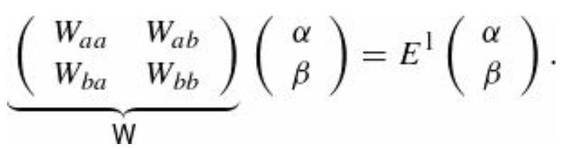
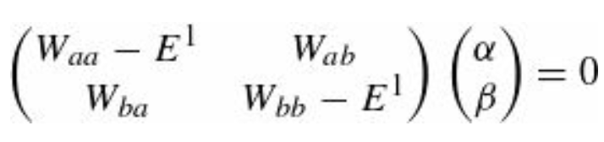
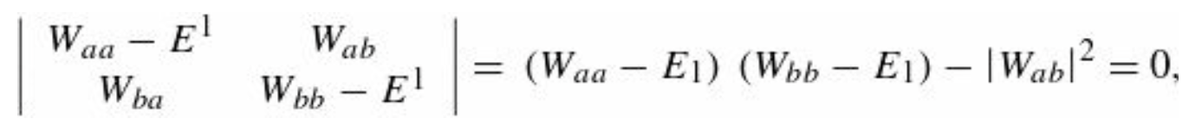
Two-Fold Degeneracy: finding the good states
Notice that the Ws are (in principle) known—they are just the “matrix elements” of $H^{′}$ with respect to the unperturbed wave functions $ψ_{a}^{0}$ and $ψ_{b}^{0}.$ $\text{Written} \text{in} \text{matrix} \text{form}\text{, }\text{the} \text{previous} \text{e}\text{quations}$read
The eigenvalues of the matrix $W$ give the first-order corrections to the energy $E^{1}$ and the corresponding eigenvectors tell us the coefficients α and β that determine the “good” states. To obtain the eigenvalues of $W$ we proceed as follows
This equation only has non-trivial solutions if the matrix on the left is non-invertible, i.e., if its determinant vanishes:

Slide 19
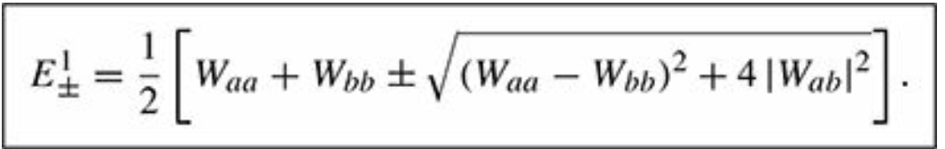
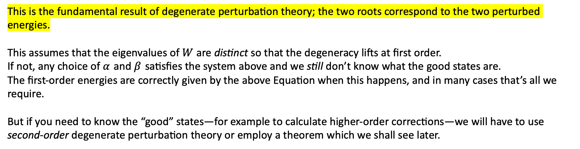
Two-Fold Degeneracy: finding the good states
Solving the quadratic for the energy $E1$, one obtains
This is the fundamental result of degenerate perturbation theory; the two roots correspond to the two perturbed energies.
This assumes that the eigenvalues of $W$ are distinct so that the degeneracy lifts at first order.
If not, any choice of $α$ and $β$ satisfies the system above and we still don’t know what the good states are.
The first-order energies are correctly given by the above Equation when this happens, and in many cases that’s all we require.
But if you need to know the “good” states—for example to calculate higher-order corrections—we will have to use second-order degenerate perturbation theory or employ a theorem which we shall see later.

Slide 20
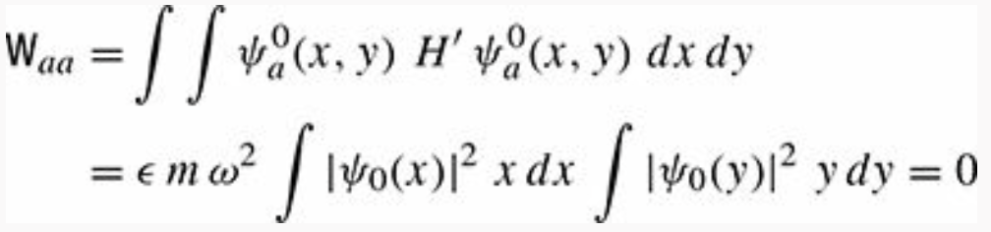
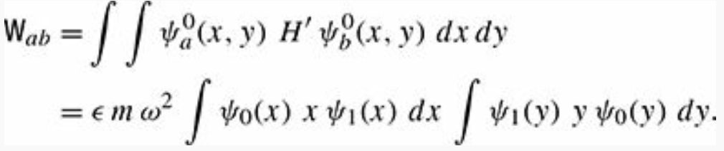

Finding the good states: Example
Let’s consider again a particle of mass m in a two-dimensional oscillator potential as we did in the previous example.
One can show that diagonalizing the matrix $W$ gives the same “good” states we found by solving the problem exactly.
The first step to show this, is to calculate the matrix elements of $W$
Recap box
as the integrands are both odd functions. Similarly, $W_{bb}=0$, and we are left with

Slide 21
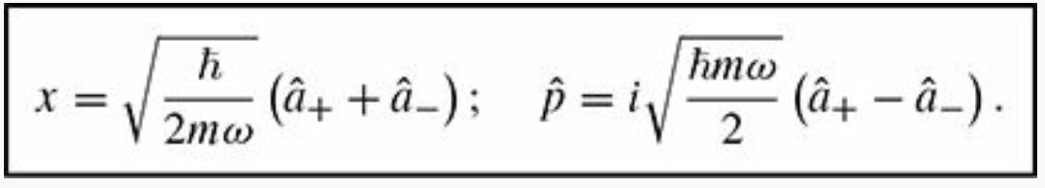
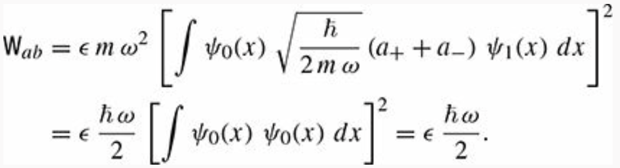

Finding the good states: Example
These two integrals are equal, and recalling the relations
one obtains
where we used , and the orthonormality of the wave functions.

