Slide 1
Modeling and Simulation
CS4632

Slide 2
Definitions Review
System
a collection of entities that act and interact together toward the accomplishment of some logical end
Model
a descriptive, functional, or physical representation of a system

Slide 3
Simulation
Simulation is the activity of:
Developing a model of a real or imagined system
Conducting experiments with the model – running the model

Slide 4
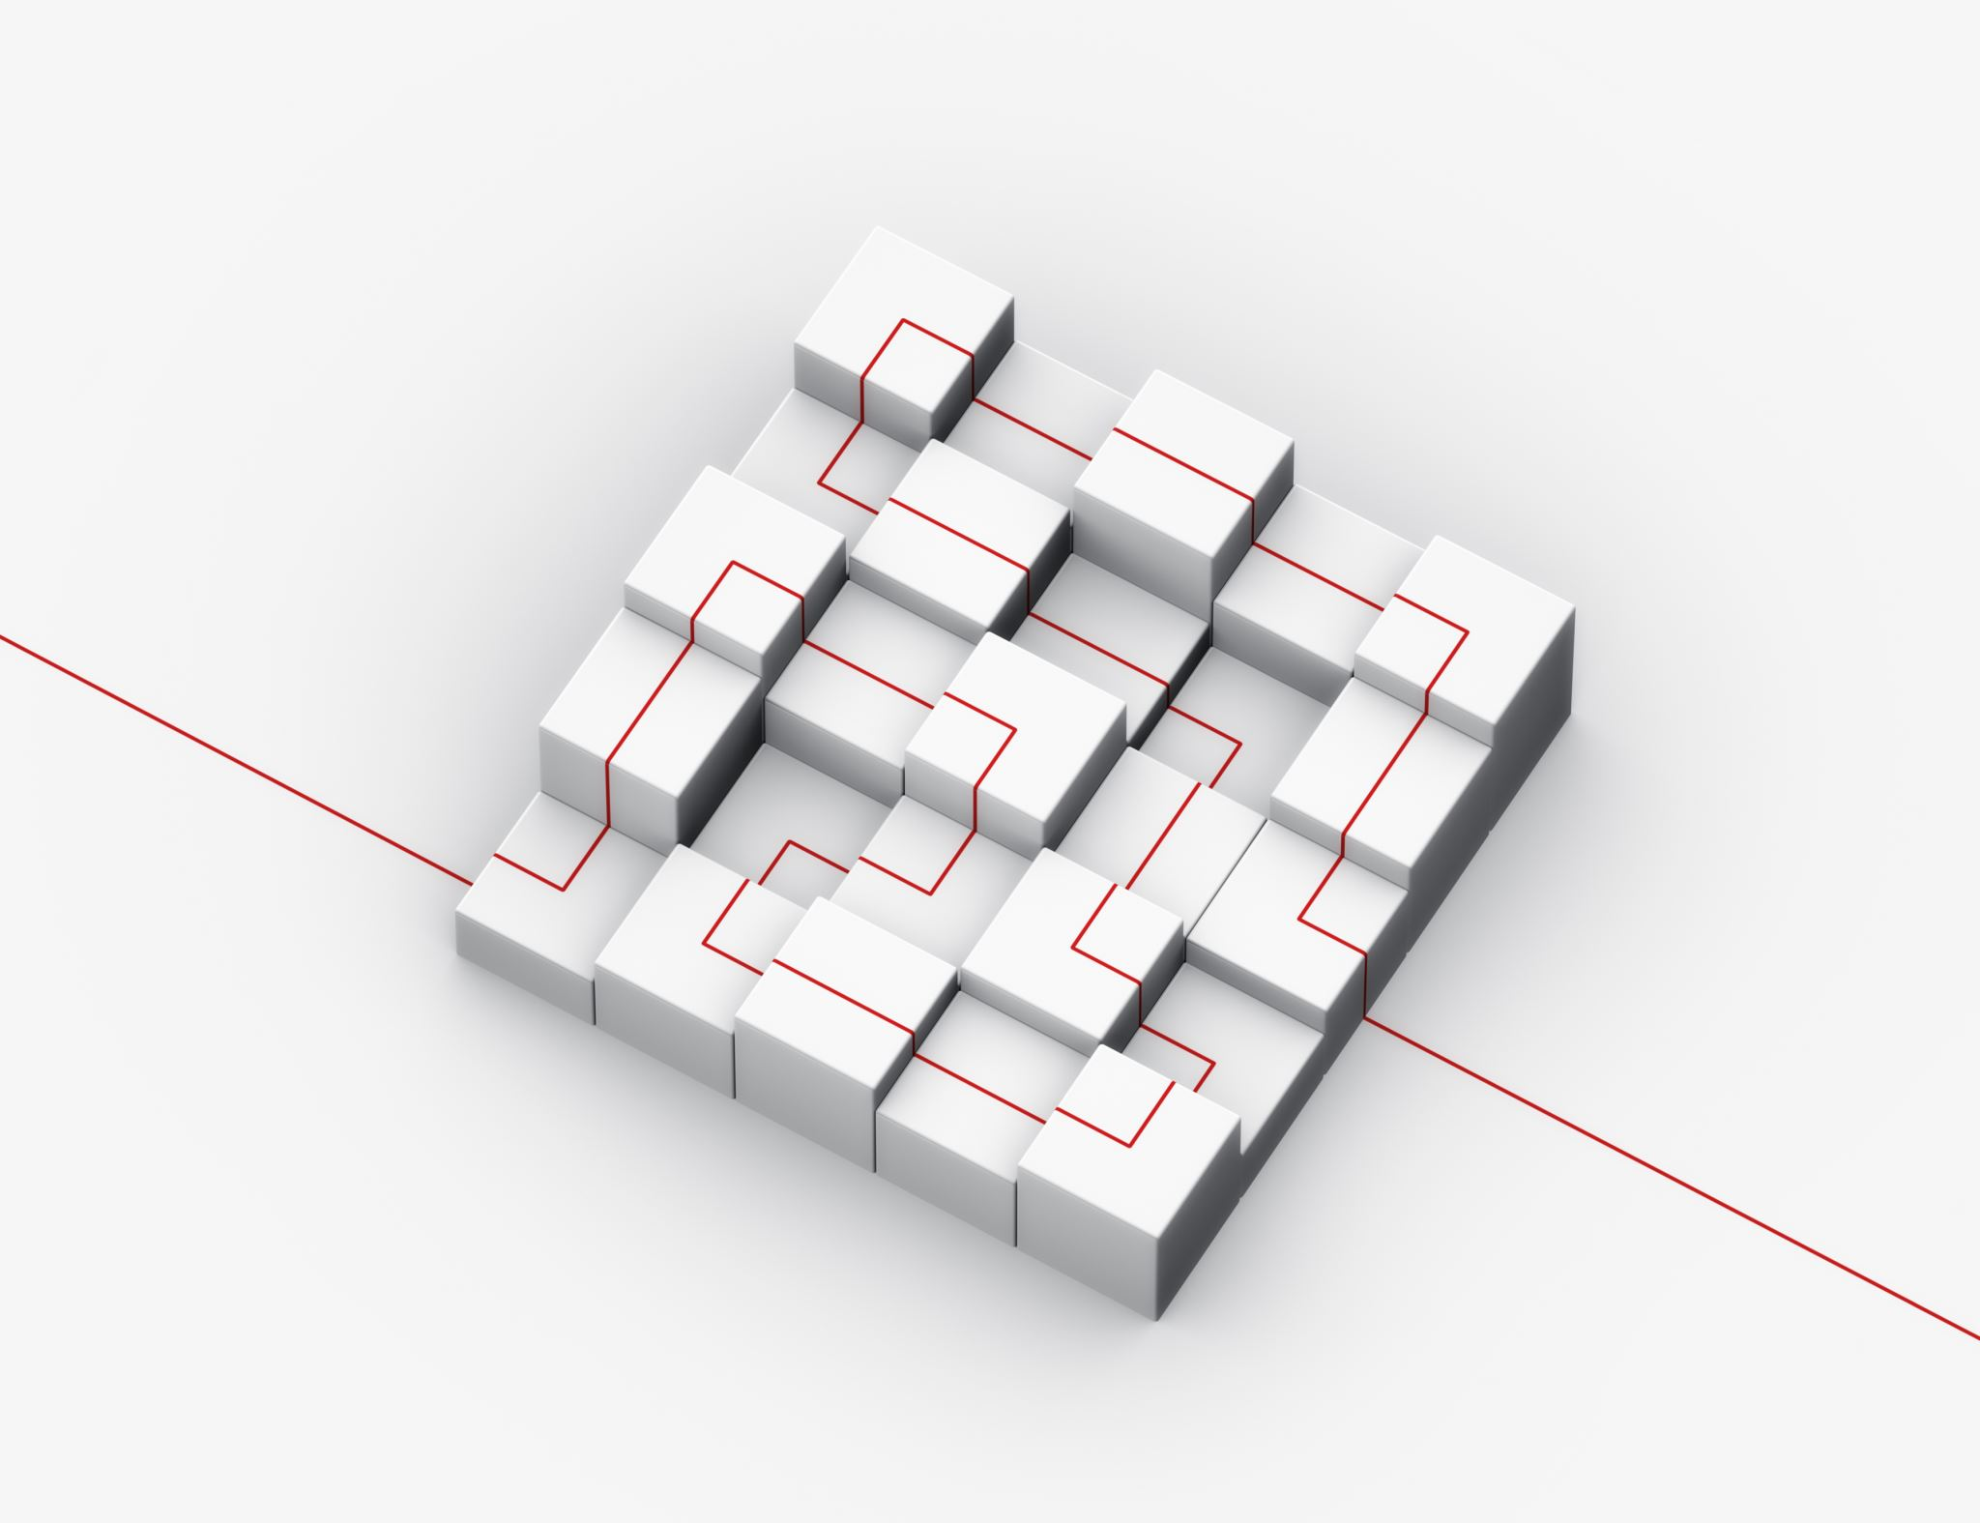
Overview of a Simulation Study
Understand the system
Clearly state the goals of the simulation study
Formulate the model representation
Design the conceptual model
Construct the simulation model with modeling software
Verify the simulation model
Validate model
Design experiments; simulation runs
Analyze, get insight, document results

Slide 5
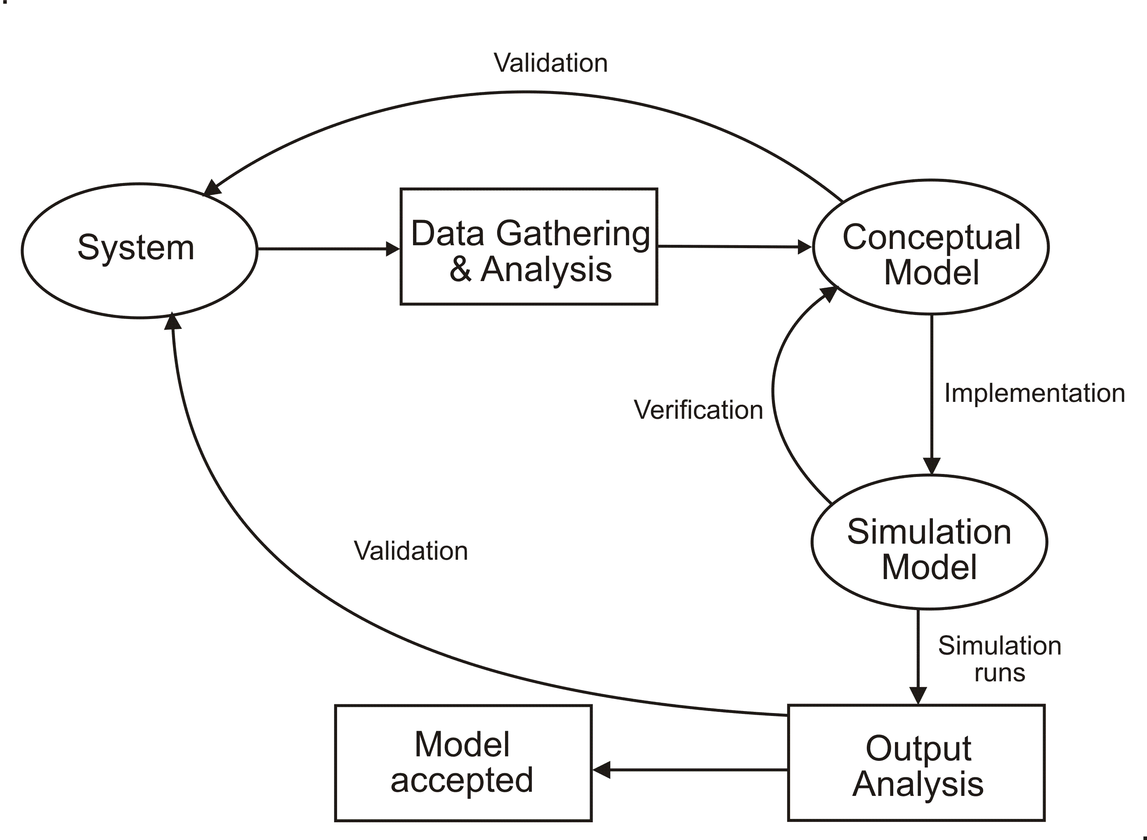
Simulation Model Development Process

Slide 6
Applications of Simulation
As an aid to thought
As an aid to communication
For purposes of training and instruction
As a tool for prediction
As an aid to experimentation
S. E. Elmahraby
Journal of Industrial Engineering,
1968

Slide 7
Applications of Simulation (cont.)
Allow to ask what-if questions
Does not provide a definitive answer
provides a probability of outcome
result only as good as the model

Slide 8
Simulation Application Examples
Wargaming
Stock market
Weather prediction
Computational fluid dynamics
Traffic management
Manufacturing
Computer Systems
Computer networks
Security
Astrophysics
Molecular dynamics
Business enterprise
Equipment training

Slide 9
Conceptual Models
Description of the system, including its goals
This results from the analysis phase of the development process
UML and other modeling notations are used to describe the structure and behavior of a model

Slide 10
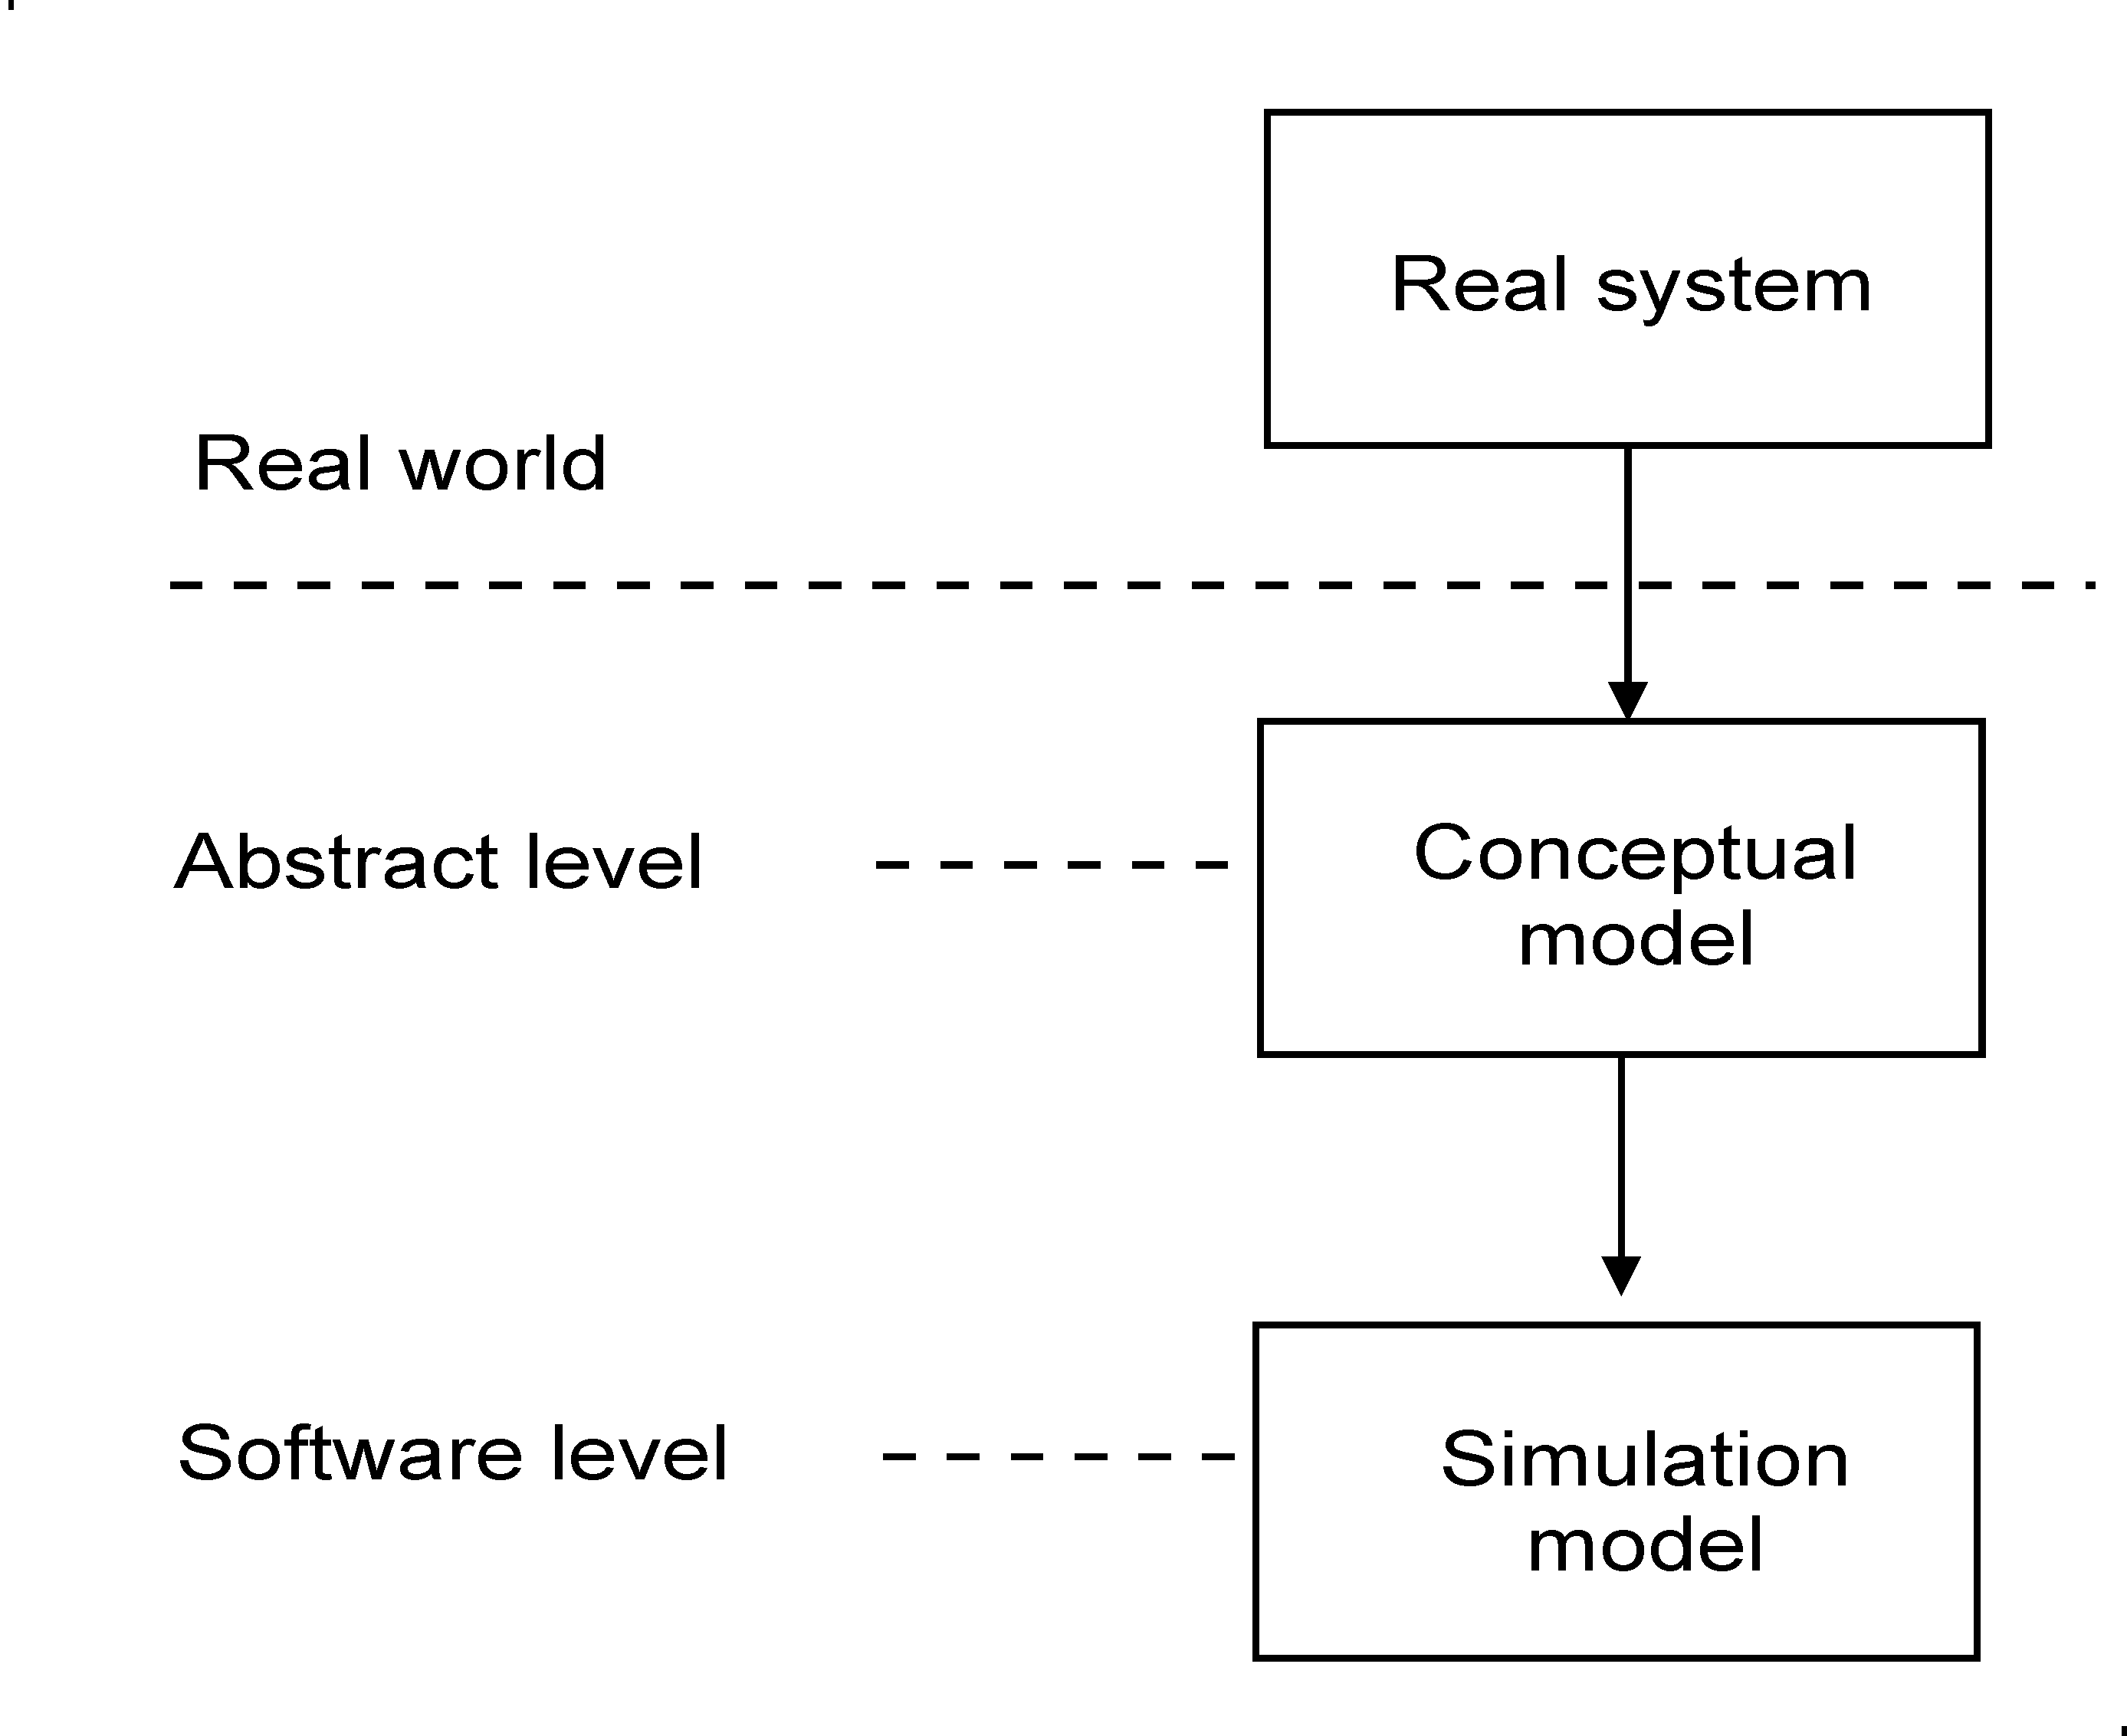
Conceptual and Simulation Models

Slide 11
Simulation Model
Built from the conceptual model of a system.
Implemented in an appropriate programming or simulation language.
Is needed to mimic the behavior of the real system under certain constraints.

Slide 12
Development of Simulation Models
Two main objectives:
To study some relevant aspects of the dynamic behavior of a system
To estimate various performance measures of the system

Slide 13
Simulation Run
A simulation run is an experiment carried out for some observation period using the simulation model to study (predict) the behavior of the system.

Slide 14
Behavior of a Simulation Model
Depends on:
The passage of time
Input data
Events generated by the environment

Slide 15
Types of Models
Physical models
Graphic models
Mathematical models
Other kinds of models

Slide 16
Stochastic Models reminder
A stochastic model incorporates inherent uncertainty in its behavior.
Key attributes within the model vary according to probability distributions, with values generated through random variables.
For example, in a carwash model:
The arrival times of cars are unpredictable and follow a probabilistic pattern.
The service time for each car also varies, reflecting real-world randomness.

Slide 17
Continuous and Discrete Models
Continuous models evolve continuously over time, with changes in state occurring smoothly and mathematically defined for every moment.
For example, a free-falling object is a continuous model, where its position
and velocity changes smoothly over time according to the laws of physics.
Discrete models, on the other hand, change their state only at specific, discrete points in time.
Events occur at these distinct moments, often following a sequence of steps.
For example, in a carwash model, the system state changes discretely when a car arrives or completes service, rather than continuously over time.

Slide 18
Discrete Model
Consider the simple carwash model, its dynamic behavior is defined by:
When an arrival event occurs, the model changes state.
When a service completion occurs, the model also changes state.

Slide 19
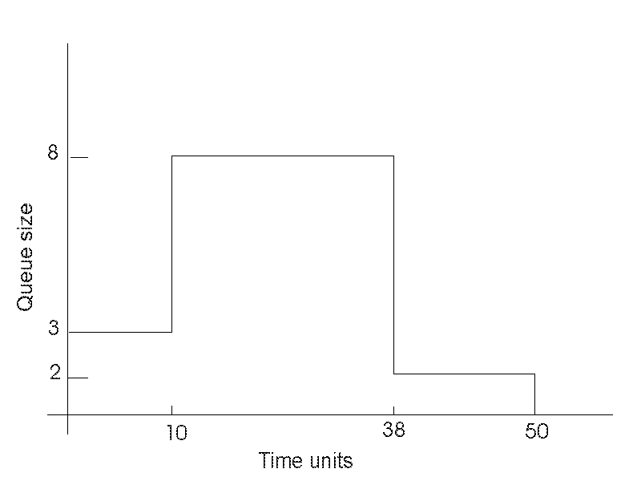
Queue Size in the Carwash Model
Example of a state variable

Slide 20
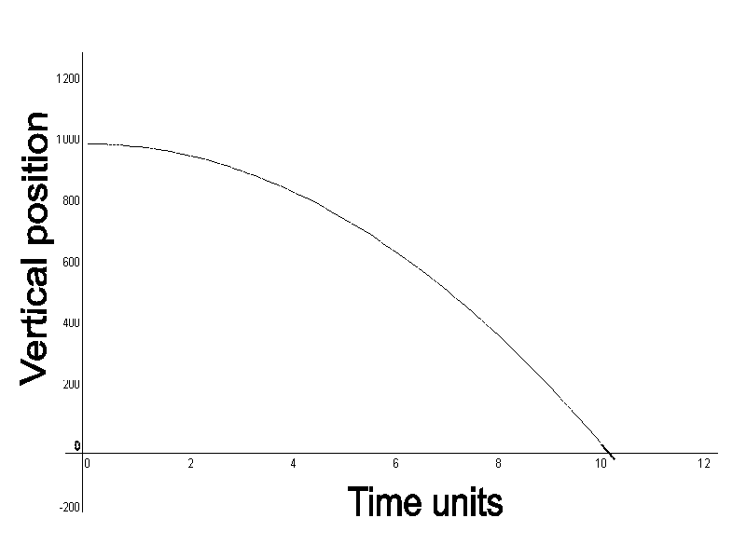
Continuous Model

Slide 21
Simula
The SIMULA language was developed by Ole-Johan Dahl and Kristen Nygaard at the Norwegian Computing Center (NCC) in Oslo around 1962.
Simula was the first language to introduce the concepts of classes and objects. The language also introduced the idea of prefixing and subclasses.
The key concepts have evolved since then and have been implemented in most modern OO programming languages.

Slide 22
DEMOS
Demos was developed by Graham Birtwistle and extends Simula
It is a library of standard process synchronization facilities for data collection, random number generation, tracing and automatic reporting.

Slide 23
SIMULA and DEMOS
The Demos package added more powerful simulation facilities to the Simula language.
Simula and Demos have not become widely used, despite the significant contribution to object orientation and simulation.

Slide 24
SmallTalk
In the early 1970’s, Alan Kay and his group at Xerox PARC used Simula as a platform for their development of Smalltalk.
Their development extended object-oriented programming importantly by the integration of graphical user interfaces (GUI) and interactive program execution.

Slide 25

C++ and Other OOP Languages
In the mid-1980s, Bjarne Stroustrup started his development of C++ by bringing the key concepts of Simula into the C programming language.
Other object-oriented programming languages such as C#, JS, Java, and others, were also influenced by Simula.

Slide 26


Important Quotes
“Simulation is one of the most powerful techniques available for the study, design, and operation of complex systems” (R. Shannon).
“Mathematical modeling is essentially a conceptual way of thinking” (L. Schruben)
“... the task of modeling a system is in itself worthwhile …” (L. Schruben)

Slide 27
Simulation in Education
Modeling and Simulation is an important part of the Computing curriculum.
In object-oriented simulation, students
Apply understanding of OO concept when modeling, i.e. building the conceptual model
Implementing a simulation model in an OOP language.

Slide 28
Simulation in Education (2)
Use of OO packages in teaching object-oriented simulation reinforces object-oriented design and programming.
Students have learned OO programming principles using OO in introductory courses
OO simulation exposes students to programming in the large
Students have taken courses in systems analysis and design using UML for modeling

