Slide 1

Modeling and Simulation
CS4632

Slide 2
Modeling System Behavior
A system is the part of the real world under study. Composed of a set of entities interacting among themselves and with the environment.
A model is an abstract representation of a system.
The system behavior is dependent on the input data and actions from the environment.

Slide 3
System Components
Active (or live) components: the processes. These are the major components in a model and have a life of their own.
Passive components:
Explicit and implicit queues.
Resources that can be acquired by the processes.

Slide 4
Types of Models
Physical models
Graphic models
Mathematical models
Are you able to list other kinds of models?

Slide 5
Stochastic Models
A stochastic model includes some uncertainty in its behavior.
One or more attributes change value according to a probability distribution. Random variable generation is used.
For example, in the carwash model:
arrival of cars
Service time for a car

Slide 6
Simulation
A simulation model is a mathematical model implemented with a general-purpose programming language or a simulation language.
Simulation is the carrying out of experiments with the simulation model to study the behavior of the model.

Slide 7
Continuous and Discrete Models
Continuous models change their state continuously with time. Mathematical notation is used to completely define the behavior. For example, the free-falling object.
Discrete models only change their state at discrete instants. For example, the carwash model.

Slide 8
Discrete Model
Consider the simple carwash model, its dynamic behavior is defined by:
When an arrival event occurs, the model changes state.
When a service completion occurs, the model also changes state.

Slide 9
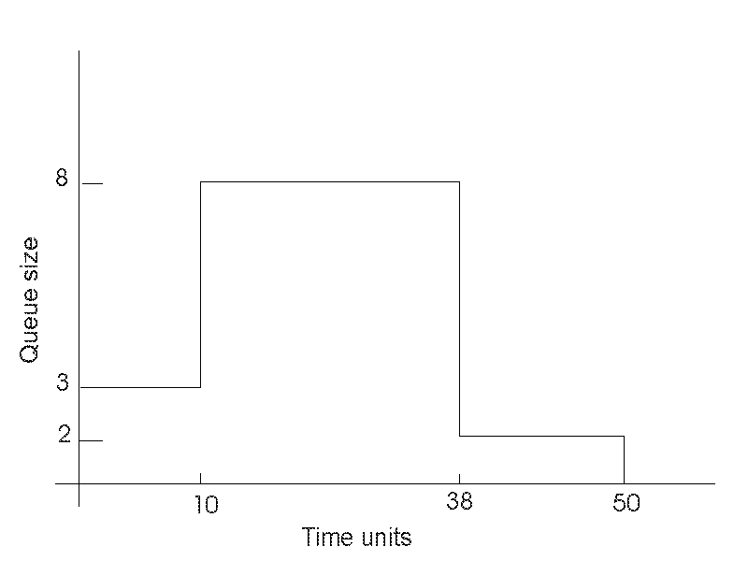
Queue Size in a Carwash Model

Slide 10
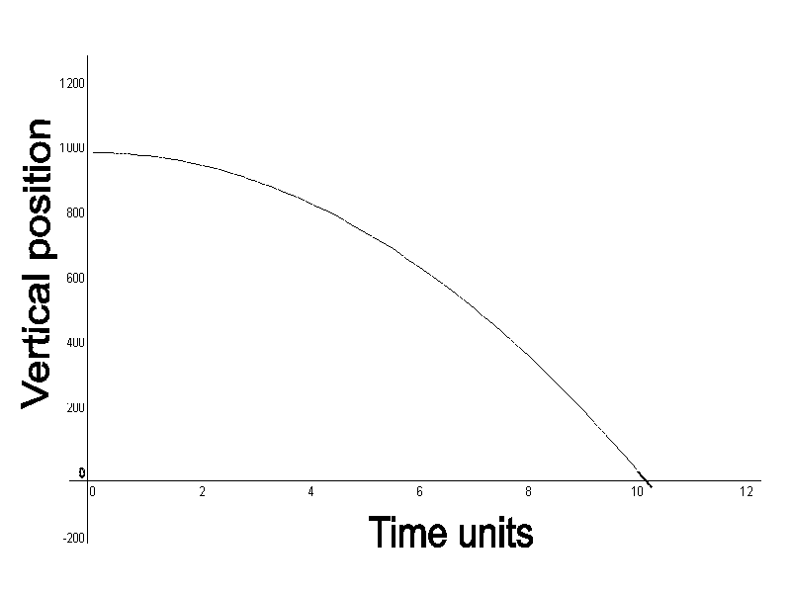
Continuous Model

Slide 11
Supporting Software
The simulation executive. The program that controls every simulation.
The set of utility functions for housekeeping tasks.

Slide 12
Facilities Provided by Simulation Software
Maintain the sequence of event records (pairs of event and event time)
Provide mechanisms for the generation and cancellation of event records
Maintain the simulation clock
Provide functions to generate random numbers from common probability distributions.

Slide 13
The Time Dimension
Simulation time, the time referenced by simulation models. This time is advanced by:
Fixed time increments
Variable time increments (event scan)
Run time, the absolute time referenced while the simulation model executes.

Slide 14
World View For Discrete-Event Simulation
Event approach
Activity approach
Process interaction approach

Slide 15
The Process Interaction Approach
A simulation model using this approach consists of a description of how different processes (active entities) are going to interact among themselves, as time passes.
A simulation run consists of creating and starting the processes interacting among themselves, synchronizing and using resources.

Slide 16
Advantages of the Process Style of Simulation
Compatible with the Object-Oriented approach to modeling and programming, every process is an active object.
Suitable for modeling large and complex systems.
C/C++, Java, C#, and any higher-level object-oriented simulation language are used to implement the models.

Slide 17
Processes
Processes are implemented as threads, which are the smallest unit of execution within a process. [See CS 3502 operating Systems for more].
The main body of a process is composed of a sequence of phases, after a phase is executed, the control is returned to the simulation executive.
The process executing a phase is the currently running process.
From the system point of view, all processes are active and interacting at the same time.

Slide 18
Process View
Static Process Description
Dynamic Process Management
Initiate Process
Delay (Time) Process
Suspend Process
Activate Process
Terminate Process

Slide 19
Resource View
Standard/Tailored Resource Handler
Resource Management
Create resource
Request resource
Acquire resource
Release resource
Status of resource
Destroy resource

Slide 20
Simulation Executive for the Process Interaction Approach
Schedule processes at particular instants, i.e., place processes in the event list
Remove processes from the event list ( to make them idle or to terminate them)
Re-schedule processes, i.e., change the position of processes in the event list.
Execute the phase for the “running” process.

Slide 21
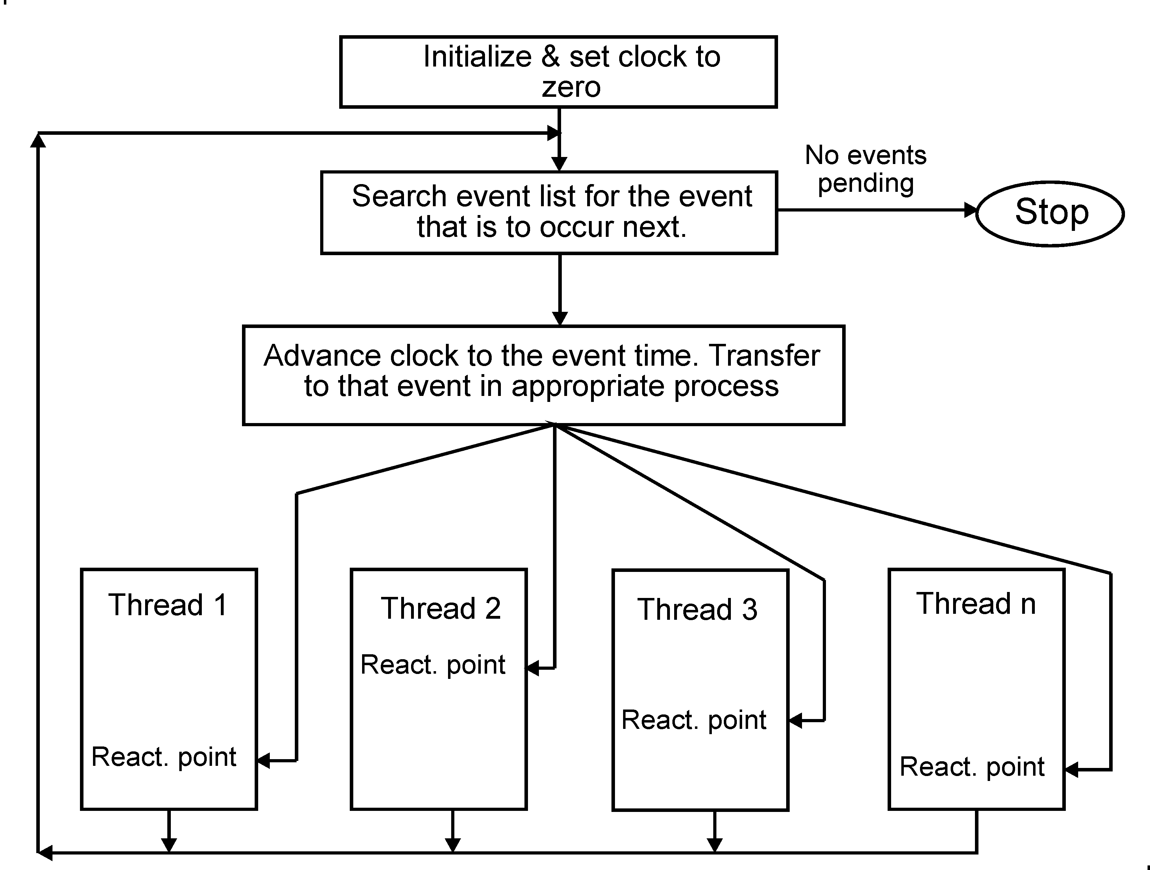
The Simulation Executive

Slide 22
Reviewing Threads
A thread consists of a set of phases, each of which is executed when the simulation executive advances the clock to the required time.
Every thread re-starts to execute at its reactivation point (in the active phase), and its corresponding event time.

Slide 23
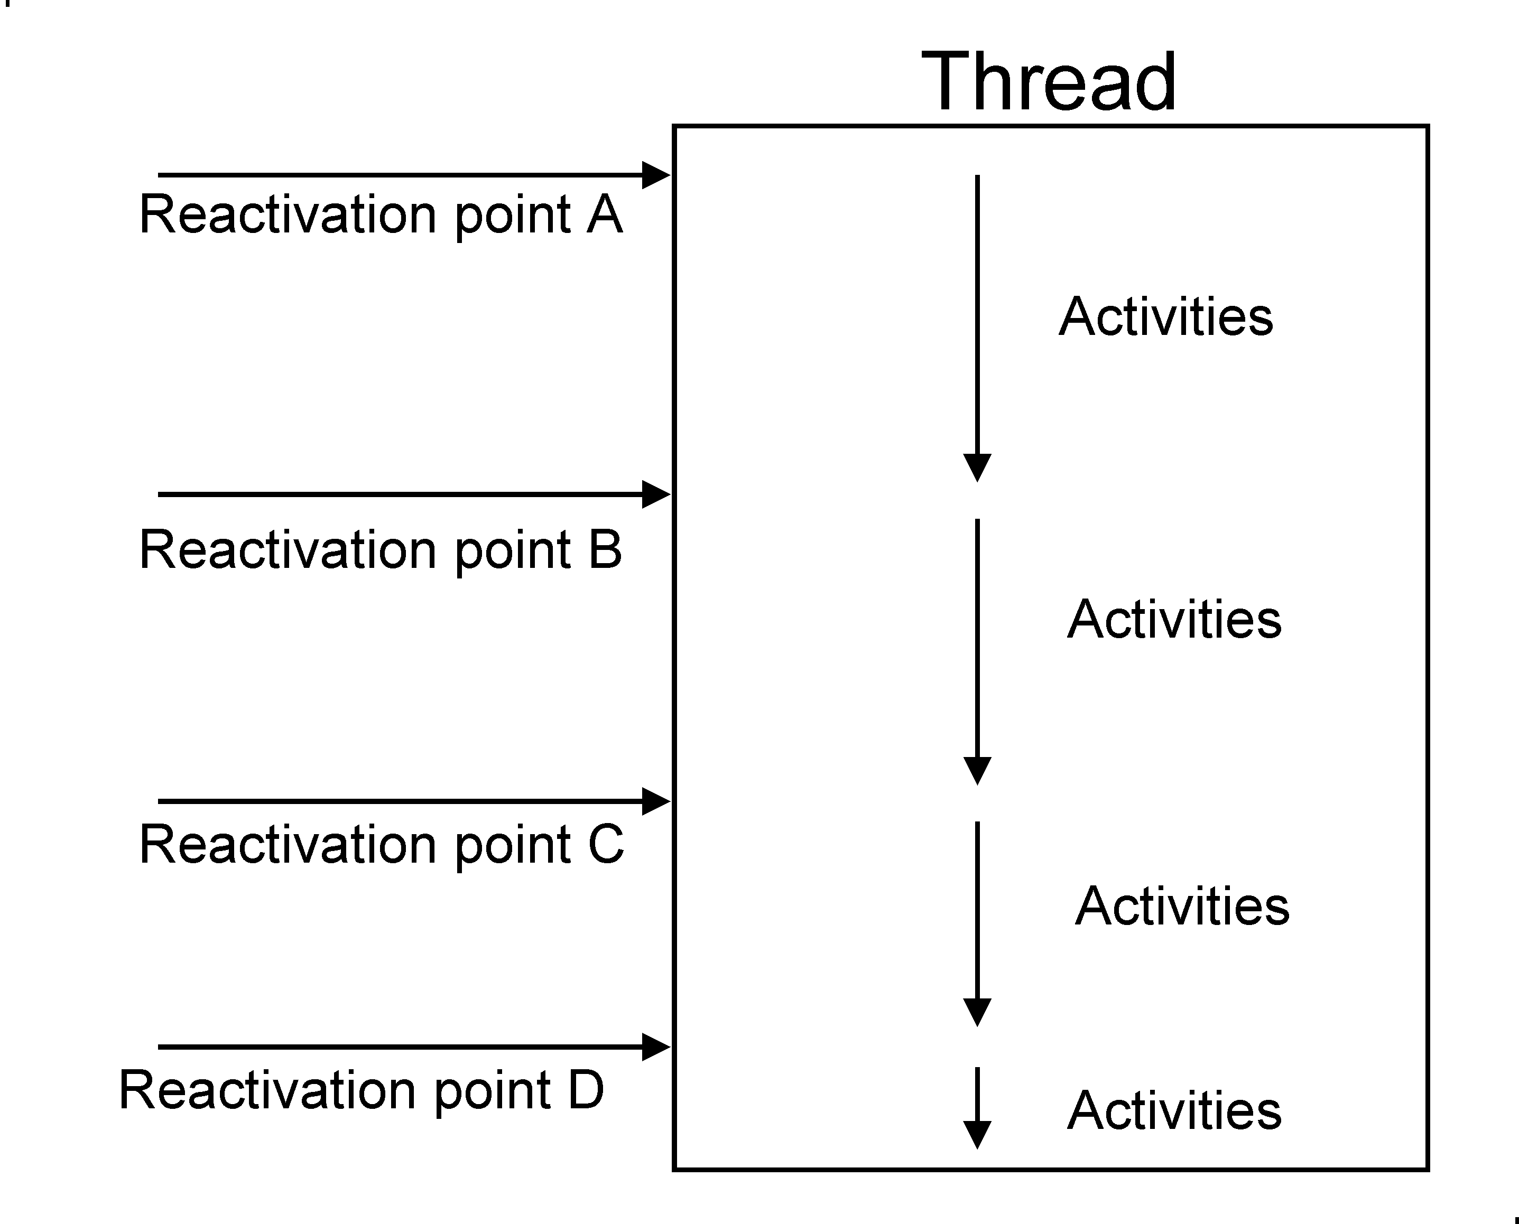
Thread With Its Reactivation Points

Slide 24
Using Simulation
Every simulation model defines a set of classes to represent various entities and behaviors, which are instantiated as needed.
Classes that represent active processes typically inherit from a base Process class or equivalent, enabling them to run concurrently using threading or coroutines.
Other classes are used to create passive objects, such as resources or data structures, which support the operation of the active processes.

Slide 25

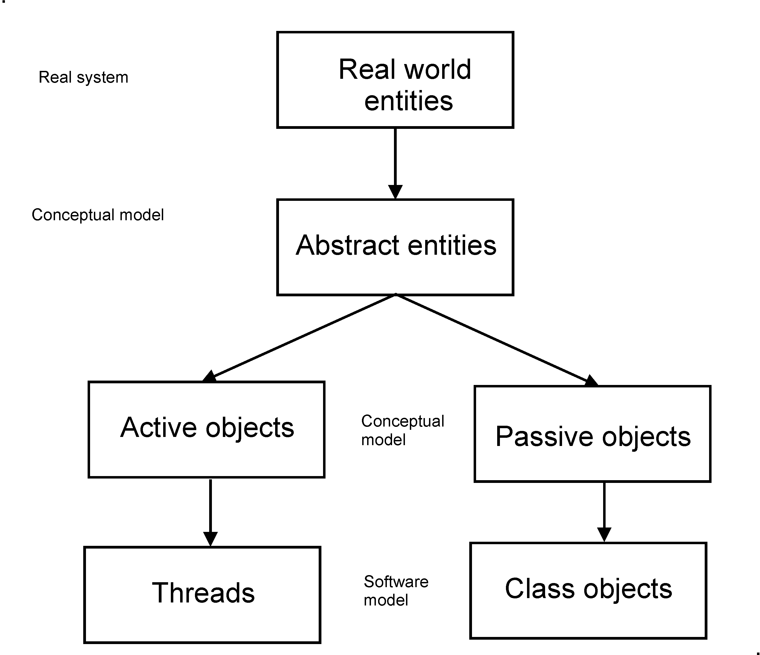

Active and Passive Objects

Slide 26
Simulation Software
MATLAB/Simulink - Extensively used in engineering, this tool is particularly popular for control system design, signal processing, and numerical simulations.
SolidWorks - A leading tool in mechanical engineering.
Ansys - A comprehensive tool for engineering simulations.
Arena - A widely recognized tool for modeling, simulating, and analyzing complex systems
AnyLogic - One of the top discrete event simulation tools that is also used for system dynamics and agent-based modeling
SimVascular - A more specialized tool used for simulating cardiovascular blood flow, particularly in medical research
Siemens NX - A powerful tool for integrated product design and simulation

Slide 27
Simulation continued
SCADE Suite - A model-based development environment for safety-critical embedded software
IBM Rational Software - Offers a suite of tools for modeling and simulation in software engineering.
Unreal Engine
Unity
NS3 - A discrete-event network simulator for internet systems.
SimPy - A process-based discrete-event simulation framework based on Python
OMNeT++ - An extensible, modular, component-based C++ simulation library and framework, primarily for building network simulations

Slide 28
Overview
In modeling a system, different levels of abstraction are used to describe the system
The most abstract level is at the top, and it is the easiest to understand
The most difficult level of abstraction is the implementation level, i.e., the programming of the model into a suitable programming language.

Slide 29
Overview (cont.)
Together with abstraction, the object-oriented approach is applied to manage complexity at all levels of system design and implementation.
High-level programming languages offer the advantage of being easier to use and more powerful for modeling and simulation tasks, compared to lower-level languages, enabling more efficient development and maintenance of complex systems.

Slide 30
The Process Interaction Approach to Simulation
The primary components in a simulation model are entities, which represent individual units or objects that interact within the system.
Active entities, also known as agents or actors, have autonomous behaviors and make decisions based on their environment and state.
Passive entities are resources, queues, or other objects that provide services or hold entities as they wait for processing.
These entities interact dynamically within the simulation environment, consuming and utilizing resources as they perform actions and respond to events.

