Slide 1
Implementing A Simulation Model General Structure of Single-Server Models Case Study
Activity Diagrams
Object Oriented Simulation
Single-Server Systems
Department of Computer Science College of Computing and Software Engineering
Kennesaw State University

Slide 2
Implementing A Simulation Model General Structure of Single-Server Models Case Study
Activity Diagrams
General Form of a Model
General steps
Define all classes for the active objects (processes), these classes inherit from the library class Process.
Define the main class, which is also a class for an active object of the model.
Include method main in the main class.
Class for active objects
All class definitions for active objects must include a method called Main_body. This method is the sequence of execution for the active object (process).

Slide 3

Implementing A Simulation Model General Structure of Single-Server Models Case Study
Activity Diagrams
The Main Class
Declare variable(s) for the queue size
Declare the workload parameters and system
parameters Declare variables for the total calculations
Declare a reference to an object of class Simulation
Declare references for the active objects of the model
Declare references to queues and other passive objects
Declare references for the output files
Define the initializer method
Define the method’s main
Define the main body of the class

Slide 4
Implementing A Simulation Model General Structure of Single-Server Models Case Study
Activity Diagrams
Method main
Create an object of the library class Simulation using a title for the model.
Create all the objects used in the model.
Start the simulation by invoking the start_sim function of the simulation object.
Set up the output files.
Create the queues and other passive objects.
Create and start an object of this class, the main object of the model.

Slide 5
Implementing A Simulation Model General Structure of Single-Server Models Case Study
Activity Diagrams
Method Main_body
Create and start the active objects declared in this class.
Start the simulation run using the declared simulation period.
Calculate total results.

Slide 6
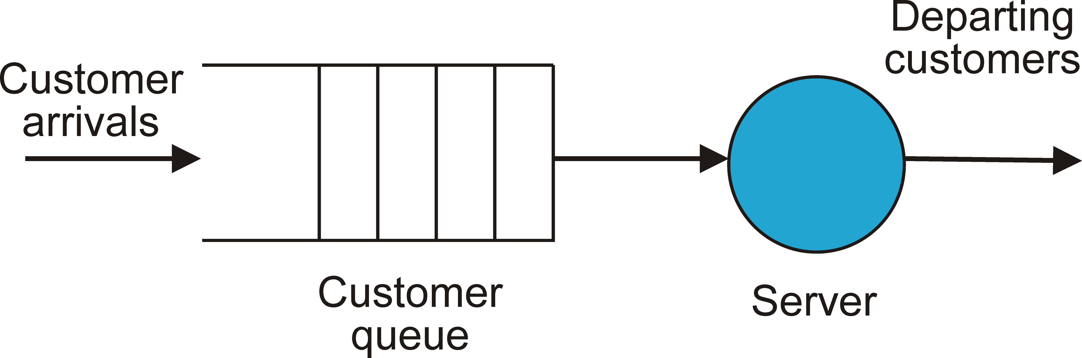
Implementing A Simulation Model General Structure of Single-Server Models Case Study
Activity Diagrams
Illustration of a Single Server System

Slide 7
Implementing A Simulation Model General Structure of Single-Server Models Case Study
Activity Diagrams
Single Server System
In a model of a single-server system, there is only one server process that provides service to the customer processes.
Components
The arrival of customers indicated with an arrow pointing to the tail of the queue
The customers that arrive requesting service
The customer queue, which is the waiting line for customers
The server, which removes the next customer from the queue and services it

Slide 8
Implementing A Simulation Model General Structure of Single-Server Models Case Study
Activity Diagrams
The Queue
A queue is a data structure that represents a waiting line and has two ends, the head and the tail.
A queue is defined as a passive entity.
An arriving customer process enters the queue at its tail. A customer can only leave the queue if it is at the head.
The server removes the customer at the head of the queue and then provides service to this customer.
The order of arrival of customers is retained in a simple queue, which follows first-in-first-out (FIFO) ordering.

Slide 9
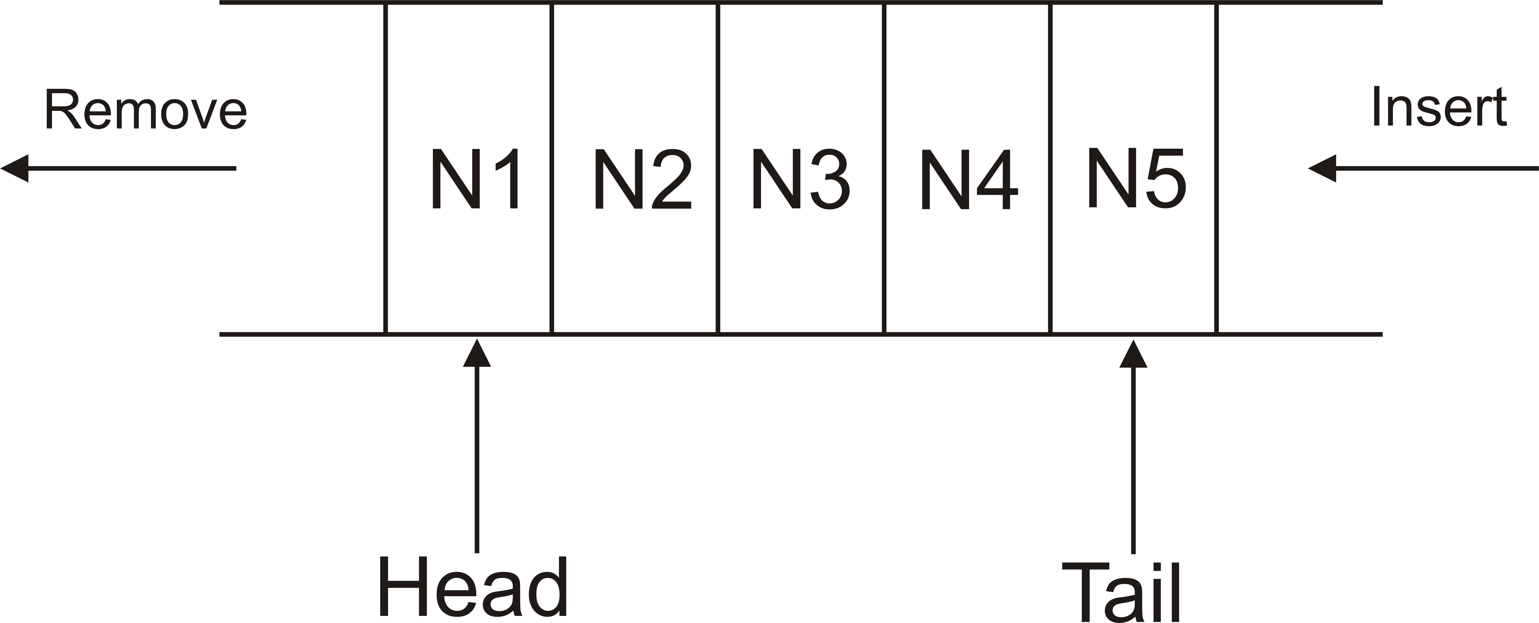
Implementing A Simulation Model General Structure of Single-Server Models Case Study
Activity Diagrams
Illustration of a Queue

Slide 10
Implementing A Simulation Model General Structure of Single-Server Models Case Study
Activity Diagrams
The Car-Wash System
Arriving cars join a queue to wait for service.
The car at the head of the queue is the one that is next serviced by the Carwash machine.
After the car wash is completed, the car leaves the system.
Cars are considered the customers of the system, as they are the processes requesting service from the server.

Slide 11
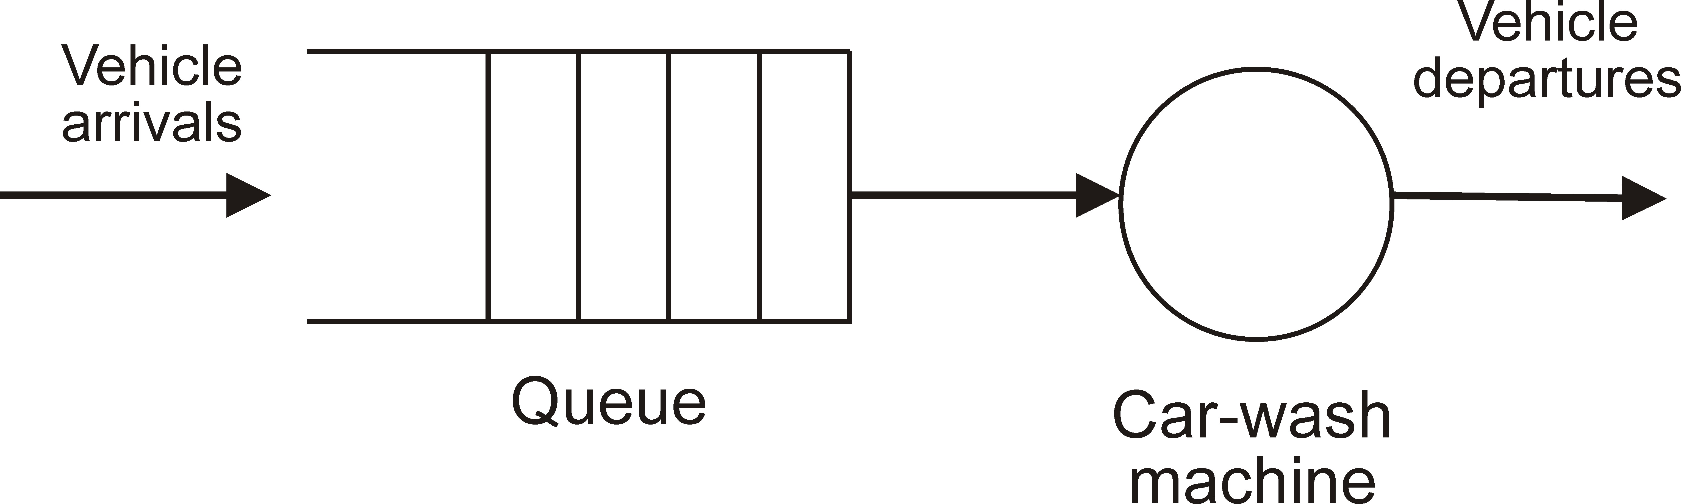
Implementing A Simulation Model General Structure of Single-Server Models Case Study
Activity Diagrams
Carwash Model View

Slide 12
Implementing A Simulation Model General Structure of Single-Server Models Case Study
Activity Diagrams
The Conceptual Model
Processes
The Car processes, which represent the customers to be serviced by the Carwash machine. Many instances of this process are created and actually executed (each one is an object of class Car ).
The Arrivals process, which creates car arrivals according to the inter-arrival period. This process represents the environment.
The Machine process, which represents the server process that services the car processes, according to the service demand of car processes.

Slide 13
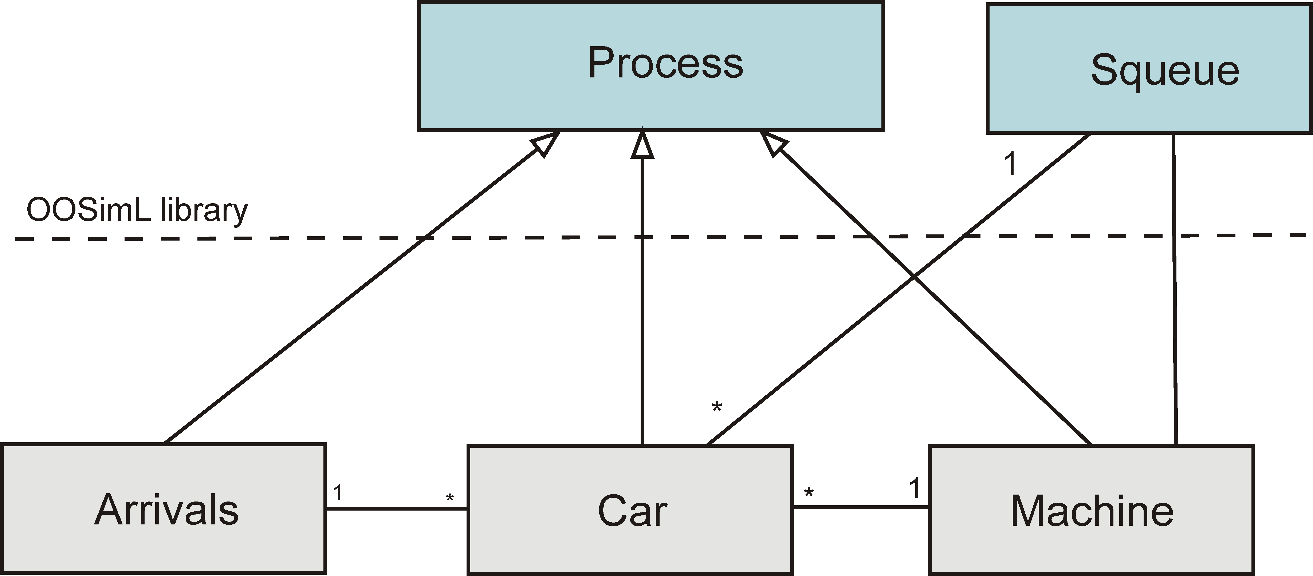
Implementing A Simulation Model General Structure of Single-Server Models Case Study
Activity Diagrams
The UML Class Diagram of the Model

Slide 14
Implementing A Simulation Model General Structure of Single-Server Models Case Study
Activity Diagrams
The Events in the Model
The arrivals of car processes, which have to join the queue. The start of service of a car
The completion of service of the current car process.
In this same instance, the server process attempts to get the next car process from the queue, and if there is none, will transition to the idle state.

Slide 15
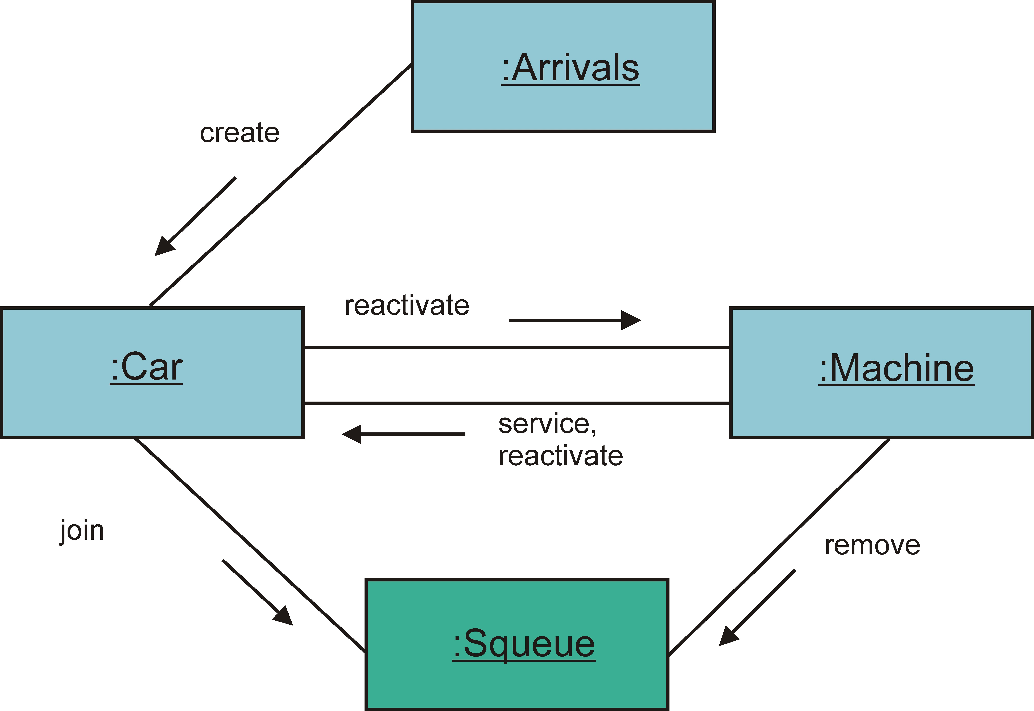
Implementing A Simulation Model General Structure of Single-Server Models Case Study
Activity Diagrams
The UML Communication Diagram

Slide 16
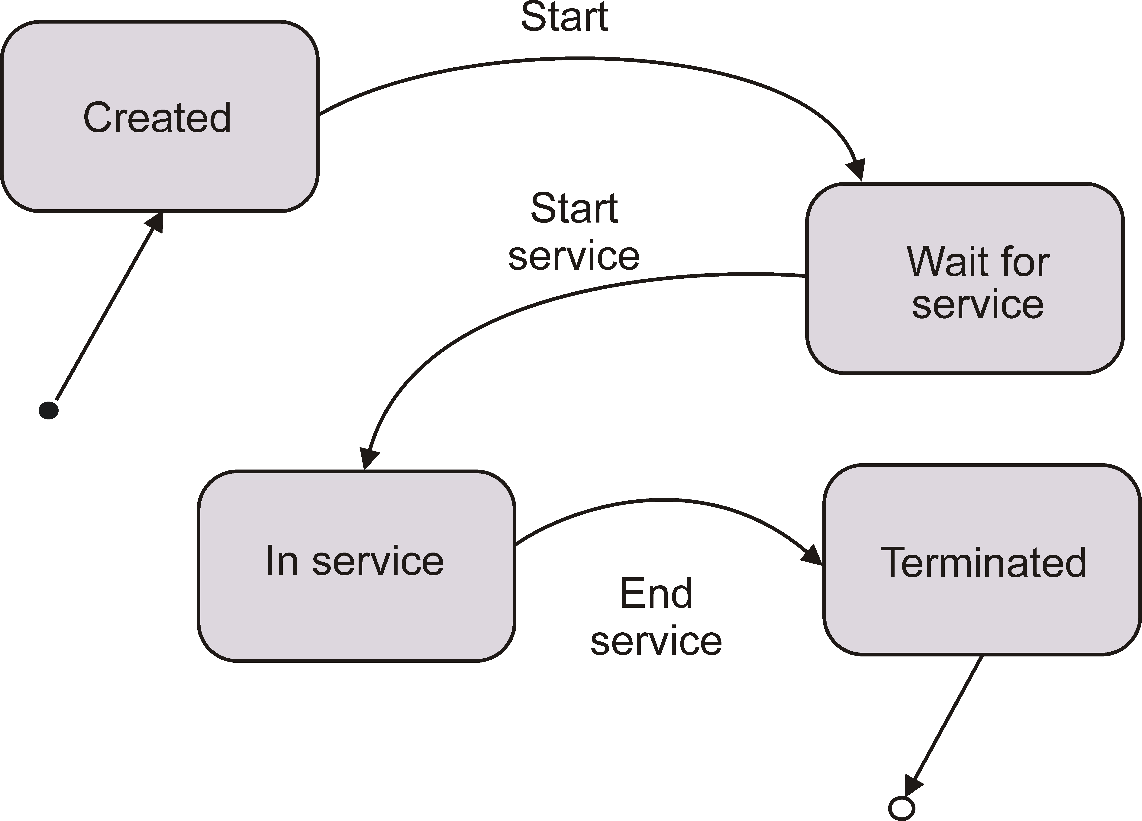
Implementing A Simulation Model General Structure of Single-Server Models Case Study
Activity Diagrams
A UML State Diagram

Slide 17
Implementing A Simulation Model General Structure of Single-Server Models Case Study
Activity Diagrams
The Car-Wash Deterministic Model
A deterministic version of the model for the Carwash system has predetermined arrivals and service periods.
Workload
Customer processes arrive at time instants:
0, 2, 5, 8, 12,13, 17, 22, and 23
A Carwash service takes 4-time units

Slide 18
Implementing A Simulation Model General Structure of Single-Server Models Case Study
Activity Diagrams
The Arrivals Process
The arrivals process represents the environment that generates new customers. There is a single arrival process in this model
Sequence of Activities
Wait until the clock advances to the next arrival event, i.e., by a time interval equal to the inter-arrival period.
Create a customer (car) object with a service period equal to
4.0-time units.
Repeat step 1 for all arriving car processes.

Slide 19
Implementing A Simulation Model General Structure of Single-Server Models Case Study
Activity Diagrams
The Server Process
There is only one object of the class Server in this model Sequence of Activities
While the arrival queue is not empty, execute the following activities:
Remove the car process at the head of the queue.
Carry out the service on the car process.
Reactivate the car process.
Wait (in the idle state) until the next car process arrives, then start from step 1.

Slide 20
Implementing A Simulation Model General Structure of Single-Server Models Case Study
Activity Diagrams
The Car Process
A car process includes the service period as one of its relevant attributes
Sequence of Activities
Join the arrival queue if it is not full.
Terminate if the queue is full (i.e., the car is rejected).
Reactivate the server if the server is idle. Suspend self.
Continue with your activities when the server process has completed the service.
Terminate.

Slide 21
Implementing A Simulation Model General Structure of Single-Server Models Case Study
Activity Diagrams
Table of Results
Table: Events in the Car-Wash Model
Time | Process | Event | Next Event
0 | arrivals | starts
0 | server | starts
0 | car 1 | arrives
0 | server | begins service | 4
2 | car 2 | arrives
4 | server | completes service | 4
4 | server | begins service | 8
5 | car 3 | arrives
8 | car 4 | arrives
8 | server | completes service | 8

Slide 22
Implementing A Simulation Model General Structure of Single-Server Models Case Study
Activity Diagrams
Table of Results (Events)
Time | Process | Event | Next Event
8 | server | begins service | 12
12 | car 5 | arrives
12 | server | completes service | 12
12 | server | begins service | 16
13 | car 6 | arrives
16 | server | completes service | 16
16 | server | begins service | 20
20 | server | completes service | 20
20 | server | begins service | 24
24 24 | server server | completes service starts waiting | 24

Slide 23
Implementing A Simulation Model General Structure of Single-Server Models Case Study
Activity Diagrams
Number of Cars in the Queue
Table: Queue Size in the Car-Wash Model
Time | Q Size
0 | 0
2 | 1
4 | 0
5 | 1
8 | 1
12 | 1
13 | 2
16 | 1
20 | 0

Slide 24
Implementing A Simulation Model General Structure of Single-Server Models Case Study
Activity Diagrams
Wait Intervals of Cars
Table: Processes Waiting Time
Process | Arrival | Start Service | Wait Time
car 1 | 0 | 0 | 0
car 2 | 2 | 4 | 2
car 3 | 5 | 8 | 3
car 4 | 8 | 12 | 4
car 5 | 12 | 16 | 4
car 6 | 13 | 20 | 7

Slide 25
Implementing A Simulation Model General Structure of Single-Server Models Case Study
Activity Diagrams
The Car-Wash Stochastic Model
Differences in deterministic and stochastic models
The arrival events are random, i.e., it is not known exactly when a car arrival event will occur.
The service periods are also random, i.e., it is not known exactly how much time it will take the machine to wash a particular car.
Random variables in the carwash model
The inter-arrival period for each car process, and the service period for each car process.

Slide 26
Implementing A Simulation Model General Structure of Single-Server Models Case Study
Activity Diagrams
Output of Simulation Runs
The results of a simulation run of the stochastic Carwash model are produced on the two output files generated by the simulation run:
carwtrace.txt carwstatf.txt
One file includes a listing of the sequence of events and the other file includes the summary statistics and performance metrics computed.
José M. Garrido C.
Object Oriented Simulation

Slide 27
Implementing A Simulation Model General Structure of Single-Server Models Case Study
Activity Diagrams
Partial Output of a Simulation Run
End Simulation of Simple Model of Car-Wash System date: 11/16/2018 time: 11:46
Elapsed computer time: 54 millisec
Total number of cars serviced: 46 Car average wait period: 90.844
Average period car spends in the shop: 87.152 Machine utilization: 0.898
José M. Garrido C.
Object Oriented Simulation

Slide 28
Implementing A Simulation Model General Structure of Single-Server Models Case Study
Activity Diagrams
Diagrams
These diagrams help describe the operations of the processes involved and the synchronization that is present when processes interact with each other.
Car processes enter a queue and transition to the idle state. The machine process removes a car process from the queue to service it. All queues are passive objects and are different from the processes.

Slide 29
Implementing A Simulation Model General Structure of Single-Server Models Case Study
Activity Diagrams
Activity Symbols
The flow of control in the diagram is composed of a sequence of symbols that denote different type of activities and synchronization actions, all joined by lines and arrows.
A general activity is represented by a rectangular box; the label in the box is the name of the activity. This activity symbol is usually called a delay because a finite interval elapses while the activity is carried out and before the process can proceed to the next activity. The arrows show the direction of the flow activity sequence.

Slide 30
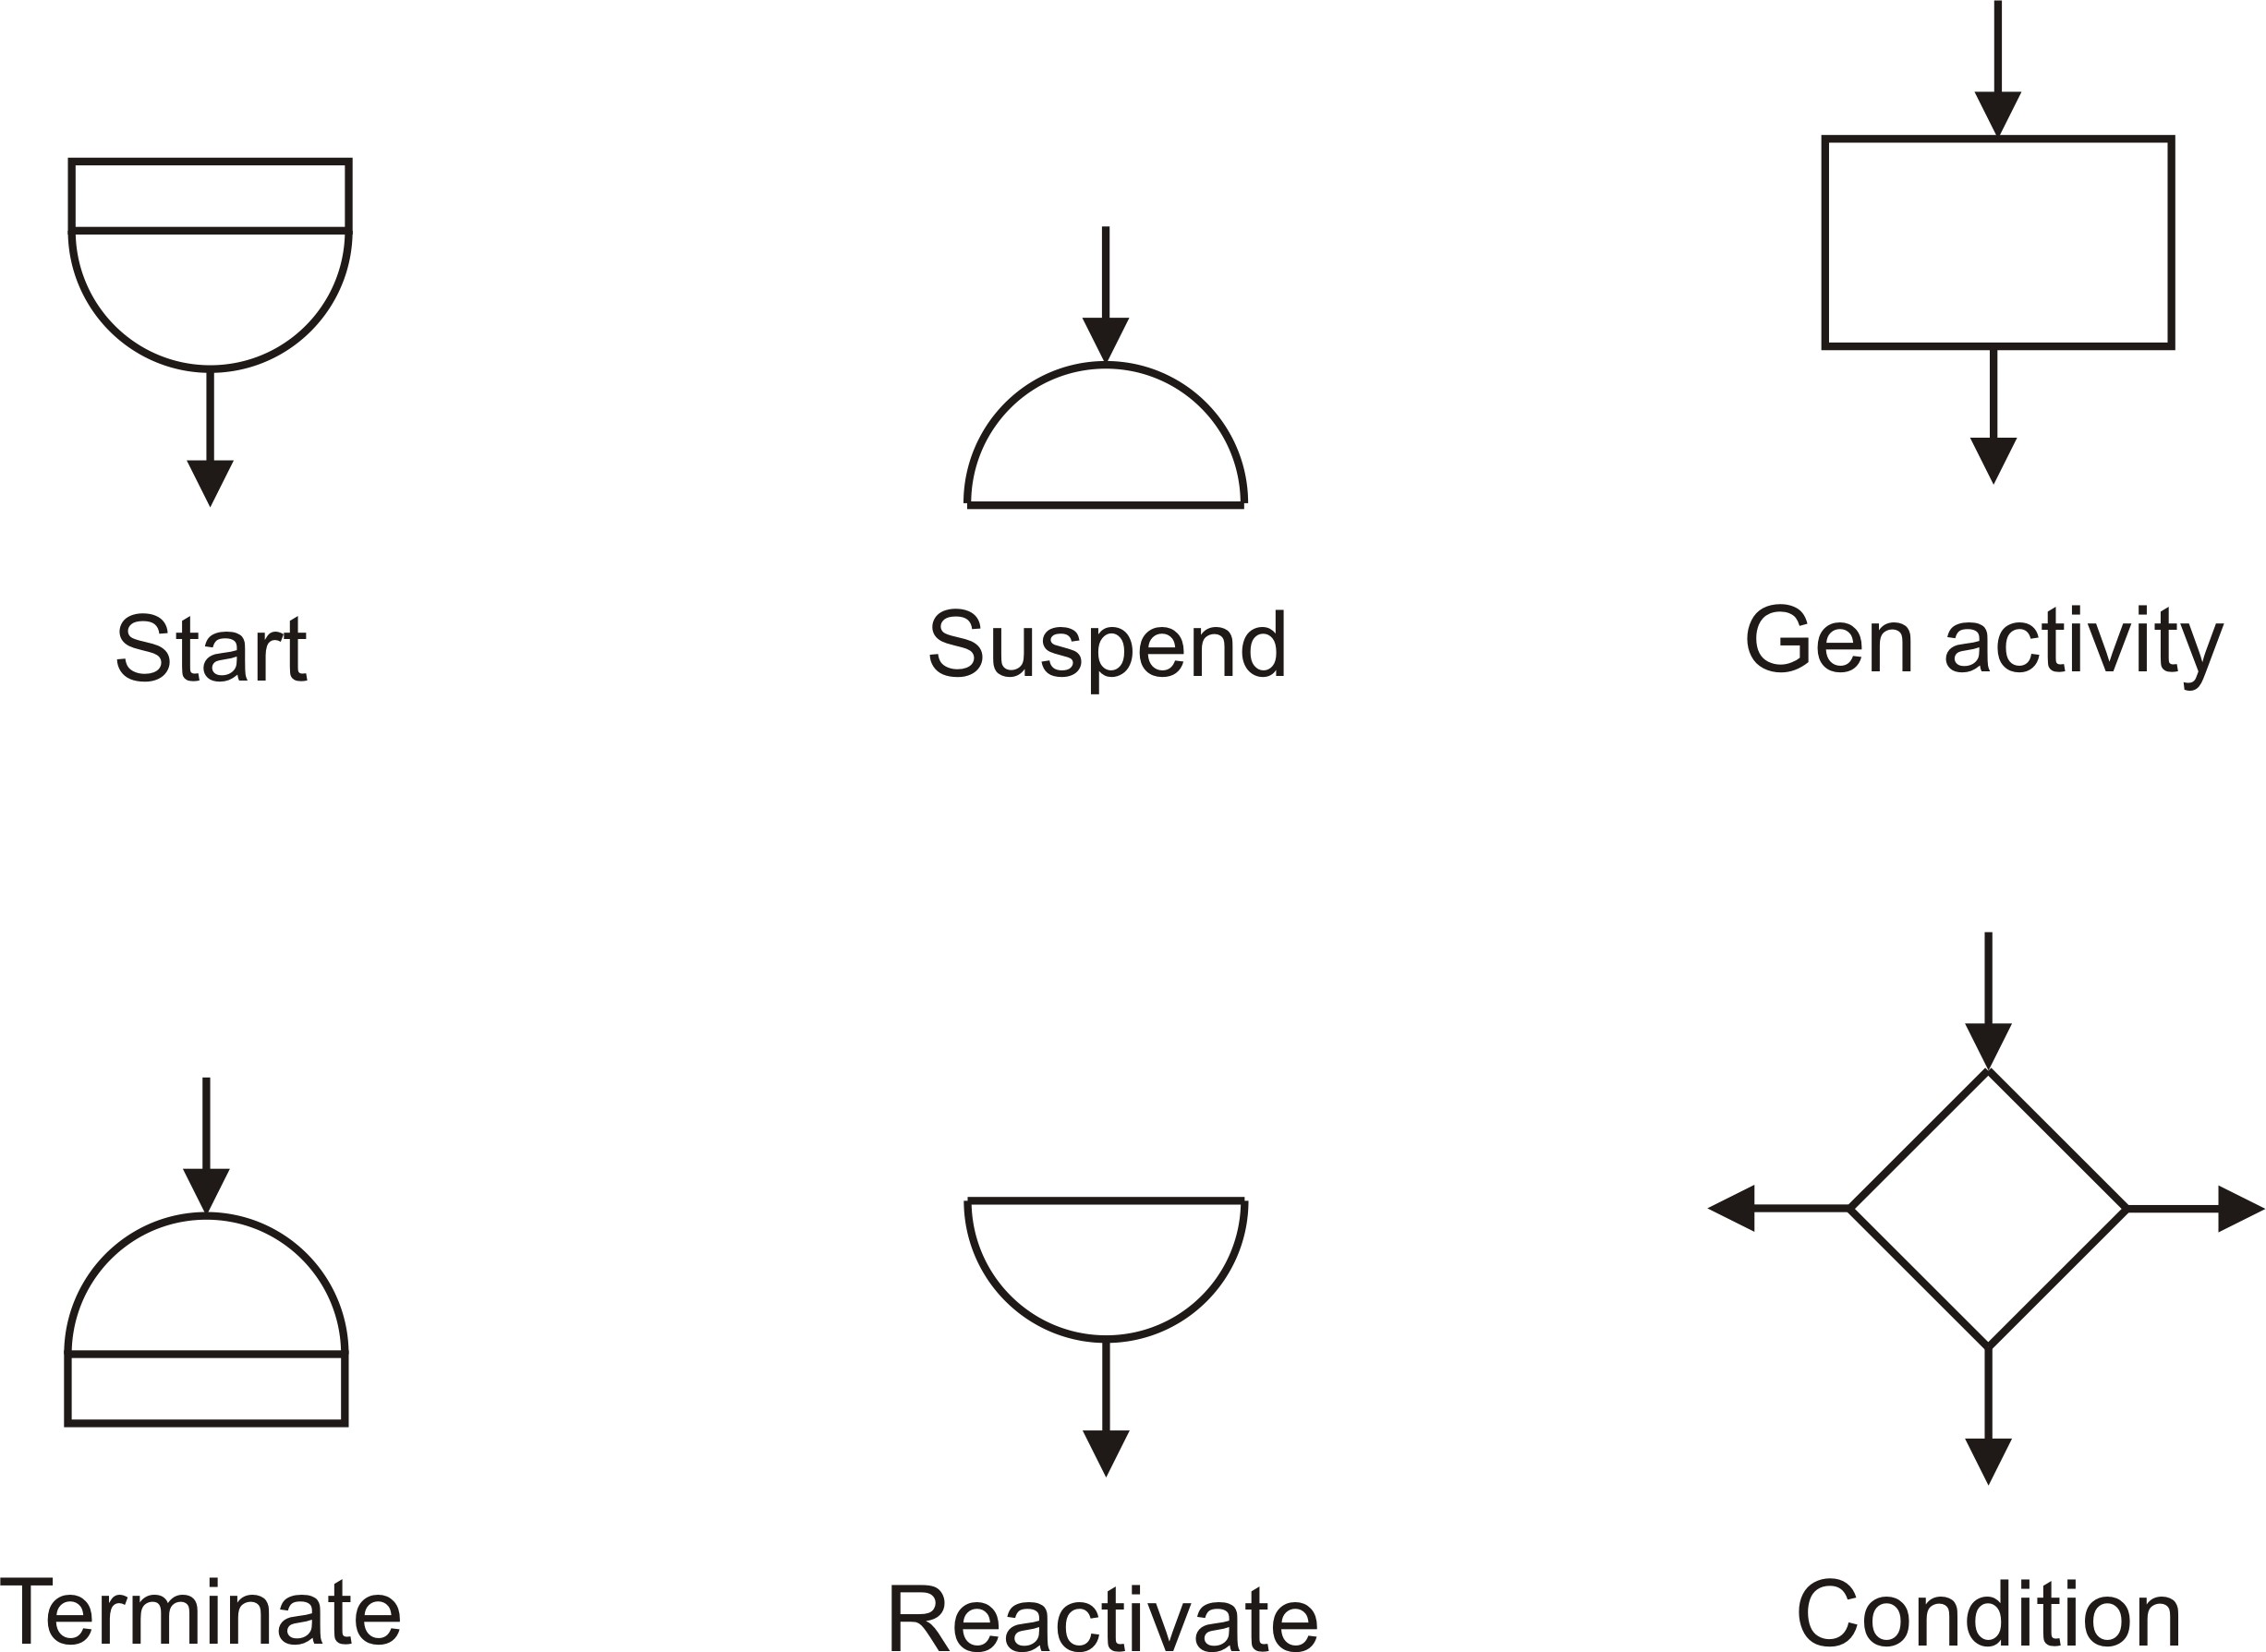
Implementing A Simulation Model General Structure of Single-Server Models Case Study
Activity Diagrams
Illustration of Activity Symbols

Slide 31
Implementing A Simulation Model General Structure of Single-Server Models Case Study
Activity Diagrams
Activity Symbols
The lower semicircle with a bar below a process name, indicates the start of a process life cycle.
The lower semicircle symbol also indicates reactivation of the activity sequence; this symbol can also have an arrow in a non-vertical inclination that shows synchronization with another process.
The inverted form of this symbol indicates the termination of the process.
The upper semicircle indicates that the object enters its idle state
a possible arrow in a non vertical inclination denotes the synchronization with another process.

Slide 32
Implementing A Simulation Model General Structure of Single-Server Models Case Study
Activity Diagrams
Interaction Symbols
Process interaction symbols indicate signals and direct synchronization among processes.
The synchronization send denotes when a signal is sent to a condition queue.
This symbol can also denote an interrupt to another process.
This symbol can also be used to send an item to a queue.
The synchronization received indicates an item being received from a queue.
José M. Garrido C.
Object Oriented Simulation

Slide 33
Implementing A Simulation Model General Structure of Single-Server Models Case Study
Activity Diagrams
Interaction Symbols (2)
The symbols for cooperation describe the effect of cooperation among processes.
The symbol for schedule describes a process that:
Schedules itself or another process after some time interval
This symbol can also denote the reactivation of another process.

Slide 34
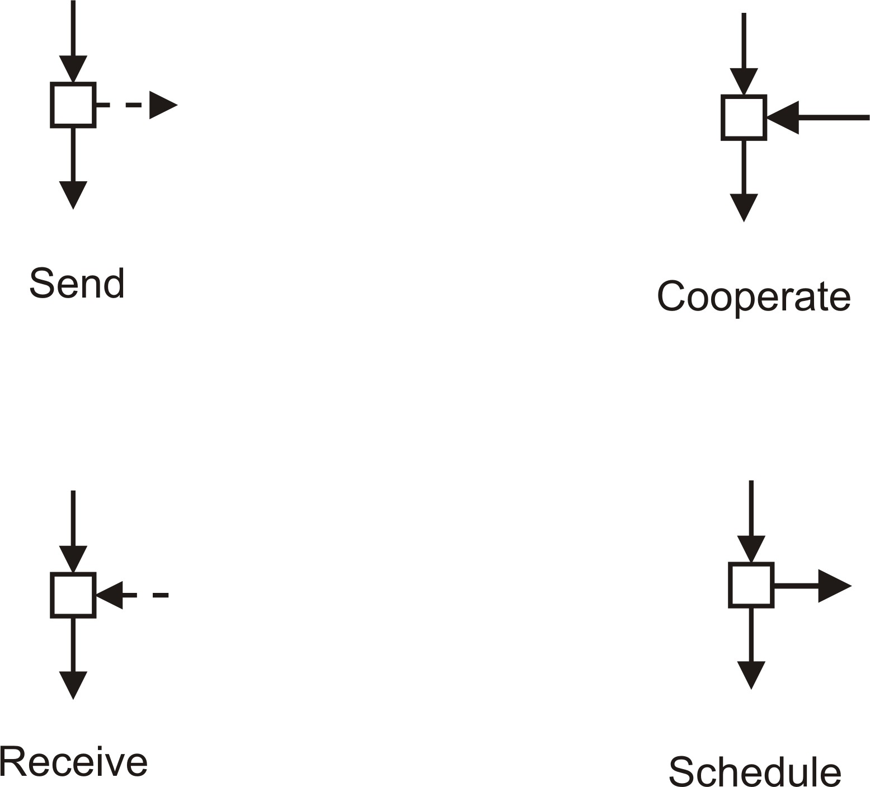
Implementing A Simulation Model General Structure of Single-Server Models Case Study
Activity Diagrams
Illustrations of Interaction Symbols

Slide 35
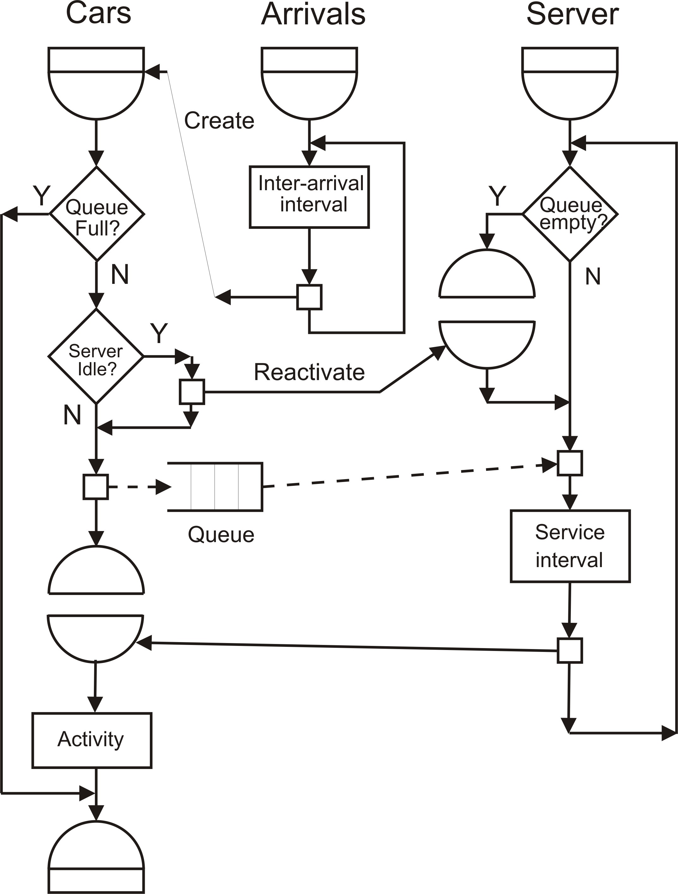
Implementing A Simulation Model General Structure of Single-Server Models Case Study
Activity Diagrams
Activity Diagram of the Carwash Model

