Slide 1
Object Oriented Simulation
Activity Diagrams
Activity Diagrams
Department of Computer Science College of Computing and Software Engineering
Kennesaw State University
Object Oriented Simulation

Slide 2
Activity Diagrams
Activity Diagrams
These diagrams help describe the operations of the processes involved and the synchronization that is present when processes interact with each other.
Car processes enter a queue and transition to the idle state. The machine process removes a car process from the queue to service it. All queues are passive objects and are different from the processes.
Object Oriented Simulation

Slide 3
Activity Symbols
Activity Diagrams
The flow of control in the diagram is composed of a sequence of symbols that denote different type of activities and synchronization actions, all joined by lines and arrows.
A general activity is represented by a rectangular box; the label in the box is the name of the activity. This activity symbol is usually called a delay because a finite interval elapses while the activity is carried out and before the process can proceed to the next activity. The arrows show the direction of the flow activity sequence.
Object Oriented Simulation

Slide 4
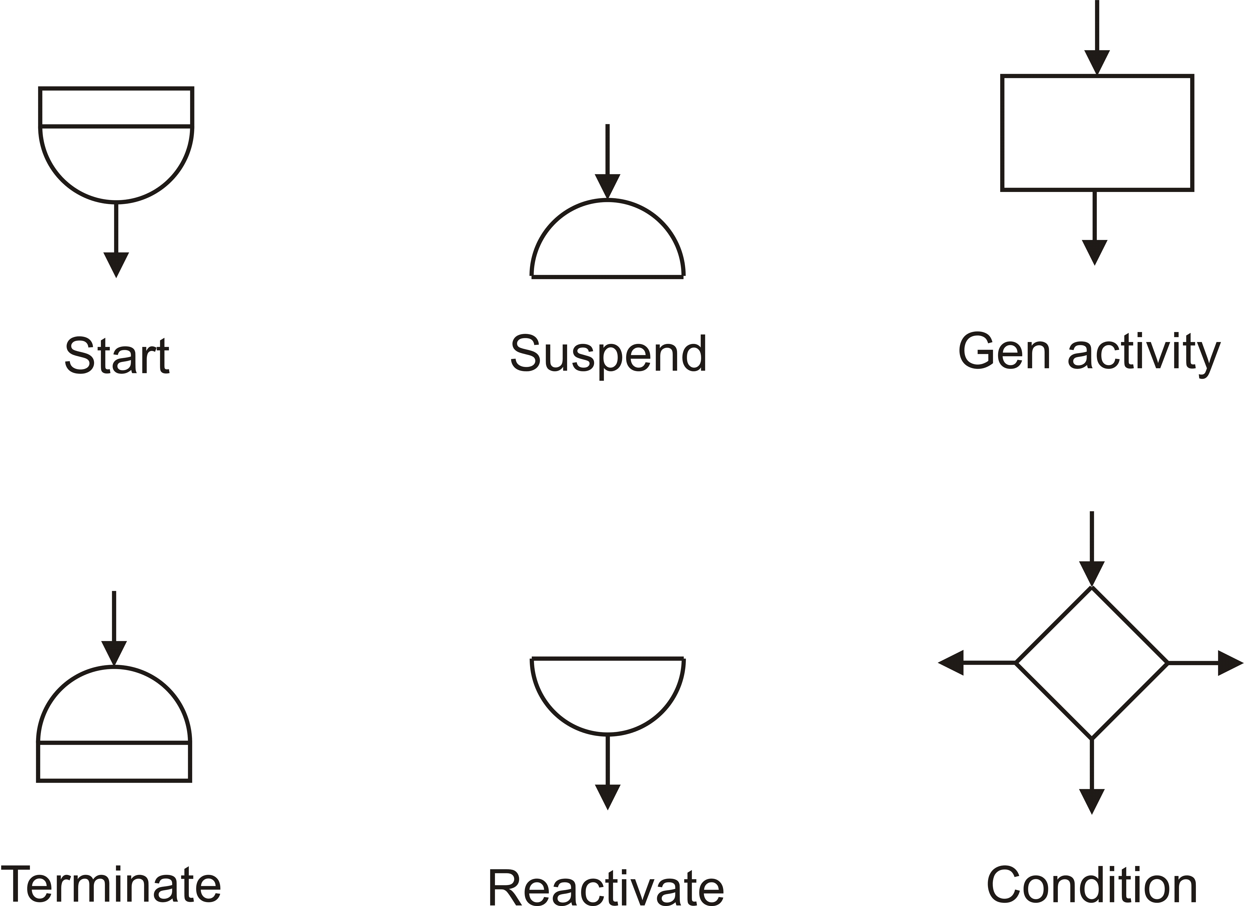
Activity Diagrams
Activity Symbols
Object Oriented Simulation
Notes:
Start (Top Left):
Symbol: A filled circle with an arrow pointing down.
Purpose: Indicates the beginning of the activity flow or process. Every activity diagram should start with this symbol to define the entry point of the process.
Suspend (Top Middle):
Symbol: A semicircle with an arrow pointing down.
Purpose: Represents a point in the activity flow where the process is temporarily paused. This is useful when modeling processes that involve waiting or timed delays.
General Activity (Top Right):
Symbol: A rectangle with an arrow pointing down.
Purpose: Denotes a generic activity or task within the process. This is the most common symbol and is used to represent the main actions performed during the process.
Terminate (Bottom Left):
Symbol: A filled semicircle with a flat base and an arrow pointing down.
Purpose: Marks the end of the activity flow or process. It’s important to use this symbol to clearly define where the process concludes.
Reactivate (Bottom Middle):
Symbol: A semicircle similar to the Suspend symbol but used to indicate resumption of an activity.
Purpose: Indicates the point where a previously suspended activity is resumed. This is essential in processes that involve conditional or iterative flows.
Condition (Bottom Right):
Symbol: A diamond with arrows pointing in multiple directions.
Purpose: Represents a decision point in the process, where the flow can diverge based on conditions. Each outgoing arrow from the condition symbol typically has a label indicating the criteria that dictate the flow.
Usage Tips:
Always start your activity diagrams with the Start symbol and end them with the Terminate symbol.
Use the Suspend and Reactivate symbols to accurately model processes that involve waiting periods or conditions that cause the flow to pause and resume.
The General Activity symbol will be your most frequently used, so ensure each represents a distinct and meaningful action within your model.
Conditions are critical for modeling decision-making processes; ensure that each branch represents a clear and distinct outcome.

Slide 5
Activity Symbols
Activity Diagrams
The lower semicircle with a bar below a process name, indicates the start of a process life cycle.
The lower semicircle symbol also indicates reactivation of the activity sequence; this symbol can also have an arrow in a non-vertical inclination that shows synchronization with another process.
The inverted form of this symbol indicates the termination of the process.
The upper semicircle indicates that the object enters its idle state
A possible arrow in a non-vertical inclination denotes the synchronization with another process.
Object Oriented Simulation

Slide 6
Interaction Symbols
Activity Diagrams
Process interaction symbols indicate signals and direct synchronization among processes.
The synchronization send denotes when a signal is sent to a condition queue.
This symbol can also denote an interrupt to another process.
This symbol can also be used to send an item to a queue.
The synchronization received indicates an item being received from a queue.
Object Oriented Simulation
Notes:
Process Interaction Symbols:
These symbols are crucial for illustrating how different processes communicate and synchronize with one another. Proper use of these symbols ensures that the interaction flow is clearly understood in your UML diagrams.
Synchronization Send:
Description: This symbol indicates that a signal is being sent to a condition queue. It represents the action of triggering or notifying another process that a particular condition or event has occurred.
Example Use: Imagine a system where a machine process needs to notify a controller that a certain task is complete. The synchronization send symbol would be used to represent this communication.
Interrupt to Another Process:
Description: The synchronization send symbol can also denote an interrupt, where one process halts the operation of another process temporarily.
Example Use: In a multitasking environment if a higher-priority task needs to be executed immediately, this symbol would represent the action of interrupting a lower-priority process.
Sending an Item to a Queue:
Description: This symbol is also used to represent the action of sending an item to a queue. Queues are often used in systems to manage tasks or data that need to be processed sequentially.
Example Use: In a job scheduling system, when a task is ready to be processed, it is sent to a queue, waiting its turn for execution. The synchronization send symbol would be used to indicate this action.
Synchronization Receive:
Description: This symbol represents the action of receiving an item from a queue. It is used to illustrate when a process picks up a task or data that was previously queued.
Example Use: Continuing from the job scheduling example, once the system is ready to process the next task in the queue, the synchronization receive symbol will show this retrieval action.
Usage Tips:
Use synchronization send and synchronization receive symbols to clearly define the points where processes interact with condition queues or manage items in a queue.
Ensure that the flow between these interaction symbols and the rest of your diagram is logical and represents the intended process interactions.
These symbols are particularly important in systems where timing, synchronization, and process coordination are critical, such as in real-time systems or complex workflows.

Slide 7
Interaction Symbols (2)
Activity Diagrams
The symbols for cooperation describe the effect of the cooperation among processes.
The symbol for schedule describes a process that schedules itself or another process after some time interval
These symbols can also denote the reactivation of another process.
Object Oriented Simulation
Notes:
Cooperation Symbol:
Description: The cooperation symbol represents the effect of collaboration or interaction between multiple processes. It illustrates how processes work together to achieve a common goal or outcome.
Example Use: In a manufacturing system, different machines might cooperate to assemble a product. The cooperation symbol would be used to show the coordination between these machines as they contribute to the final assembly.
Schedule Symbol:
Description: This symbol indicates that a process is scheduled to occur after a specific time interval or that it schedules another process to start. This is crucial in systems where timing and order of operations are important.
Example Use: In a time-sensitive system, such as an automated email responder, the schedule symbol would represent the process that triggers an email to be sent after a certain delay.
Reactivation of Another Process:
Description: The schedule symbol can also be used to denote the reactivation of a previously paused or dormant process. This is common in scenarios where a process is temporarily halted and then resumed based on certain conditions or after a delay.
Example Use: Consider a system where a user session is suspended after inactivity. The reactivation of this session when the user returns would be represented using this symbol.
Usage Tips:
Use the cooperation symbol to clearly show how processes interact and depend on each other within the system. It helps in visualizing the synergy between different components.
The schedule symbol is vital for accurately depicting time-dependent processes. Make sure to clearly define the time intervals or conditions that trigger the scheduling.
For systems that involve reactivation of processes, use the schedule symbol to indicate when and how these processes are brought back into operation, ensuring that the flow is logical and easy to follow.

Slide 8
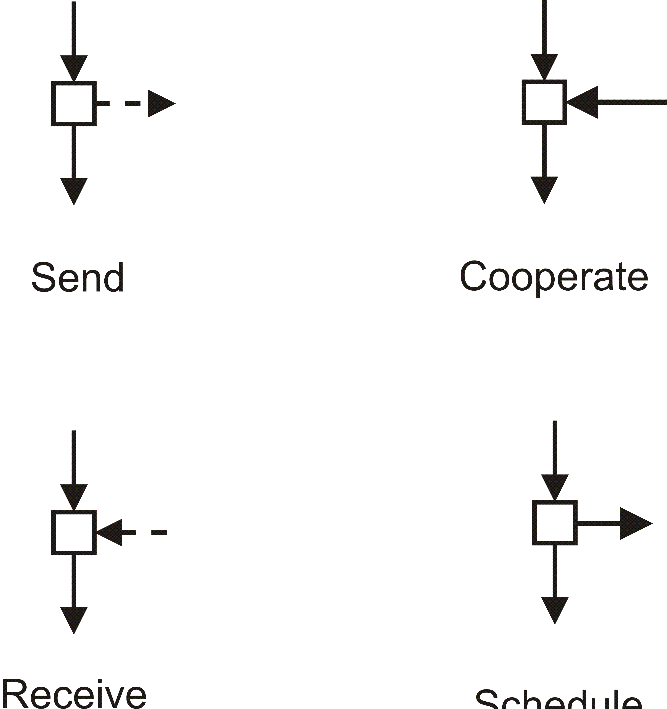
Activity Diagrams
Interaction Symbols
Object Oriented Simulation
Notes:
Send Symbol (Top Left and Bottom Left):
Description: The send symbol represents the action of transmitting a signal or data from one process to another. The arrow leaving the square indicates the direction of the data or signal flow.
Example Use: In a communication system, when a process sends a message to another process, this symbol would be used to represent the action. It helps visualize the points in the diagram where data is being transmitted between different components.
Diagram Placement: Place the send symbol where one process needs to notify or communicate with another process, ensuring the direction of the arrow accurately reflects the flow of information.
Cooperate Symbol (Top Right and Bottom Right):
Description: The cooperate symbol shows collaboration or coordination between processes. It indicates that multiple processes are working together, sharing information or resources. The arrows entering and leaving the square illustrate the bidirectional flow of interaction.
Example Use: In a multi-process system, such as a distributed computing environment, where different nodes must work together to complete a task, the cooperate symbol would be used to depict this collaborative effort.
Diagram Placement: Use the cooperate symbol in your diagram where processes must interact closely, either by sharing data or by synchronizing their activities to achieve a common goal.
Usage Tips:
Ensure that the send symbol is used wherever a process needs to pass information or trigger an event in another process. This helps clarify the communication pathways in your model.
The cooperate symbol is essential for representing collaboration between processes. Use it to show how different components interact, ensuring that the flow of interaction is logical and clearly depicted.
Remember that these symbols are key for understanding and representing the dynamic interactions within your system, especially in complex models involving multiple interacting components.

Slide 9
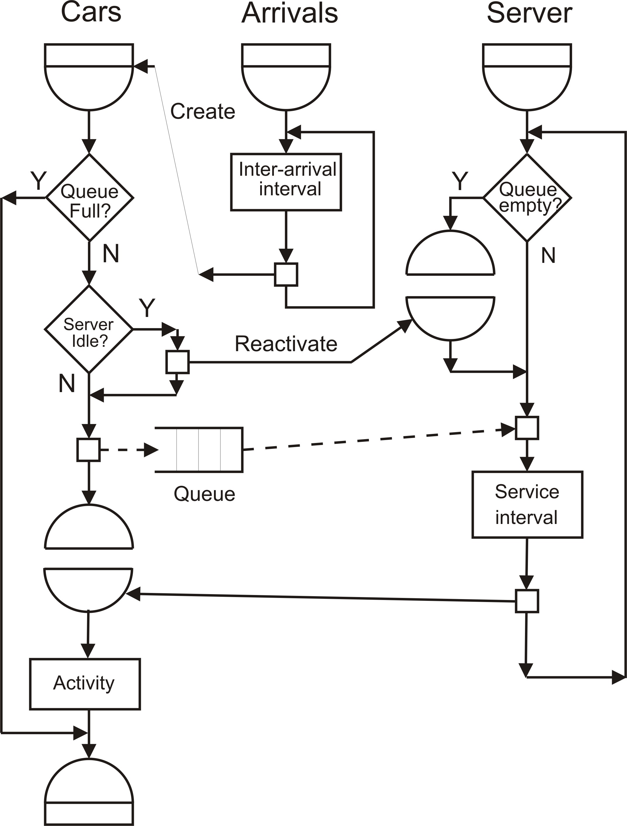
Activity Diagrams
Activity Diagram of the Carwash Model
Object Oriented Simulation
Notes:
Cars (Left)
Start Symbol: The process begins when a car arrives at the carwash.
Decision Point: Queue Full?: The first decision checks if the queue for the carwash is full.
Yes (Y): If the queue is full, the car must wait, and no further action is taken until space becomes available.
No (N): If the queue is not full, the car proceeds to the next decision point.
Server Idle?
Decision Point: This checks if the server (carwash station) is idle and ready to service a car.
Yes (Y): If the server is idle, the car moves forward to be serviced.
No (N): If the server is busy, the car is added to the queue, waiting for its turn.
Queue
Queue Interaction: Cars that cannot be immediately serviced are sent to the queue. This is depicted with a dashed line to indicate that the car is being sent to a passive state, waiting for the server to become available.
Arrivals (Center)
Inter-arrival Interval: This process determines the time between the arrivals of consecutive cars. It's an essential part of the simulation as it impacts the overall flow and timing.
Reactivate: After determining the interval, the process reactivates, indicating that the system is ready for the next arrival or action.
Server (Right)
Queue Empty?: This decision checks if cars are waiting in the queue.
Yes (Y): If the queue is empty, the server remains idle until a car arrives.
No (N): If there are cars in the queue, the next car is serviced.
Service Interval: This process defines the time it takes for the carwash to service a car. Once completed, the car leaves the system, and the server checks the queue again.
End of Process
Terminate Symbol: The process concludes after the car has been serviced, indicating the end of that particular activity cycle.
Key Concepts:
Decision Points: These are crucial for modeling the flow of activities based on conditions (e.g., whether the queue is full or the server is idle).
Queues: Represented as a passive holding area where cars wait their turn, crucial in systems where resources (like a carwash) are limited.
Synchronization: The model includes reactivation points where the system must wait for certain conditions (like the inter-arrival interval or service interval) before proceeding.
Usage Tips:
Use this diagram as a template to model other systems where entities (like cars) must wait in queues and are serviced by a limited number of servers.
Pay attention to how decision points guide the flow, which is critical in ensuring the accuracy of your simulation models.
This diagram is a comprehensive example of how to model a real-world process using UML activity diagrams, providing a clear picture of the sequence and conditions involved in the carwash model.

