Slide 1
CUDA C/C++ BASICS
NVIDIA Corporation

Slide 2
What is CUDA?
CUDA Architecture
Expose GPU parallelism for general-purpose computing
Retain performance
CUDA C/C++
Based on industry-standard C/C++
Small set of extensions to enable heterogeneous programming
Straightforward APIs to manage devices, memory etc.
This session introduces CUDA C/C++

Slide 3

Introduction to CUDA C/C++
What will you learn in this session?
Start from “Hello World!”
Write and launch CUDA C/C++ kernels
Manage GPU memory
Manage communication and synchronization

Slide 4



Prerequisites
You (probably) need experience with C or C++
You don’t need GPU experience
You don’t need parallel programming experience
You don’t need graphics experience

Slide 5
Heterogeneous Computing
Blocks
Threads
Indexing
CONCEPTS
Shared memory
__syncthreads()
Asynchronous operation
Handling errors
Managing devices

Slide 6
CONCEPTS
Heterogeneous Computing
Blocks
Threads
Indexing
Shared memory
__syncthreads()
Asynchronous operation
Hello World!
Handling errors
Managing devices

Slide 7
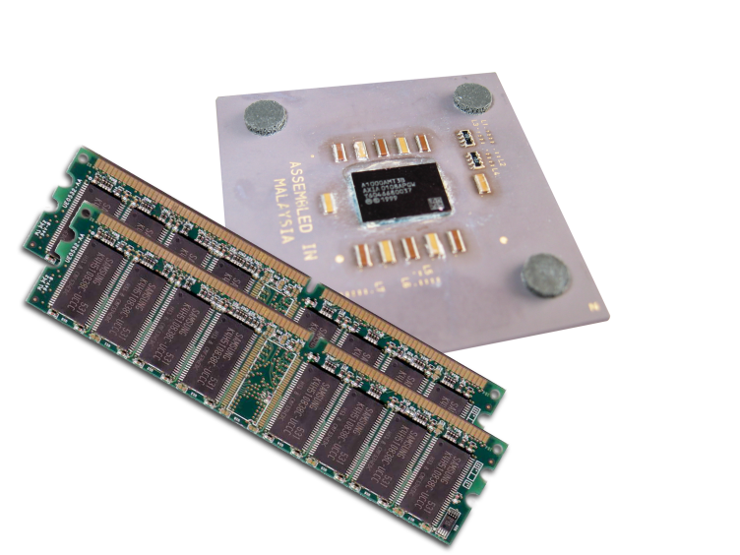
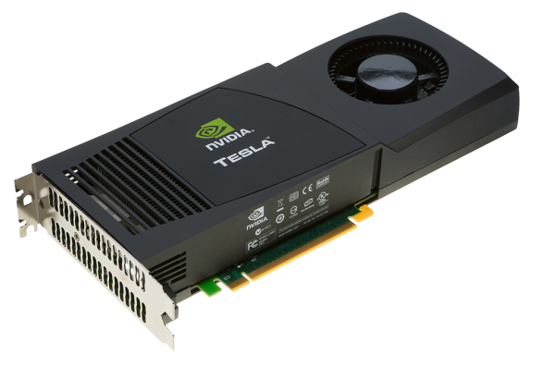
Heterogeneous Computing
Terminology:
Host The CPU and its memory (host memory)
Device The GPU and its memory (device memory)
Host
Device

Slide 8
Heterogeneous Computing
#include <iostream>
#include <algorithm>
using namespace std;
#define N 1024
#define RADIUS 3
#define BLOCK_SIZE 16
__global__ void stencil_1d(int *in, int *out) {
__shared__ int temp[BLOCK_SIZE + 2 * RADIUS];
int gindex = threadIdx.x + blockIdx.x * blockDim.x;
int lindex = threadIdx.x + RADIUS;
// Read input elements into shared memory
temp[lindex] = in[gindex];
if (threadIdx.x < RADIUS) {
temp[lindex - RADIUS] = in[gindex - RADIUS];
temp[lindex + BLOCK_SIZE] = in[gindex + BLOCK_SIZE];
}
// Synchronize (ensure all the data is available)
__syncthreads();
// Apply the stencil
int result = 0;
for (int offset = -RADIUS ; offset <= RADIUS ; offset++)
result += temp[lindex + offset];
// Store the result
out[gindex] = result;
}
void fill_ints(int *x, int n) {
fill_n(x, n, 1);
}
int main(void) {
int *in, *out; // host copies of a, b, c
int *d_in, *d_out; // device copies of a, b, c
int size = (N + 2*RADIUS) * sizeof(int);
// Alloc space for host copies and setup values
in = (int *)malloc(size); fill_ints(in, N + 2*RADIUS);
out = (int *)malloc(size); fill_ints(out, N + 2*RADIUS);
// Alloc space for device copies
cudaMalloc((void **)&d_in, size);
cudaMalloc((void **)&d_out, size);
// Copy to device
cudaMemcpy(d_in, in, size, cudaMemcpyHostToDevice);
cudaMemcpy(d_out, out, size, cudaMemcpyHostToDevice);
// Launch stencil_1d() kernel on GPU
stencil_1d<<<N/BLOCK_SIZE,BLOCK_SIZE>>>(d_in + RADIUS, d_out + RADIUS);
// Copy result back to host
cudaMemcpy(out, d_out, size, cudaMemcpyDeviceToHost);
// Cleanup
free(in); free(out);
cudaFree(d_in); cudaFree(d_out);
return 0;
}
parallel fn
serial code
parallel code
serial code

Slide 9
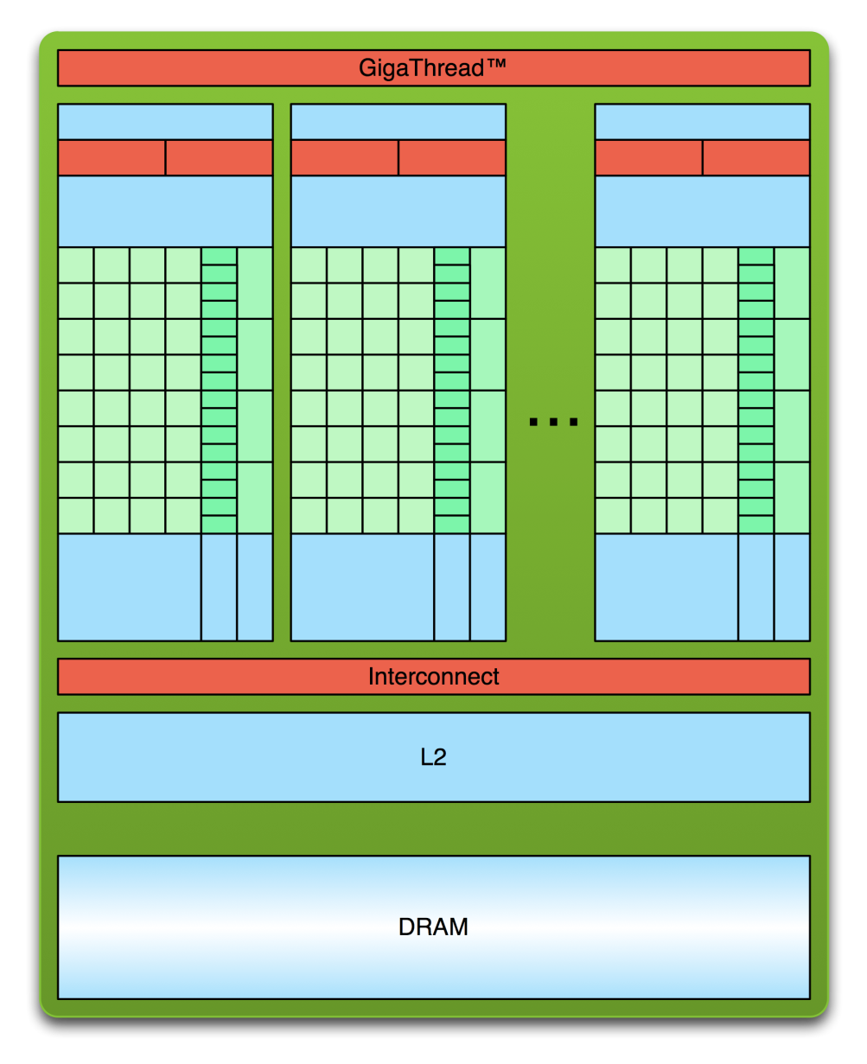
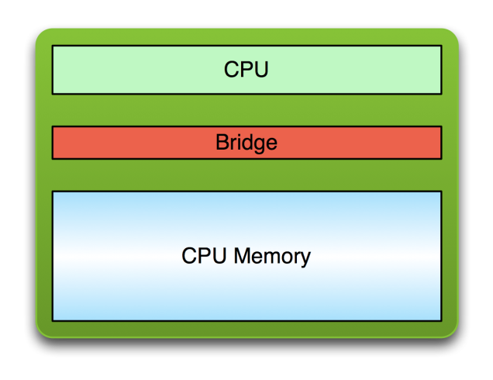
Simple Processing Flow
PCI Bus
Copy input data from CPU memory to GPU memory

Slide 10
Simple Processing Flow
PCI Bus
Copy input data from CPU memory to GPU memory
Load GPU program and execute, caching data on the chip for performance

Slide 11
Simple Processing Flow
PCI Bus
Copy input data from CPU memory to GPU memory
Load GPU program and execute, caching data on the chip for performance
Copy results from GPU memory to CPU memory

Slide 12

Hello World!
int main(void) {
printf("Hello World!\n");
return 0;
}
Standard C that runs on the host
NVIDIA compiler (nvcc) can be used to compile programs with no device code
Output:
$ nvcc hello_world.cu
$ a.out
Hello World!
$

Slide 13
Hello World! with Device Code
__global__ void mykernel(void) {
}
int main(void) {
mykernel<<<1,1>>>();
printf("Hello World!\n");
return 0;
}
Two new syntactic elements…

Slide 14
Hello World! with Device Code
__global__ void mykernel(void) {
}
CUDA C/C++ keyword __global__ indicates a function that:
Runs on the device
Is called from host code
nvcc separates source code into host and device components
Device functions (e.g. mykernel()) processed by NVIDIA compiler
Host functions (e.g. main()) processed by standard host compiler
gcc, cl.exe

Slide 15
Hello World! with Device Code
mykernel<<<1,1>>>();
Triple angle brackets mark a call from host code to device code
Also called a “kernel launch”
We’ll return to the parameters (1,1) in a moment
That’s all that is required to execute a function on the GPU!

Slide 16
Hello World! with Device Code
__global__ void mykernel(void){
}
int main(void) {
mykernel<<<1,1>>>();
printf("Hello World!\n");
return 0;
}
mykernel() does nothing, somewhat anticlimactic!
Output:
$ nvcc hello.cu
$ a.out
Hello World!
$

Slide 17
Parallel Programming in CUDA C/C++
But wait… GPU computing is about massive parallelism!
We need a more interesting example…
We’ll start by adding two integers and build up to vector addition
a
b
c

Slide 18
Addition on the Device
A simple kernel to add two integers
__global__ void add(int *a, int *b, int *c) {
*c = *a + *b;
}
As before __global__ is a CUDA C/C++ keyword meaning
add() will execute on the device
add() will be called from the host

Slide 19
Addition on the Device
Note that we use pointers for the variables
__global__ void add(int *a, int *b, int *c) {
*c = *a + *b;
}
add() runs on the device, so a, b and c must point to device memory
We need to allocate memory on the GPU

Slide 20
Memory Management
Host and device memory are separate entities
Device pointers point to GPU memory
May be passed to/from the host code
May not be dereferenced in the host code
Host pointers point to CPU memory
May be passed to/from the device code
May not be dereferenced in the device code
Simple CUDA API for handling device memory
cudaMalloc(), cudaFree(), cudaMemcpy()
Similar to the C equivalents malloc(), free(), memcpy()

Slide 21
Addition on the Device: add()
Returning to our add() kernel
__global__ void add(int *a, int *b, int *c) {
*c = *a + *b;
}
Let’s take a look at main()…

Slide 22
Addition on the Device: main()
int main(void) {
int a, b, c; // host copies of a, b, c
int *d_a, *d_b, *d_c; // device copies of a, b, c
int size = sizeof(int);
// Allocate space for device copies of a, b, c
cudaMalloc((void **)&d_a, size);
cudaMalloc((void **)&d_b, size);
cudaMalloc((void **)&d_c, size);
// Setup input values
a = 2;
b = 7;

Slide 23
Addition on the Device: main()
// Copy inputs to the device
cudaMemcpy(d_a, &a, size, cudaMemcpyHostToDevice);
cudaMemcpy(d_b, &b, size, cudaMemcpyHostToDevice);
// Launch add() kernel on GPU
add<<<1,1>>>(d_a, d_b, d_c);
// Copy the result back to the host
cudaMemcpy(&c, d_c, size, cudaMemcpyDeviceToHost);
// Cleanup
cudaFree(d_a); cudaFree(d_b); cudaFree(d_c);
return 0;
}

Slide 24
CONCEPTS
Heterogeneous Computing
Blocks
Threads
Indexing
Shared memory
__syncthreads()
Asynchronous operation
Running in Parallel
Handling errors
Managing devices

Slide 25
Moving to Parallel
GPU computing is about massive parallelism
So how do we run code in parallel on the device?
add<<< 1, 1 >>>();
add<<< N, 1 >>>();
Instead of executing add() once, execute N times in parallel

Slide 26
Vector Addition on the Device
With add() running in parallel we can do vector addition
Terminology: each parallel invocation of add() is referred to as a block
The set of blocks is referred to as a grid
Each invocation can refer to its block index using blockIdx.x
__global__ void add(int *a, int *b, int *c) {
c[blockIdx.x] = a[blockIdx.x] + b[blockIdx.x];
}
By using blockIdx.x to index into the array, each block handles a different index

Slide 27
Vector Addition on the Device
__global__ void add(int *a, int *b, int *c) {
c[blockIdx.x] = a[blockIdx.x] + b[blockIdx.x];
}
On the device, each block can execute in parallel:
Block 0
Block 1
Block 2
Block 3
c[0] = a[0] + b[0];
c[1] = a[1] + b[1];
c[2] = a[2] + b[2];
c[3] = a[3] + b[3];

Slide 28
Vector Addition on the Device: add()
Returning to our parallelized add() kernel
__global__ void add(int *a, int *b, int *c) {
c[blockIdx.x] = a[blockIdx.x] + b[blockIdx.x];
}
Let’s take a look at main()…

Slide 29
Vector Addition on the Device: main()
#define N 512
int main(void) {
int *a, *b, *c; // host copies of a, b, c
int *d_a, *d_b, *d_c; // device copies of a, b, c
int size = N * sizeof(int);
// Alloc space for device copies of a, b, c
cudaMalloc((void **)&d_a, size);
cudaMalloc((void **)&d_b, size);
cudaMalloc((void **)&d_c, size);
// Alloc space for host copies of a, b, c,
and setup input values
a = (int *)malloc(size); random_ints(a, N);
b = (int *)malloc(size); random_ints(b, N);
c = (int *)malloc(size);

Slide 30
Vector Addition on the Device: main()
// Copy inputs to device
cudaMemcpy(d_a, a, size, cudaMemcpyHostToDevice);
cudaMemcpy(d_b, b, size, cudaMemcpyHostToDevice);
// Launch add() kernel on GPU with N blocks
add<<<N,1>>>(d_a, d_b, d_c);
// Copy result back to host
cudaMemcpy(c, d_c, size, cudaMemcpyDeviceToHost);
// Cleanup
free(a); free(b); free(c);
cudaFree(d_a); cudaFree(d_b); cudaFree(d_c);
return 0;
}

Slide 31
Review (1 of 2)
Difference between host and device
Host CPU
Device GPU
Using __global__ to declare a function as device code
Executes on the device
Called from the host
Passing parameters from host code to a device function

Slide 32
Review (2 of 2)
Basic device memory management
cudaMalloc()
cudaMemcpy()
cudaFree()
Launching parallel kernels
Launch N copies of add() with add<<<N,1>>>(…);
Use blockIdx.x to access block index

Slide 33
CONCEPTS
Heterogeneous Computing
Blocks
Threads
Indexing
Shared memory
__syncthreads()
Asynchronous operation
Introducing Threads
Handling errors
Managing devices

Slide 34
CUDA Threads
Terminology: a block can be split into parallel threads
Let’s change add() to use parallel threads instead of parallel blocks
__global__ void add(int *a, int *b, int *c) {
c[threadIdx.x] = a[threadIdx.x] + b[threadIdx.x];
}
We use threadIdx.x instead of blockIdx.x
Need to make one change in main()…

Slide 35
Vector Addition Using Threads: main()
#define N 512
int main(void) {
int *a, *b, *c;
// host copies of a, b, c
int *d_a, *d_b, *d_c;
// device copies of a, b, c
int size = N * sizeof(int);
// Alloc space for device copies of a, b, c
cudaMalloc((void **)&d_a, size);
cudaMalloc((void **)&d_b, size);
cudaMalloc((void **)&d_c, size);
// Alloc space for host copies of a, b, c
and setup input values
a = (int *)malloc(size); random_ints(a, N);
b = (int *)malloc(size); random_ints(b, N);
c = (int *)malloc(size);

Slide 36
Vector Addition Using Threads: main()
// Copy inputs to device
cudaMemcpy(d_a, a, size, cudaMemcpyHostToDevice);
cudaMemcpy(d_b, b, size, cudaMemcpyHostToDevice);
// Launch add() kernel on GPU with N threads
add<<<1,N>>>(d_a, d_b, d_c);
// Copy result back to host
cudaMemcpy(c, d_c, size, cudaMemcpyDeviceToHost);
// Cleanup
free(a); free(b); free(c);
cudaFree(d_a); cudaFree(d_b); cudaFree(d_c);
return 0;
}

Slide 37
CONCEPTS
Heterogeneous Computing
Blocks
Threads
Indexing
Shared memory
__syncthreads()
Asynchronous operation
Combining
Threads And Blocks
Handling errors
Managing devices

Slide 38
Combining Blocks and Threads
We’ve seen parallel vector addition using:
Many blocks with one thread each
One block with many threads
Let’s adapt vector addition to use both blocks and threads
Why? We’ll come to that…
First let’s discuss data indexing…

Slide 39
Indexing Arrays with Blocks and Threads
No longer as simple as using blockIdx.x and threadIdx.x
Consider indexing an array with one element per thread (8 threads/block)
threadIdx.x
threadIdx.x
threadIdx.x
threadIdx.x
0
1
2
3
4
5
6
7
0
1
2
3
4
5
6
7
0
1
2
3
4
5
6
7
0
1
2
3
4
5
6
7
blockIdx.x = 0
blockIdx.x = 1
blockIdx.x = 2
blockIdx.x = 3
With M threads/block a unique index for each thread is given by:
int index = threadIdx.x + blockIdx.x * M;
Notes:
Identical to finding offset in 1-dimensional storage of a 2-dimensional matrix:
int index = x + width * y;

Slide 40
Indexing Arrays: Example
Which thread will operate on the red element?
0
1
2
3
4
5
6
7
8
9
10
11
12
13
14
15
16
17
18
19
20
21
22
23
24
25
26
27
28
29
30
31
M = 8
threadIdx.x = 5
0
1
2
3
4
5
6
7
0
1
2
3
4
5
6
7
0
1
2
3
4
5
6
7
0
1
2
3
4
5
6
7
blockIdx.x = 2
int index = threadIdx.x + blockIdx.x * M;
= 5 + 2 * 8;
= 21;

Slide 41
Vector Addition with Blocks and Threads
Use the built-in variable blockDim.x for threads per block
int index = threadIdx.x + blockIdx.x * blockDim.x;
Combined version of add() to use parallel threads and parallel blocks
What changes need to be made in main()?
__global__ void add(int *a, int *b, int *c) {
int index = threadIdx.x + blockIdx.x * blockDim.x;
c[index] = a[index] + b[index];
}

Slide 42
Addition with Blocks and Threads: main()
#define N (2048*2048)
#define THREADS_PER_BLOCK 512
int main(void) {
int *a, *b, *c;
// host copies of a, b, c
int *d_a, *d_b, *d_c;
// device copies of a, b, c
int size = N * sizeof(int);
// Alloc space for device copies of a, b, c
cudaMalloc((void **)&d_a, size);
cudaMalloc((void **)&d_b, size);
cudaMalloc((void **)&d_c, size);
// Alloc space for host copies of a, b, c,
and setup input values
a = (int *)malloc(size); random_ints(a, N);
b = (int *)malloc(size); random_ints(b, N);
c = (int *)malloc(size);

Slide 43
Addition with Blocks and Threads: main()
// Copy inputs to device
cudaMemcpy(d_a, a, size, cudaMemcpyHostToDevice);
cudaMemcpy(d_b, b, size, cudaMemcpyHostToDevice);
// Launch add() kernel on GPU
add<<<N/THREADS_PER_BLOCK,,THREADS_PER_BLOCK>>>(d_a, d_b, d_c);
// Copy result back to host
cudaMemcpy(c, d_c, size, cudaMemcpyDeviceToHost);
// Cleanup
free(a); free(b); free(c);
cudaFree(d_a); cudaFree(d_b); cudaFree(d_c);
return 0;
}

Slide 44
Handling Arbitrary Vector Sizes
Typical problems are not friendly multiples of blockDim.x
Avoid accessing beyond the end of the arrays:
__global__ void add(int *a, int *b, int *c, int n) {
int index = threadIdx.x + blockIdx.x * blockDim.x;
if (index < n)
c[index] = a[index] + b[index];
}
Update the kernel launch:
add<<<(N + M-1) / M,M>>>(d_a, d_b, d_c, N);

Slide 45
Why Bother with Threads?
Threads seem unnecessary
They add a level of complexity
What do we gain?
Unlike parallel blocks, threads have mechanisms to:
Communicate
Synchronize
To look closer, we need a new example…

Slide 46
Review
Launching parallel kernels
Launch N copies of add() with add<<<N/M,M>>>(…);
Use blockIdx.x to access block index
Use threadIdx.x to access thread index within block
Allocate elements to threads:
int index = threadIdx.x + blockIdx.x * blockDim.x;

Slide 47
CONCEPTS
Heterogeneous Computing
Blocks
Threads
Indexing
Shared memory
__syncthreads()
Asynchronous operation
Cooperating Threads
Handling errors
Managing devices

Slide 48
1D Stencil
Consider applying a 1D stencil to a 1D array of elements
Each output element is the sum of input elements within a radius
If the radius is 3, then each output element is the sum of 7 input elements:
radius
radius

Slide 49
Implementing Within a Block
Each thread processes one output element
blockDim.x elements per block
Input elements are read several times
With radius 3, each input element is read seven times

Slide 50
Sharing Data Between Threads
Terminology: within a block, threads share data via shared memory
Extremely fast on-chip memory, user-managed
Declare using __shared__, allocated per block
Data is not visible to threads in other blocks

Slide 51
Implementing With Shared Memory
Cache data in shared memory
Read (blockDim.x + 2 * radius) input elements from global memory to shared memory
Compute blockDim.x output elements
Write blockDim.x output elements to global memory
Each block needs a halo of radius elements at each boundary
halo on left
halo on right
blockDim.x output elements

Slide 52
Stencil Kernel
__global__ void stencil_1d(int *in, int *out) {
__shared__ int temp[BLOCK_SIZE + 2 * RADIUS];
int gindex = threadIdx.x + blockIdx.x * blockDim.x;
int lindex = threadIdx.x + RADIUS;
// Read input elements into shared memory
temp[lindex] = in[gindex];
if (threadIdx.x < RADIUS) {
temp[lindex - RADIUS] = in[gindex - RADIUS];
temp[lindex + BLOCK_SIZE] =
in[gindex + BLOCK_SIZE];
}

Slide 53
Stencil Kernel
// Apply the stencil
int result = 0;
for (int offset = -RADIUS ; offset <= RADIUS ; offset++)
result += temp[lindex + offset];
// Store the result
out[gindex] = result;
}

Slide 54
Data Race!
The stencil example will not work…
Suppose thread 15 reads the halo before thread 0 has fetched it…
temp[lindex] = in[gindex];
if (threadIdx.x < RADIUS) {
temp[lindex – RADIUS = in[gindex – RADIUS];
temp[lindex + BLOCK_SIZE] = in[gindex + BLOCK_SIZE];
}
int result = 0;
result += temp[lindex + 1];
Store at temp[18]
Skipped, threadIdx > RADIUS
Load from temp[19]

Slide 55
__syncthreads()
void __syncthreads();
Synchronizes all threads within a block
Used to prevent RAW / WAR / WAW hazards
All threads must reach the barrier
In conditional code, the condition must be uniform across the block

Slide 56
Stencil Kernel
__global__ void stencil_1d(int *in, int *out) {
__shared__ int temp[BLOCK_SIZE + 2 * RADIUS];
int gindex = threadIdx.x + blockIdx.x * blockDim.x;
int lindex = threadIdx.x + radius;
// Read input elements into shared memory
temp[lindex] = in[gindex];
if (threadIdx.x < RADIUS) {
temp[lindex – RADIUS] = in[gindex – RADIUS];
temp[lindex + BLOCK_SIZE] = in[gindex + BLOCK_SIZE];
}
// Synchronize (ensure all the data is available)
__syncthreads();

Slide 57
Stencil Kernel
// Apply the stencil
int result = 0;
for (int offset = -RADIUS ; offset <= RADIUS ; offset++)
result += temp[lindex + offset];
// Store the result
out[gindex] = result;
}

Slide 58
Review (1 of 2)
Launching parallel threads
Launch N blocks with M threads per block with kernel<<<N,M>>>(…);
Use blockIdx.x to access the block index within the grid
Use threadIdx.x to access the thread index within a block
Allocate elements to threads:
int index = threadIdx.x + blockIdx.x * blockDim.x;

Slide 59
Review (2 of 2)
Use __shared__ to declare a variable/array in shared memory
Data is shared between threads in a block
Not visible to threads in other blocks
Use __syncthreads() as a barrier
Use to prevent data hazards

Slide 60
CONCEPTS
Heterogeneous Computing
Blocks
Threads
Indexing
Shared memory
__syncthreads()
Asynchronous operation
Managing the Device
Handling errors
Managing devices

Slide 61
Coordinating Host & Device
Kernel launches are asynchronous
Control returns to the CPU immediately
CPU needs to synchronize before consuming the results
cudaMemcpy() | Blocks the CPU until the copy is complete Copy begins when all preceding CUDA calls have completed
cudaMemcpyAsync() | Asynchronous, does not block the CPU
cudaDeviceSynchronize() | Blocks the CPU until all preceding CUDA calls have completed

Slide 62
Reporting Errors
All CUDA API calls return an error code (cudaError_t)
Error in the API call itself
OR
Error in an earlier asynchronous operation (e.g. kernel)
Get the error code for the last error:
cudaError_t cudaGetLastError(void)
Get a string to describe the error:
char *cudaGetErrorString(cudaError_t)
printf("%s\n", cudaGetErrorString(cudaGetLastError()));

Slide 63
Device Management
Application can query and select GPUs
cudaGetDeviceCount(int *count)
cudaSetDevice(int device)
cudaGetDevice(int *device)
cudaGetDeviceProperties(cudaDeviceProp *prop, int device)
Multiple threads can share a device
A single thread can manage multiple devices
cudaSetDevice(i) to select the current device
cudaMemcpy(…) for peer-to-peer copies✝
✝ requires OS and device support

Slide 64
Introduction to CUDA C/C++
What have we learned?
Write and launch CUDA C/C++ kernels
__global__, blockIdx.x, threadIdx.x, <<<>>>
Manage GPU memory
cudaMalloc(), cudaMemcpy(), cudaFree()
Manage communication and synchronization
__shared__, __syncthreads()
cudaMemcpy() vs cudaMemcpyAsync(), cudaDeviceSynchronize()

Slide 65
Compute Capability
The compute capability of a device describes its architecture, e.g.
Number of registers
Sizes of memories
Features & Capabilities
Compute Capability | Selected Features (see CUDA C Programming Guide for complete list) | Tesla models
1.0 | Fundamental CUDA support | 870
1.3 | Double precision, improved memory accesses, atomics | 10-series
2.0 | Caches, fused multiply-add, 3D grids, surfaces, ECC, P2P, concurrent kernels/copies, function pointers, recursion | 20-series
The following presentations concentrate on Fermi devices
Compute Capability >= 2.0

Slide 66
IDs and Dimensions
A kernel is launched as a grid of blocks of threads
blockIdx and threadIdx are 3D
We showed only one dimension (x)
Built-in variables:
threadIdx
blockIdx
blockDim
gridDim
Device
Grid 1
Block (0,0,0)
Block (1,0,0)
Block (2,0,0)
Block (0,1,0)
Block (1,1,0)
Block (2,1,0)
Block (1,1,0)
Thread (0,0,0) | Thread (1,0,0) | Thread (2,0,0) | Thread (3,0,0) | Thread (4,0,0)
Thread (0,1,0) | Thread (1,1,0) | Thread (2,1,0) | Thread (3,1,0) | Thread (4,1,0)
Thread (0,2,0) | Thread (1,2,0) | Thread (2,2,0) | Thread (3,2,0) | Thread (4,2,0)

Slide 67
Textures
Read-only object
Dedicated cache
Dedicated filtering hardware
(Linear, bilinear, trilinear)
Addressable as 1D, 2D or 3D
Out-of-bounds address handling
(Wrap, clamp)
0
1
2
3
4
0
1
(2.5, 0.5)
(1.0, 1.0)
2

Slide 68
Topics we skipped
We skipped some details; you can learn more:
CUDA Programming Guide
CUDA Zone – tools, training, webinars, and more
developer.nvidia.com/cuda
Need a quick primer for later:
Multi-dimensional indexing
Textures

