Slide 1
PHYS4260 Quantum Mechanics II Spring 2025
Symmetries and Conservation laws

Slide 2
Outline
Ehrenfest’s theorem
Conservation Laws (Translations)
Parity

Slide 3
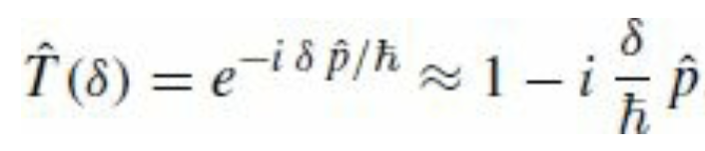
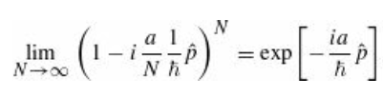
Recap: Continuous Translational Symmetry and Momentum Conservation
Important observation related to infinitesimal transformations
For the case of continuous symmetries, it is often much easier to work with the infinitesimal form of the transformation; any finite transformation can then be built up as a product of infinitesimal transformations. In particular, the finite translation by a is a sequence of N infinitesimal translations with $δ=a/N$ in the limit that $N→∞$

Slide 4
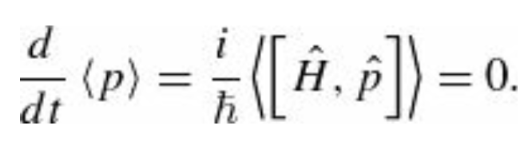
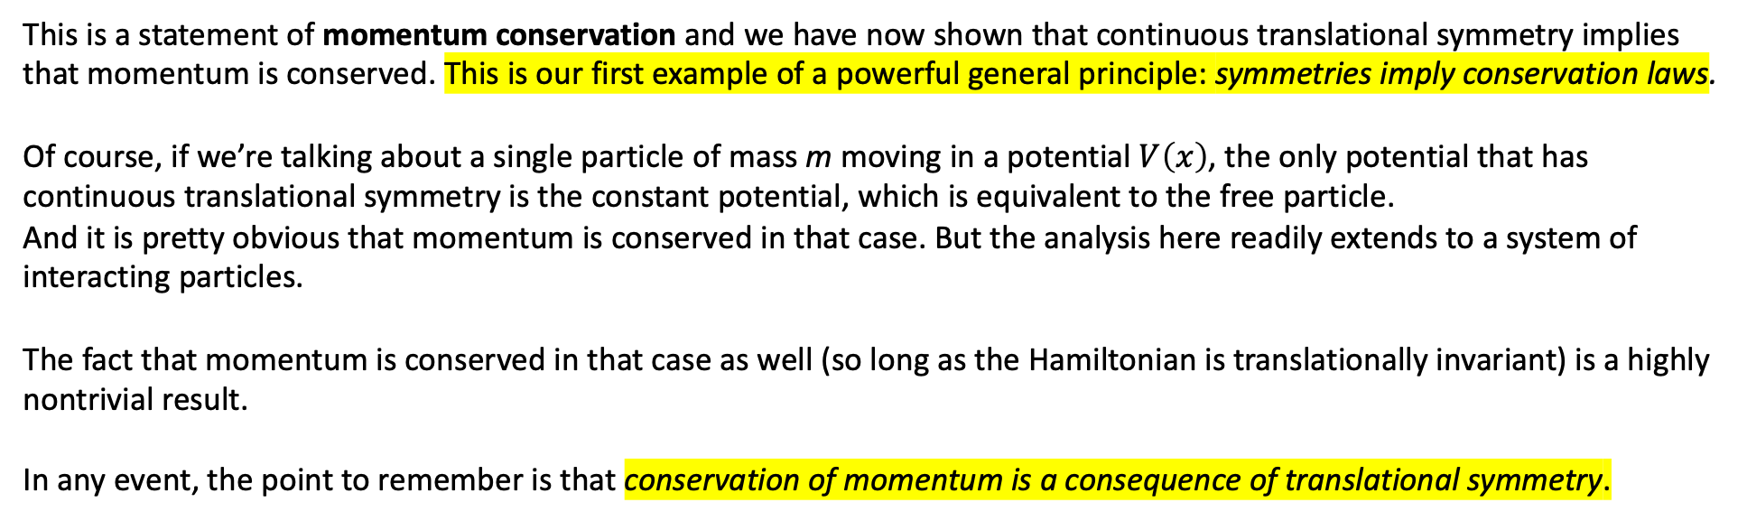
Continuous Translational Symmetry and Momentum Conservation
This is a statement of momentum conservation and we have now shown that continuous translational symmetry implies that momentum is conserved. This is our first example of a powerful general principle: symmetries imply conservation laws.
Of course, if we’re talking about a single particle of mass m moving in a potential $V\left(x\right)$, the only potential that has continuous translational symmetry is the constant potential, which is equivalent to the free particle.
And it is pretty obvious that momentum is conserved in that case. But the analysis here readily extends to a system of interacting particles.
The fact that momentum is conserved in that case as well (so long as the Hamiltonian is translationally invariant) is a highly nontrivial result.
In any event, the point to remember is that conservation of momentum is a consequence of translational symmetry.

Slide 5
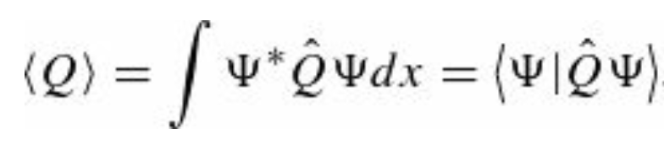
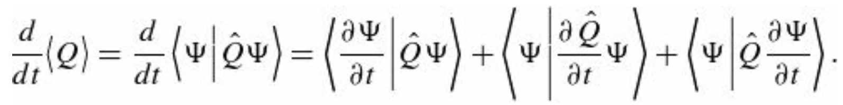
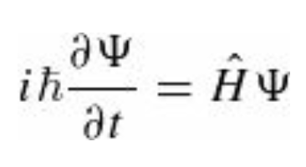

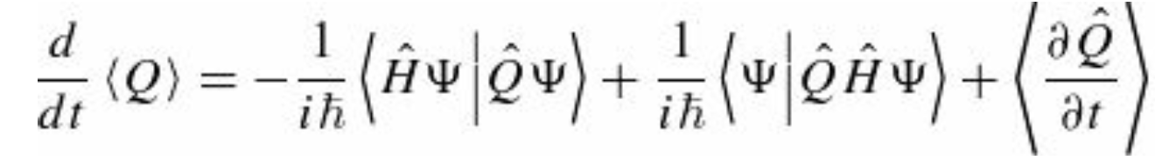

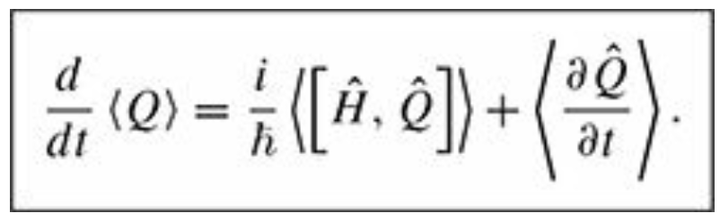
Generalized Ehrenfest’s theorem
As a measure of how fast the system is changing, let us compute the time derivative of the expectation value of some
observable $Q(x,p,t)$
then
Using the Schrödinger equation with gives
But $\hat{H}$ is Hermitian, therefore, which gives

Slide 6
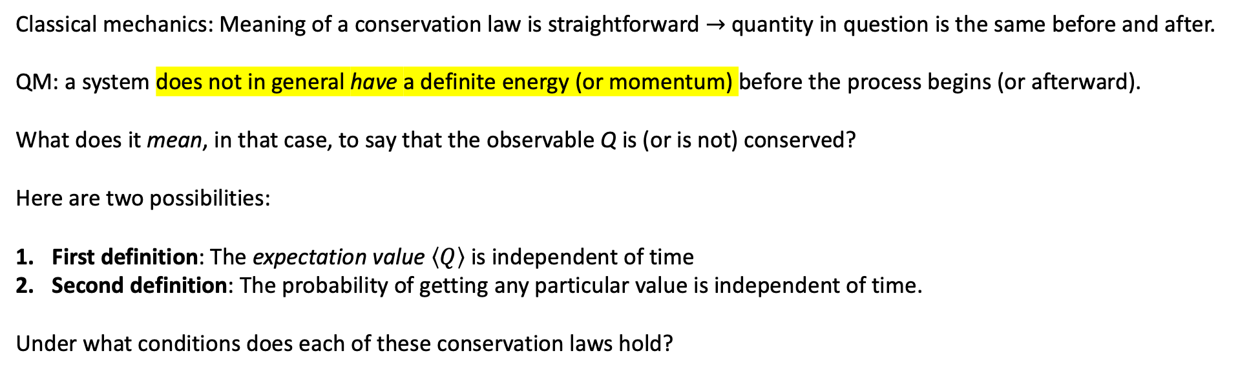
Conservations Laws
Classical mechanics: Meaning of a conservation law is straightforward $→$ quantity in question is the same before and after.
QM: a system does not in general have a definite energy (or momentum) before the process begins (or afterward).
What does it mean, in that case, to say that the observable Q is (or is not) conserved?
Here are two possibilities:
First definition: The expectation value $\left\langle Q\right\rangle$ is independent of time
Second definition: The probability of getting any particular value is independent of time.
Under what conditions does each of these conservation laws hold?

Slide 7
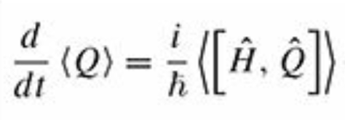





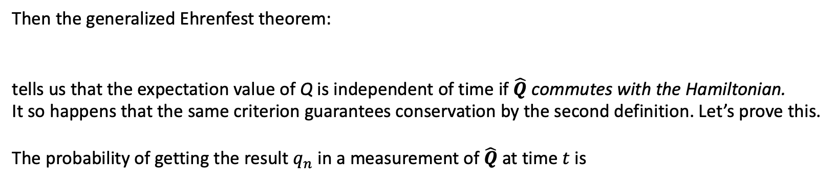
Conservations Laws
Let’s assume that the observable in question does not depend explicitly on time
Then the generalized Ehrenfest theorem:
tells us that the expectation value of Q is independent of time if $\hat{Q}$ commutes with the Hamiltonian.
It so happens that the same criterion guarantees conservation by the second definition. Let’s prove this.
The probability of getting the result $q_{n}$ in a measurement of $\hat{Q}$ at time $t$ is
where $f_{n}$ is the corresponding eigenvector
Quantitatively, $c_{n}$ tells us how much $f_{n}$ is contained in $Ψ$ and given that a measurement has to return one of the eigenvalues of $\hat{Q}$ it seems reasonable that the probability of getting the particular eigenvalue $q_{n}$ would be determined by the amount of $f_{n}$ in $Ψ.$

Slide 8

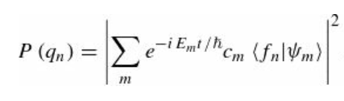
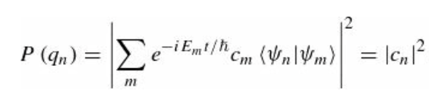


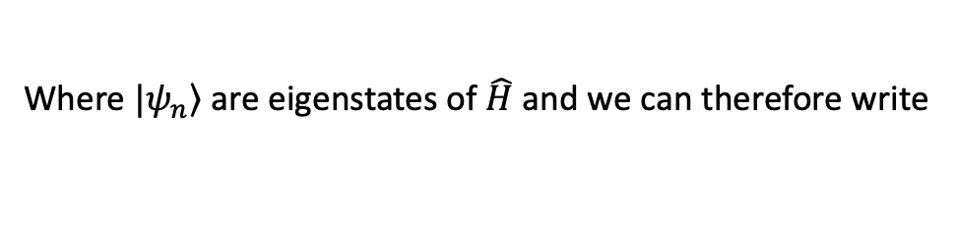

Conservations Laws
The time evolution of the wave function is
Where $|\left.ψ_{n}\right\rangle$ are eigenstates of $\hat{H}$ and we can therefore write
Now the key point: since $\hat{H}$ and $\hat{Q}$ commute we can find a complete set of simultaneous eigenstates for them.
Without loss of generality then $|\left.ψ_{n}\right\rangle =|\left.f_{n}\right\rangle$. Using the orthonormality of the $|\left.ψ_{n}\right\rangle$ states
which is clearly independent of time.
We used
=

Slide 9


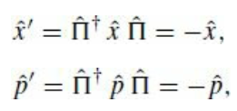
Parity
We have already mentioned that a spatial inversion is implemented by the parity operator in 1dim
It is easy to see that the parity operator is its own inverse ${\hat{Π}}^{−1}=\hat{Π}$ and we can also show that ${\hat{Π}}^{†}=\hat{Π}$ is Hermitian.
$${\hat{Π}}^{−1}=\hat{Π}={\hat{Π}}^{†}$$
Operators in this case transform under spatial inversion as (the argument is the same as for the translations seen before)
The position and momentum operators are “odd under parity”

Slide 10




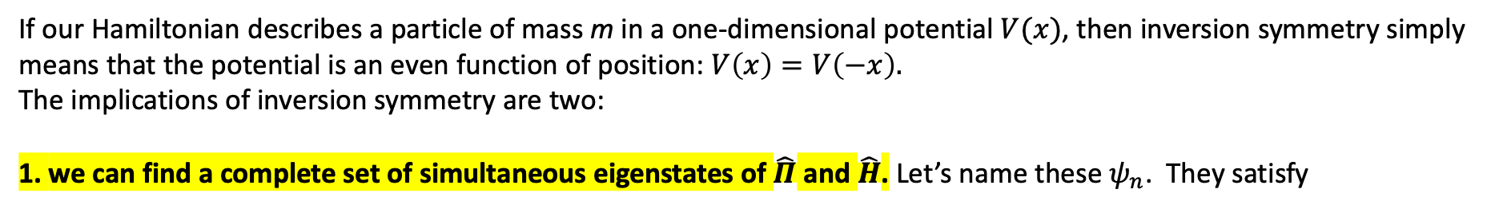
Parity
and this tells us how any operator transforms under parity
A system has inversion symmetry if the Hamiltonian is unchanged by a parity transformation:
or, using the unitarity of the parity operator,
If our Hamiltonian describes a particle of mass m in a one-dimensional potential $V(x)$, then inversion symmetry simply
means that the potential is an even function of position: $V\left(x\right)=V\left(−x\right).$
The implications of inversion symmetry are two:
1. we can find a complete set of simultaneous eigenstates of $\hat{Π}$ and $\hat{H}$. Let’s name these $ψ_{n}$. They satisfy
because the eigenvalues of the parity operator are restricted to $±1$. We’ll verify this in the next slide.

Slide 11
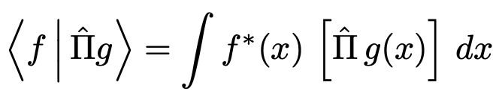
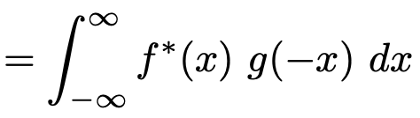
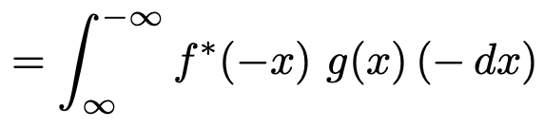
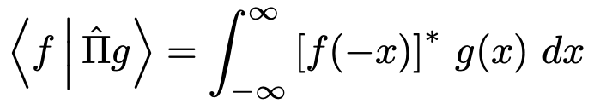
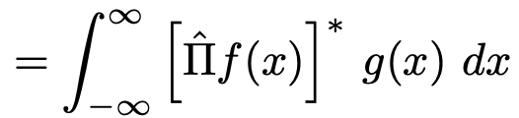
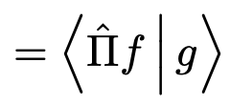
Parity eigenvalues
Let’s check verify that the eigenvalues are $±1$. Let’s consider the action on $g$
where we have changed the integration variable from $x$ to $−x$ in then last line. Then using the minus sign
to reverse the limits of integration we have
showing that the parity operator is Hermitian.
Parity $\hat{Π}$ satisfies: $\hat{Π}{=\hat{Π}}^{†}{=\hat{Π}}^{−1}$, $⟹$ is also unitary. $\hat{Π}$ is Hermitian $⟹$ eigenvalues λ $∈ℝ$,
Unitary operator $⟹$ eigenvalues λ are such that |λ| = 1.
The only way to satisfy both these conditions is $\text{λ}=±1$.
All even functions are eigenfunctions of the parity operator with eigenvalue 1 and all odd functions are eigenfunctions of the parity operator with eigenvalue −1.
stationary states of a potential that is an even function of position are themselves even or odd functions

Slide 12
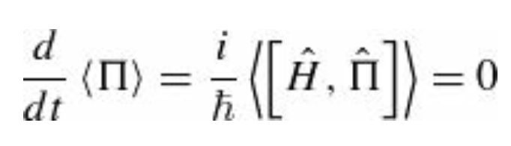
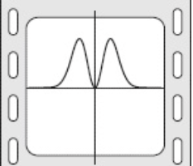
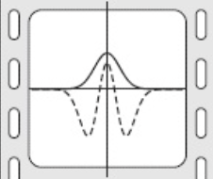
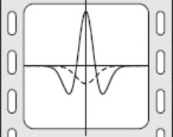
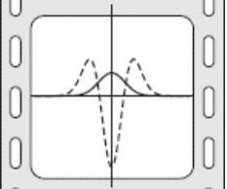
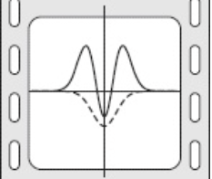
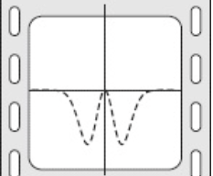



Parity
2. according to Ehrenfest’s theorem, if the Hamiltonian has an inversion symmetry, then
Parity is conserved for a particle moving in a symmetric potential. And not just the expectation value, but the probability of any particular outcome in a measurement. Parity conservation means, for example, that if the wave function of a particle in a harmonic oscillator potential is even at $t=0$then it will be even at any later time $t$
Re[$Ψ$]
---- Im[$Ψ$]
TIME
Time evolution of particle wave function $Ψ_{0}$ in the harmonic oscillator potential. The solid and dashed curves are the real and imaginary parts of the wave function respectively, and time increases from left to right. Since parity is conserved, a wave function which is initially an even function of position (as this one is) remains an even function at all later times.

Slide 13

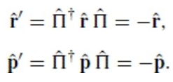

Parity in 3Dim
The spatial inversion generated by the parity operator in three dimensions is
The operators $\hat{r}$ and $\hat{p}$ transform as
Any other operator transforms as
Let’s review an application of this.

Slide 14

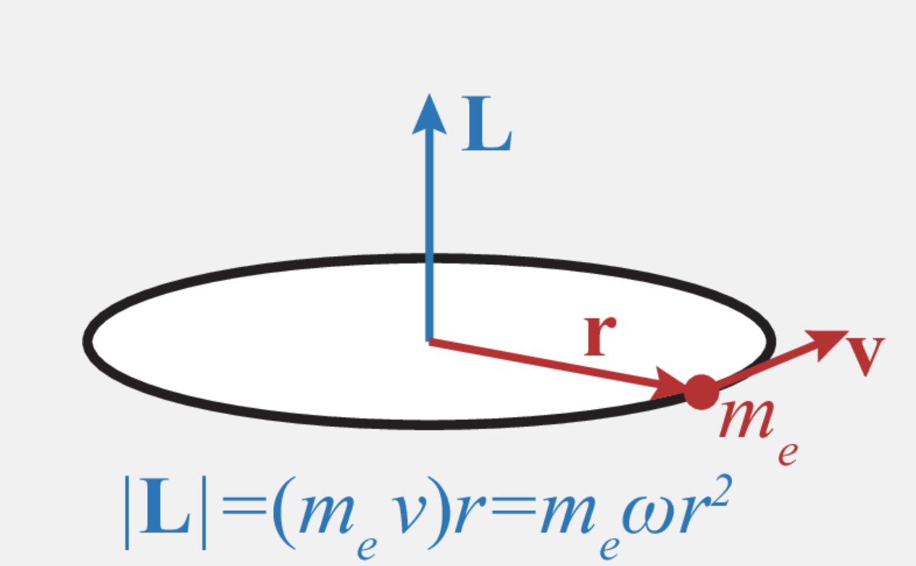

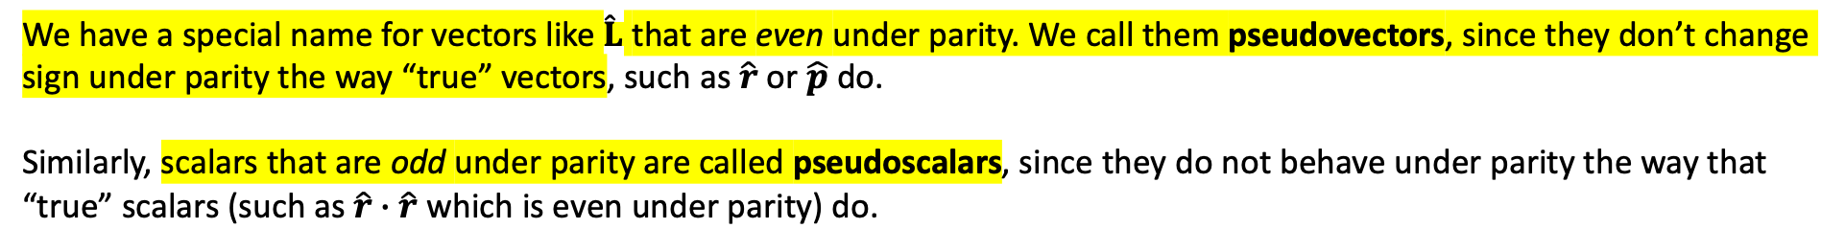
Parity-transformed Angular Momentum
Let’s find the parity-transformed angular momentum operator in terms of $\hat{L}$
by definition. Applying the above formula to this operator we obtain
We have a special name for vectors like $\hat{L}$ that are even under parity. We call them pseudovectors, since they don’t change sign under parity the way “true” vectors, such as $\hat{r}$ or $\hat{p}$ do.
Similarly, scalars that are odd under parity are called pseudoscalars, since they do not behave under parity the way that “true” scalars (such as $\hat{r}∙\hat{r}$ which is even under parity) do.

Slide 15
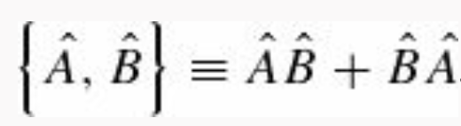
Parity transformations: Scalars & Vectors
Important: The labels scalar and vector describe how the operators behave under rotations; we will define these terms carefully later. “True” vectors and pseudovectors behave the same way under a rotation—they are both vectors.
True scalar: ${\hat{Π}}^{†}\hat{f} \hat{Π}=\hat{f}$ and $\left[\hat{Π},\hat{f}\right]=0$
True Vector: ${\hat{Π}}^{†}\hat{V} \hat{Π}=−\hat{V}$ and $\{\hat{Π},\hat{V}\}=0$
Pseudovector: ${\hat{Π}}^{†}\hat{V} \hat{Π}=\hat{V}$ and $\left[\hat{Π},\hat{V}\right]=0$
Pseudoscalar: ${\hat{Π}}^{†}\hat{f} \hat{Π}=−\hat{f}$ and $\{\hat{Π},\hat{f}\}=0$
Anticommutator (aka Poisson’s bracket)

Slide 16
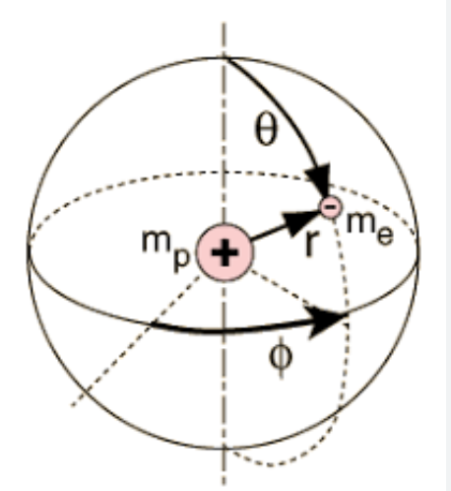

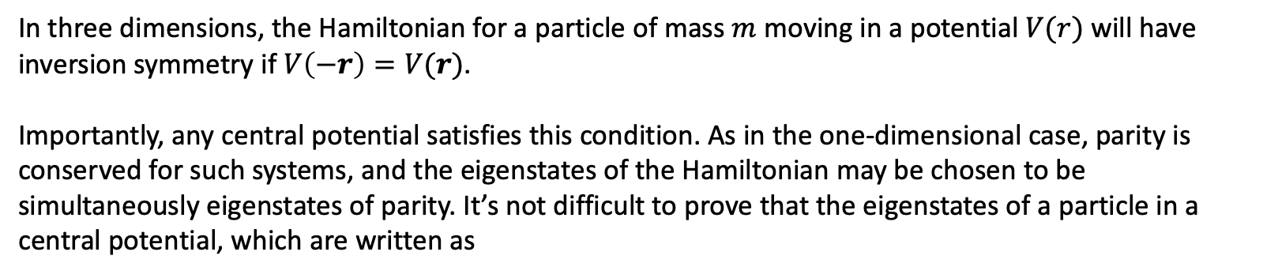
Parity in 3Dim
In three dimensions, the Hamiltonian for a particle of mass $m$ moving in a potential $V(r)$ will have
inversion symmetry if $V\left(−r\right)=V(r)$.
Importantly, any central potential satisfies this condition. As in the one-dimensional case, parity is conserved for such systems, and the eigenstates of the Hamiltonian may be chosen to be simultaneously eigenstates of parity. It’s not difficult to prove that the eigenstates of a particle in a central potential, which are written as
are eigenstates of parity

