Slide 1
Preselection Criteria
taus_n_NOSYS >= 1
jets_n_NOSYS >= 2
nbJets77_NOSYS >= 1
abs(Mll01_NOSYS/1.0e3 - 91.2) > 10.0
Mll01_NOSYS/1.0e3 > 12.0
leps_pt_0_NOSYS/1.0e3 > 25.0
leps_pt_1_NOSYS/1.0e3 > 25.0
taus_pt_0_NOSYS/1.0e3 >= 50.0

Slide 2
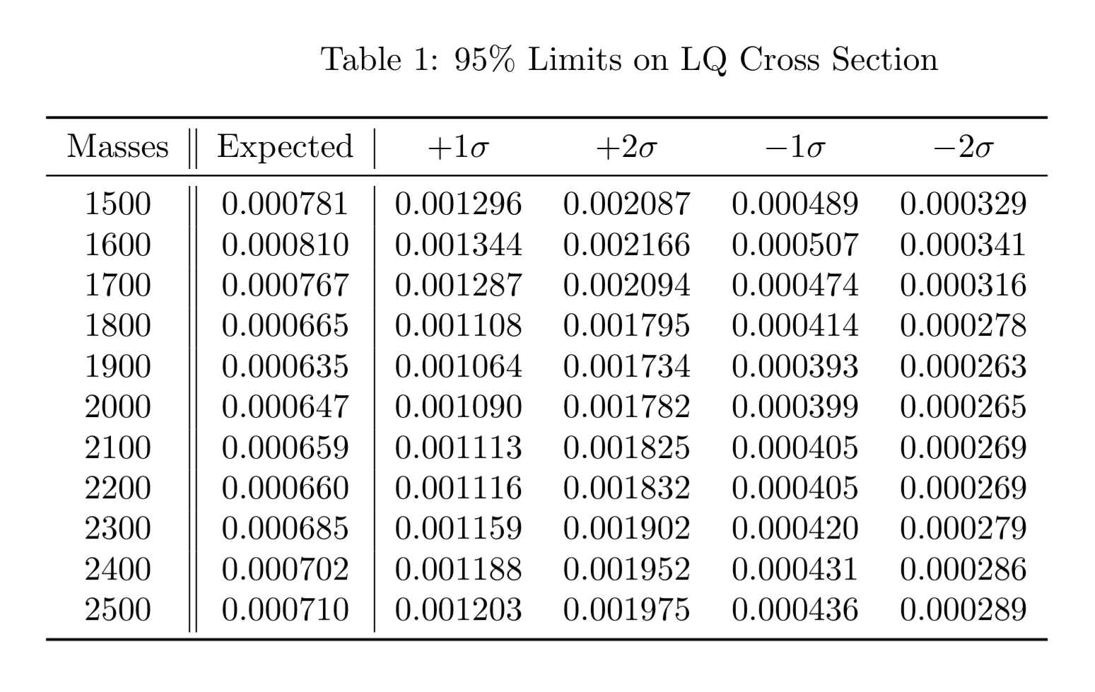
Limits

Slide 3
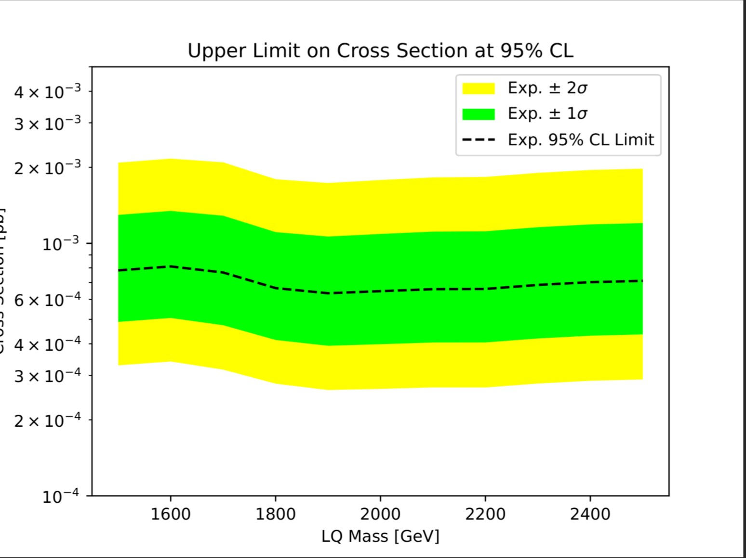
Limits

Slide 4
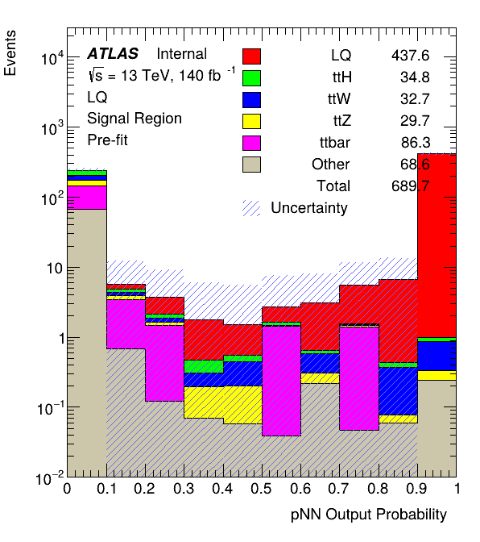
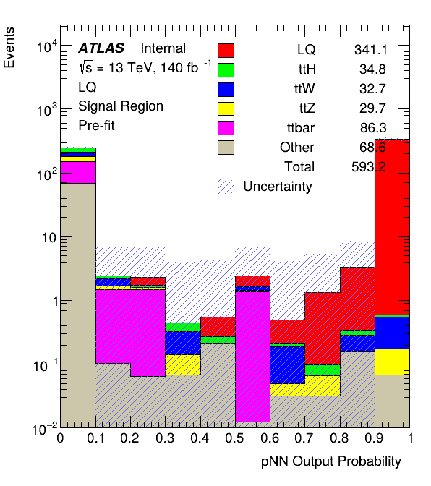
M = 1500GeV
M = 2500GeV

