Slide 1
Startup Funding Analysis and Insights

Slide 2
Overview of Startup Funding Trends
Objective: Analyze trends, geographical distributions, and funding types in the startup ecosystem.
Key Areas of Analysis:
Funding distribution by region
Trends over time
Regional preferences in funding types
Funding recommendations: Recommendations for fostering a sustainable and inclusive funding ecosystem.

Slide 3
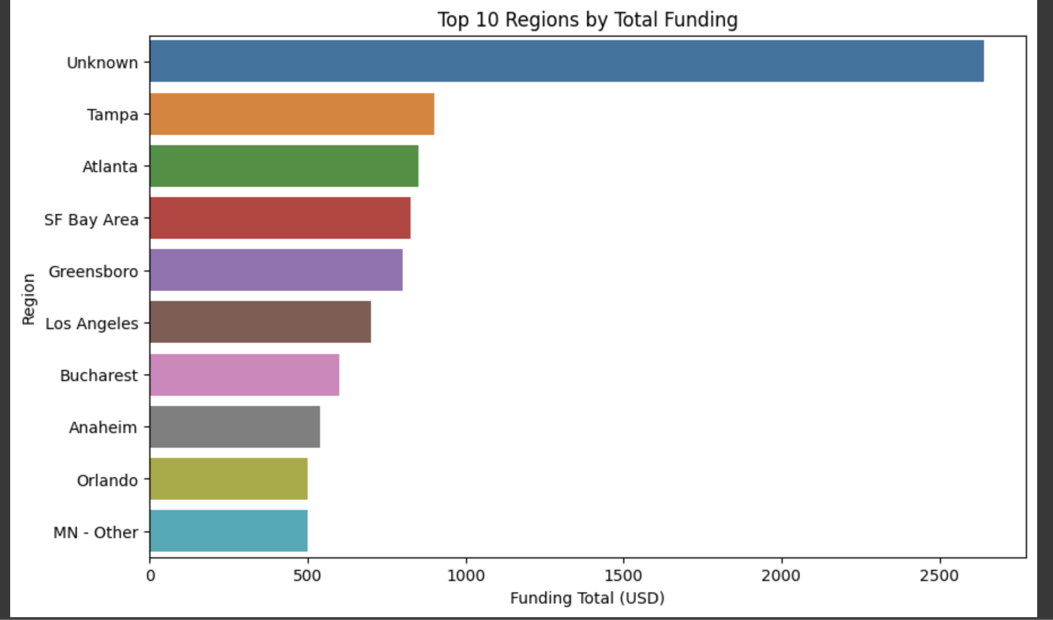
Funding Distribution By Region
Key Insight:
Tampa and Atlanta rank high in total funding.
Greensboro, Los Angeles, and Bucharest demonstrate promising growth, indicating expanding opportunities.
Recommendation:
Focus investments on regions like Tampa, Atlanta, and SF Bay Area, as they show significant funding activity and likely have a well-established startup ecosystem.

Slide 4
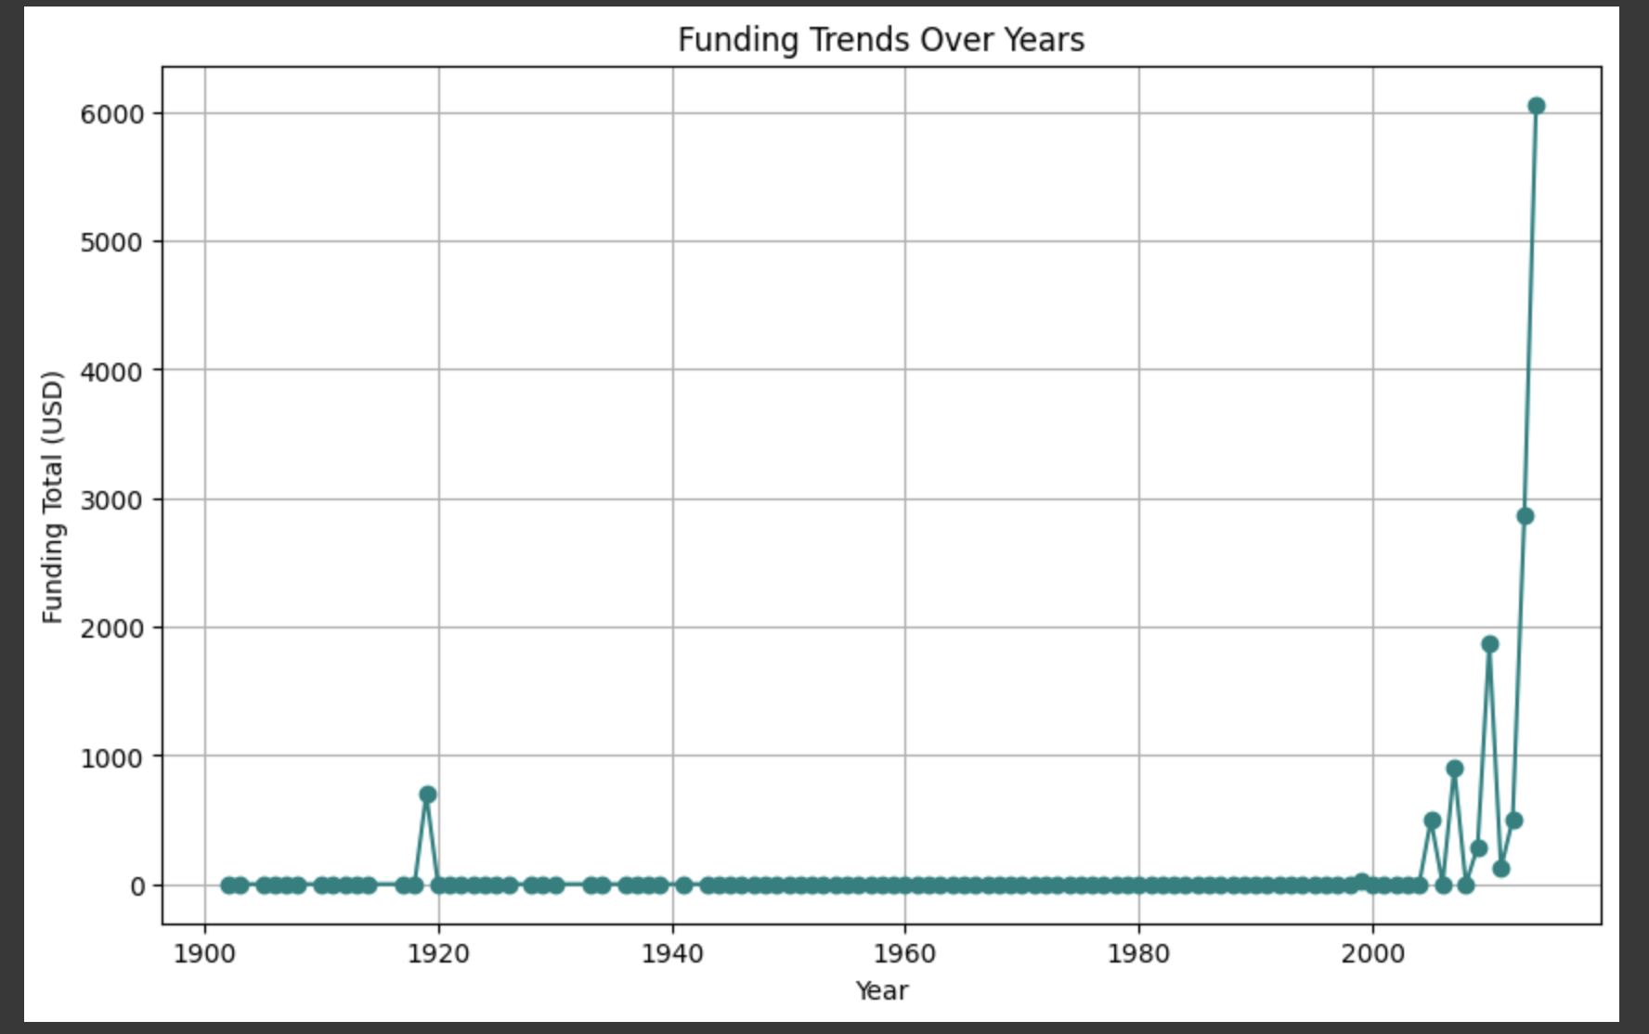
Funding Trends (1900–2023)
Key Insight:
Massive funding surge post-2000 driven by technology startups.
Reflects global growth in venture capital investments and tech innovations.
Recommendation:
Evaluate long-term sustainability of the funding boom to avoid market saturation and bubble risks.

Slide 5
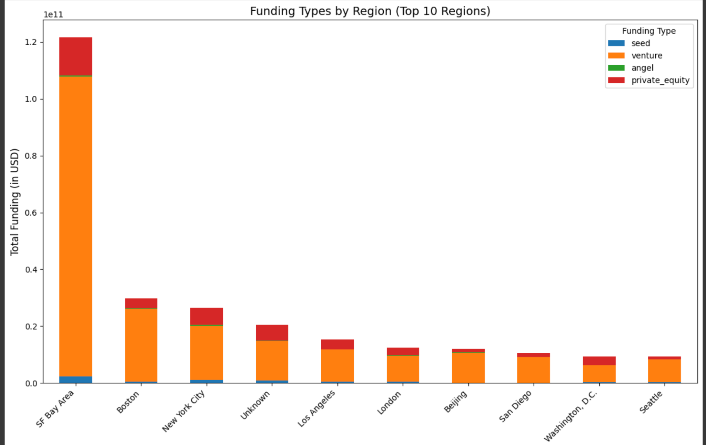
Funding Types in Key Regions
Key Insights:
Venture capital is the dominant funding type across regions.
Regional variations exist:
Boston sees higher private equity investments.
SF Bay Area and NYC focus on venture capital.
Recommendation:
Encourage diversified funding models to balance regional ecosystems.

Slide 6
Actionable Recommendations
Foster early-stage funding globally.
Build supportive policies for emerging startup hubs.
Encourage investors to diversify portfolios across regions and sectors.
Focus on sustainable growth in funding ecosystems.
Align regional funding efforts with core strengths.

Slide 7
Conclusion
The startup funding ecosystem is growing rapidly, with dominant regions driving most activity.
To ensure sustainable growth, we must focus on inclusive funding practices and leverage regional strengths.
Thank You!

