Slide 1
Certification Cegefos Big Data
Analyses des DataSets GitHub
Sujet de certification :
Il s’agit de travailler sur des données venant de Github. Ces données ne sont pas disponibles en csv ou en ndjson, elles se méritent. Elles sont notamment disponibles directement sur Google Big Query (comme souvent) ou pour certaines en téléchargement de fichiers ndjson compressés, à recombiner ! Google Big Query

Slide 2
Certification Cegefos Big Data
Analyses des DataSets GitHub
Organisation (1/2):
DAB | NHA | DFA | RKO
DAB => Architecture + Support + Dév + Requêtes + SGBD + ML
NHA => Architecture + Simulateur + Système Consommateur-Producteur
DFA => Analyses basiques + Moteur de recherche + Moteur de recommandation
RKO => Machine Learning

Slide 3
Certification Cegefos Big Data
Analyses des DataSets GitHub
Organisation (2/2):
https://github.com/chams2012/bigDataGr1
0.Helper / 1.StorageData / 2.RandomGeneratorCommitFiles / 3.RecommandationEngine / 4.SearchEngine / 5.BasivAnalysis / 6. MachineLearning
Outils :
Slack / GitHub / appear.in / AnyDesk / Docker / Dropbox
2 réunions d’avancement par semaine

Slide 4
Certification Cegefos Big Data
Analyses des DataSets GitHub
DataSets GitHub (‘’repos’’) :
tensorflow/tensorflow
torvalds/linux
facebook/react
apple/swift
Microsoft/vscode
twbs/bootstrap

Slide 5
Certification Cegefos Big Data
Analyses des DataSets GitHub
DataSets GitHub (Export Tables : ‘’language’’) : (1/2)
SCHEMA | DESCRIPTION | REMARKS
|- repo_name : STRING
+- language : RECORD | Not Leaf Field / Repeated | To Request, Use FLATTEN
| |- name : STRING | SQL Field : language_name
| |- bytes : STRING | SQL Field : language_bytes

Slide 6
Certification Cegefos Big Data
Analyses des DataSets GitHub
DataSets GitHub (Export Tables : ‘’license’’) : (2/2)
SCHEMA | DESCRIPTION | REMARKS
|- repo_name : STRING
|- license : STRING

Slide 7
Certification Cegefos Big Data
Analyses des DataSets GitHub
DataSets GitHub (Export Dynamique) (1/7) :
« commits »
« files »
« contents »
« gitarchive* »
BigQuery
« Legacy Query » VS « Standard Query »
« FLATTEN » VS « UNNEST »

Slide 8
Certification Cegefos Big Data
Analyses des DataSets GitHub
DataSets GitHub (Export Dynamique : ‘’commits’’) (2/7) :
SCHEMA | DESCRIPTION | REMARKS
|- commit : STRING
|- tree : STRING
|- parent : STRING
+- author : RECORD | Not Leaf Field / Not Repeated
| |- name : STRING | SQL Field : author_name
| |- email : STRING | SQL Field : author_email
| |- time_sec : INTEGER | SQL Field : author_time_sec
| |- tz_offset : INTEGER | SQL Field : author_tz_offset
| |- date : TIMESTAMP | SQL Field : author_date
+- committer : RECORD | Not Leaf Field / Not Repeated
| |- name : STRING | SQL Field : committer_name
| |- email : STRING | SQL Field : committer_email
| |- time_sec : INTEGER | SQL Field : committer_time_sec
| |- tz_offset : INTEGER | SQL Field : committer_tz_offset
| |- date : TIMESTAMP | SQL Field : committer_date
|- subject : STRING
|- message : STRING
+- trailer : RECORD | Not Leaf Field / Repeated | To Request, Use FLATTEN
| |- key : STRING | SQL Field : trailer_key
| |- value : STRING | SQL Field : trailer_value
| |- email : STRING | SQL Field : trailer_email
+- difference : RECORD | Not Leaf Field / Repeated | To Request, Use FLATTEN
| |- old_mode : INTEGER | SQL Field : difference_old_mode
| |- new_mode : INTEGER | SQL Field : difference_new_mode | Same as files.mode
| |- old_path : STRING | SQL Field : difference_old_path
| |- new_path : STRING | SQL Field : difference_new_path | Same as files.new_path
| |- old_sha1 : STRING | SQL Field : difference_old_sha1
| |- new_sha1 : STRING | SQL Field : difference_new_sha1
| |- old_repo : STRING | SQL Field : difference_old_repo
| |- new_repo : STRING | SQL Field : difference_new_repo
|- difference_truncated : BOOLEAN
|- repo_name : STRING | Leaf Field / Repeated
|- encoding : STRING

Slide 9
Certification Cegefos Big Data
Analyses des DataSets GitHub
DataSets GitHub (Export Dynamique : ‘’files’’) (3/7) :
SCHEMA | DESCRIPTION | REMARKS
|- repo_name : STRING
|- ref : STRING
|- path : STRING |  | Same as commits.difference.new_path
|- mode : INTEGER |  | Same as commits.diffrence.mode
|- id : STRING |  | Same as 'id' of 'contents' table / Relation 1 --> n
|- symlink_target : STRING

Slide 10
Certification Cegefos Big Data
Analyses des DataSets GitHub
DataSets GitHub (Export Dynamique : ‘’contents’’) : (4/7)
SCHEMA | DESCRIPTION | REMARKS
|- id : STRING |  | Same as 'id' of 'files' table / Relation n --> 1
|- size : INTEGER
|- content : STRING
|- binary : BOOLEAN
|- copies : INTEGER

Slide 11
Certification Cegefos Big Data
Analyses des DataSets GitHub
DataSets GitHub (Export Dynamique : ‘’archive*’’) : (5/7)
SCHEMA | DESCRIPTION | REMARKS
|- public : BOOLEAN
|- playload : STRING |  | CommitCommentEvent : commit_id <-> ['commits':commit]
+- repo : RECORD | Not Leaf Field / Not Repeated
| |- id : INTEGER | SQL Field : repo_id
| |- name : STRING | SQL Field : repo_name
| |- url : STRING | SQL Field : repo_url
+- actor : RECORD | Not Leaf Field / Not Repeated
| |- id : INTEGER | SQL Field : actor_id
| |- login : STRING | SQL Field : actor_login
| |- gravatard_id : STRING | SQL Field : actor_gavatard_id
| |- avatard_url : STRING | SQL Field : actor_avatard_url
| |- url : STRING | SQL Field : actor_url
+- org : RECORD | Not Leaf Field / Not Repeated
| |- id : INTEGER | SQL Field : org_id
| |- login : STRING | SQL Field : org_login
| |- gravatard_id : STRING | SQL Field : org_gavatard_id
| |- avatard_url : STRING | SQL Field : org_avatard_url
| |- url : STRING | SQL Field : org_url
|- created_at : TIMESTAMP
|- id : STRING
|- other : STRING

Slide 12
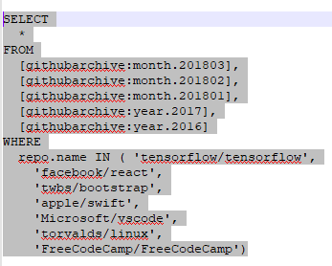
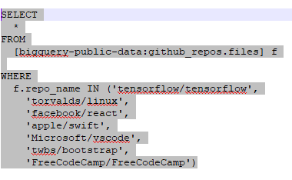
Certification Cegefos Big Data
Analyses des DataSets GitHub
DataSets GitHub (Export dynamique) (6/7):
gitarchive*
files

Slide 13
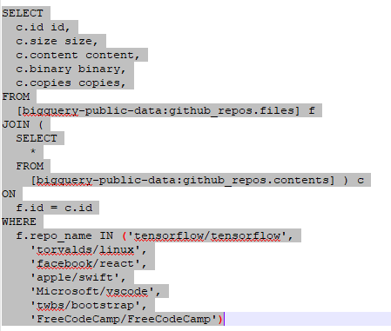
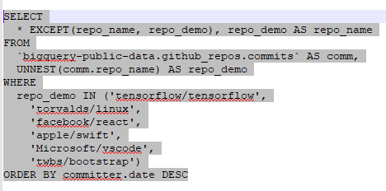
Certification Cegefos Big Data
Analyses des DataSets GitHub
DataSets GitHub (Export dynamique) (7/7):
copies
commits

Slide 14
Certification Cegefos Big Data
Analyses des DataSets GitHub
DataSets GitHub (Reverse Enginnering) :
« commits » : difference.new_mode ⬄ « files » : mode
« commits » : difference,new_path ⬄ « files » : new_path
« files » : id ⬄ « contents » : id
« gitarchive* » : playload (Evénement : CommitCommentEvent / commit_id) ⬄ « commits » : commit

Slide 15
Certification Cegefos Big Data
Analyses des DataSets GitHub
Architecture Générale :
Random Files
Queue
CommitCommentEvent
Consumer
POST JSON DATA
Publisher
MongoDB GitHub Base
Cluster
Elastic Search / Moteur de Recherche
Cluster
neo4j-doc-manager
kibana
Neo4J Moteur de Recommandation

Slide 16
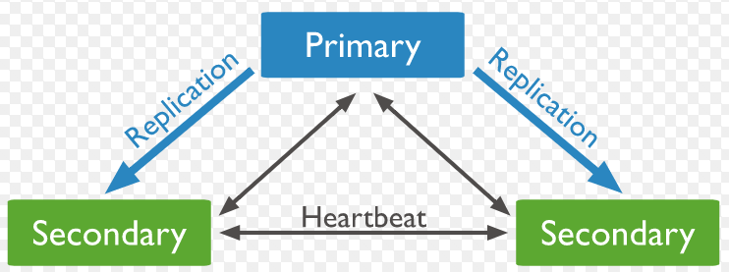
Certification Cegefos Big Data
Analyses des DataSets GitHub
StorageData :

Slide 17
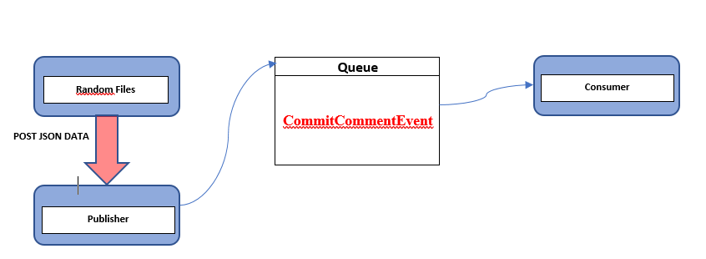
Certification Cegefos Big Data
Analyses des DataSets GitHub
RandomGeneratorCommitFiles :

Slide 18
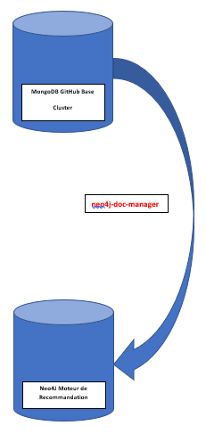
Certification Cegefos Big Data
Analyses des DataSets GitHub
RecommandationEngine :

Slide 19
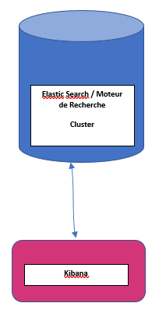
Certification Cegefos Big Data
Analyses des DataSets GitHub
SearchEngine (1/3) :

Slide 20
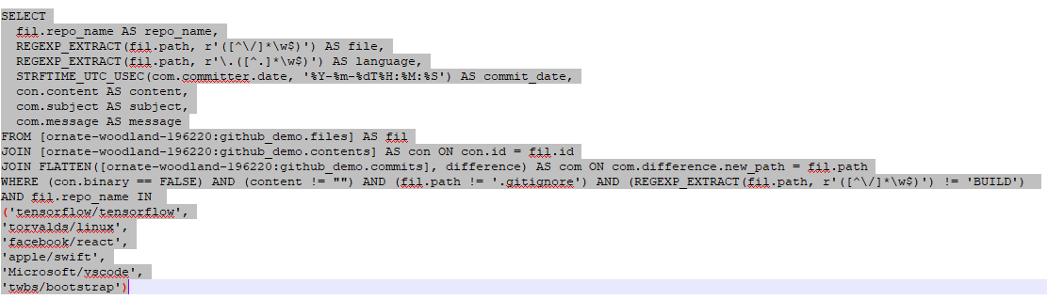
Certification Cegefos Big Data
Analyses des DataSets GitHub
SearchEngine (2/3) :

Slide 21
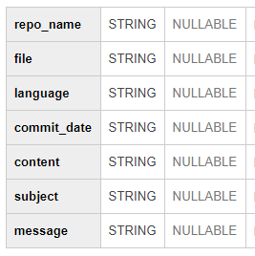
Certification Cegefos Big Data
Analyses des DataSets GitHub
SearchEngine (3/3) :

Slide 22
Certification Cegefos Big Data
Analyses des DataSets GitHub
BasicAnalysis :
BigQuery API GoogleCloud
Création d’un projet
Certificat PKCS12 ou fichier Json
Administrateur Big Query
Docker Spark Jupyter BigQuery
bq_helper.py (https://github.com/SohierDane/BigQuery_Helper/blob/master/bq_helper.py)

Slide 23
Certification Cegefos Big Data
Analyses des DataSets GitHub
Machine Learning (1/2) :
repo_name ?
Nombre de commit
Subject !!!
Watch_count
Age_repository (date dernier commit – date created_at)
Langugae de progrmmation
Licences
Nombre de licences.

Slide 24
Certification Cegefos Big Data
Analyses des DataSets GitHub
Machine Learning (2/2) :
Supervised Learning
Régression logistique
Discriminant Analysis
Decision Tree
Random Forest
Réseaux de neuronnes

Slide 25
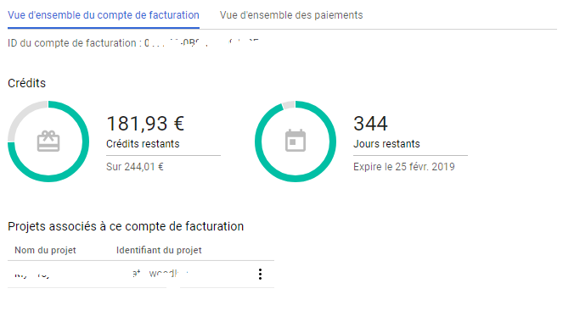
Certification Cegefos Big Data
Analyses des DataSets GitHub
Google Billing

Slide 26
Certification Cegefos Big Data
Analyses des DataSets GitHub
Questions :
MERCI

