Slide 1
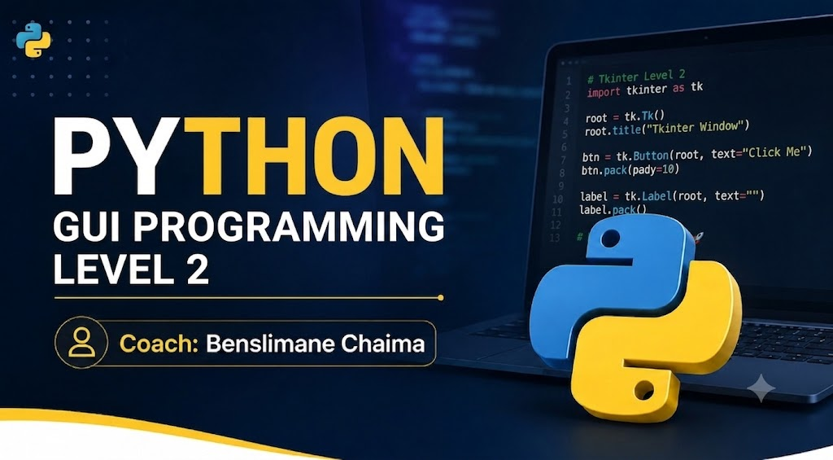

Slide 2
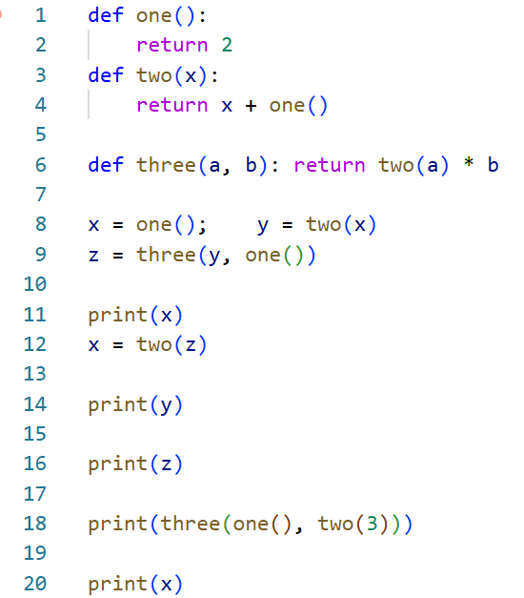

Slide 3
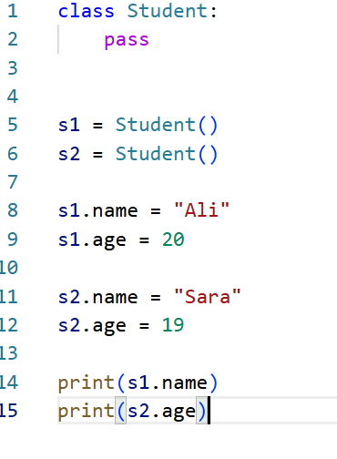
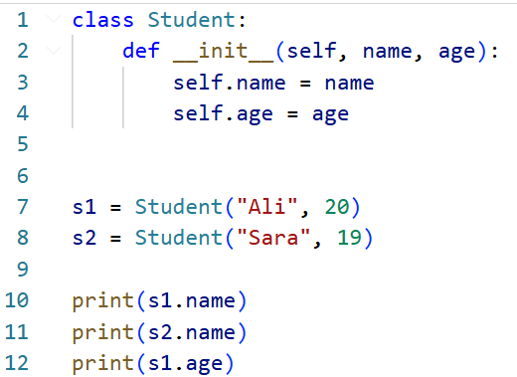

Slide 4
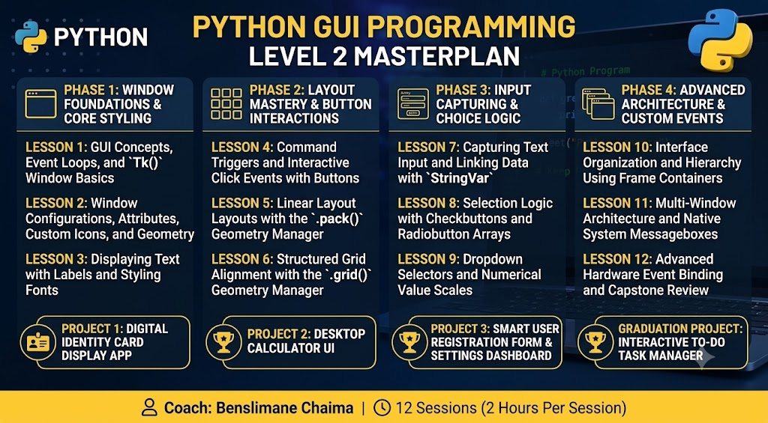

Slide 5
GUI Programming
GUI stands for Graphical User Interface.
A GUI is a visual interface that allows users to interact with a program using graphical elements instead of typing commands.
CLI (Command-Line Interface)
programs run in a text-based environment called the console or terminal.

Slide 6
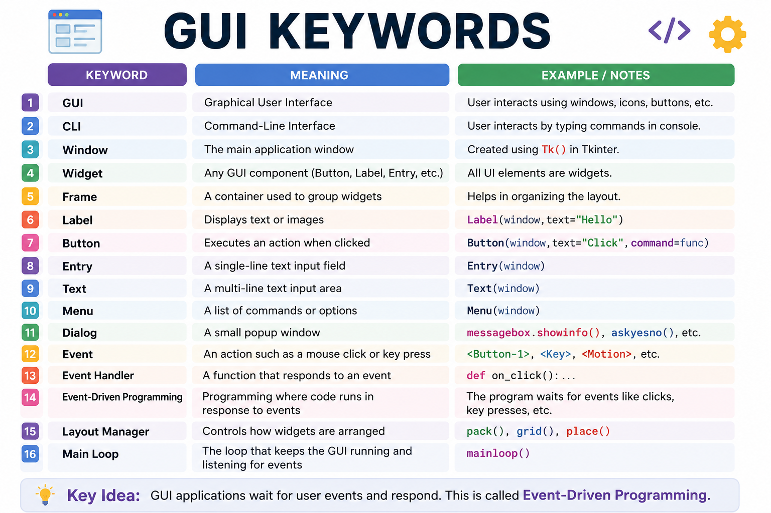

Slide 7
What is Tkinter?
Tkinter is Python's standard library for creating desktop GUI.
It allows us to build applications with:
Windows
Buttons
Labels
Menus
Text boxes
Images
Tables
Dialog boxes
without installing any extra packages (it is included with most Python installations).

Slide 8
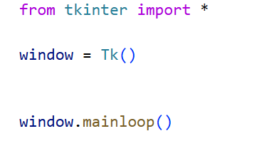
FIRST CODE TKINTER

