Slide 1


Slide 2

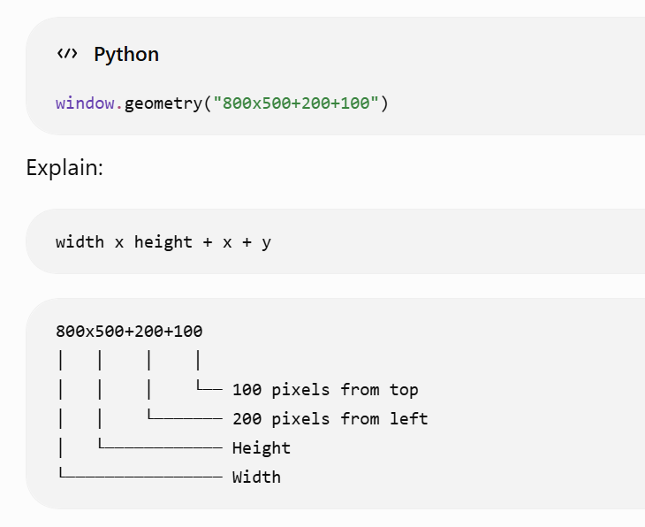
Window Size (geometry)

Slide 3


Window Icon

Slide 4

Window color

Slide 5
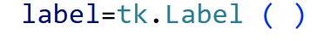
Label widget
The Label widget in Tkinter is used to display text or images. .

Slide 6
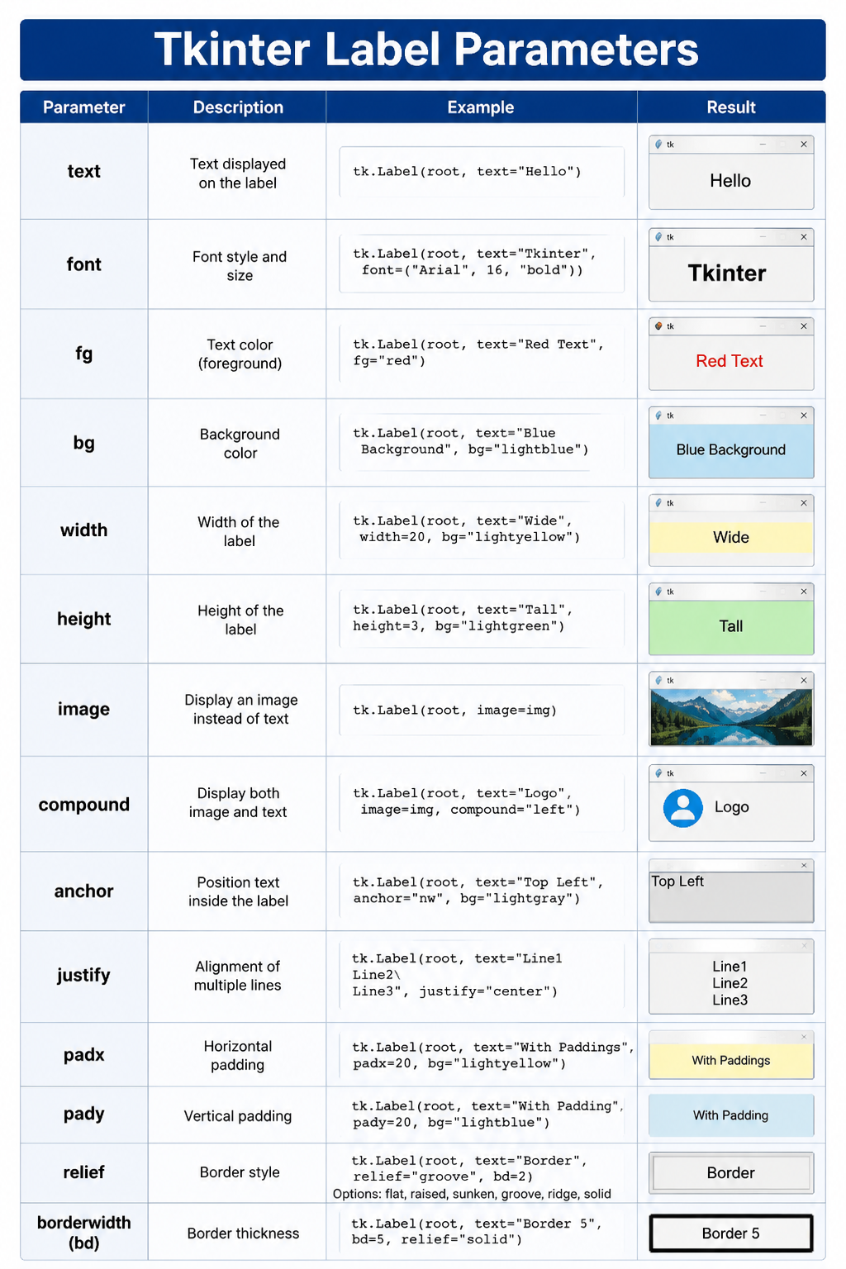

Slide 7
pack() is the method that makes a widget appear in the window and determines its position and spacing.
Parameter | Choices | Description | Example
side | "top", "bottom", "left", "right" | Specifies which side of the parent the widget is packed against. | pack(side="left")
fill | "x", "y", "both", "none" (default) | Stretches the widget to fill available space. | pack(fill="x")
expand | True, False | Allows the widget to use any extra space in the parent. | pack(expand=True)
anchor | "n", "s", "e", "w", "ne", "nw", "se", "sw", "center" | Positions the widget inside the available space. | pack(anchor="nw")
padx | Integer (0, 10, 20, ...) | Adds horizontal space outside the widget. | pack(padx=20)
pady | Integer (0, 10, 20, ...) | Adds vertical space outside the widget. | pack(pady=15)
ipadx | Integer (0, 10, 20, ...) | Adds horizontal space inside the widget. | pack(ipadx=10)
ipady | Integer (0, 10, 20, ...) | Adds vertical space inside the widget. | pack(ipady=10)
before | Another widget | Places the widget before another packed widget. | pack(before=label2)
after | Another widget | Places the widget after another packed widget. | pack(after=label1)

