Slide 1


Slide 2
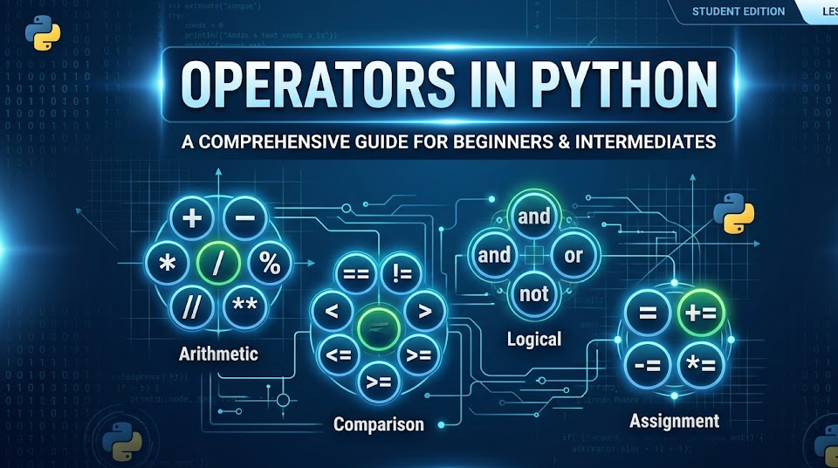

Slide 3
1. Arithmetic Operators
Operator | Name | Example | Result (if x = 5, y = 2)
+ | Addition | x + y | 7
- | Subtraction | x - y | 3
* | Multiplication | x * y | 10
/ | Division (Float) | x / y | 2.5
// | Floor Division (Rounds down) | x // y | 2
% | Modulus (Remainder) | x % y | 1
** | Exponentiation (Power) | x ** y | 25

Slide 4
2. Assignment Operators
= : Standard assignment (x = 5)
+= : Add and assign (x += 3 is equivalent to x = x + 3)
-= : Subtract and assign (x -= 2 is equivalent to x = x - 2)
*= : Multiply and assign (x *= 4 is equivalent to x = x * 4)
/= : Divide and assign (x /= 2 is equivalent to x = x / 2)

Slide 5
3. Comparison Operators
Operator | Meaning | Example | Result (if x = 5, y = 3)
== | Equal to | x == y | False
!= | Not equal to | x != y | True
> | Greater than | x > y | True
< | Less than | x < y | False
>= | Greater than or equal to | x >= 5 | True
<= | Less than or equal to | y <= 2 | False

Slide 6
4. Logical Operators
Used to combine conditional statements.
and: Returns True if both statements are true (e.g., 5 > 3 and 4 > 2).
or: Returns True if at least one of the statements is true (e.g., 5 > 3 or 1 > 4).
not: Reverses the logical result; returns False if the result is true (e.g., not(5 > 3) returns False
5. Identity Operators
These compare objects, not just their values. They check if both variables actually point to the exact same location in memory.
is: Returns True if both variables are the same object.
is not: Returns True if both variables are not the same object.

Slide 7
6. Membership Operators
Used to test if a sequence (such as a string, list, or tuple) contains a specific value.
in: Returns True if the value is found in the sequence.
not in: Returns True if the value is not found in the sequence.

Slide 8
Function Name | Purpose / What it does | Example Code | Result
round() | Rounds to the nearest whole number (or decimal place) | round(3.7) round(3.1415, 2) | 4 3.14
abs() | Returns the absolute (positive) value of a number | abs(-15) | 15
max() | Returns the largest item from the inputs | max(4, 9, 2) | 9
min() | Returns the smallest item from the inputs | min(4, 9, 2) | 2
pow() | Raises a base number to an exponent ($x^y$) | pow(2, 3) | 8
math.sqrt() | Calculates the square root of a number | math.sqrt(25) | 5.0
math.ceil() | Rounds a decimal UP to the nearest integer | math.ceil(4.1) | 5
math.floor() | Rounds a decimal DOWN to the nearest integer | math.floor(4.9) | 4

Slide 9
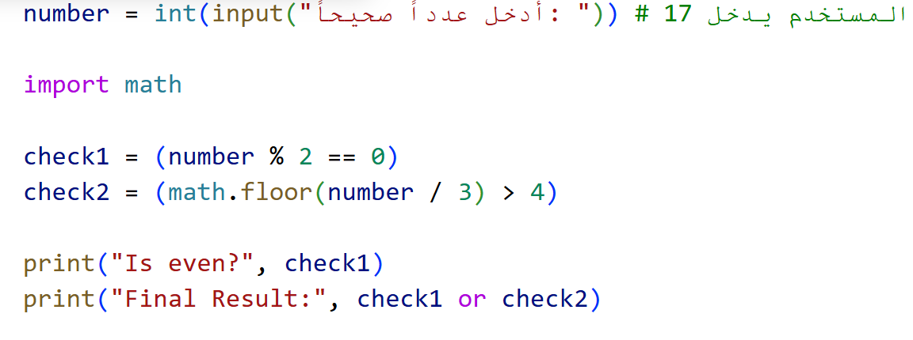
المطلوب: بدون تشغيل البرنامج، ما هي النتيجة التي ستظهر على الشاشة إذا أدخل المستخدم العدد 17؟

Slide 10
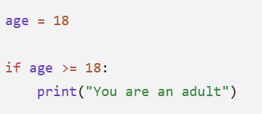
if Statement
The if statement is used to make decisions in a program.

Slide 11
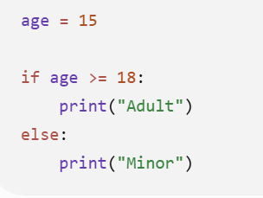
if else

Slide 12
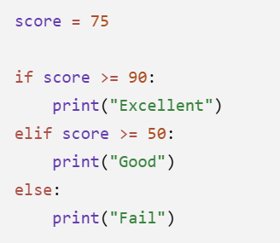
if elif else

Slide 13
1) Password Strength Checker (Advanced)
Ask the user to enter a password.
✔ Rules:
A password is Strong if:
length ≥ 8
contains at least one *
contains at least one @
If not:
if only 1 condition is true → "Weak"
if 2 conditions are true → "Medium"
if all false → "Very Weak"

