Slide 1
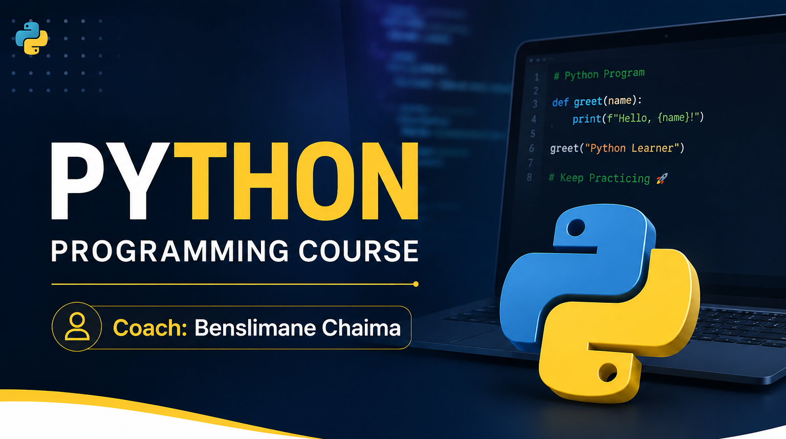

Slide 2
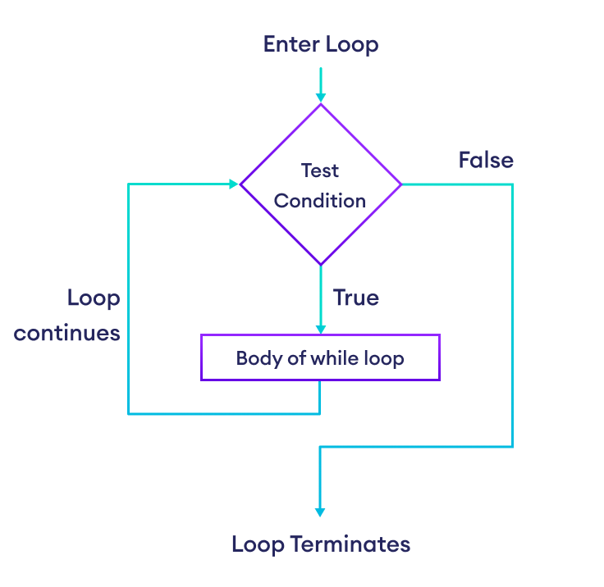

Slide 3
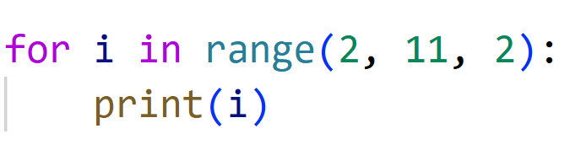
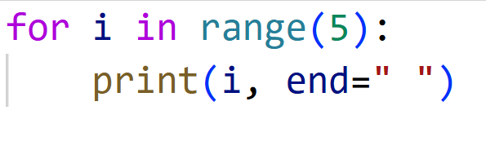
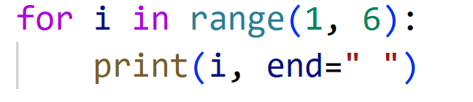
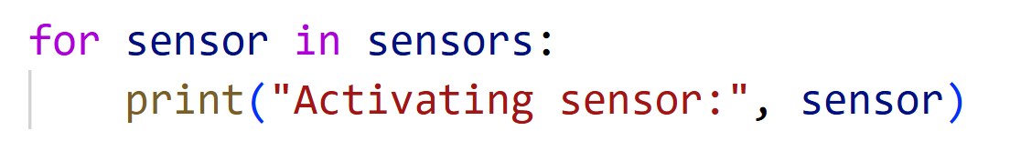
The for Loop
is used to iterate over a sequence (such as a list, a string, or a range of numbers) and execute a block of code multiple times.

Slide 4
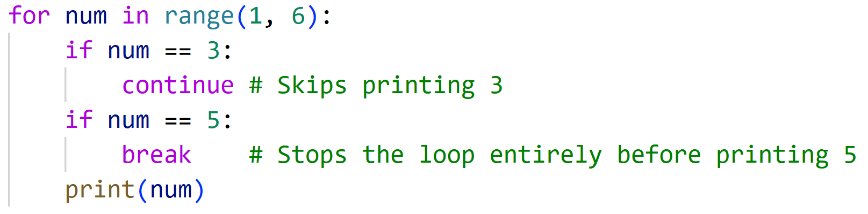
Loop Control: break and continue
These statements give students fine-grained control over the loop's execution based on conditions.
break: Exits the loop immediately.
continue: Skips the rest of the current iteration and jumps straight to the next one.

Slide 5
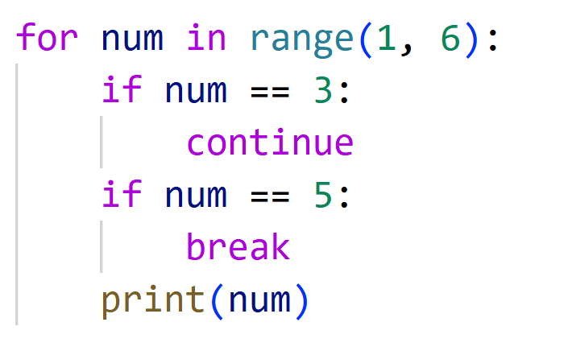

Slide 6
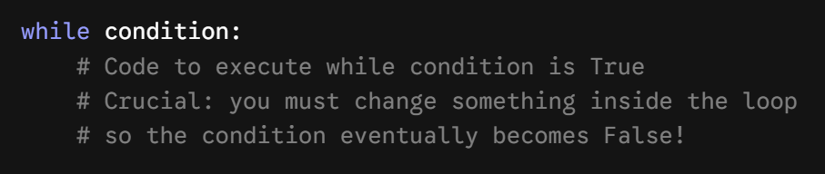
The while Loop
A while loop is used to repeat a block of code as long as a specific condition remains True. Unlike a for loop (which usually knows how many times it will run in advance), a while loop is driven by a condition.
2. Basic Syntax and Structure

Slide 7
