Slide 1
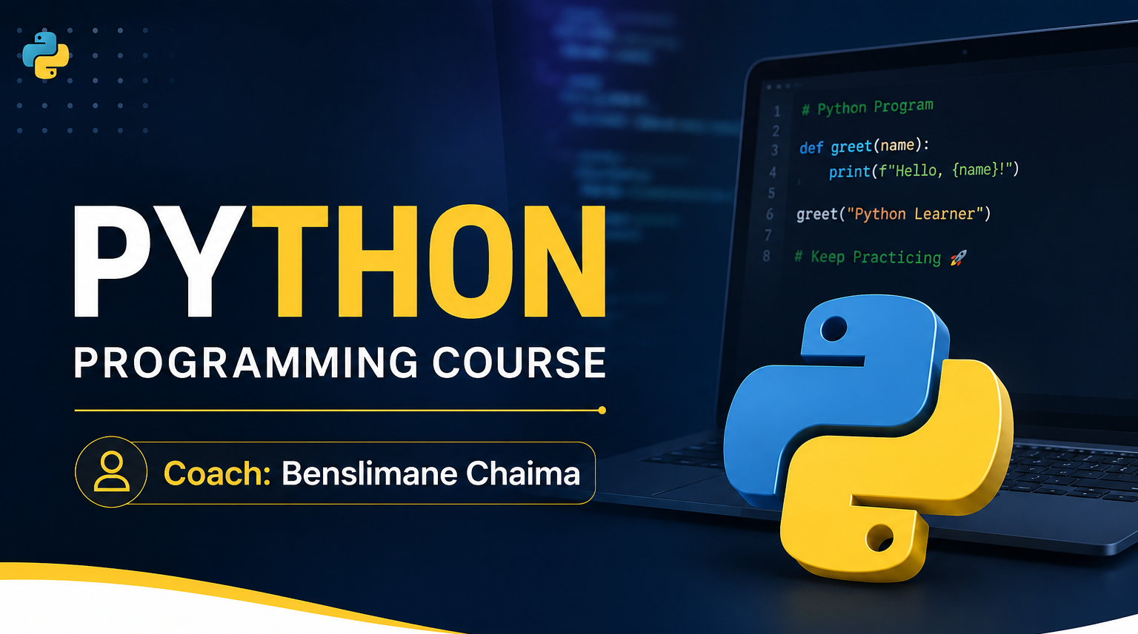

Slide 2
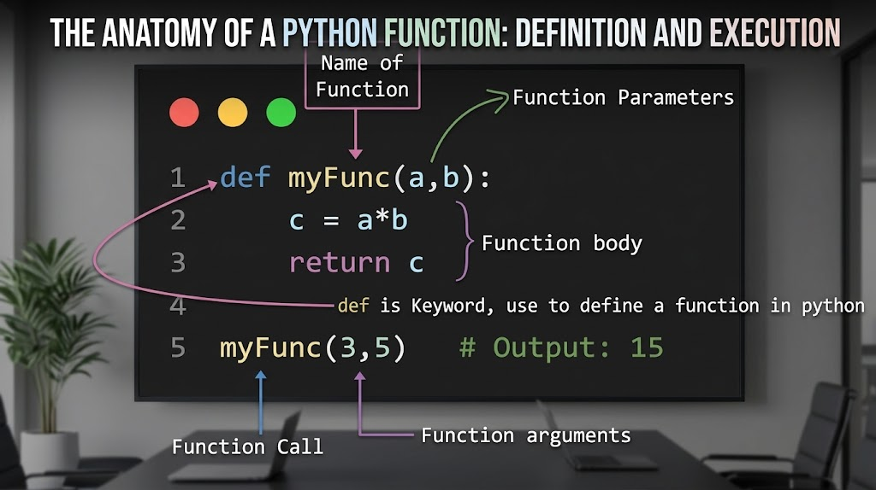

Slide 3
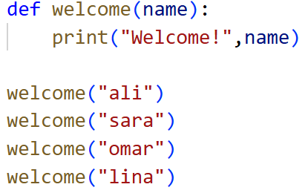
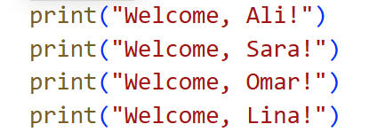
1. What is a Function?
A function is a reusable block of code that performs a specific task.
Instead of writing the same code multiple times, we write it once inside a function and call it whenever we need it.
Without a function
Using a function:

Slide 4
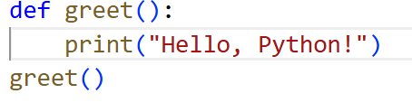

2. Defining a Function
The keyword def is used to create a function.
Syntax
def function_name():
statements…
Example:
Output

Slide 5
3. Function Parameters
A parameter is a variable defined inside the function.
Example:
A paramater
An argument

Slide 6
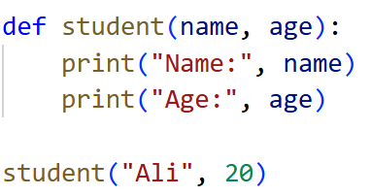
4. Multiple Parameters
Functions can receive multiple parameters.
Example

Slide 7
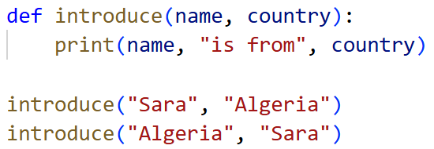
5.Positional Arguments
Arguments are matched according to their position.

Slide 8
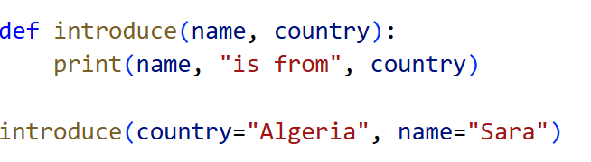
6. Keyword Arguments
Arguments can also be passed using parameter names.

Slide 9
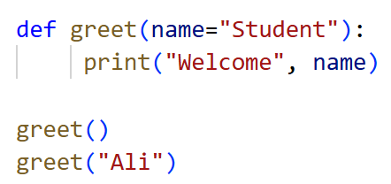
7. Default Parameters
A parameter can have a default value.

Slide 10
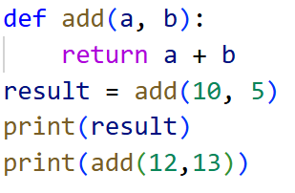
8. Returning Values
So far, our functions have displayed information using print().
Sometimes we need a function to send a result back to the program.
This is done using the return statement.

Slide 11
