Slide 1


Slide 2
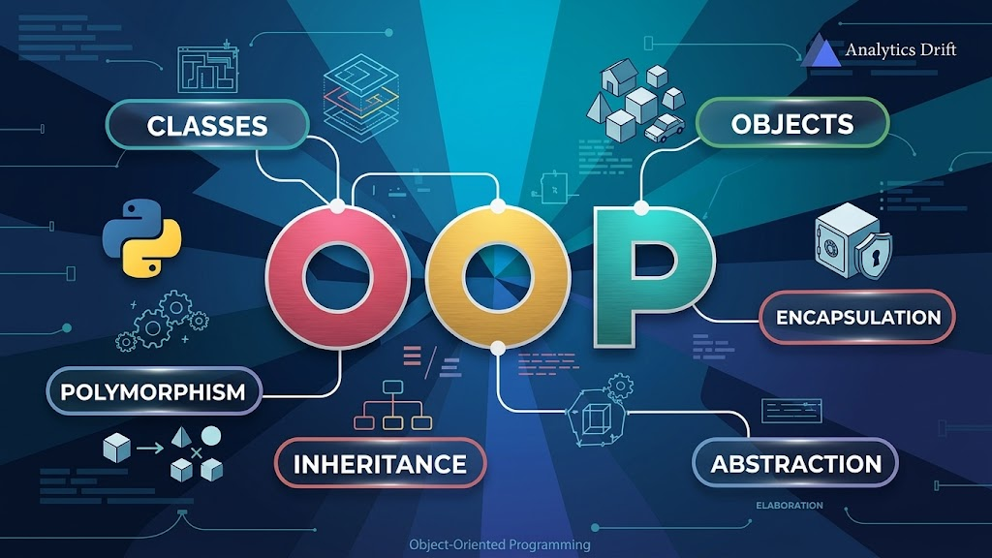

Slide 3
What is an Object?
An object is anything that has:
✅ Attributes (Variables)
Name
Color
Age
✅ Behaviors (Methods)
Walk
Run
Study
Drive

Slide 4
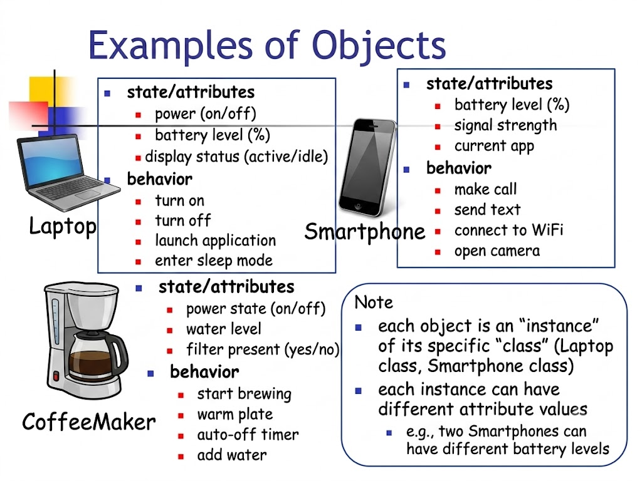

Slide 5
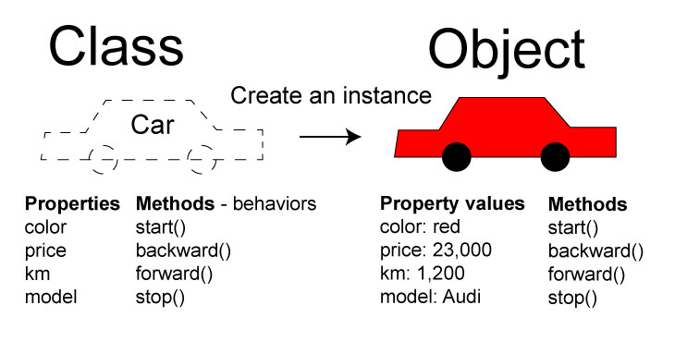
Class?
A class is a blueprint used to create objects.

Slide 6
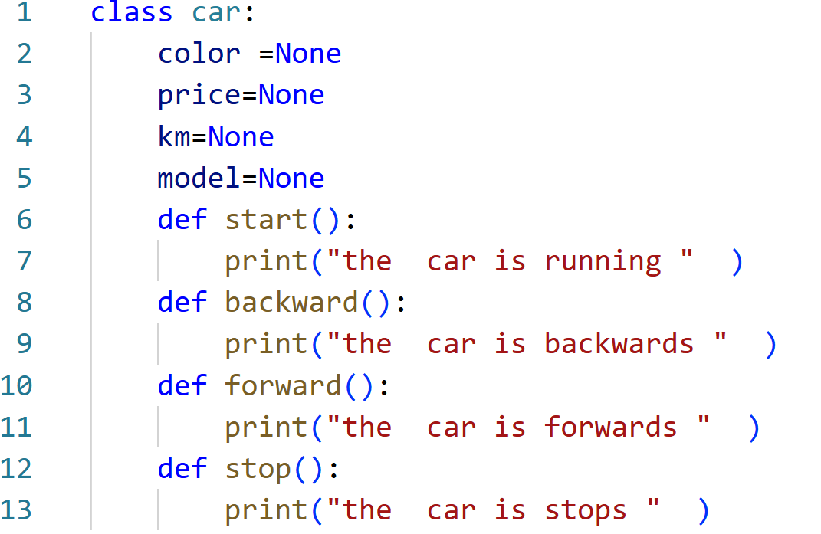
Creating a Class

Slide 7
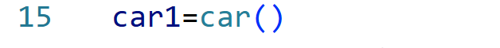
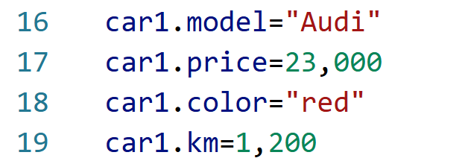
Creating an Object
Adding Attributes

Slide 8
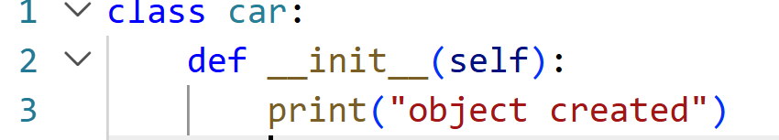
Constructor (__init__)
__init__() is a method runs automatically when an object is created.

Slide 9
