Slide 1
PROJECT TITLE: SECURE DATA HIDING IN IMAGES USING STEGANOGRAPHY
CAPSTONE PROJECT
Presented By:
Student Name : Chamundeswari Devi
College Name & Department : GVR&S College Of Engineering and Technology, Department of Computer Science and Engineering

Slide 2
OUTLINE
Problem Statement
Technology used
Wow factor
End users
Result
Conclusion
Git-hub Link
Future scope

Slide 3
Problem Statement
This project focuses on secure data hiding in images using steganography as traditional encryption methods are vulnerable to attacks.
It combines AES encryption with Least Significant Bit (LSB) steganography to embed encrypted messages within images.
The goal is to ensure data confidentiality, integrity, and privacy while keeping the hidden message undetectable.
This technique enhances secure communication and prevents unauthorized access.

Slide 4
Technology used
Libraries: OpenCV (cv2) for image processing, hashlib for password hashing, base64 for encoding/decoding encrypted messages
Programming Language: Python
Platforms: OpenStego, IDLE (Python 3.10.5)
Techniques: Least Significant Bit (LSB) Steganography, AES Encryption
Image Format: JPEG/PNG for embedding and extraction

Slide 5
Wow factors
Enhanced Security: Uses a passcode-based authentication system for encryption and decryption.
Image-Based Encryption: Hides secret messages within images using Least Significant Bit (LSB) Steganography.
Cross-Platform Compatibility: Works with OpenStego and Python, making it accessible across different environments.
User-Friendly Interface: Simple input prompts for encoding and decoding messages.
Double Layer Protection: Combines image steganography with password authentication for added Security.

Slide 6
End users
Cybersecurity Professionals – To securely exchange sensitive data.
Journalists & Activists – For protecting confidential communications.
Military & Intelligence Agencies – To safeguard classified information.
Corporations & Businesses – For secure data transmission within organizations.
General Users – Anyone needing a secure way to hide and share information.

Slide 7
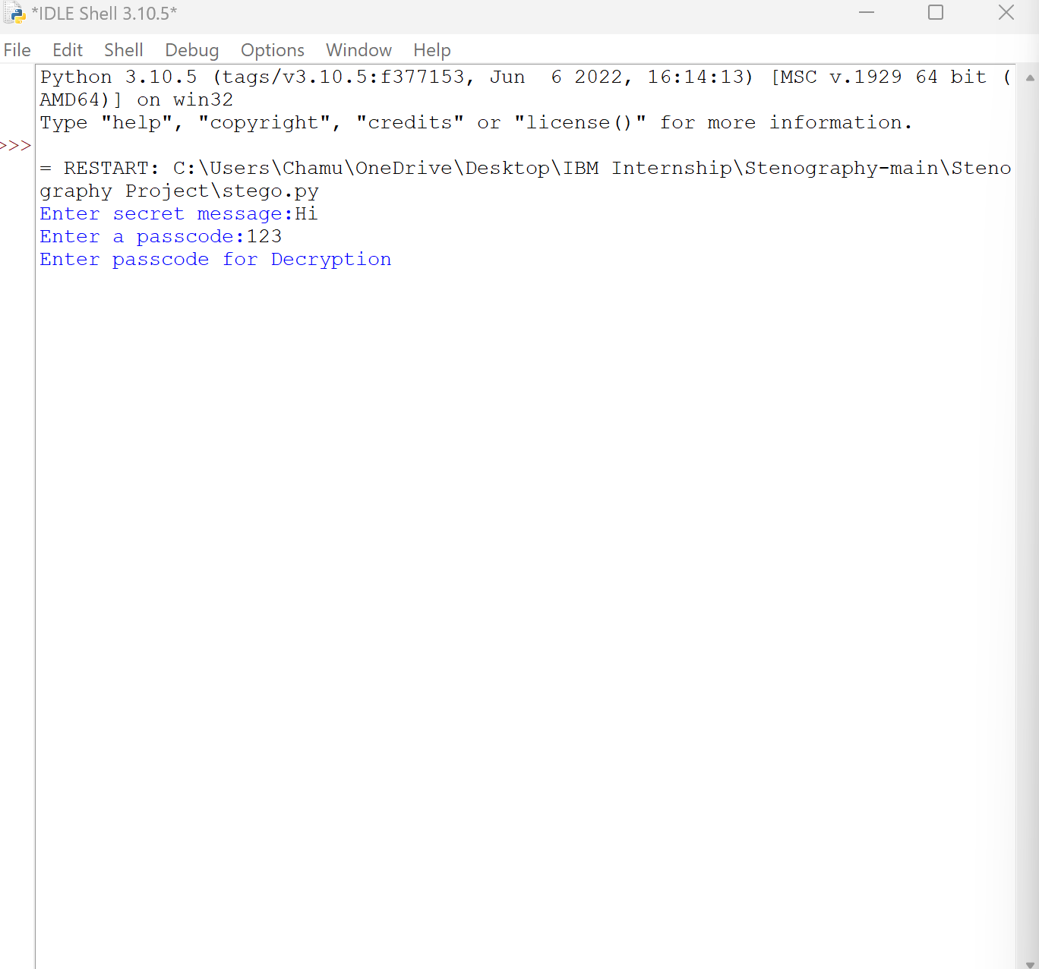
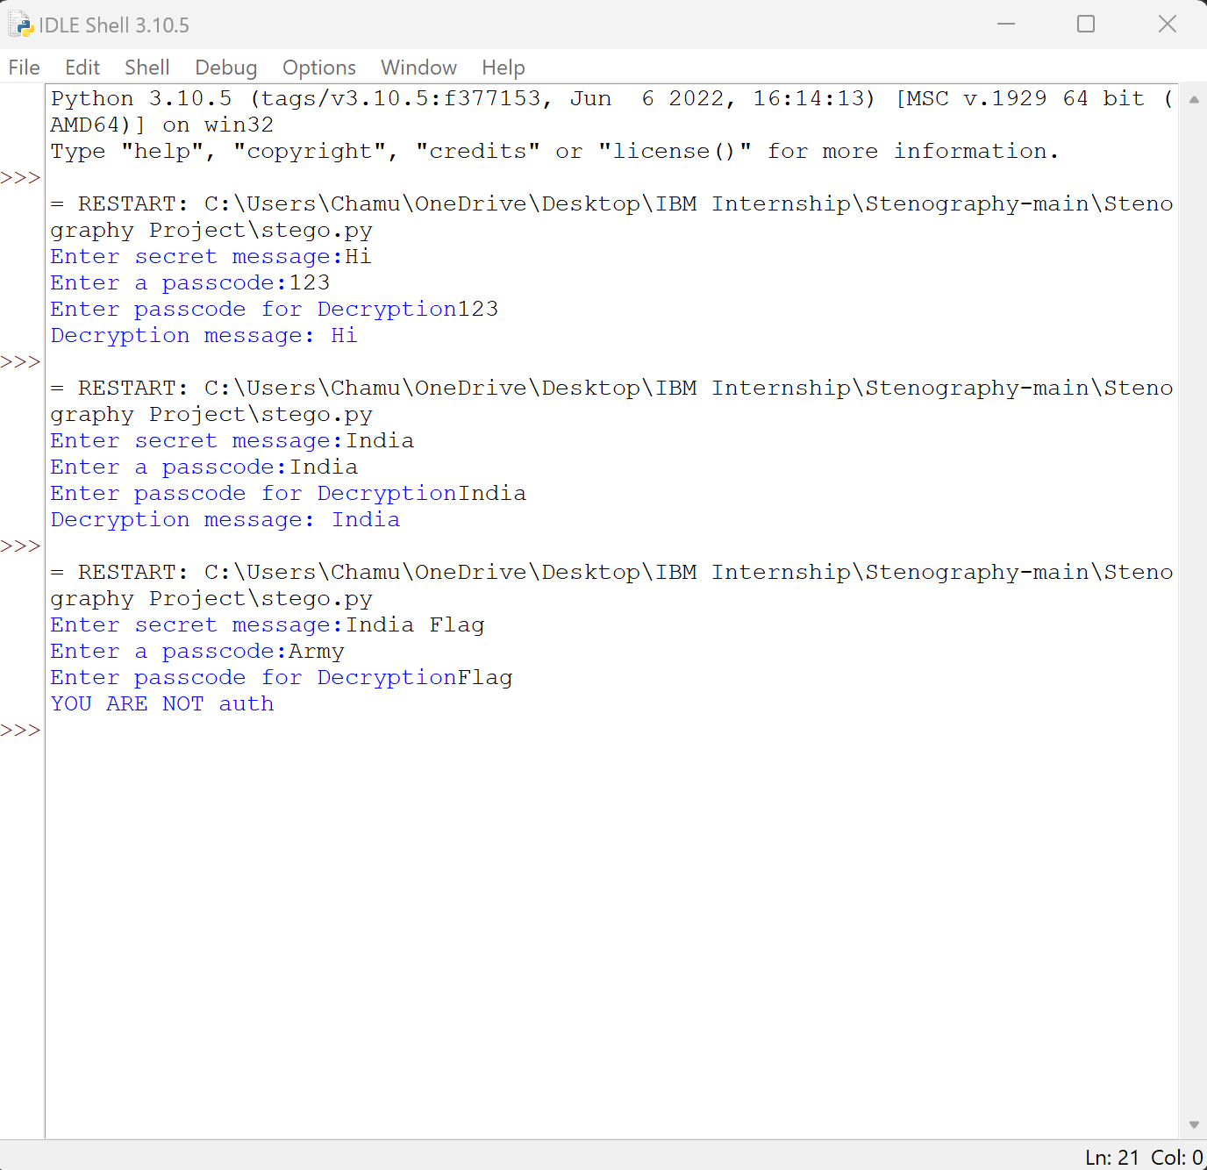
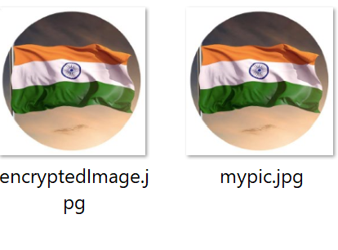
Results

Slide 8
Conclusion
This project successfully addresses the need for secure data transmission using steganography. By leveraging libraries like OpenCV, OS, and String, and utilizing platforms like OpenStegno, it ensures effective data concealment within images. The implementation enhances cybersecurity by providing a robust method to hide sensitive information from unauthorized access. The project stands out due to its ease of use, efficiency, and applicability across various sectors, including cybersecurity, journalism, and corporate security.

Slide 9
GitHub Link
GitHub Link: https://github.com/chamu1999-Devi/Stegnography-Project.git
README File: https://github.com/chamu1999-Devi/Stegnography-Project/blob/main/README.md

Slide 10
Future scope
Advanced Encryption Methods – Integration of more robust cryptographic algorithms like AES or RSA for added security.
Steganalysis Resistance – Enhancing the system to evade steganalysis techniques used for detecting hidden messages.
Cloud Integration – Allowing encrypted images to be securely stored and shared via cloud platforms.
Multimedia Steganography – Expanding support beyond images to include audio, video, and text-based steganography.
AI-Powered Security – Implementing machine learning techniques to detect tampering attempts and improve encryption reliability.
These advancements will improve the system’s security, usability, and adaptability for future cybersecurity needs.

Slide 11
THANK YOU

