Slide 1
COMP2021: Object-Oriented Programming
Project Presentation
Group15
KONG, Siu Chun (19071318d)
NG, Tsz Hin (19053208d)
YEUNG, Lai Wing (19061722d)
CHAN, Pak Hin (19071928d)

Slide 2
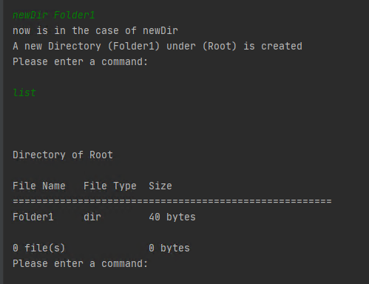
General overview
Enter a command
Output something according to the requirement document

Slide 3
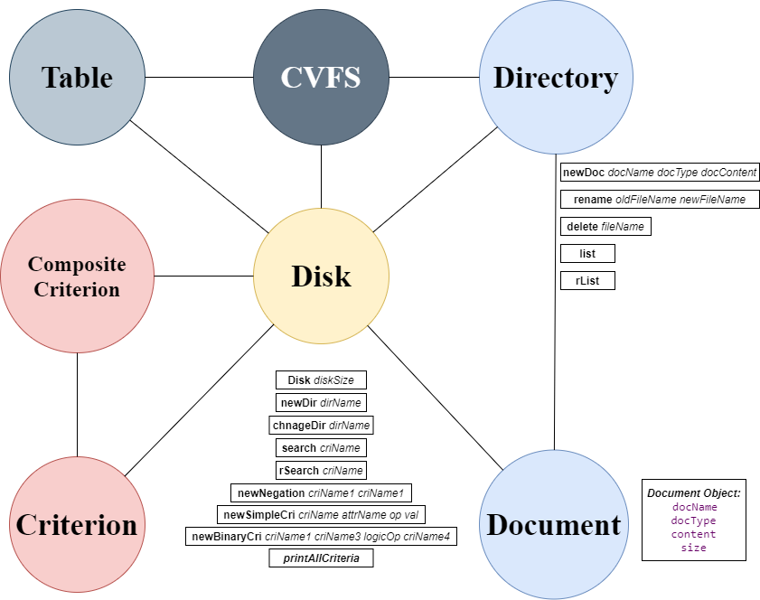

Slide 4
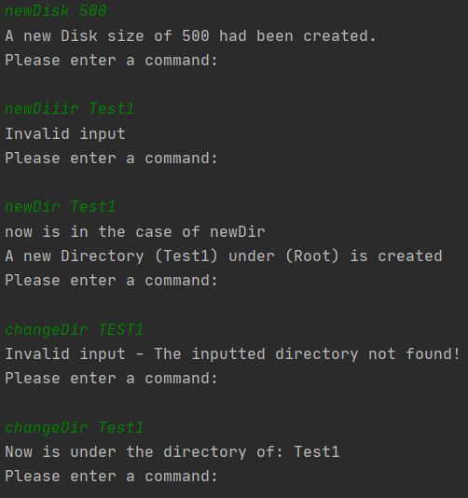
Functions of CVFS
Allow user to input command to call various methods
Perform input checking for different parameters

Slide 5
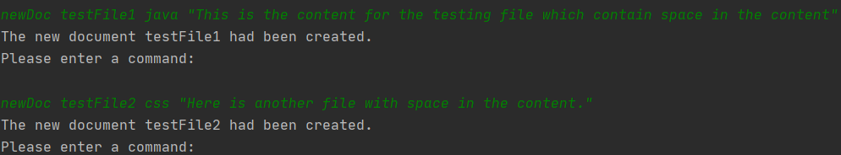
Featured Highlights
Allow user to input string with space for file content with “ ”

Slide 6
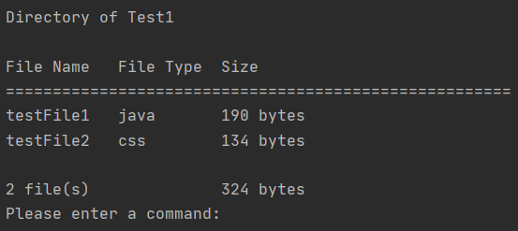
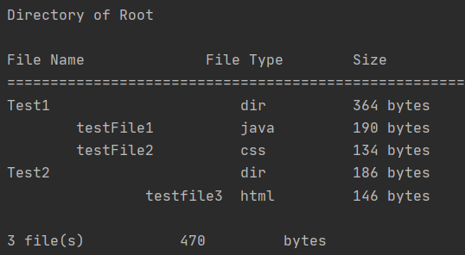
Formatting of the listing function in various method (eg. List, rList, search, rSearch)
List method
rList method

Slide 7
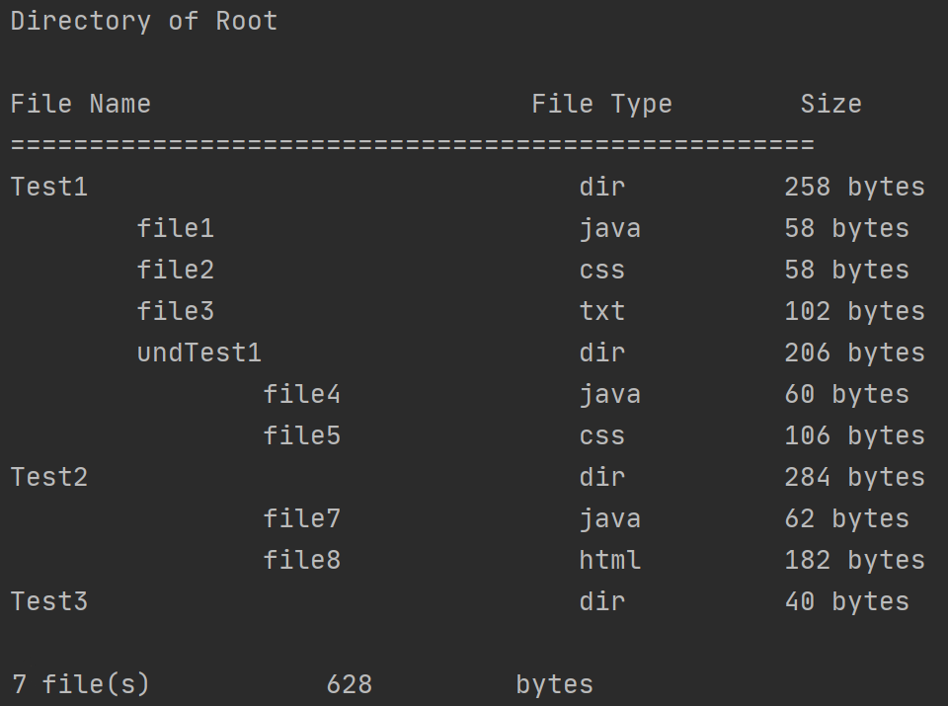
Input: rList (under the Root directory)

Slide 8
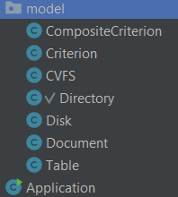
Use of classes to simulate real file system
Make use of different classes
Disk
Directory
Contained Files
Criterion
Composite Criterion

Slide 9
CompositeCriterion extends Criterion
According to the requirement criterion can be categorized into 2 main types
Make use of sub-class
Use of the super class to facilitate the development of the system

Slide 10
How object-orientation improve the reusability/scalability of the code
We implement data encapsulation in our classes
For the different variables in our classes, we have various methods for us to access it or modify it.
Give us a lot of flexibility to modify the attributes of criterions, directories, documents

Slide 11
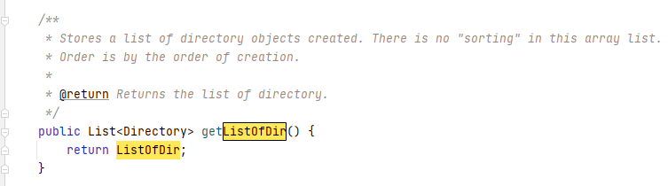
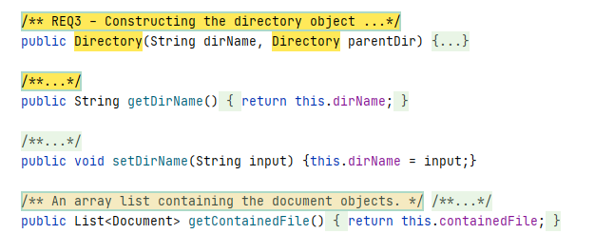
Under Disk Class:
Accessing a directory:
Manipulating a directory (under Directory class):

Slide 12
Accessing/manipulating the document class:
Manipulating a directory (under Directory class):

Slide 13
Q&A Section

