Slide 1

Predicting Vintage Vinyl Prices

Slide 2
Four main ideas
Motivation
Data Processing
Eda and model selection
Results and predictions

Slide 3
Record Shopping Experience (as a new collector) Pcitre of record bins
More people in the market place
Collectibles are harder to price – auction – based on supply and demand
Rec Shop A sells Miles Davis kind of blue for $40. Rec Shop B same albume for $50. Why hard to price?

Slide 4
Goal – to price recs
A.
B.
Records sales Trends
Jazz Record sales Trends

Slide 5
Data Collection and Features
Assumptions
Price
Records
Jazz Bebop only
Picture of Discogs
Features in website to scrape
Added features to understand the relationship
Number of records (literally)

Slide 6
Here we’ll talk about the features used in the model form the website

Slide 7
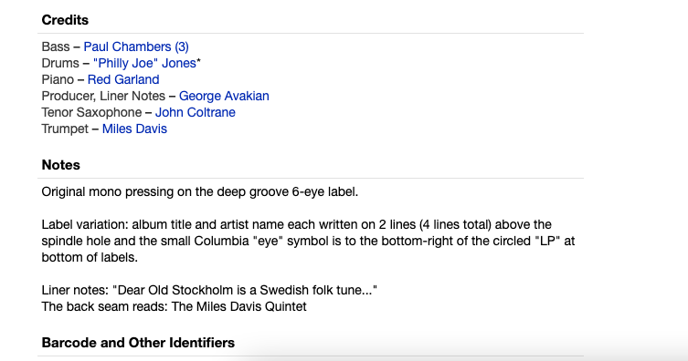
Add more screenshots of artist and notes
Highlight the notes (first press, etc
Grouped into one binary

Slide 8
Graph 1 EDA (TABLE)
Show votes drop noise
Show notes drop noise
Haves and wants – could be an indicator of supply and demand – wants/haves
Show R^2, RMSE, MAE?
Maybe corr matrix

Slide 9
Final Features

Slide 10
Table 2 : Model, R2, RMSE

Slide 11
Graph of poly / interaction
2 tables
Rec label by price / grouped Media condition (VG+,etc) vs. VG-
Graph of important features

Slide 12
Important features from model
Interactions media cond + label
Media cond + wants/haves
Seller ratings
NOT Important
Votes
X notes

Slide 13
Maybe residual plots / QQ

Slide 14
Predictions
Table of predictions

