Slide 1

Predicting the next Hit Song

Slide 2

Can we predict whether a song will be a “Hit”? “Hit” defined as a song having made it to the Billboard Hot 100 Weekly Charts

Slide 3

Agenda
Data Framework
Modeling Framework
Results and Examples
Future Improvements

Slide 4


Data
14,000 Unique Songs
9,000 Billboard Hit Songs (Target)
5,000 MSD Random “Popular” Songs
Spotify Audio Features
Years 1990 - 2018
MILLION
SONG
DATASET

Slide 5



features
Danceability
Energy
Acousticness
Valence
Loudenss
Key
Tempo
Instrumentalness
Speechiness
Song Duration
Liveness
Mode
Hit Song (Target)
Artist
Song Title
Song Popularity

Slide 6
features
Danceability
Energy
Acousticness
Valence
Loudenss
Key
Tempo
Instrumentalness
Speechiness
Song Duration
Liveness
Mode
Hit Song (Target)
Artist
Song Title
Song Popularity

Slide 7
features
Danceability
Energy
Acousticness
Valence
Loudenss
Key
Tempo
Instrumentalness
Speechiness
Song Duration
Liveness
Mode
Hit Song (Target)
Artist
Song Title
Song Popularity

Slide 8
EDA: hits vs. non-hits
Re-scaled (0 to 1):
Loudness
Tempo
Track Seconds

Slide 9
EDA: Closer look at features
Acousticness
Instrumentalness
Loudness

Slide 10



Optimization Metric
Minimizing the Hit Songs we Missed
Not as important
Optimizing for Correctly Predicting a Hit Song
Aggressive but meaningful
Evaluation Metric Emphasis
Metric: Precision

Slide 11

Model Evaluation - Baseline
Model | AUC / ROC | Accuracy | Precision | Recall | F1
XGB | 0.853 | 0.805 | 0.798 | 0.915 | 0.852
RF | 0.838 | 0.791 | 0.794 | 0.891 | 0.839
Logistic Regression | 0.818 | 0.770 | 0.757 | 0.919 | 0.830
KNN | 0.685 | 0.698 | 0.716 | 0.840 | 0.773
DT | 0.690 | 0.703 | 0.765 | 0.744 | 0.754

Slide 12
Model Evaluation - Baseline
Model | AUC / ROC | Accuracy | Precision | Recall | F1
XGB | 0.853 | 0.805 | 0.798 | 0.915 | 0.852
RF | 0.838 | 0.791 | 0.794 | 0.891 | 0.839
Logistic Regression | 0.818 | 0.770 | 0.757 | 0.919 | 0.830
KNN | 0.685 | 0.698 | 0.716 | 0.840 | 0.773
DT | 0.690 | 0.703 | 0.765 | 0.744 | 0.754

Slide 13
XGB: Model Tuning
1. Feature Importance
Removed from Model

Slide 14
XGB: Model Tuning
1. Feature Importance
II. Best parameters
Max Depth: 3
Max Features: 4
N Estimators: 100
Learning Rate: 0.10
Removed from Model

Slide 15
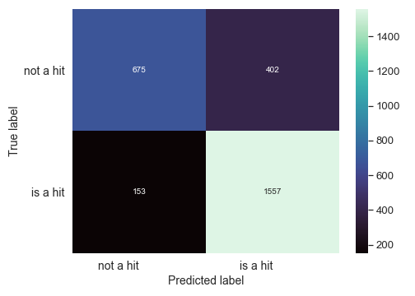
XGB: Model Evaluation
Threshold @ 0.50: Precision: 0.795, Recall: 0.910

Slide 16
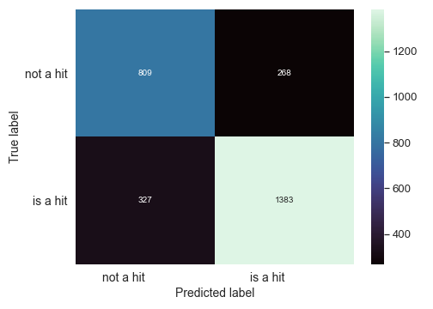
XGB: Model Evaluation
Threshold @ 0.50: Precision: 0.795, Recall: 0.910
Threshold @ 0.65: Precision: 0.843, Recall: 0.800

Slide 17

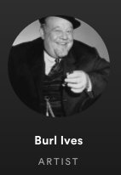
Hit prediction (Miss) Post Malone vs. burl ives
HIT
MISS
Post = 0.91
Ives = 0.03

Slide 18

Edge case Post Malone vs. muse
HIT
EDGE
Post = 0.91
Muse = 0.64

Slide 19

Good prediction Post Malone vs. taylor swift
HIT
HIT
Post = 0.91
Swift = 0.89

Slide 20

Future improvements
Account for song release year in Billboard data
Account for music genre
Incorporate data from sites such as TikTok, Youtube data
Using the song popularity feature
Obtaining sentiment / lyrical features

Slide 21

Thank you

Slide 22

Appendix

Slide 23
Spotify audio features
Danceability: Danceability describes how suitable a track is for dancing based on a combination of musical elements including tempo, rhythm stability, beat strength, and overall regularity. A value of 0.0 is least danceable and 1.0 is most danceable.
Acousticness: A measure from 0.0 to 1.0 of whether the track is acoustic.
Energy: Energy is a measure from 0.0 to 1.0 and represents a perceptual measure of intensity and activity. Typically, energetic tracks feel fast, loud, and noisy.
Instrumentalness: Predicts whether a track contains no vocals. The closer the instrumentalness value is to 1.0, the greater likelihood the track contains no vocal content.
Liveness: Detects the presence of an audience in the recording. Higher liveness values represent an increased probability that the track was performed live.
Loudness: The overall loudness of a track in decibels (dB). Loudness values are averaged across the entire track. Values typical range between -60 and 0 db.
Speechiness: Speechiness detects the presence of spoken words in a track. The more exclusively speech-like the recording (e.g. talk show, audio book, poetry), the closer to 1.0 the attribute value.
Tempo: The overall estimated tempo of a track in beats per minute (BPM). In musical terminology, tempo is the speed or pace of a given piece and derives directly from the average beat duration.
Valence: A measure from 0.0 to 1.0 describing the musical positiveness conveyed by a track. Tracks with high valence sound more positive (e.g. happy, cheerful, euphoric), while tracks with low valence sound more negative (e.g. sad, depressed, angry).

Slide 24
Million song dataset
The Million Song Dataset started as a collaborative project between The Echo Nest and LabROSA. It was supported in part by the NSF.
The Million Song Dataset is a freely-available collection of audio features and metadata for a million contemporary popular music tracks.
Its purposes are:
To encourage research on algorithms that scale to commercial sizes
To provide a reference dataset for evaluating research
As a shortcut alternative to creating a large dataset with APIs (e.g. The Echo Nest's)
To help new researchers get started in the MIR field
The core of the dataset is the feature analysis and metadata for one million songs, provided by The Echo Nest. The dataset does not include any audio, only the derived features. Note, however, that sample audio can be fetched from services like 7digital, using code we provide.

Slide 25
References
HITPREDICT: PREDICTING HIT SONGS USING SPOTIFY DATA STANFORD COMPUTER SCIENCE 229: MACHINE LEARNING Elena Georgieva,1 Marcella Suta,2 and Nicholas Burton2 1Center for Computer Research in Music and Acoustics, Stanford University, USA 2Department of Civil and Environmental Engineering, Stanford University, USA {egeorgie, msuta, ngburton}@stanford.edu
http://cs229.stanford.edu/proj2018/report/16.pdf

Slide 26
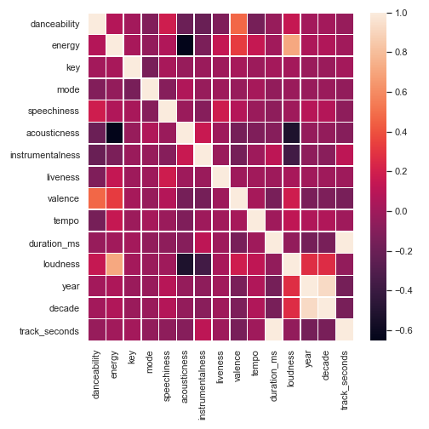
Correlation matrix

Slide 27
EDA – Audio feature violin graphs

Slide 28
Final Model – Xgboost AUC/ROC Curve

Slide 29
wrong prediction Post Malone vs. Beyonce
Predicted Probabilities:
Post Malone = 0.91
Beyonce = 0.91

Slide 30
Missed prediction
post Malone vs. coldplay
Predicted Probabilities:
Post Malone = 0.91
Coldplay = 0.14

