Slide 1
Predicting a Hit Song

Slide 2
Agenda
Motivation
Data & Features
EDA & Model Selection
Results
Future Improvements

Slide 3







Data & Methods
Logos
Billboard Hot 100 (weekly) between 1990-2018
Random Songs from Million Song Dataset between 1990-2018
Audio Features from Spotify (~10 Features):
Danceability (0-1 scale)
Loudness
Energy
Mode
etc.
Target = Song was on the Billboard Hot 100
~14,000 obs
Programs/pagkages, etc. sklearn, python, postgresql, seaborn, matplotlib

Slide 4
Features – maybe with some defs or take from spotify
Liveness:
Danceability:
Loudness:
Energy:
Acousticness:
Key:
Tempo:
~12 Features
~12,000 Records
Instrumentalness:
Speechiness:
Valence:
Song Duration:
Mode:

Slide 5
Danceability
Energy
Acousticness
Valence
Loudenss
Key
Tempo
Instrumentalness
Speechiness
Song Duration
Liveness
Mode

Slide 6
EDA – radar – features hit vs. nonhit

Slide 7
EDA – Deeper dive violin plots

Slide 8
Baseilne Model
Logistic regression
KNN
Model Refinement
Gridsearch CV
Feature Importance
Examining Predictions
Actuals vs. Predicted
DT
RF
XGB
Thresholds

Slide 9
Model Evaluation – Baseline Scores
Model | AUC / ROC | Accuracy | Precision | Recall | f1
Logistic Regression | 0.818 | 0.770 | 0.757 | 0.919 | 0.830
KNN | 0.685 | 0.698 | 0.716 | 0.840 | 0.773
DT | 0.690 | 0.703 | 0.765 | 0.744 | 0.754
RF | 0.838 | 0.791 | 0.794 | 0.891 | 0.839
XGB | 0.853 | 0.805 | 0.798 | 0.915 | 0.852

Slide 10
XGB: important features
Graphs
Show what is improtatn and real examples

Slide 11
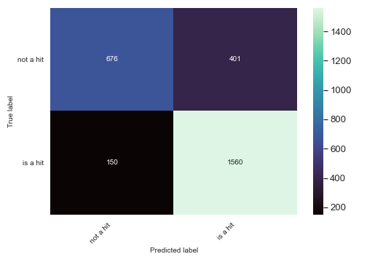
Logistic Reg vs. XGB: Process Flow
Conf Matrix – XGB – after Hyper tune Feature Selection

Slide 12
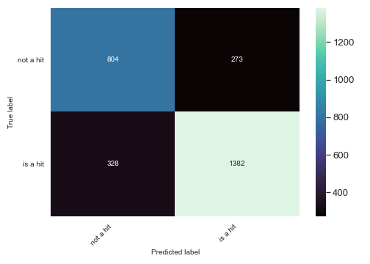
Final Model: XGB results
Scores
Graphs – Conf Matrix
Precision Recall - adjusting

Slide 13
XGB: Example of hits and misses
Radar + numbers
Probabilites + pop scores?
Vs. bulr ives – Valence, Loudness, Acousticness, time (weightier). Also that we don’t account for older seasonal hits. Featuers may be so different
Vs. beyonce – similar in most but high speech which is something we took out fo the model – therefore we predicted a hit
Vs. muse – example of similar songs features that barely missed bc of raised threshold. Otherwise would’ve predicted
Vs. swift – example of very close match which was successful
Vs. coldplay – example of how much weight was on instrumentalness. We missed bc we said the songs should not be instrumental for a hit and yet here’s an opposite case.

Slide 19
Conclusions

Slide 20
Next Steps

Slide 21
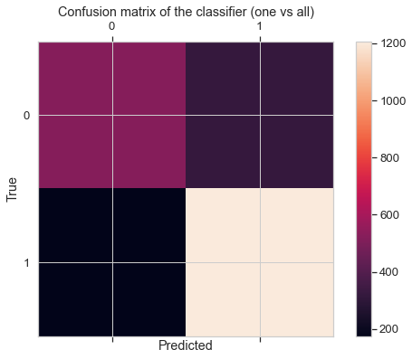
Final Model – Random Forest: Confusion Matrix

Slide 22
Appendix

Slide 23
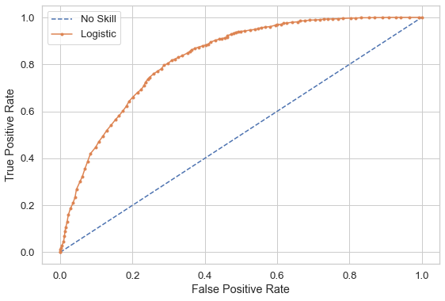
Final Model – Random Forest: AUC/ROC Curve

Slide 24
Hits and misses

