Slide 1

Predicting a Hit Song

Slide 2
Agenda
Data Framework
Modeling Framework
Results and Examples
Future Improvements

Slide 3



Data
14,000 Observations
9,000 Billboard Hit Songs
5,000 Random Pop Songs
Years 1990 - 2019

Slide 4




Applications

Slide 5
features
Danceability
Energy
Acousticness
Valence
Loudenss
Key
Tempo
Instrumentalness
Speechiness
Song Duration
Liveness
Mode
Hit Song (Target)
Artist
Song Title
Song Popularity

Slide 6
EDA: hits vs. non-hits

Slide 7
EDA – Deeper dive violin plots

Slide 8
Optimization Metric
Minimizing the hit songs we missed
Too passive
Optimizing for predicting a hit song
Aggressive but meaningful
Balance of precision and recall
Metric: Precision (F1 to a lesser extent)

Slide 9
Model Evaluation - Baseline
Model | AUC / ROC | Accuracy | Precision | Recall | F1
XGB | 0.853 | 0.805 | 0.798 | 0.915 | 0.852
RF | 0.838 | 0.791 | 0.794 | 0.891 | 0.839
Logistic Regression | 0.818 | 0.770 | 0.757 | 0.919 | 0.830
KNN | 0.685 | 0.698 | 0.716 | 0.840 | 0.773
DT | 0.690 | 0.703 | 0.765 | 0.744 | 0.754

Slide 10
XGB: Model Tuning
Feature Importance
Best parameters
Max Depth: 3
Max Features: 4
N Estimators: 100
Learning Rate: 0.1
Removed From Model

Slide 11
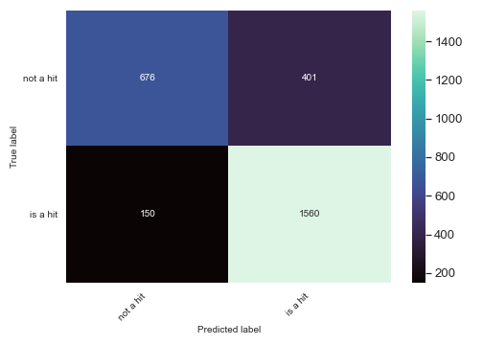
XGB: Model Evaluation
Threshold = 0.50
Precision: 0.795
Recall: 0.910
F1: 0.848

Slide 12
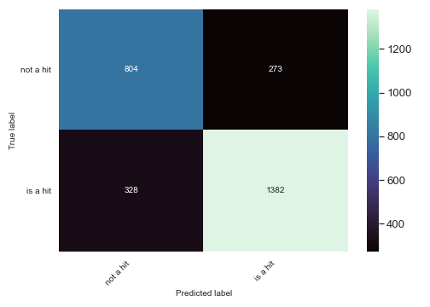
Final Model: XGB results
Threshold=0.65
Precision: 0.833
Recall: 0.800
F1: 0.814

Slide 18
Future improvements
Account for year of song release
Account for seasonalility
Incorporate popular apps such as TikTok, Facebook data
Using the song popularity feature
Obtaining sentiment / lyrical features

Slide 19
XGB: Example of hits and misses
Radar + numbers
Probabilites + pop scores?
Vs. bulr ives – Valence, Loudness, Acousticness, time (weightier). Also that we don’t account for older seasonal hits. Featuers may be so different
Vs. beyonce – similar in most but high speech which is something we took out fo the model – therefore we predicted a hit
Vs. muse – example of similar songs features that barely missed bc of raised threshold. Otherwise would’ve predicted
Vs. swift – example of very close match which was successful
Vs. coldplay – example of how much weight was on instrumentalness. We missed bc we said the songs should not be instrumental for a hit and yet here’s an opposite case.

Slide 20
Baseilne Model
Logistic regression
KNN
Model Refinement
Gridsearch CV
Feature Importance
Examining Predictions
Actuals vs. Predicted
DT
RF
XGB
Thresholds

Slide 21
Appendix

Slide 22
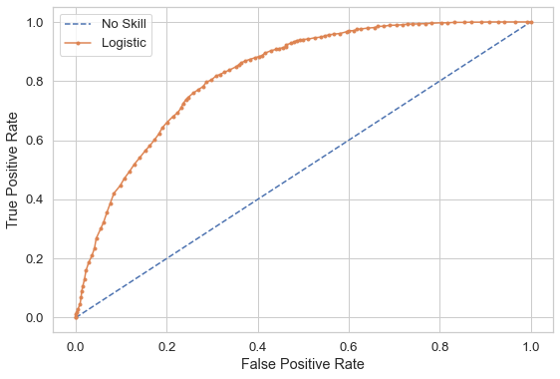
Final Model – Random Forest: AUC/ROC Curve

Slide 23
Features – maybe with some defs or take from spotify
Liveness:
Danceability:
Loudness:
Energy:
Acousticness:
Key:
Tempo:
~12 Features
~12,000 Records
Instrumentalness:
Speechiness:
Valence:
Song Duration:
Mode:

Slide 24
Hits and misses

