Slide 1
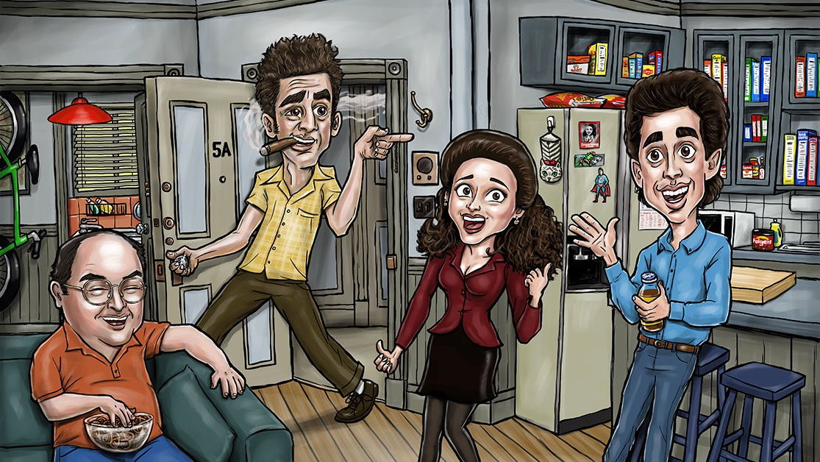
Seinfeld

Slide 2
Motivations
Show about nothing
George manifested Larry David
a "short, stocky, slow-witted, bald man" (by Elaine Benes and Costanza himself), "weak, spineless, man of temptations" (by Cosmo Kramer), and "Lord of the Idiots" (by Costanza himself).
George is neurotic, self-loathing and dominated by his parents, yet also prone to occasional periods of overconfidence that invariably arise at the worst possible time.
George exhibits a number of negative character traits, among them dishonesty, insecurity and anxiety, many of which seem to stem from a dysfunctional childhood with his eccentric parents Frank and Estelle, and often form the basis of his involvement in various plots, schemes and embarrassing social encounters

Slide 3
Motivations
Show about nothing
George manifested Larry David
a "short, stocky, slow-witted, bald man" (by Elaine Benes and Costanza himself), "weak, spineless, man of temptations" (by Cosmo Kramer), and "Lord of the Idiots" (by Costanza himself).
George is neurotic, self-loathing and dominated by his parents, yet also prone to occasional periods of overconfidence that invariably arise at the worst possible time.
George exhibits a number of negative character traits, among them dishonesty, insecurity and anxiety, many of which seem to stem from a dysfunctional childhood with his eccentric parents Frank and Estelle, and often form the basis of his involvement in various plots, schemes and embarrassing social encounters

Slide 4
Agenda
Psychoanalyze George Costanza
Walk through our journey

Slide 5
Data & Processes
Seinfeld Transcripts https://www.kaggle.com/thec03u5/seinfeld-chronicles
9 seasons (1989-1998)
173 episodes
Document level – character lines per episode
Processes
Topic Modeling (SVD, NMF, LDA)
Sentiment / Emotions
Textblob
Vader
Lexicon of emotions (National Research Council of Canada)

Slide 6
EDA
Character Line Counts Total

Slide 7
EDA
Character Line Counts by Season

Slide 8
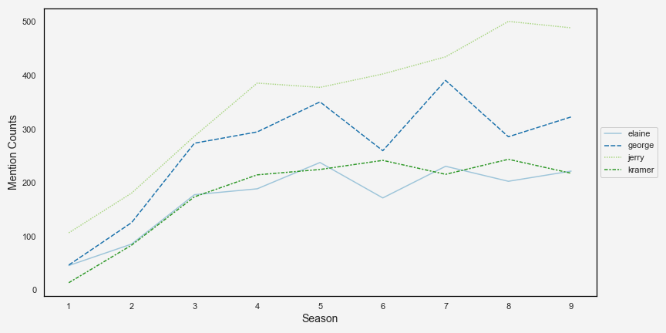
EDA
Character Mentions by Season

Slide 9
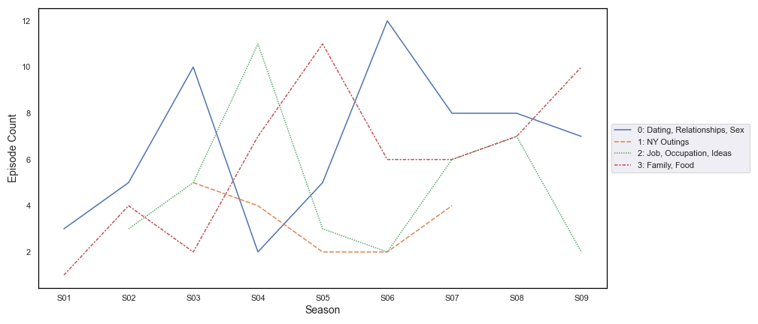
Topic Modeling
George “Can’t Stand Ya”

Slide 10
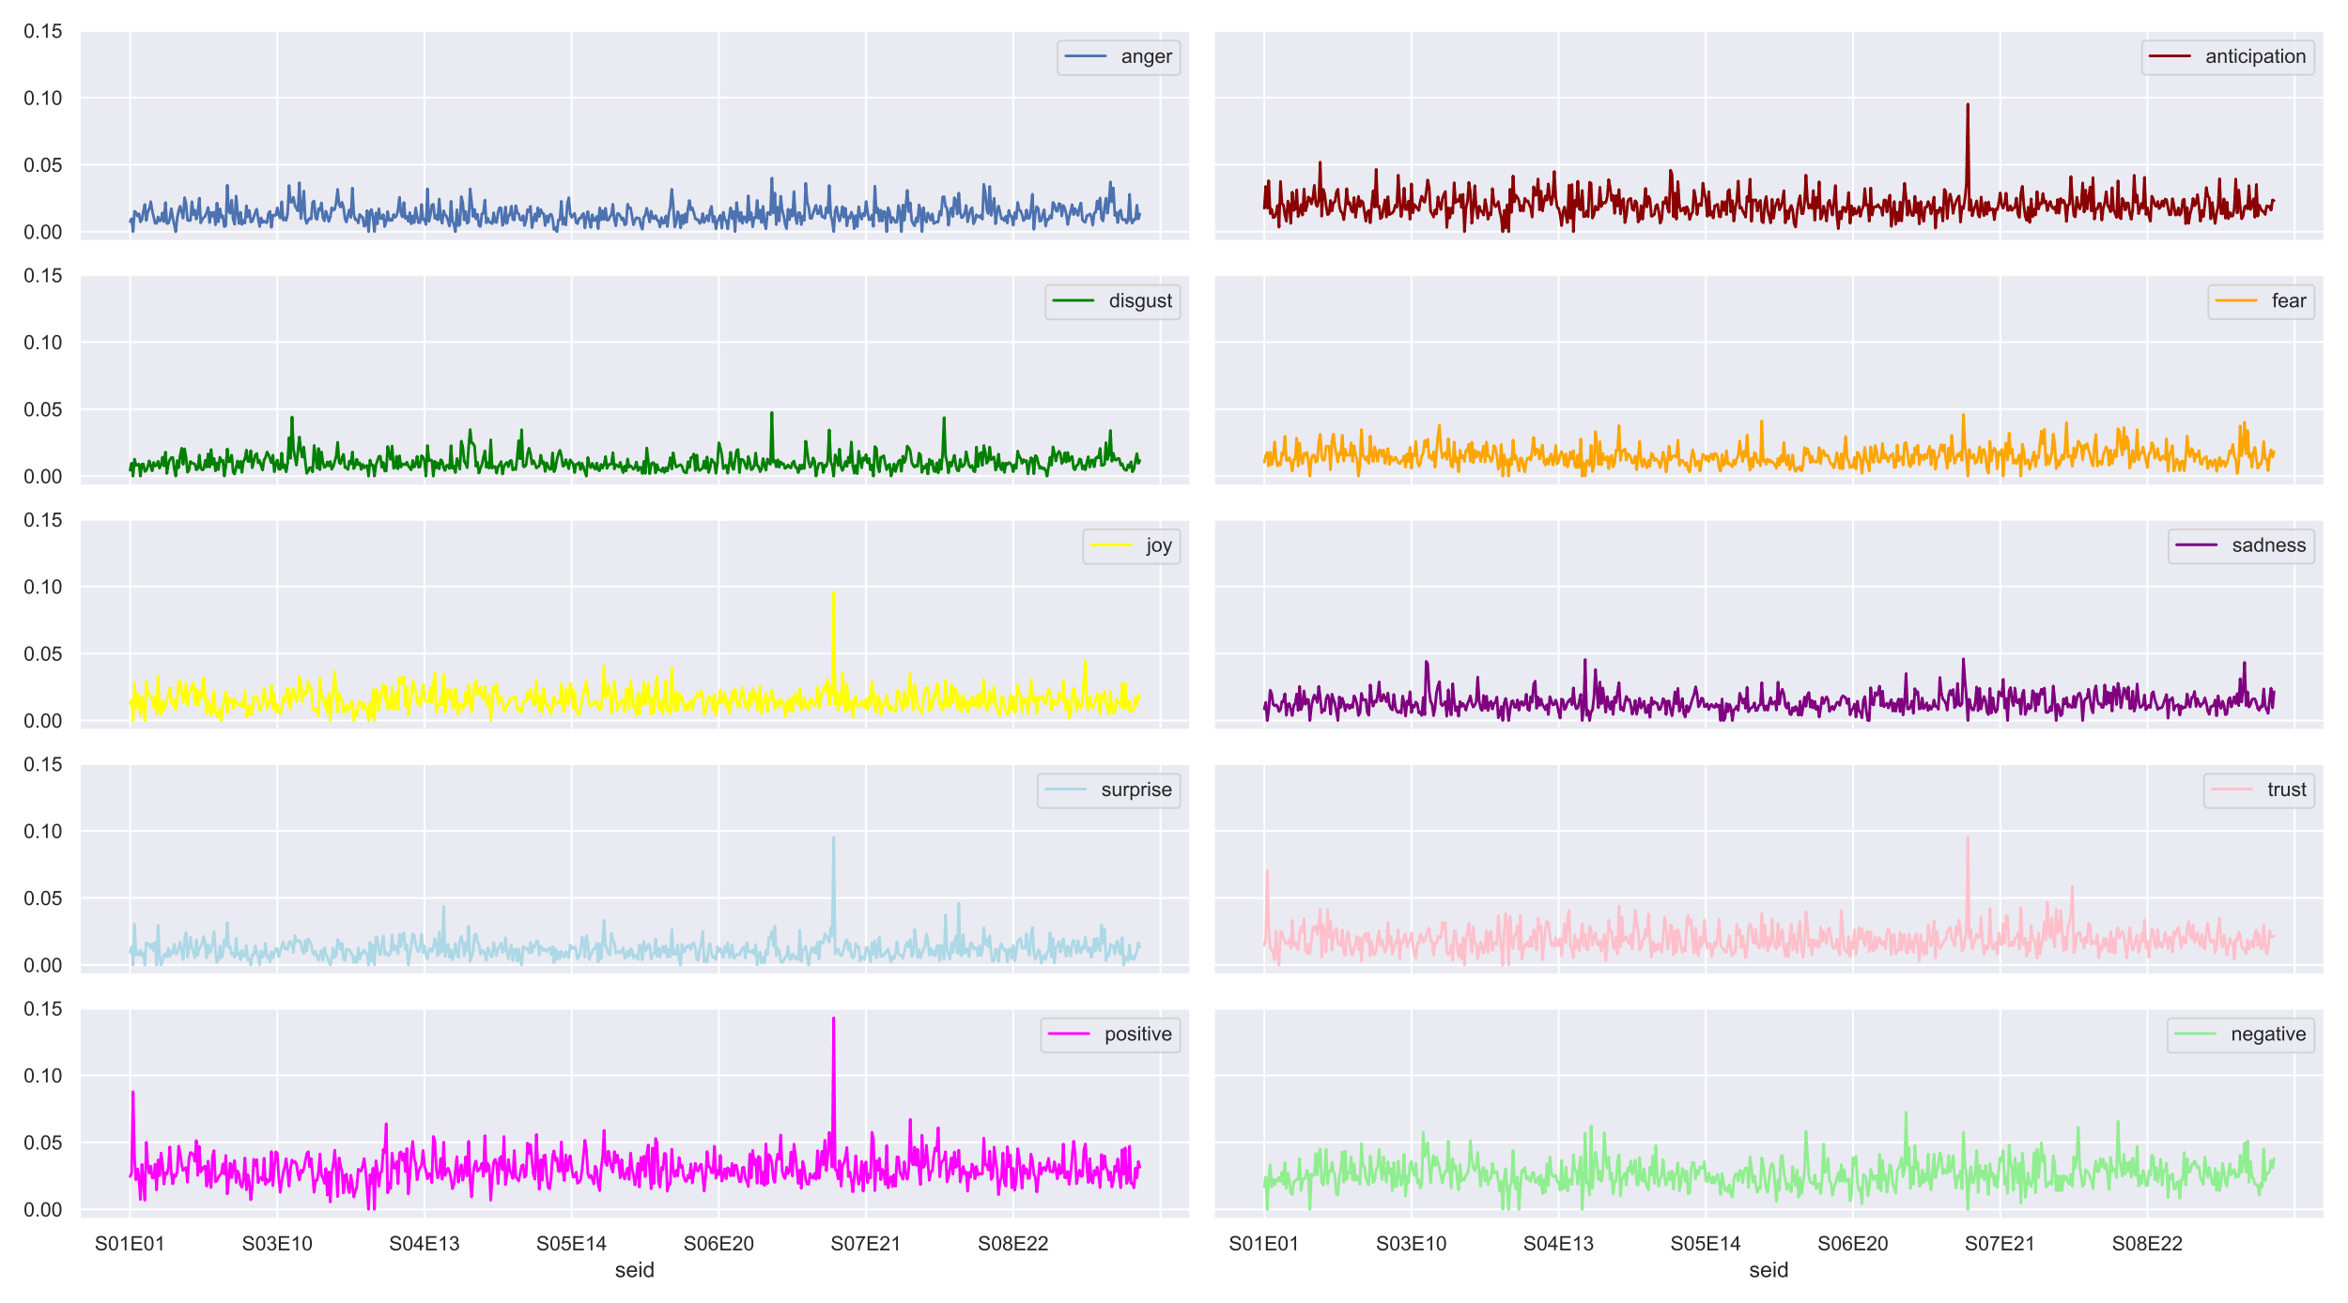
Emotional Analysis
All Characters

Slide 11
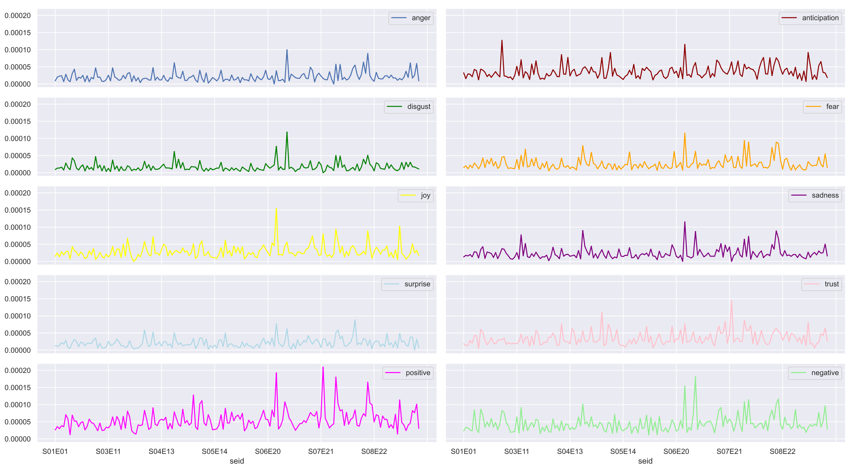
Emotional Analysis
George Costanza

Slide 12
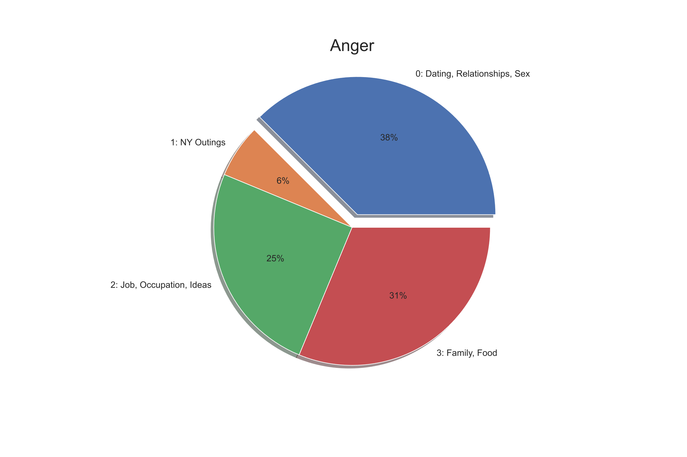
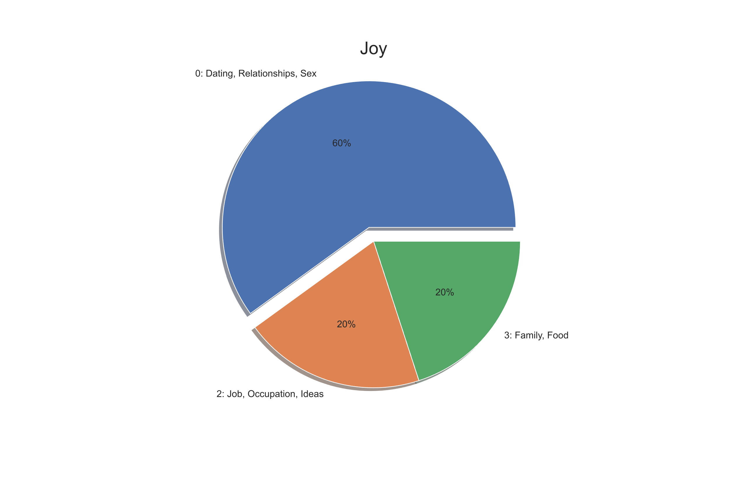
Sentiment by character – episode/season

Slide 13
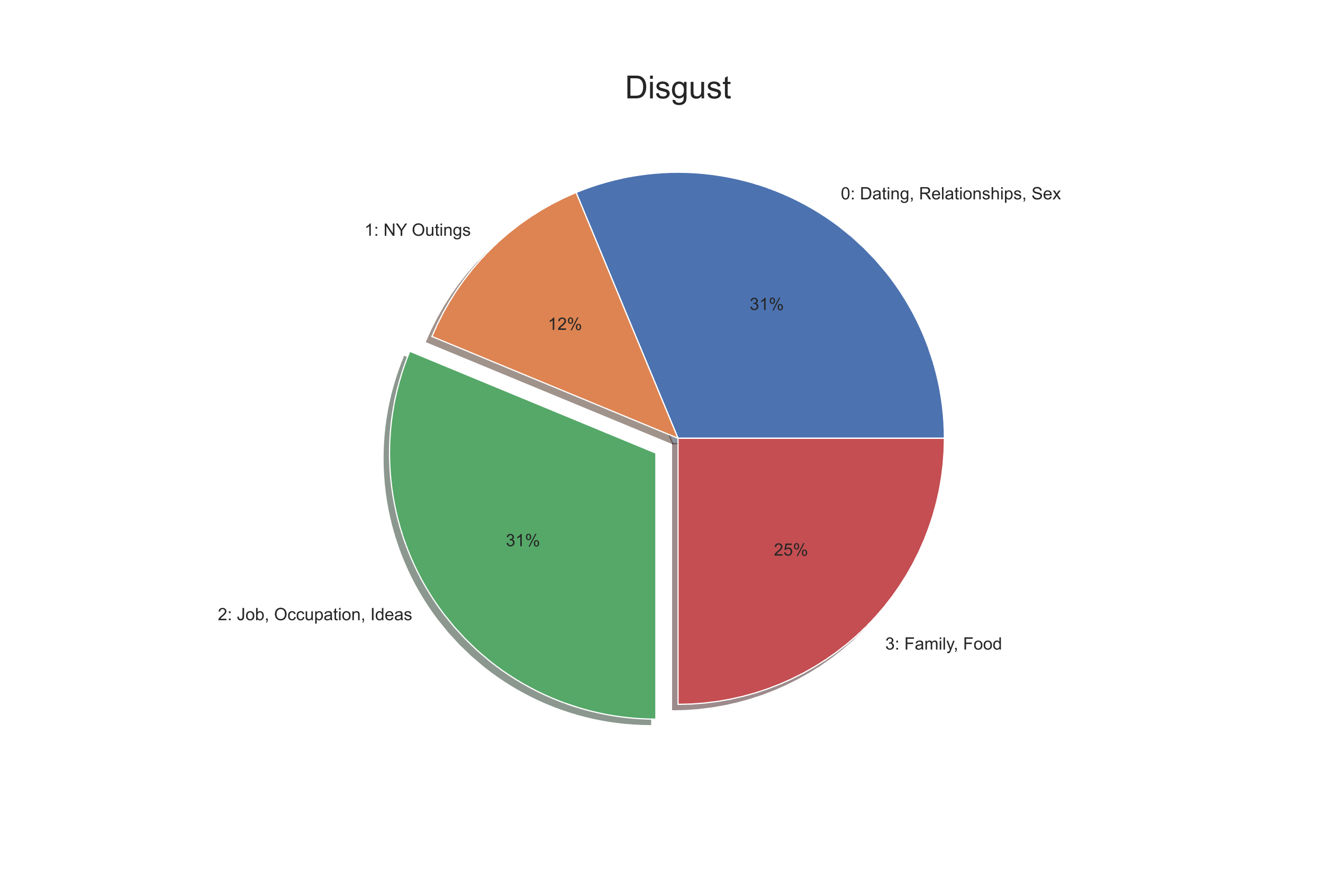
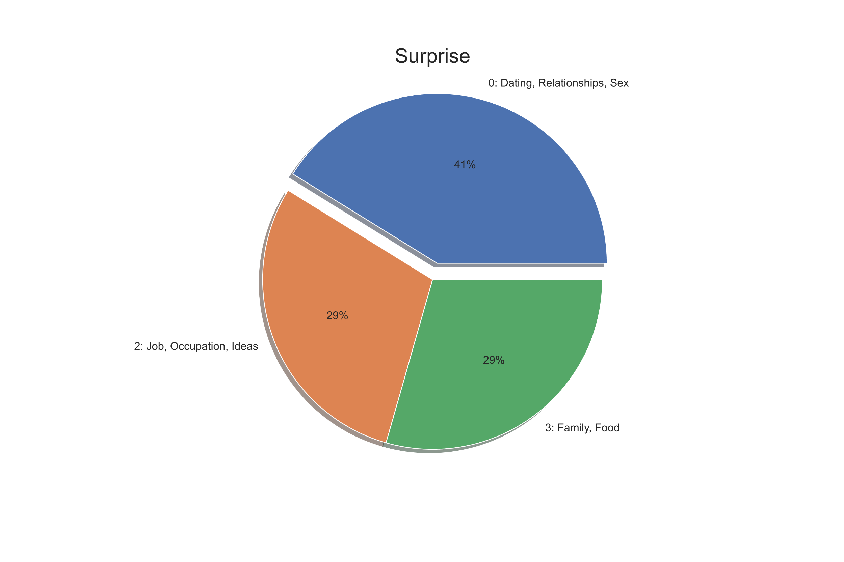
Sentiment by character – episode/season

Slide 14
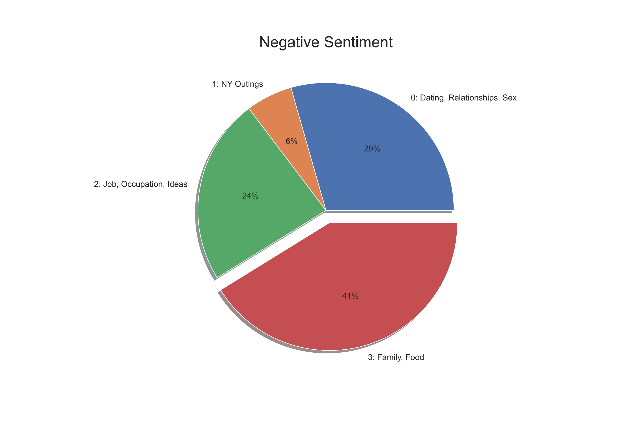
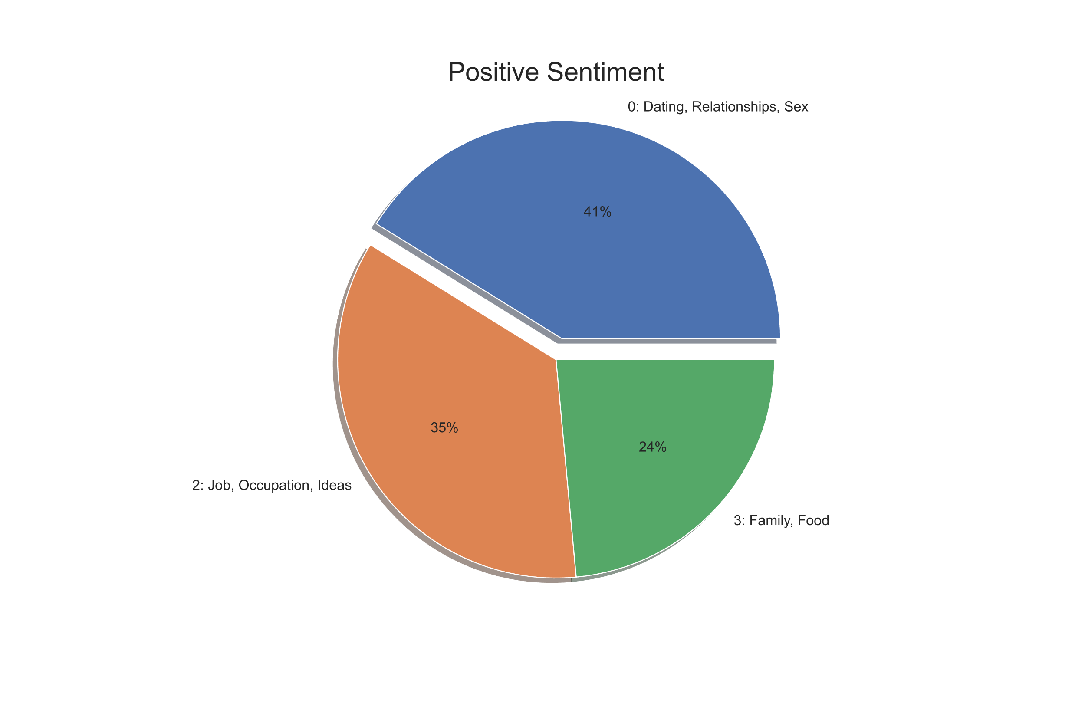
Sentiment by character – episode/season

Slide 15
Costanza word clouds good vs. bad

Slide 16
Costanza – emotion analysis

