Slide 1

Jazz Discovery

Slide 2
Motivations
People’s notion of jazz maybe stuck in early 1900’s when it was dominant pop music.
Modern day, jazz has infused its way into main stream music
Hope is to introduce people to modern jazz as it relates to some of their musical tastes
Word cloud (old) / word cloud (new) OR sub genres (bebop vs. hip hop)
In a lot of jazz you don’t necessarily have lyrics. Therefore the reviewer acts as a proxy of expression of the music (the objective parts)

Slide 3
Agenda

Slide 4
Data & Processes
Phrase matching (genres)

Slide 5
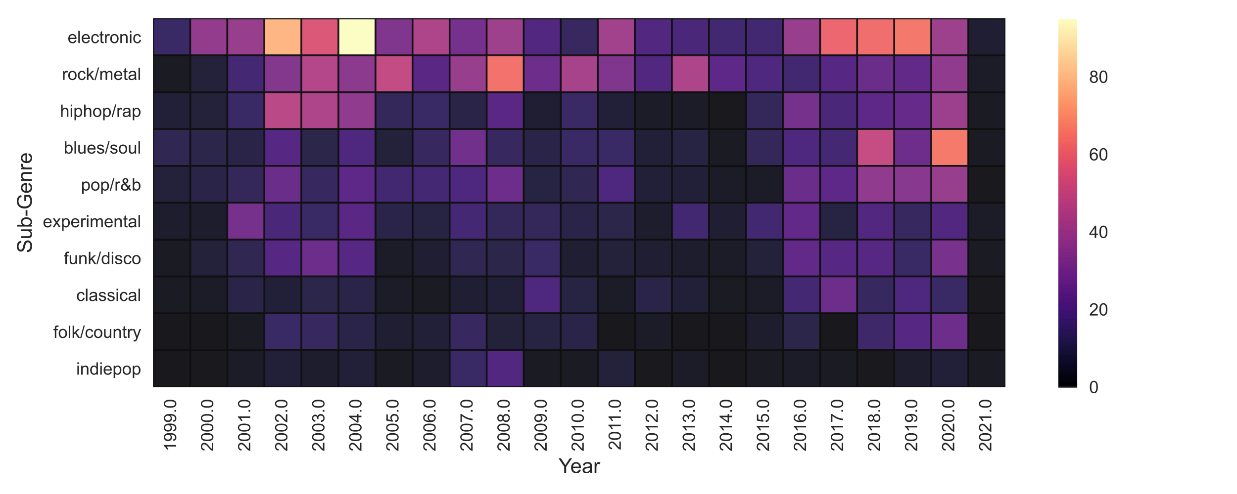
EDA

Slide 6
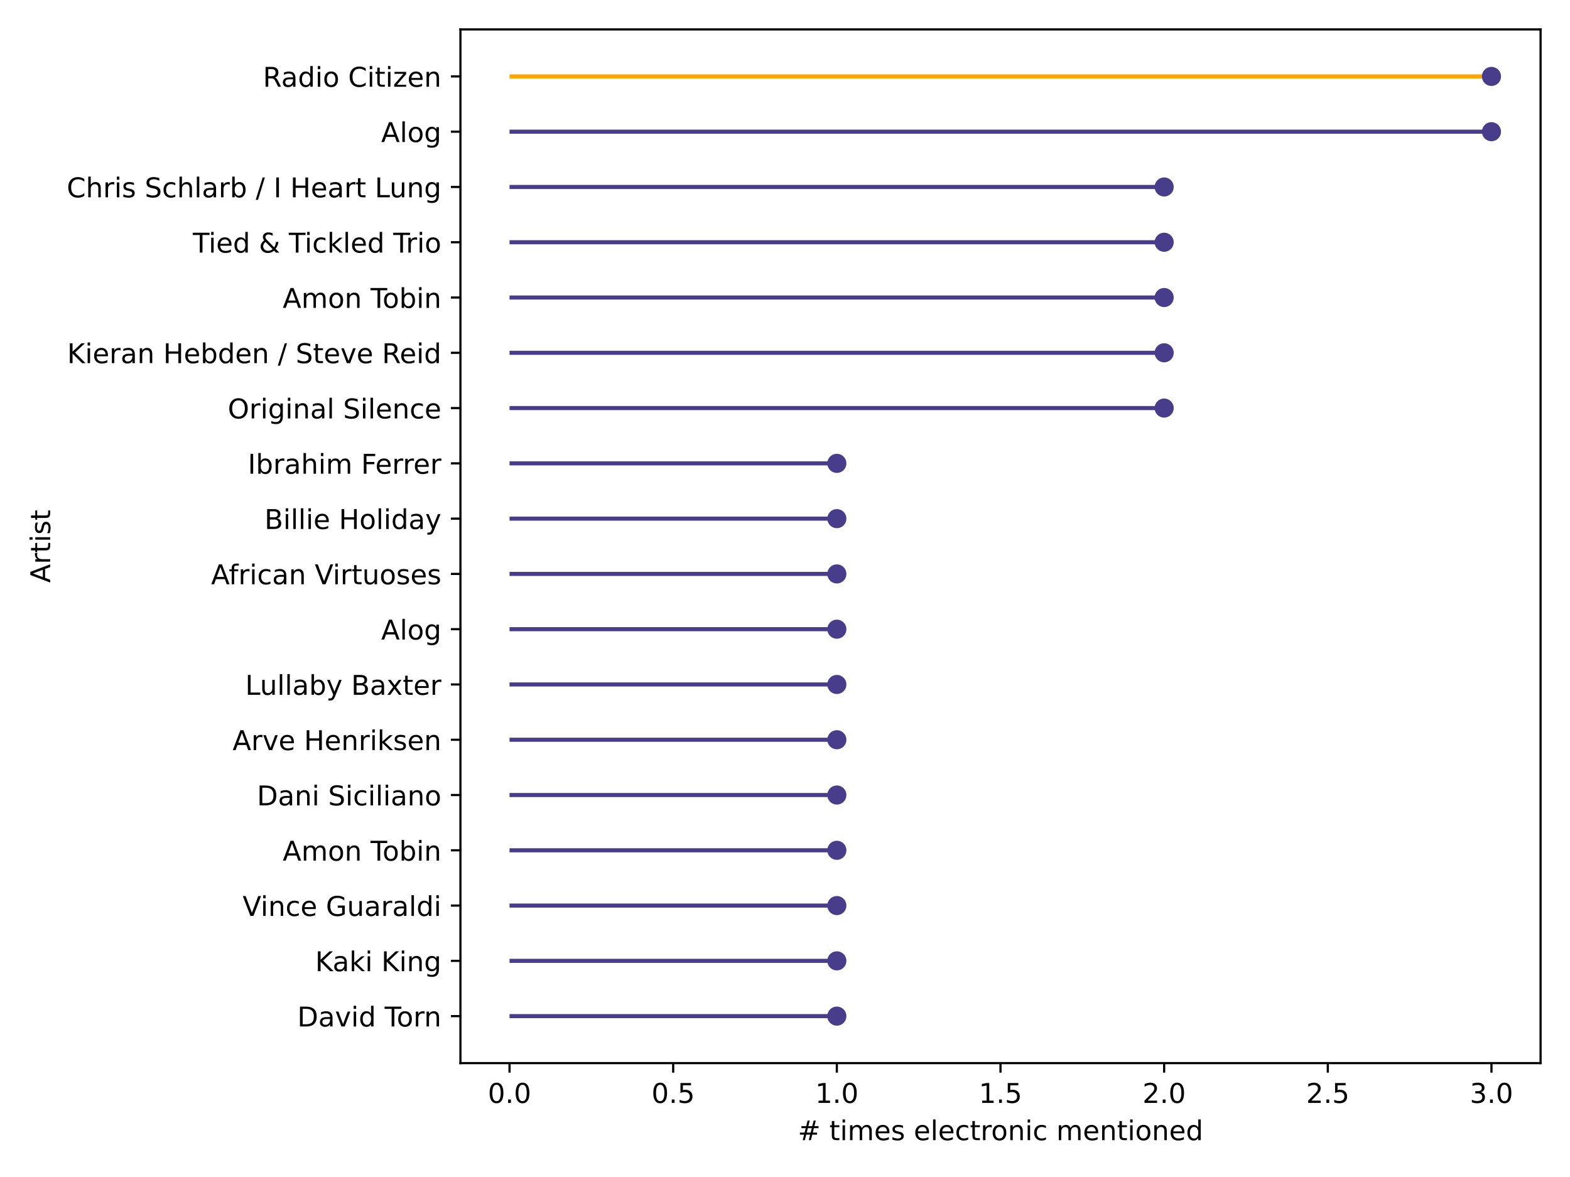
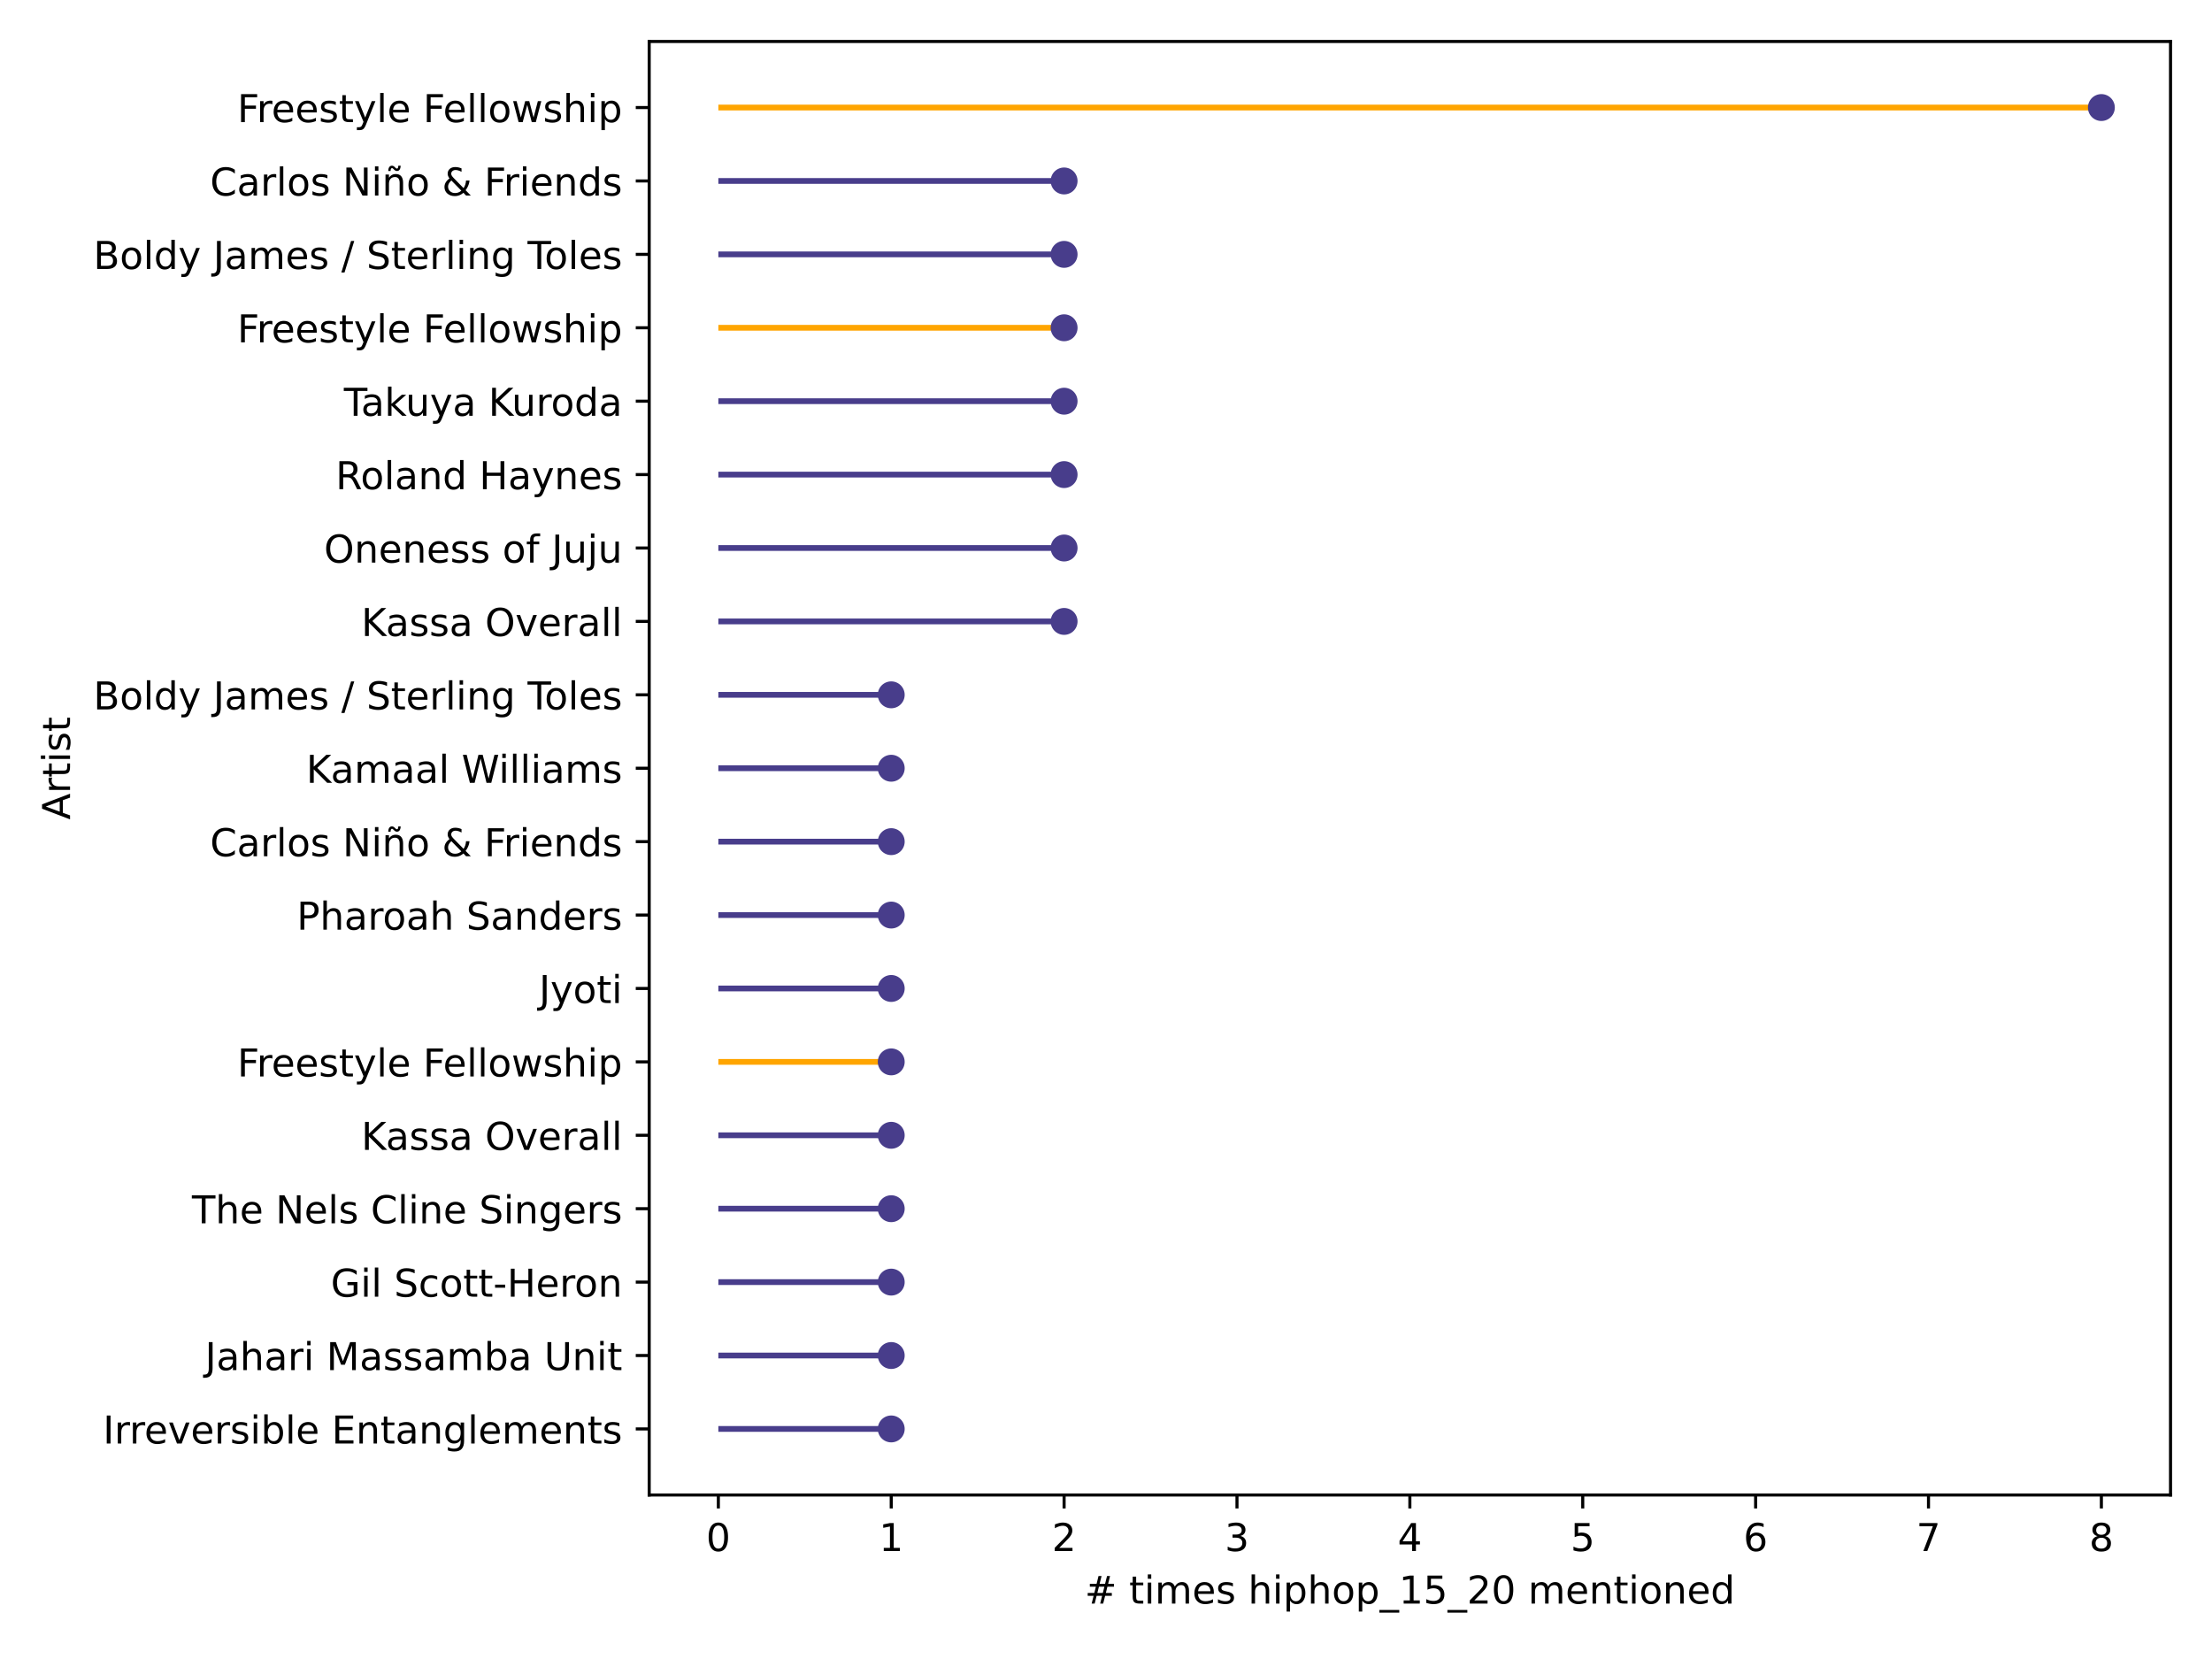
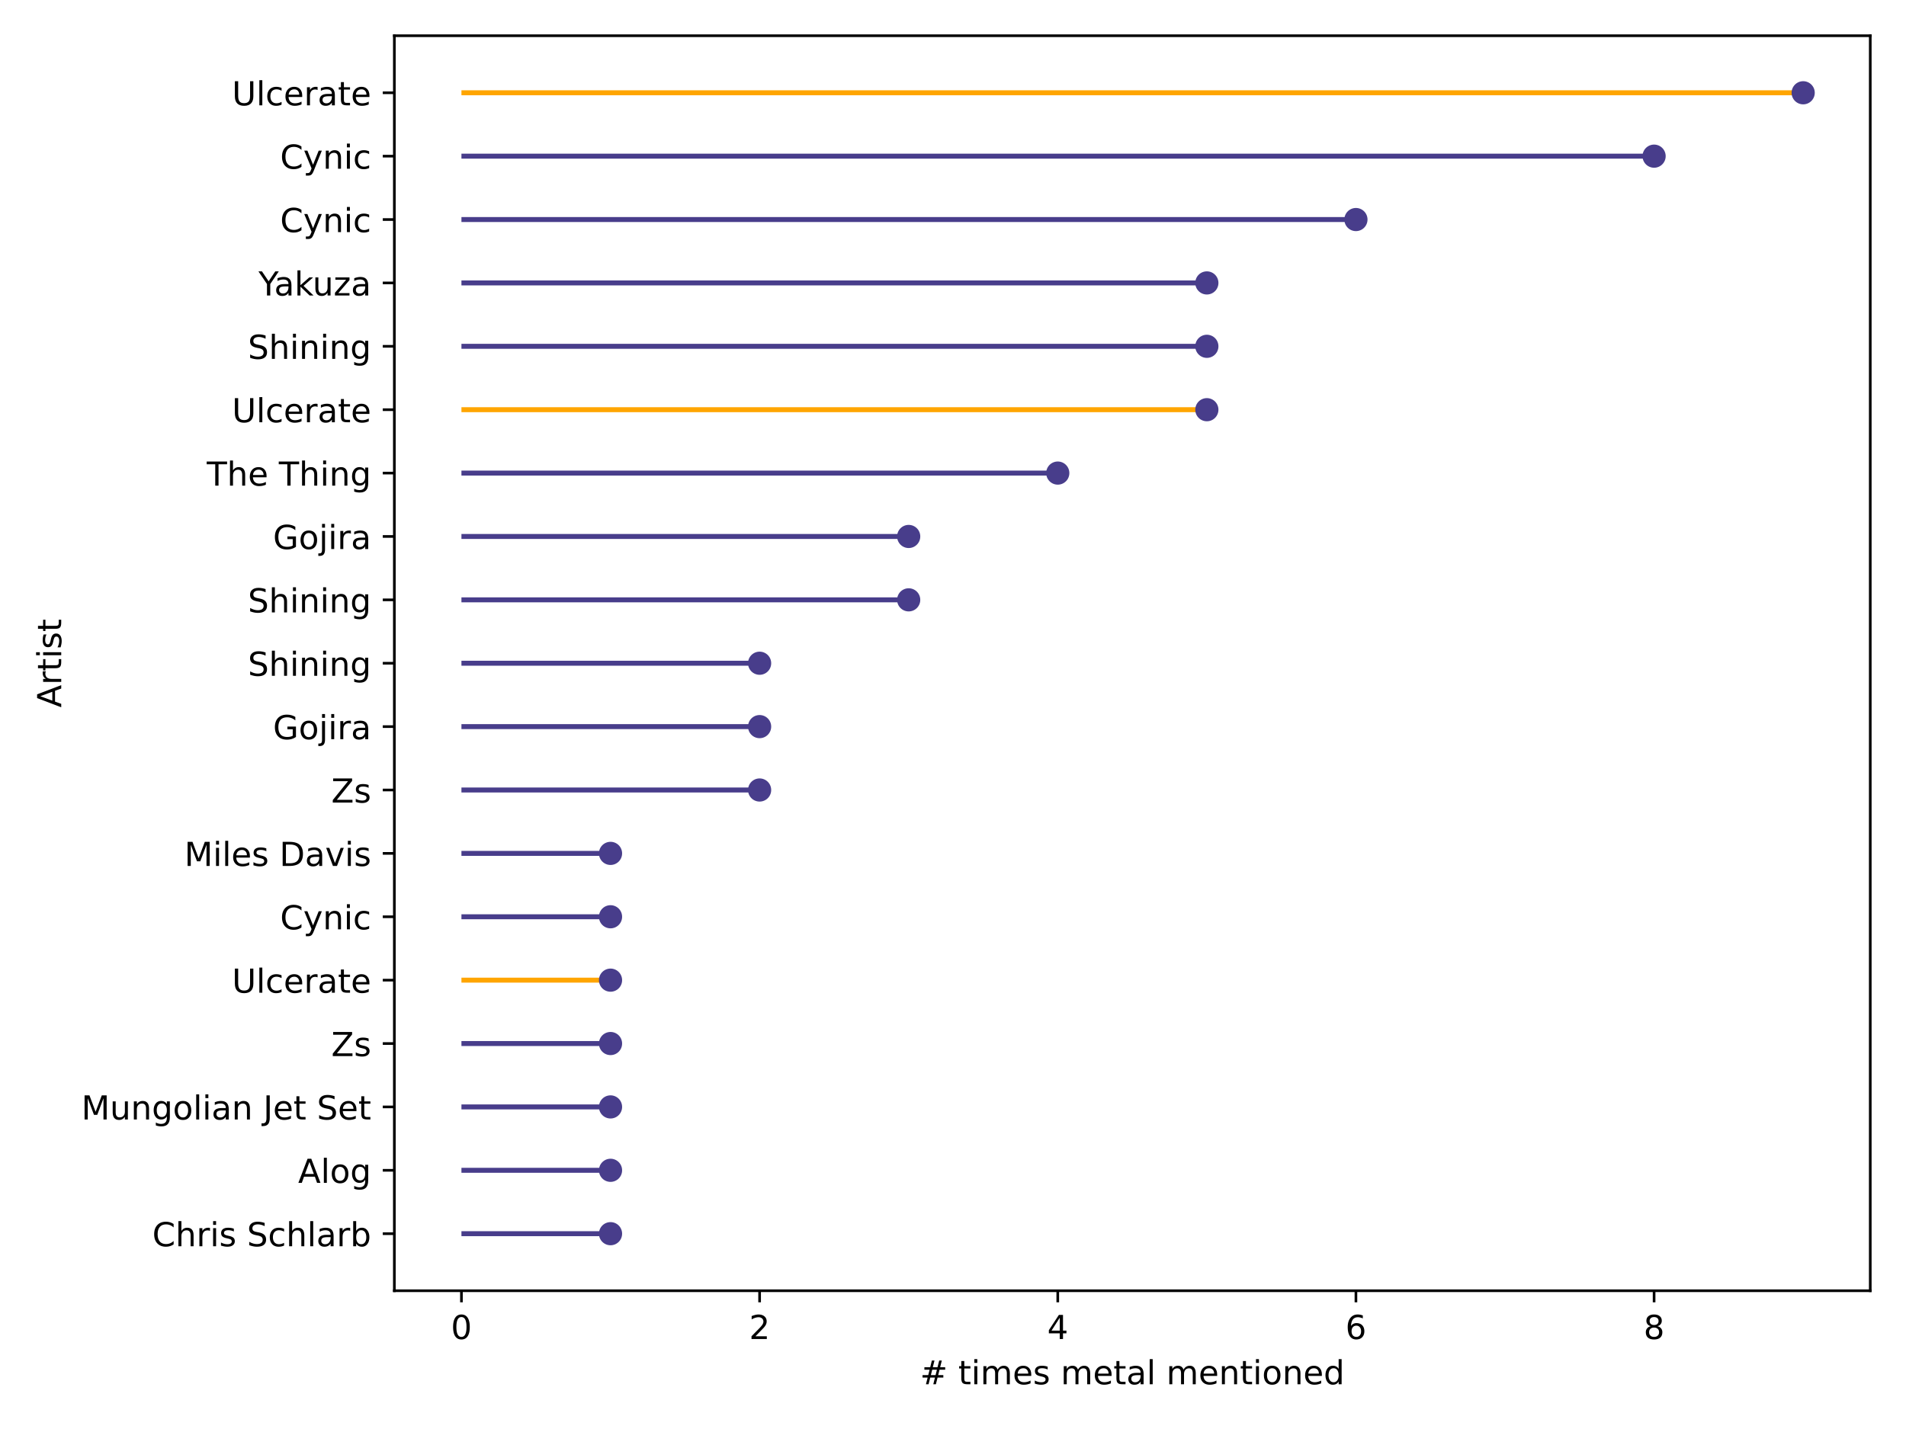
EDA
Timeline: 1999-2008 Electronic; 2009-2014 Rock ; 2015-2021 Hip Hop
Use the color map gradient and a timeline with artists beneath

Slide 7
EDA -
Change gears to originals – mentions in reviews
Interestingly we see miles and Coltrane stand out so much compared even though they’re far removed from the scene
Network graph? Colors based on different subgenres?

Slide 8
Content-based Model
1. Cosine sim – using TF-IDF and Cosine sim
Examples of similar albums
2. Cosine sim - using PCA and Cosine sim
Examples of similar albums

Slide 9
Layer 1: Reviewer words (emotion)
Words of the reviewer can often be a reflection of the reviewer themselves but also the nature of the music

Slide 10
Layer 2: Instruments

Slide 11
TO DO
Radiohead is a vector – aggregate / average – then get similiarities on that
Put 8 into a list – similarities have duplicate votes – strengthen those votes
slides
Provide Context in the slides (somehow in the app)
EDA – overview graph – jazz as a whole
. Infusion of other music into jazz as it transforms over time (how has it transformed) - heatmap
. History of transformation? Artists and quotes by 3 decades – lollipop / wordcloud?
. named entity features (mentions) – has maintained it’s roots as well as influence – network map??
. Check a few primary artists – what subgenre are they mentioned along with
. Maybe spotify (with what we have)
Reviewers
. Subgenre by EMO / Sentiment
Modeling (2 runs)
. PCA
. TF IDF
streamlit
Spotify – audio features
Artist images (last)
Artist audio snippets (last)
Cleanup app as-is
Topic modeling into the viz (instrument selection)
Emotion graph – radar-ish
Audio feature graph – radar-ish

