Slide 1
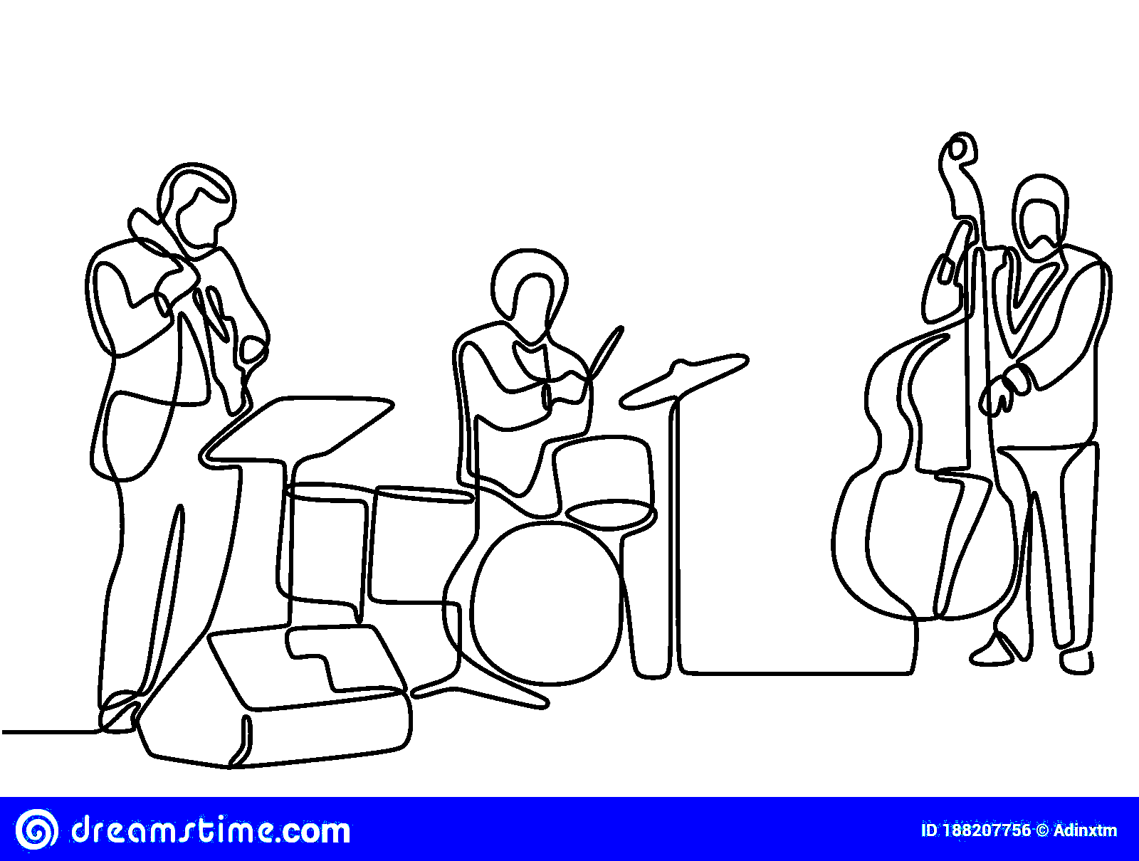
Modern Jazz Discovery Tool

Slide 2
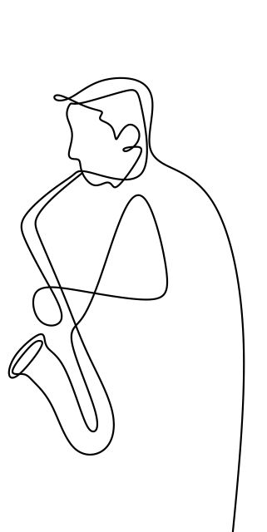
Motivations

Slide 3
Motivations
Enjoyment of DISCOVERY!

Slide 4
Motivations
Enjoyment of DISCOVERY!
How were you introduced to music you love?

Slide 5
Motivations
Enjoyment of DISCOVERY!
How were you introduced to music you love?
Music Industry Machine (Emphasizes Non-Jazz Artists)

Slide 6
Motivations
Enjoyment of DISCOVERY!
How were you introduced to music you love?
Music Industry Machine (Emphasizes Non-Jazz Artists)
Modern Jazz Reviews point out the connections with mainstream music - lending itself to beautiful and artistic expressions

Slide 7
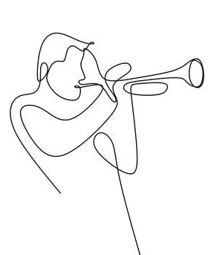
Purpose
Give audiences a tool to discover Modern Jazz Music

Slide 8
Purpose
Give mainstream (non-jazz) audiences a tool to discover Modern Jazz Music
Allowing users to explore connections to music they already know and love

Slide 9
Agenda
Data
1.
Review Insights
2.
Features
3.
Cosine Similarity
Modern Jazz Discovery App

Slide 10
Agenda
Data
1.
Review Insights
2.
Features
3.
Cosine Similarity
Modern Jazz Discovery App

Slide 11
Agenda
Data
1.
Data Insights
2.
Features
3.
Cosine Similarity
Modern Jazz Discovery App

Slide 12
Agenda
Data
1.
Data Insights
2.
Tool Features
3.
Cosine Similarity
Modern Jazz Discovery App

Slide 13
Agenda
Data
1.
Data Insights
2.
Tool Features
3.
Recommender
Modern Jazz Discovery App

Slide 14
Agenda
Data
1.
Data Insights
2.
Tool Features
3.
Recommender
Modern Jazz Discovery App

Slide 15
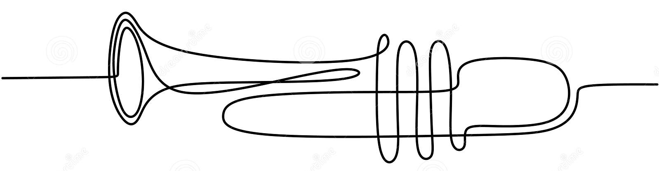
Data

Slide 16
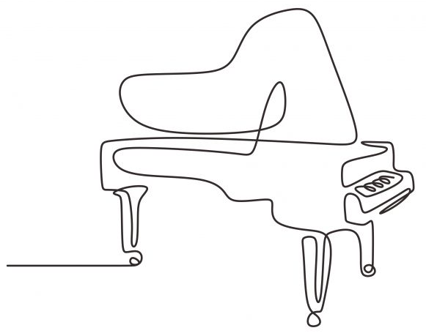
Data
Pitchfork Reviews 1999-2021
~20,000 Pitchfork reviews (~700 Jazz Reviews)
Scraped using Beautiful Soup and Selenium
Spotify Audio Features
Tools used:
python, streamlit scikit-learn, spaCy, NLTK, beautiful soup, selenium networkx, matplotlib, seaborn

Slide 17
1. Data Insights

Slide 18

Sub-Genre Classifying (Phrase Matching)
GENRE
Electronic
Jazz
Blues/Soul
Folk/Country

Slide 19
Sub-Genre Classifying (Phrase Matching)
GENRE
Electronic
Jazz
Blues/Soul
Folk/Country
SUB-GENRE
Down tempo
House
Jazz
Soul
Folk
Minimalism

Slide 20

Sub-Genre Classifying (Phrase Matching)
GENRE
Electronic
Jazz
Blues/Soul
Folk/Country
SUB-GENRE
Down tempo
House
Jazz
Soul
Folk
Minimalism
PITCHFORK REVIEW
“….an artist best known for soulful, worldly down tempo tries his hand at upbeat house…his melodies and live instrumentation hint at a fondness for jazz, soul, folk, and minimalism…” (Pitchfork Review of Bonobo)

Slide 21
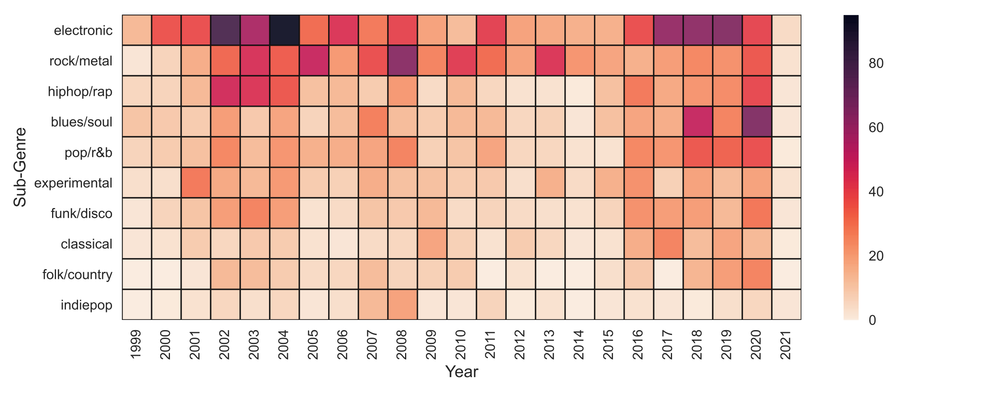
Sub-Genre Mentions Over Time

Slide 22
Sub-Genre Mentions Over Time
St Germain, Thievery Corporation
Radiohead, Wilco
Kendrick Lamar, Tyler the Creator
Top 3

Slide 23
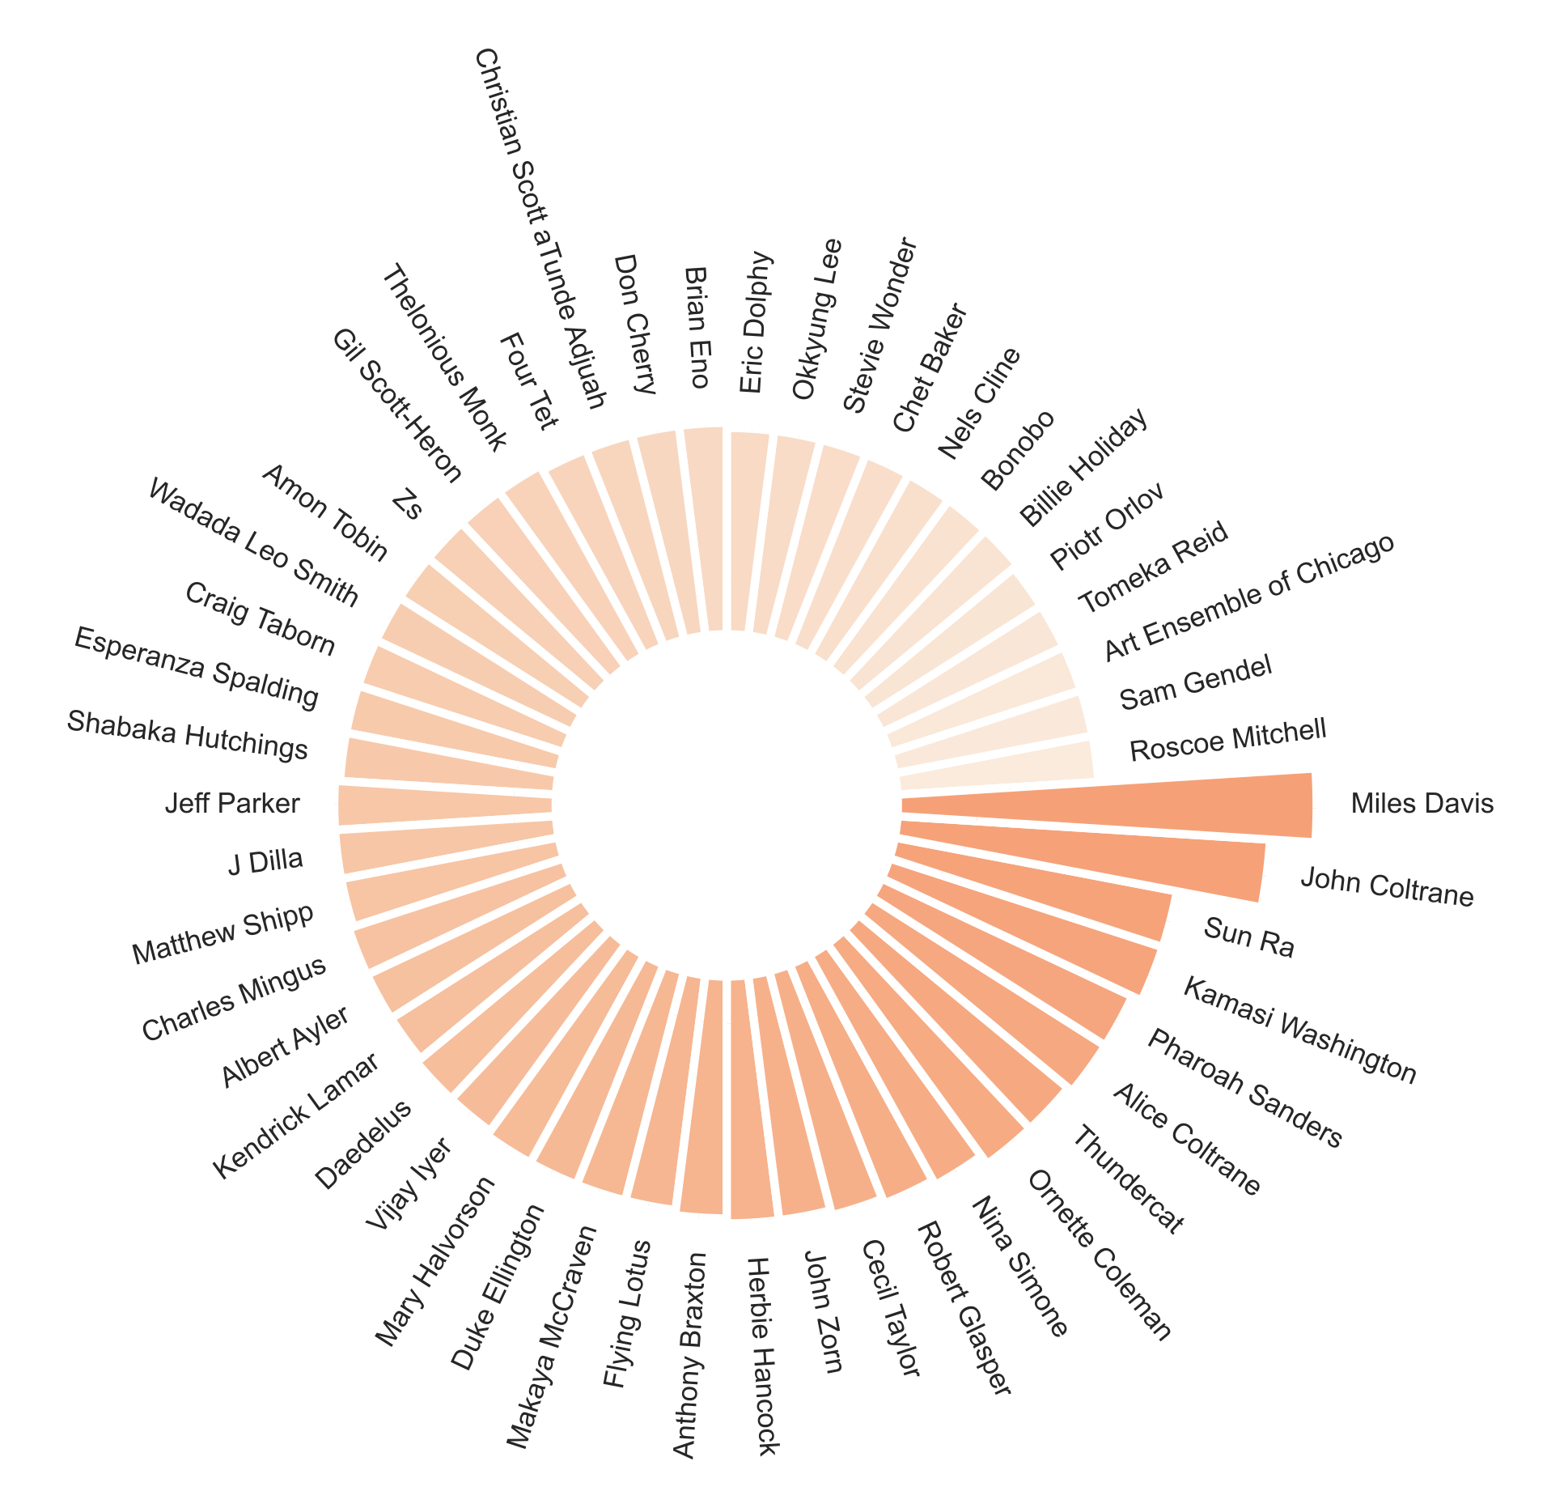
Top 50 Artists most frequently mentioned in reviews

Slide 24
Top 50 Artists most frequently mentioned in reviews

Slide 25
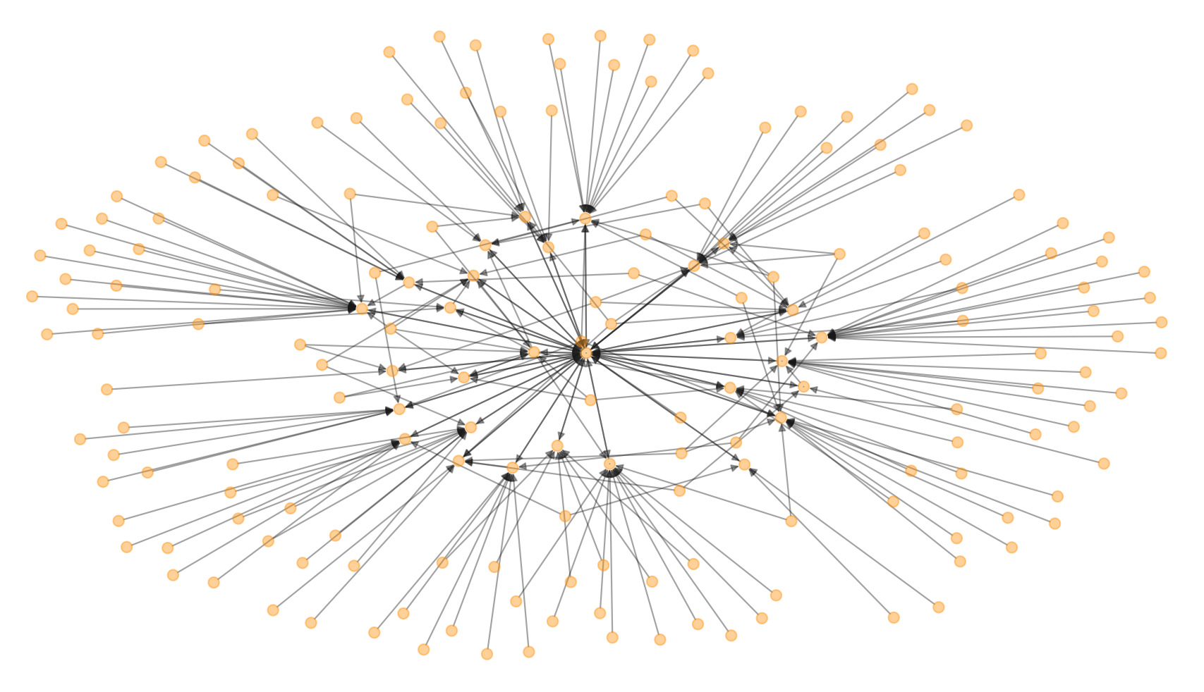
Modern Jazz Influencers (New and Old)
Peter Gabriel
Joey DeFrancesco
Beastie Boys
Miles Davis
Steely Dan
Funkadelic
Pete Rock
Robert Glasper
Kaytranada
9th Wonder
Questlove
Black Milk / Nat Turner
Sonic Youth
Wilco
Danger Mouse

Slide 26
2. Tool Features

Slide 27
NMF Topic Modeling: Instruments
1: piano, piece, composition, quartet, trumpet, solo, melody
2. beat, hiphop, track, sample, dj, drum, mix, rap, bass, production
3. guitar, rock, sound, noise, guitarist, solo, melody, drum
4. horns, voice, singer, life, love, soul, people, day, world
5. experimental, metal, death, riff, fusion, saxophone, eye, drum
6. classic, studio, record, session, performance, version, concert, tune
7. fusion, group, member, guitarist, saxophonist, cover
8. cinematic, film, soundtrack, score, world, cut, earth, percussion

Slide 28
NMF Topic Modeling: Instruments
1: piano, piece, composition, quartet, trumpet, solo, melody
2. beat, hiphop, track, sample, dj, drum, mix, rap, bass, production
3. guitar, rock, sound, noise, guitarist, solo, melody, drum
4. horns, voice, singer, life, love, soul, people, day, world
5. experimental, metal, death, riff, fusion, saxophone, eye, drum
6. classic, studio, record, session, performance, version, concert, tune
7. fusion, group, member, guitarist, saxophonist, cover
8. cinematic, film, soundtrack, score, world, cut, earth, percussion

Slide 29
NMF Topic Modeling: Instruments
1: piano, piece, composition, quartet, trumpet, solo, melody
2. beat, hiphop, track, sample, dj, drum, mix, rap, bass, production
3. guitar, rock, sound, noise, guitarist, solo, melody, drum
4. horns, voice, singer, life, love, soul, people, day, world
5. experimental, metal, death, riff, fusion, saxophone, eye, drum
6. classic, studio, record, session, performance, version, concert, tune
7. fusion, group, member, guitarist, saxophonist, cover
8. cinematic, film, soundtrack, score, world, cut, earth, percussion

Slide 30
NMF Topic Modeling: Instruments
1: piano, piece, composition, quartet, trumpet, solo, melody
2. beat, hiphop, track, sample, dj, drum, mix, rap, bass, production
3. guitar, rock, sound, noise, guitarist, solo, melody, drum
4. horns, voice, singer, life, love, soul, people, day, world
5. experimental, metal, death, riff, fusion, saxophone, eye, drum
6. classic, studio, record, session, performance, version, concert, tune
7. fusion, group, member, guitarist, saxophonist, cover
8. cinematic, film, soundtrack, score, world, cut, earth, percussion

Slide 31
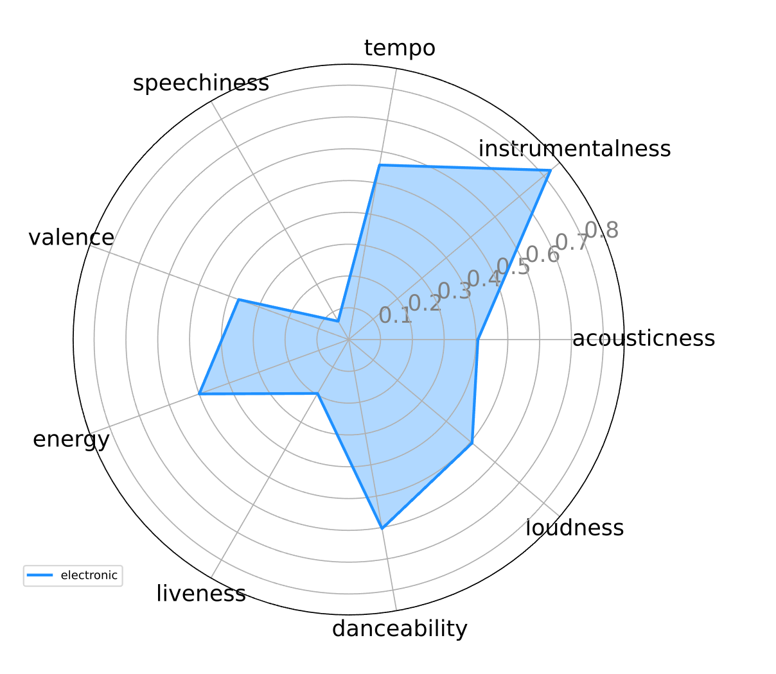
Spotify Audio Features
Electronic: Bonobo (Animal Magic)

Slide 32
3. Recommendation System

Slide 33
Recommendation System (Content-Based)
TF-IDF Vectorizer (Reviews)

Slide 34
Recommendation System (Content-Based)
TF-IDF Vectorizer (Reviews)
Cosine Similarity

Slide 35
Recommendation System (Content-Based)
TF-IDF Vectorizer (Reviews)
Cosine Similarity
Cosine Similarity | Album | Artist
1.000 | Day Breaks | Norah Jones
0.168 | Swiss Radio Days Vol. 41 – Zurich 1961 | Ray Charles
0.132 | Artscience | Robert Glasper Experiment
0.108 | Harmony of Difference EP | Kamasi Washington

Slide 36
Recommendation System (Content-Based)
TF-IDF Vectorizer (Reviews)
Cosine Similarity
Cosine Similarity | Album | Artist
1.000 | Day Breaks | Norah Jones
0.168 | Swiss Radio Days Vol. 41 – Zurich 1961 | Ray Charles
0.132 | Artscience | Robert Glasper Experiment
0.108 | Harmony of Difference EP | Kamasi Washington

Slide 37
Recommendation System (Content-Based)
TF-IDF Vectorizer (Reviews)
Cosine Similarity
Cosine Similarity | Album | Artist
1.000 | Day Breaks | Norah Jones
0.168 | Swiss Radio Days Vol. 41 – Zurich 1961 | Ray Charles
0.132 | Artscience | Robert Glasper Experiment
0.108 | Harmony of Difference EP | Kamasi Washington
“Country music”
“Honky-Tonk”

Slide 38
Recommendation System (Content-Based)
TF-IDF Vectorizer (Reviews)
Cosine Similarity
Cosine Similarity | Album | Artist
1.000 | Day Breaks | Norah Jones
0.168 | Swiss Radio Days Vol. 41 – Zurich 1961 | Ray Charles
0.132 | Artscience | Robert Glasper Experiment
0.108 | Harmony of Difference EP | Kamasi Washington
“Country music”
“Honky-Tonk”
“Career”

Slide 39
Recommendation System (Content-Based)
TF-IDF Vectorizer (Reviews)
Cosine Similarity
Cosine Similarity | Album | Artist
1.000 | Day Breaks | Norah Jones
0.168 | Swiss Radio Days Vol. 41 – Zurich 1961 | Ray Charles
0.132 | Artscience | Robert Glasper Experiment
0.108 | Harmony of Difference EP | Kamasi Washington
“Country music”
“Honky-Tonk”
“Career”
“Singer”
“Voice”

Slide 40
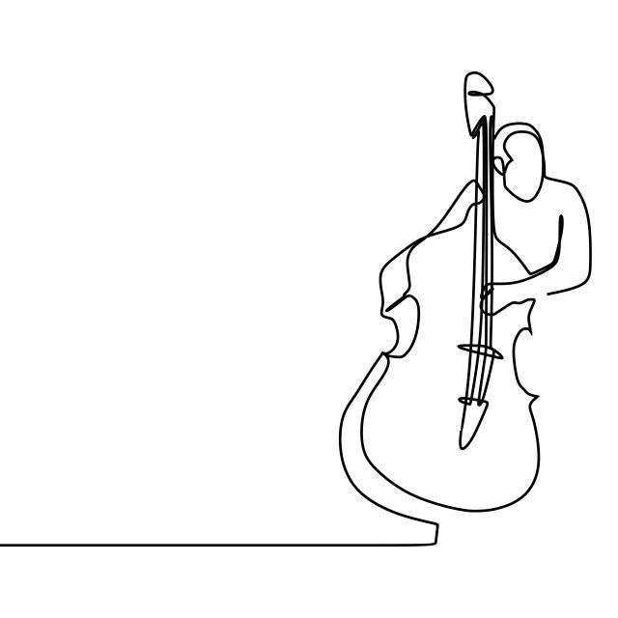
Thank You

Slide 41
Appendix

Slide 42
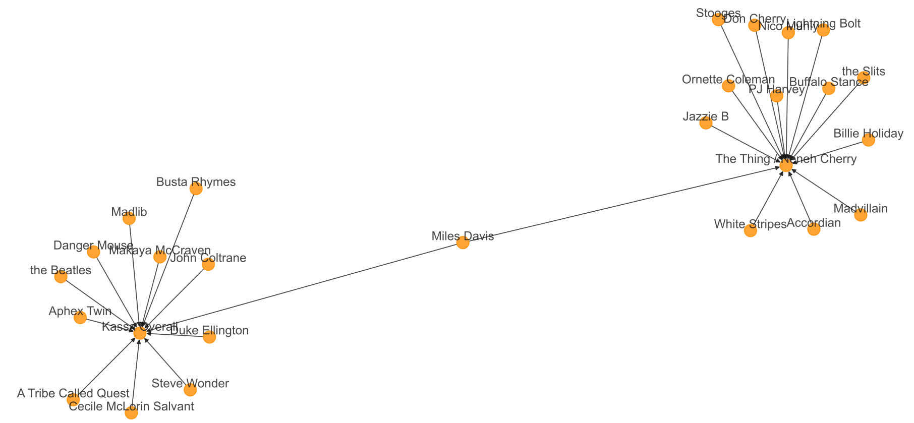
Modern Jazz Influencers (New and Old)

Slide 43
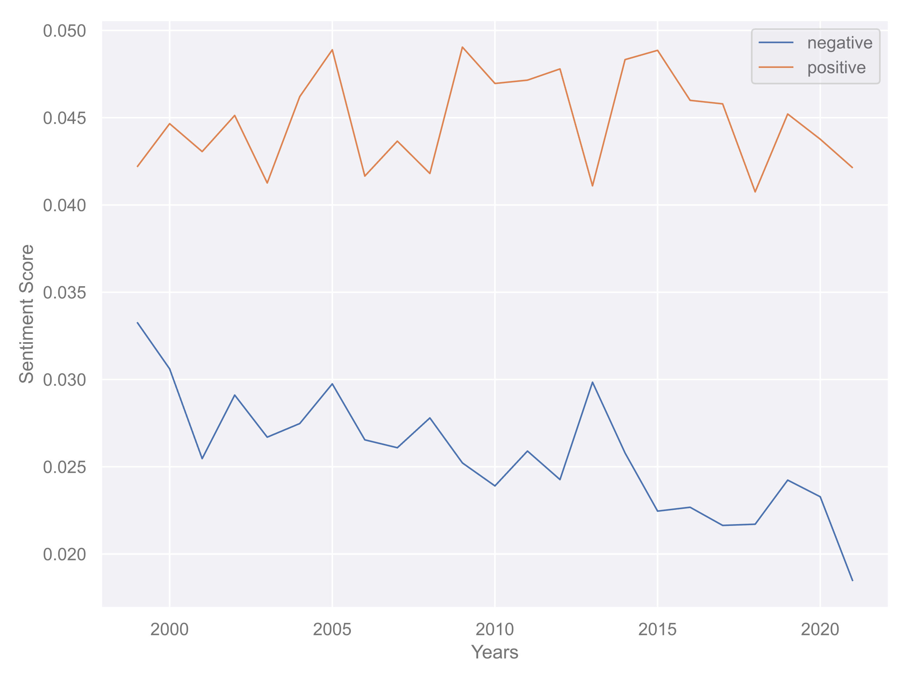
Sentiment Analysis: Pitchfork Jazz Reviews
Positive Sentiment
– no change
Negative Sentiment
– decreasing

Slide 44
Sub-Genre Classifying (Phrase Matching)
“….an artist best known for soulful, worldly down tempo tries his hand at upbeat house…his melodies and live instrumentation hint at a fondness for jazz, soul, folk, and minimalism…” (Pitchfork Review of Bonobo)

Slide 45
Sub-Genre Classifying (Phrase Matching)
“….an artist best known for soulful, worldly down tempo tries his hand at upbeat house…his melodies and live instrumentation hint at a fondness for jazz, soul, folk, and minimalism…” (Pitchfork Review of Bonobo)
Down tempo
House
Jazz
Soul
Folk
Minimalism

Slide 46
TO DO
Radiohead is a vector – aggregate / average – then get similiarities on that
Put 8 into a list – similarities have duplicate votes – strengthen those votes
slides
Provide Context in the slides (somehow in the app)
EDA – overview graph – jazz as a whole
. Infusion of other music into jazz as it transforms over time (how has it transformed) - heatmap
. History of transformation? Artists and quotes by 3 decades – lollipop / wordcloud?
. named entity features (mentions) – has maintained it’s roots as well as influence – network map??
. Check a few primary artists – what subgenre are they mentioned along with
. Maybe spotify (with what we have)
Reviewers
. Subgenre by EMO / Sentiment
Modeling (2 runs)
. PCA
. TF IDF
streamlit
Spotify – audio features
Artist images (last)
Artist audio snippets (last)
Cleanup app as-is
Topic modeling into the viz (instrument selection)
Emotion graph – radar-ish
Audio feature graph – radar-ish

Slide 47
. Eras, what’s the point
. Years – remove decimal
. Circle bar – highlight miles/Coltrane in different way
. Sentiment score – what’s the correct scale
. Min/max df – remove
. Radar – remove labels
. Remove rank colors in topic mod and jazz discovery lists
. Keep headers consistent
. Recommender – include album artwork
. Divider don’t use plus – use drop line
. Cutout slides @ 820
. Network graph – pick 1 or 2 and show artists
. Remove EDA from headlines
. Lots of content – show workflow of how they all come together

