Slide 1

Modern Jazz Discovery Tool

Slide 2
Motivations
Enjoyment of DISCOVERY!
How were you introduced to music you love?
Music Industry Machine
Cross breeding of Traditional Jazz and Mainstream music lends itself to beautiful and artistic expressions

Slide 3
Motivations
Purpose
PURPOSE: Give mainstream (non-jazz) audiences a tool to discover Modern Jazz Music
Allowing users to explore connection to music they already know and love

Slide 4
Agenda
Data & Processes
EDA
Modeling
Modern Jazz Discovery Tool

Slide 5
Data & Processes
Data
Pitchfork Reviews 1999-2021
Scraped using Beautiful Soup
Spotify Audio Features
Processes
Topic Modeling (NMF)
Sentiment / Emotions
NRC Lexicon
TF-IDF – Cosine Similarity

Slide 6


Data & Processes
….an artist best known for soulful, worldly downtempo tries his hand at upbeat house…his melodies and live instrumentation hint at a fondness for jazz, soul, folk, and minimalism…
Downtempo
House
Jazz
Soul
Folk
Minimalism
Electronic
Jazz
Blues/Soul
Folk/Country

Slide 7
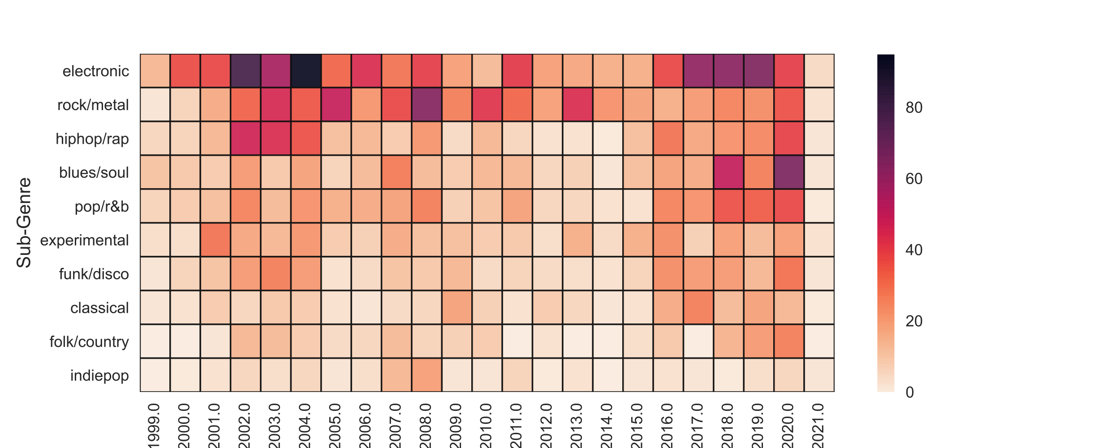
EDA: Pitchfork Review Timeline by Sub-genre

Slide 8
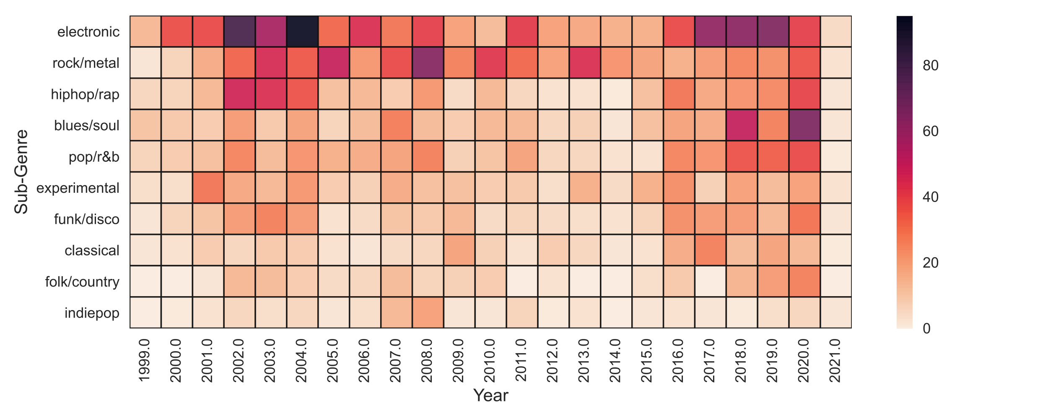
EDA: Pitchfork Review Timeline by Sub-genre
St Germain
Thievery Corporation
Electronic Era
“…jazztronica, is a genre of jazz and electronic music. The term was coined in the late 1990s to refer to music that blends jazz elements with other musical styles…”
(source: Wikipedia)

Slide 9
EDA: Pitchfork Review Timeline by Sub-genre
Radiohead
Wilco
Electronic Era
Rock Era
“…When someone says Radiohead, most think of an ‘alternative’ rock band…the reality is, Radiohead in many ways functions like jazz fusion bands...”

Slide 10
EDA: Pitchfork Review Timeline by Sub-genre
Kendrick Lamar
Flying Lotus
Electronic Era
Rock Era
Hip Hop Era
“…Jazz musicians…collaborate with Kendrick Lamar; The Internet, which spun off from Odd Future…incorporates jazz elements into their music; the label Brainfeeder, purveyor of underground cool, releases jazz-tinged records from Thundercat and label boss Flying Lotus…”

Slide 11
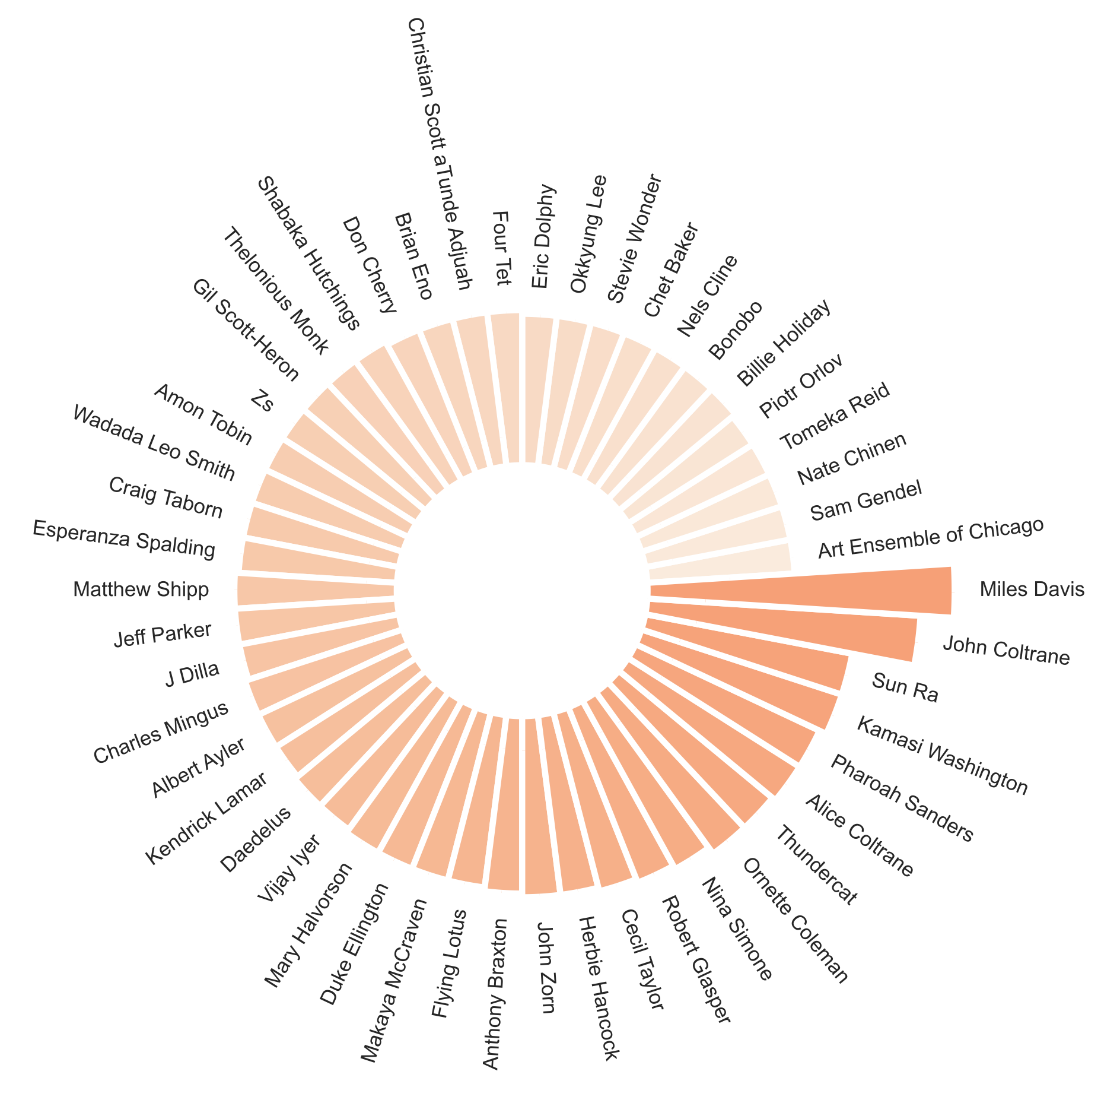
EDA: Top 40 Artists most frequently mentioned in reviews

Slide 12
EDA: Top 40 Artists most frequently mentioned in reviews

Slide 13
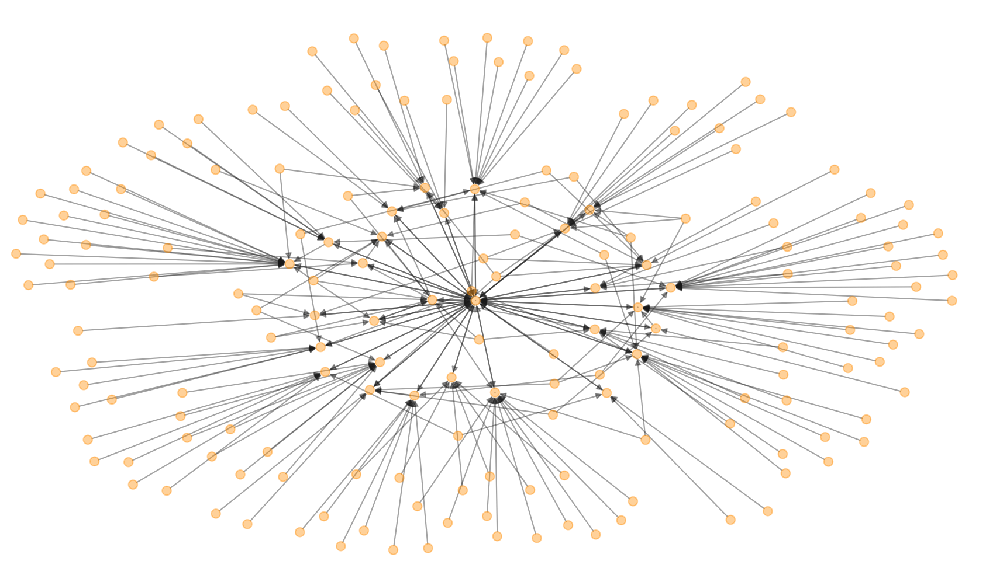
EDA -

Slide 14
Layer 1: Reviewer words (emotion)
Words of the reviewer can often be a reflection of the reviewer themselves but also the nature of the music
Graph emotion/sentiment of reviews over time
Either chord or ridgeline – else lines

Slide 15
Layer 2: Instruments
Representation of words and instruments as topics
These are used as descriptives for the audience to understand the nature of the album

Slide 16
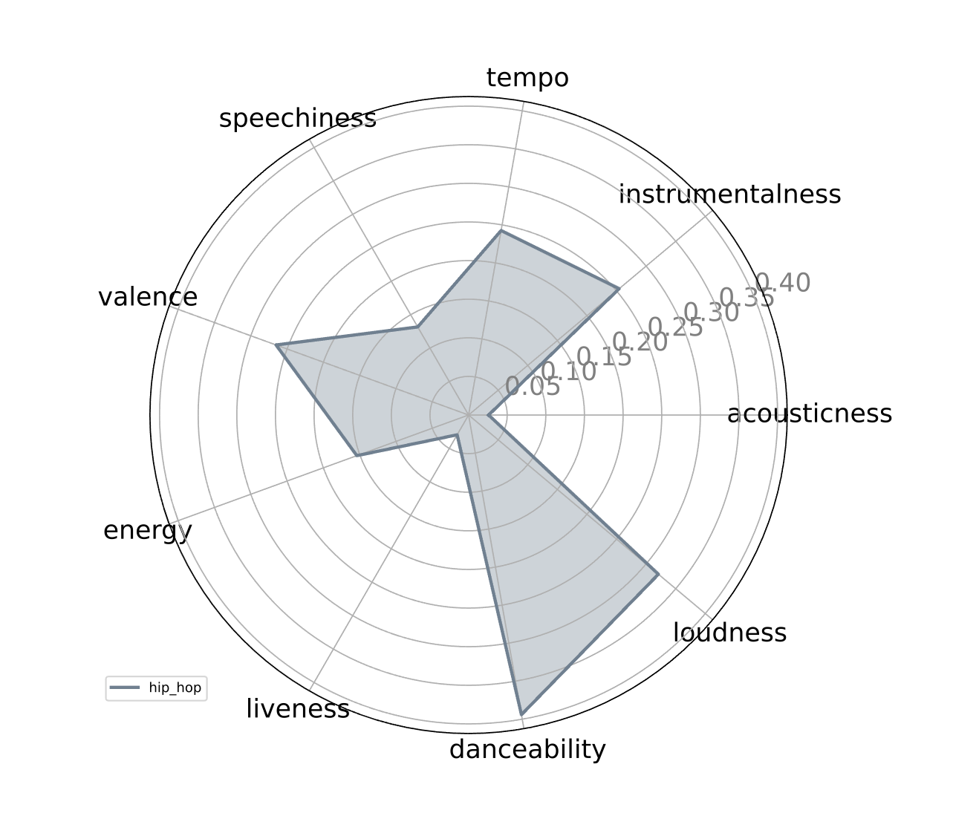
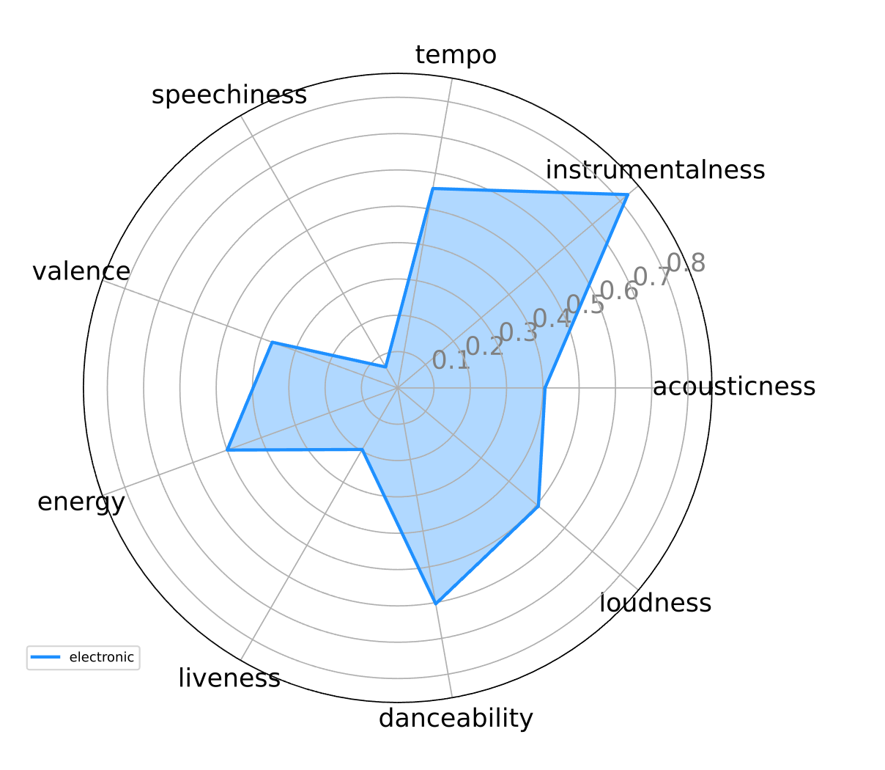
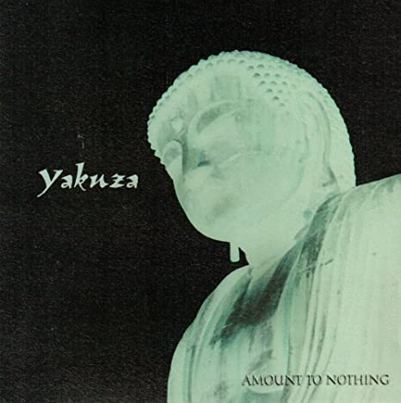
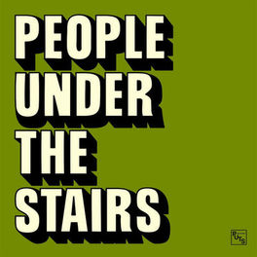
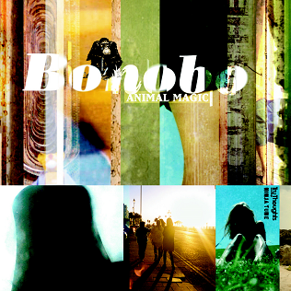
Audio Features
Rock/Metal: Yakuza (Transmutations)
Hip Hop/Rap: People Under the Stairs (O.S.T)
Electronic: Bonobo (Animal Magic)

Slide 17
Content-based Model
1. Cosine sim – using TF-IDF and Cosine sim
Examples of similar albums
2. Cosine sim - using PCA and Cosine sim
Examples of similar albums
Some images to show how similarity works

Slide 18
TO DO
Radiohead is a vector – aggregate / average – then get similiarities on that
Put 8 into a list – similarities have duplicate votes – strengthen those votes
slides
Provide Context in the slides (somehow in the app)
EDA – overview graph – jazz as a whole
. Infusion of other music into jazz as it transforms over time (how has it transformed) - heatmap
. History of transformation? Artists and quotes by 3 decades – lollipop / wordcloud?
. named entity features (mentions) – has maintained it’s roots as well as influence – network map??
. Check a few primary artists – what subgenre are they mentioned along with
. Maybe spotify (with what we have)
Reviewers
. Subgenre by EMO / Sentiment
Modeling (2 runs)
. PCA
. TF IDF
streamlit
Spotify – audio features
Artist images (last)
Artist audio snippets (last)
Cleanup app as-is
Topic modeling into the viz (instrument selection)
Emotion graph – radar-ish
Audio feature graph – radar-ish

