Slide 1
Class Attendent
Micheal Chen, Chong Liu

Slide 2
What is this ?
Notes:
Class Attendent is a class attendence manage system that help instructors and students recording attendency history. The system makes easy for the user to visualize and manipulate all the student in all classes as well as their attendency records.

Slide 3
Why bother ?
Easier to visualize and operate on computer
Easier to manage all records in one system
Save paper, save trees

Slide 4
Demo !

Slide 5
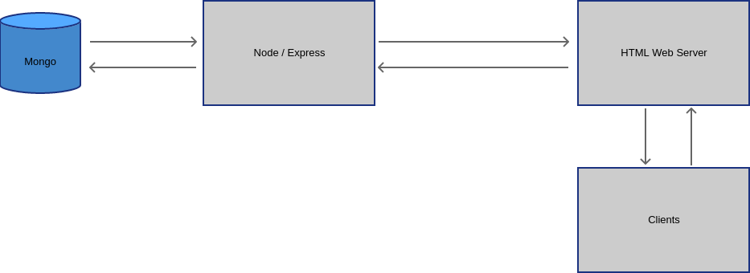
What we used in the project

Slide 6
Future Improvment
Add interface to add / delete students for class
Add interface to register students to class
Connect node server to html server

