Slide 1
Software Engineering -II
-“The ratio of time spent reading (code) versus writing is well over 10 to 1 ... (therefore) making it easy to read makes it easier to write.”

Slide 2
Coding Style
Proper Syntax
Programmer should be able to read your code.
Commenting on your code.
Giving adequate spaces or lines when a new concept or module is being coded.

Slide 3
Computer Network-II
-“Without Computer Networks we would never have internet.”

Slide 4
TCP Protocol
‪TCP enables two hosts to establish a connection and exchange streams of data.‬

Slide 5
Java Programming-II
-“Android applications and games are coded in Java.”

Slide 6
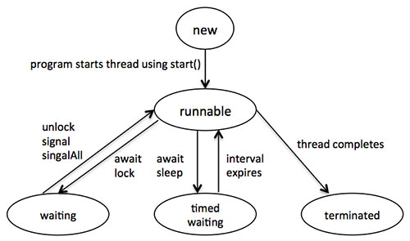
Concept of thread.
A thread is a single sequential flow of control within a program.

Slide 7
PHP/MYSQL
-“Facebook was developed in PHP and Mysql when it was a startup.”

Slide 8
String Functions
strrev() - Reverses a string. Example : Hello -> olleH
strpos() - Returns the position of the first occurrence of a string inside another string. Example : Hello, e -> 1
rtrim() - Removes whitespace or other characters from the right side of a string. Example : Hello -> Hello
ltrim() -Removes whitespace or other characters from the left side of a string. Example: Hello ->Hello
trim() - Removes whitespace or other characters from the right & left side of a string. Example : Hello -> Hello

Slide 9
String Functions
strlen() - Counts the total number of character in a string. Example : hello -> 5
strtolower – Converts string to lower. Example : HeLLo -> hello.
strtoupper – Converts string to upper. Example : hello -> HELLO
toupper – Coverts 1st character of string to upper. Example : hello -> Hello
tolower – Converts 1st character of string to lower. Example : HELLO -> hELLO

Slide 10
Operating System
-“If there were no operating system there wouldn't’t have been a computer .”

Slide 11
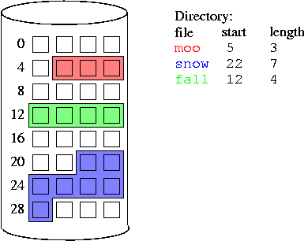
Disk allocation method.
first fit, best fit, or worst fit algorithms to manage storage

Slide 12
Thank You!
-“Computers themselves, and software yet to be developed, will revolutionize the way we learn.”

