Slide 1




ICRTAC-DTI - 2019
22 - Region Driven Remote Sensing Image Captioning
Chandeesh Kumar - taekchan331@gmail.com
Hemalatha M – hemam@annauniv.edu
Badri Narayan - badrinarayan1998@gmail.com
Nandini P - nandhinikumar2105@gmail.com
Date: 11-Nov-2019
11/11/2019
22 Chandeesh Kumar et al. ICRTAC- DTI 2019

Slide 2
Outline
Motivation
Background information/Related works
Proposed Method
Results
Summary
Future Work
References
11/11/2019
22 Chandeesh Kumar et al. ICRTAC- DTI 2019

Slide 3
Motivation
Image Captioning
Image Captioning is the method of generating a sentence for an image, that serves as a description of the image. The sentences consist of words denoting the various objects in the image and the relationship between them.
Applications
    Military Intelligence
    Scene Classification/Land Quality Assessment
    Activity Detection
11/11/2019
22 Chandeesh Kumar et al. ICRTAC- DTI 2019

Slide 4
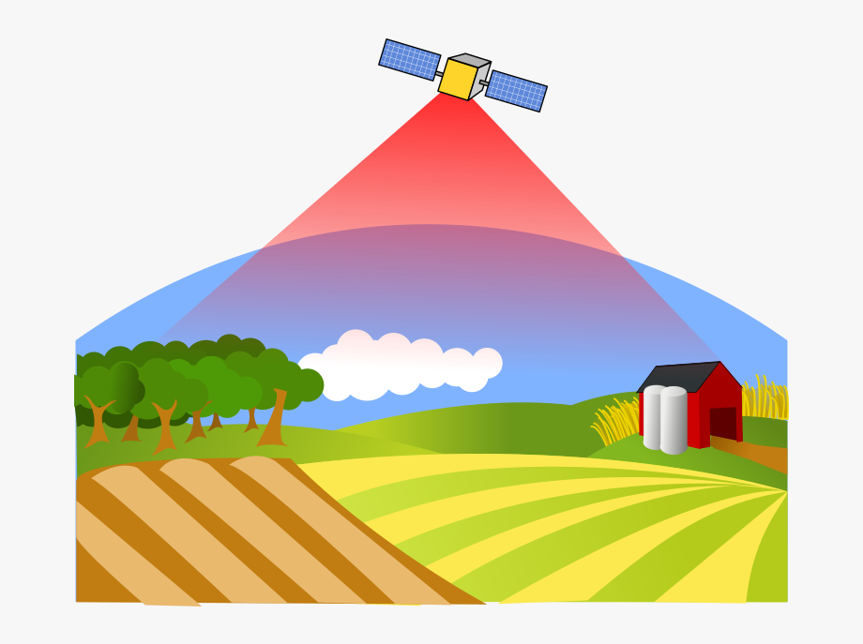
Motivation (2)
Remote Sensing Image characteristics
Scale Ambiguity: The objects in the ground have different scales under different views. (Mostly top view)
Category Ambiguity: Objects maybe fused together and hence may fall under different categories.
Rotation Ambiguity: The image can be in different rotated angle or translation. There is no up, down, left and right in a remote sensing image.
11/11/2019
22 Chandeesh Kumar et al. ICRTAC- DTI 2019

Slide 5
Related Works
Retrieved-based
These methods search for similar images with the query image first, and then generate sentences based on the sentences that describe the same kinds of images in data sets.
Object detection-based
These methods detect the objects in an image and then model the relation between the detected objects.
Encoder-Decoder based
These methods encoded an image to a vector first, and then utilized a model to decode the vector to a sentence.
11/11/2019
22 Chandeesh Kumar et al. ICRTAC- DTI 2019

Slide 6
Related Works - Limitations
Retrieved-based
  Grammatical structure is very poor and performs badly when an image outside dataset is given.
Object detection-based
The result of object detection has tremendous influence on the finally generated sentences.
Encoder-Decoder based
Has to deal with variations in transformations like translation, rotation for a special case like remote sensing image captioning.
11/11/2019
22 Chandeesh Kumar et al. ICRTAC- DTI 2019

Slide 7
Dataset
UC Merced Land Captions dataset is the dataset used for training and testing.
It consists of 21 classes of land including agricultural, airplane, baseball diamond, beach, buildings, chaparral, dense residential, forest, freeway with 100 images for each class.
Every image is 256x256 pixels.
There are 5 coherent captions for each image.
11/11/2019
22 Chandeesh Kumar et al. ICRTAC- DTI 2019

Slide 8
New Dataset – UAVIC Dataset
Based on RAW images obtained from Team Dhaksha.
  Unprocessed Image
  Count - 840
  Dimensions - 6000 x 3376
Processed Image (Using OpenCV in Python)
  Count - 150 per class
  Number of Classes – 12
  Dimensions - 400 x 400
11/11/2019
22 Chandeesh Kumar et al. ICRTAC- DTI 2019

Slide 9
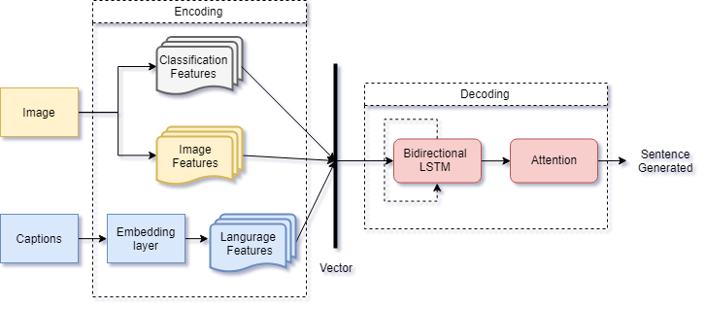
Architecture
11/11/2019
22 Chandeesh Kumar et al. ICRTAC- DTI 2019

Slide 10
Proposed Method
Domain-driven Multimodal Method
  Representing RS Images
  Feature extraction using CNN.
  Sentence Representation
  Words in a sentence are represented using embedding matrix.
  Sentence Generation
Sentences are generated using LSTMs. The process of sentence generating is considered as a problem that maximizes the correct sentence generating probability conditioned on the given image information.
11/11/2019
22 Chandeesh Kumar et al. ICRTAC- DTI 2019

Slide 11
Results - BLEU
Bilingual Evaluation Understudy.
Popular methods to compare captions.
Compare Machine generated sentence with Human reference sentence for evaluation.
11/11/2019
22 Chandeesh Kumar et al. ICRTAC- DTI 2019

Slide 12
Results
Domain-driven Model Scores
Model | BLEU-1 | BLEU-2 | BLEU-3 | BLEU-4
UCM_Dataset | 0.841121 | 0.745565 | 0.683783 | 0.610143
UAVIC_Dataset | 0.749809 | 0.51589 | 0.396456 | 0.290019
Combined | 0.755707 | 0.590448 | 0.559345 | 0.481025
Different Methods
Model | BLEU – 1 | BLEU – 2 | BLEU – 3 | BLEU - 4
ResNet152 | 0.71569 | 0.65976 | 0.59485 | 0.50932
InceptionV3 with LSTM | 0.762451 | 0.669016 | 0.632124 | 0.543431
ResNet152 with LSTM | 0.80078 | 0.708322 | 0.668718 | 0.581832
ResNet152 with Attention- based Bi-directional LSTM | 0.812111 | 0.729575 | 0.693783 | 0.600643
11/11/2019
22 Chandeesh Kumar et al. ICRTAC- DTI 2019

Slide 13
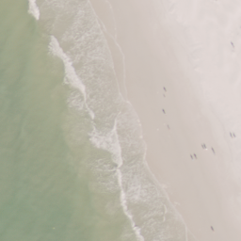
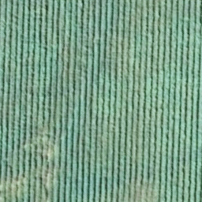
Prediction – Only UCM Dataset
Ground Truth
this is a beach with bluegreen sea and white sand
the sea water melt into the sand beach
the sea water melt into the sand beach
the sand beach mixed with the waters
the white sand beach melt into the sea
Generated Sentence
waves slapping a white sand beach throwing up white foams
Ground Truth
there is a piece of farmland
there is a piece of cropland
it is a piece of farmland
it is a piece of cropland
here is a piece of farmland
Generated Sentence
there is a piece of cropland
11/11/2019
22 Chandeesh Kumar et al. ICRTAC- DTI 2019

Slide 14
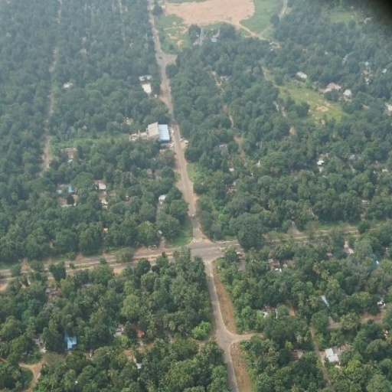
Prediction – Combined Dataset
Ground Truth
lot of trees are seen near the roads
there are large number of trees covering the roads
there is small road which passes through the forest area
a large residential area with big trees and roads
a large residential area with many trees and roads
Generated Sentence
a piece of land with trees and roads inbetween.
Ground Truth
there is a piece of farmland
there is a piece of cropland
it is a piece of farmland
it is a piece of cropland
here is a piece of farmland
Generated Sentence
it is a piece of cropland
11/11/2019
22 Chandeesh Kumar et al. ICRTAC- DTI 2019

Slide 15
Summary
The new dataset UAVIC is more diverse and is not as simple as single object classification.
UAVIC dataset is close to real-time.
The captions in UAVIC are more informative than in UCM
Domain-driven method produces better results that when using pretrained CNN features.
11/11/2019
22 Chandeesh Kumar et al. ICRTAC- DTI 2019

Slide 16
Future Work
The dataset for remote sensing images is limited.
Need to develop special methods specifically for remote sensing domain while implementing captioning methods.
11/11/2019
22 Chandeesh Kumar et al. ICRTAC- DTI 2019

Slide 17
References
Lu, Xiaoqiang and Wang, Binqiang and Zheng, Xiangtao and Li, Xuelong (2017) “Exploring models and data for remote sensing image caption generation”, IEEE Transactions on Geoscience and Remote Sensing, 5 (4): 2183–2195.
Dhaksha Team (2018) “Drone Manufacture in INDIA - Team Dhaksha”, https://www.teamdhaksha.com/.
Xu, Kelvin and Ba, Jimmy and Kiros, Ryan and Cho, Kyunghyun and Courville, Aaron and Salakhudinov, Ruslan and Zemel, Rich and Bengio,Yoshua (2015) “Show, attend and tell: Neural image caption generation with visual attention”, International conference on machine learning, 2048–2057.
Shi, Zhenwei and Zou, Zhengxia (2017) “Can a machine generate humanlike language descriptions for a remote sensing image?”, IEEETransactions on Geoscience and Remote Sensing,55 (6): 3623–3634.
11/11/2019
22 Chandeesh Kumar et al. ICRTAC- DTI 2019

