Slide 1

Tenth International Conference on Contemporary Engineering and Technology
Smart Delivery Box based on TensorFlow Object Detection and Recognition API
Paper ID : ICCET 22033
Authors:
Dr.B.Muthusenthil - Associate Professor
Dr.V.Dhanakoti - Associate Professor
Dr.M.Mayuranathan - Associate Professor
T.S.Ramachandran - CSE Student
Notes:
‹#›

Slide 2
OBJECTIVES
To detect the object in the delivery box using machine learning and indicate the users using Receiver module with built-in speaker and display, Android application to access the smart delivery box.
To create the platform for users to remotely open the delivery box with the help of an Android application. To recognize the package and mails the picture of the package to user. To display the name of the package and tells what package is delivered.

Slide 3
LITERATURE SURVEY
S.No | Year | Author | Transaction Title | Objectives
1 | 12-14 Aug. 2018 2018 International Conference on Computer, Control, Electrical, and Electronics Engineering (ICCCEEE) | Fatma Salih; Mysoon S.A. Omer | Raspberry pi as a Video Server | This system finds somehow solutions for high cost and complex video server systems as well as the mass storage used for such systems. This system uses a video stream of 800 × 400 at 24 frames per second. This paper recommends expanding the project to a WAN network.
2 | 25-27 Sept. 2020 2020 International Conference on Electrical Engineering (ICEE) | Irfan Kilic; Galip Aydin | Traffic Sign Detection And Recognition Using TensorFlow’ s Object Detection API | TensorFlow Object Detection API used in Turkey traffic sign detection and recognition of the aid intended traffic signs. A dataset suitable for TensorFlow Object Detection API has been prepared for traffic signs by using photographs in different traffic and weather conditions.

Slide 4
LITERATURE SURVEY
S.No | Year | Author | Transaction Title | Objectives
3 | 25-27 Aug. 2020 2020 IEEE International Conference on Advances in Electrical Engineering and Computer Applications( AEECA) | Ying Li; Junxin Cheng; Xin Wang | An Optophone Based on Raspberry Pi and Android Wireless Communication | CSI camera to the raspberry PI interface to complete the image acquisition of physical paper reading materials and connected the playback device to the Raspberry Pi audio interface to provide users with reading services. The Android app communicates with the Raspberry Pi to control the Raspberry Pi's actions, including recognizing images to generate text.
4 | 18-21 Nov. 2019 2019 6th International Conference on Electric Vehicular Technology (ICEVT) | Mochammad Ariyanto; Ismoyo Haryanto; Joga Dharma Setiawan | Real-Time Image Processing Method Using Raspberry Pi for a Car Model | Image processing methods are selected to detect edge, line, corner, and traffic light color of the road model. The algorithms are developed in Simulink diagram block and embedded into Raspberry Pi using Simulink Support Package for Raspberry Pi Hardware.

Slide 5
ABSTRACT
The Object Detection Smart Delivery box operates on raspberry pi with two cameras, one camera that takes a picture of the delivery person and sends it to the user so that the user can remotely open the delivery box with the help of an android application. Another camera which is placed inside the box scans the package, recognizes it with help of “TensorFlow object detection API” and mails the picture of the package to the user. Receiver module displays the name of the package and tells what package is delivered. The user can also use Google assistant voice command to open or close the Object Detection Smart Delivery box.

Slide 6
PROPOSED SYSTEM
In Object Detection Smart Delivery Box, The delivery boy delivers products such as Newspaper, Food Package, Online shopping package, Milk etc. The Pi-camera, which is fixed inside the delivery box scans the package, recognizes it with help of “TensorFlow object detection API” and mails the picture of the package to the user. Receiver module, gets data from the Raspberry Pi through radio waves, speaker that tells the user what package is delivered, 16X2 LCD Display module displays the details of the package. The user can also use Google assistant voice command to open or close the Smart Delivery box. The android application consists of User Login and activity consists of two buttons, one to open the door and another to close the door. The top of the activity screen displays the current status of the Smart box door and the bottom of the screen displays the log files.

Slide 7
PROGRAMMING LANGUAGES
TensorFlow Object Detection API: TensorFlow is developed for deep learning.ssd_mobilenet_v1_coco architecture runs on Raspberry Pi 4 to perform object detection on live video feeds from a Pi-camera or USB webcam and it is used to train neural networks to identify specific objects.
Automated Python script: This script will start then the package is placed inside the box. It takes the picture of the package with “fswebcam” and sends it to TensorFlow API for product recognition. If the package in the box is recognized by TensorFlow, it sends a mail to the user with the name of the package.
Android application: It consists of two activities namely the first activity consists of User Login screen which is integrated with Firebase authenticator. The second activity consists of two buttons, one to open the door and another to close the door. The top of the screen displays the current status of the Smart box door and the bottom of the screen displays the log files.

Slide 8
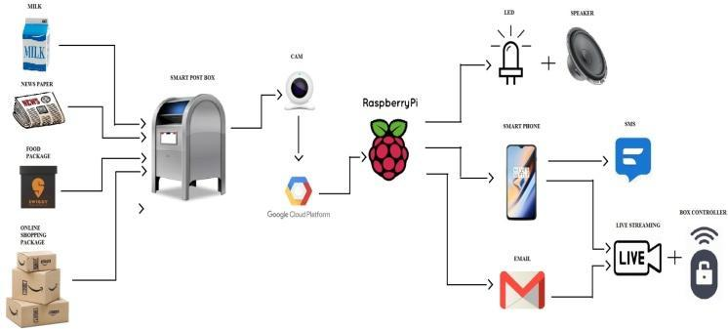
ARCHITECTURE
Fig. 1 Proposed system of Object Detection Smart delivery Box

Slide 9
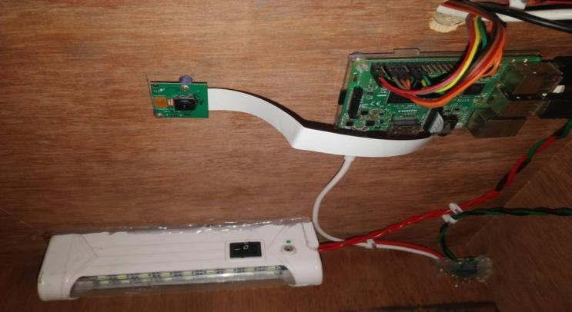
TensorFlow Object Detection API
Fig. 2 TensorFlow 2.0 on Raspberry pi with Pi-cam

Slide 10
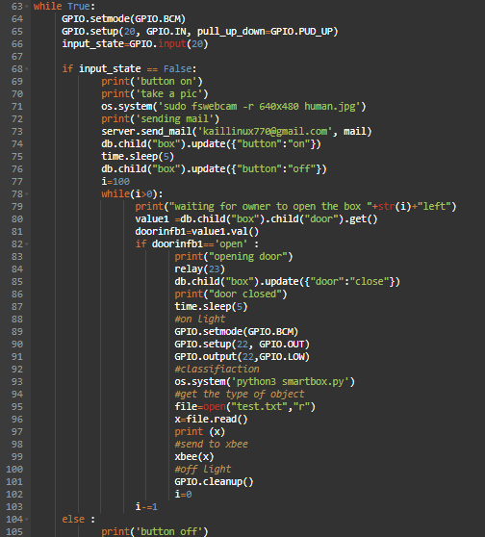
Automated Python script
Fig. 3 Code for Automated Python script

Slide 11
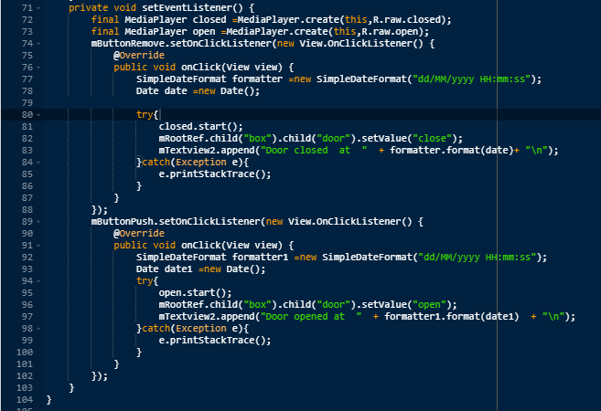
Android Application
Fig. 4 Code for Android Application

Slide 12
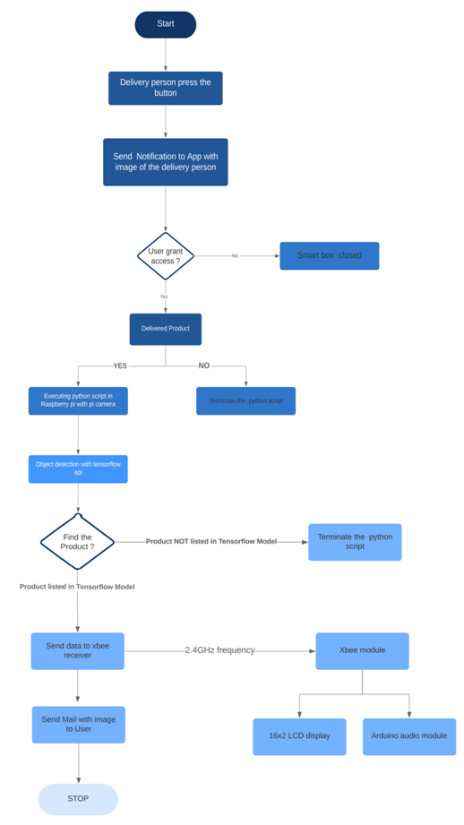
FLOWCHART
Fig. 5.1 Flowchart for Smart post box

Slide 13
FLOWCHART
Fig. 5.2 Flowchart for Smart post box

Slide 14
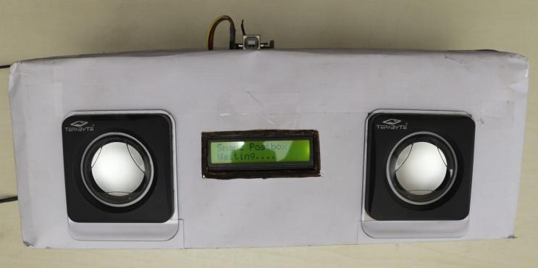
RECEIVER MODULE
Fig. 6 Receiver model

Slide 15
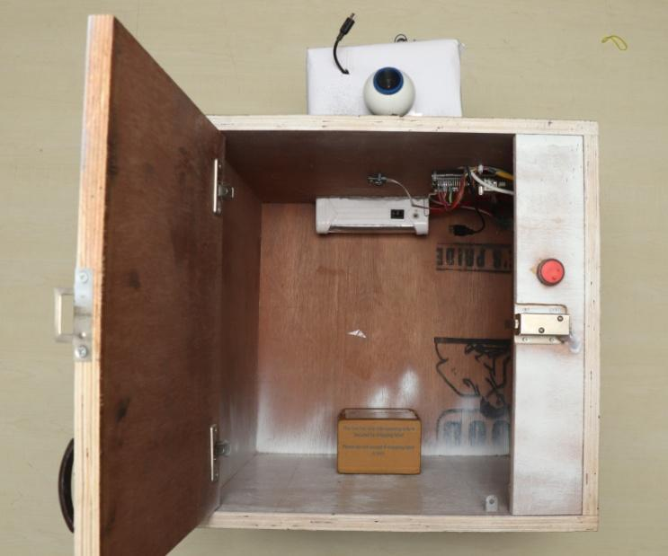
Object detection smart delivery box
Fig. 6 Object detection smart delivery box

Slide 16
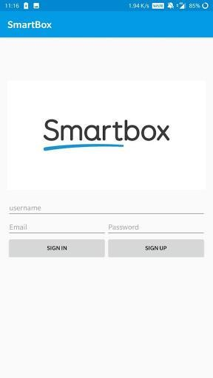
Android application login activity
Fig. 7 Android application login activity

Slide 17
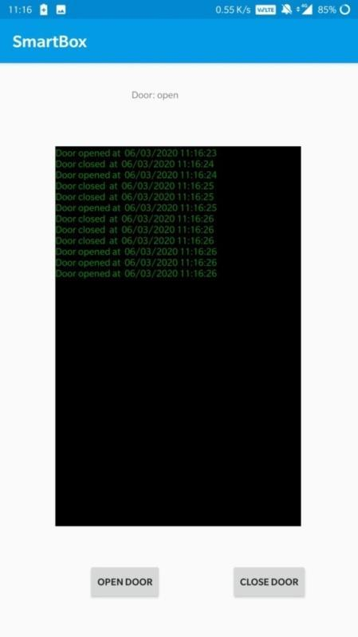
Android application login activity
Fig. 8 Android application main activity

Slide 18
FUTURE SCOPE
This product has an added feature of sanitizing the packages with the help of UV light which ensures that the package is free from any kind of germs. This acts as an added advantage to the users from communicating any infections through the packages thereby making their online shopping experience stress-free. It also has a feature of voice interaction that enables the user to speak with the delivery person from a remote position.

Slide 19
REFERENCES
Irfan Kilic; Galip Aydin ― Traffic Sign Detection And Recognition Using TensorFlow’ s Object Detection API With A New Benchmark Dataset DOI:10.1109/ICEE49691.2020.9249914 Available:https://ieeexplore.ieee.org/document/9249914
Yunxia Ju; Xichang Wang; Xiangxi Chen ―Research on OMR Recognition Based on Convolutional Neural Network TensorFlow Platform DOI:10.1109/ICMTMA.2019.00157 Available:https://ieeexplore.ieee.org/document/8858693
Cheng-Hsiung Hsieh; Dung-Ching Lin; Cheng-Jia Wang; Zong-Ting Chen; Jiun-Jian Liaw ― Real-Time Car Detection and Driving Safety Alarm System With Google TensorFlow Object Detection API DOI:10.1109/ICMLC48188.2019.8949265 Available:https://ieeexplore.ieee.org/document/8949265
Fatma Salih; Mysoon S.A. Omer ― Raspberry pi as a Video Server DOI:10.1109/ICCCEEE.2018.8515817 Available:https://ieeexplore.ieee.org/document/8515817

Slide 20
REFERENCES
Ying Li; Junxin Cheng; Xin Wang ― An Optophone Based on Raspberry Pi and Android Wireless Communication DOI:10.1109/AEECA49918.2020.9213587 Available:https://ieeexplore.ieee.org/document/9213587
Tussanai Parthornratt ; Natchaphon Burapanonte; Wisarute Gunjarueg ― People identification and counting system using raspberry Pi DOI:10.1109/ELINFOCOM.2016.7563020 Available:https://ieeexplore.ieee.org/document/7563020
Yi-Chen Lee; Ching-Min Lee ― Real-Time Smart Home Surveillance System of Based on Raspberry Pi DOI:10.1109/ECICE50847.2020.9301929 Available:https://ieeexplore.ieee.org/document/9301929
Md. Tobibul Islam; Mohiuddin Ahmad; Akash Shingha Bappy ― Real-Time Family Member Recognition Using Raspberry Pi for Visually Impaired People DOI: 10.1109/TENSYMP50017.2020.9230937 Available:https://ieeexplore.ieee.org/document/9230937

Slide 21
THANK YOU

