Slide 1
The N-Queens Problem
Chandan Singh Rajput
12220324

Slide 2

Introduction Chess and Its Queen
Chess originated in India around the 6th century AD. It evolved from earlier Indian board games
Chess is a timeless game of strategy and intellect, played on an 8x8 grid where each player commands an army of 16 pieces
The queen in chess moves any number of squares in a straight line horizontally, vertically, or diagonally. This exceptional range makes it a versatile and powerful piece on the board, capable of both attacking and defending effectively.

Slide 3
N-queens problem
The N-Queens problem is a classic puzzle where the challenge is to place N queens on an N×N chessboard such that no two queens threaten each other. In other words, no two queens can share the same row, column, or diagonal.

Slide 4
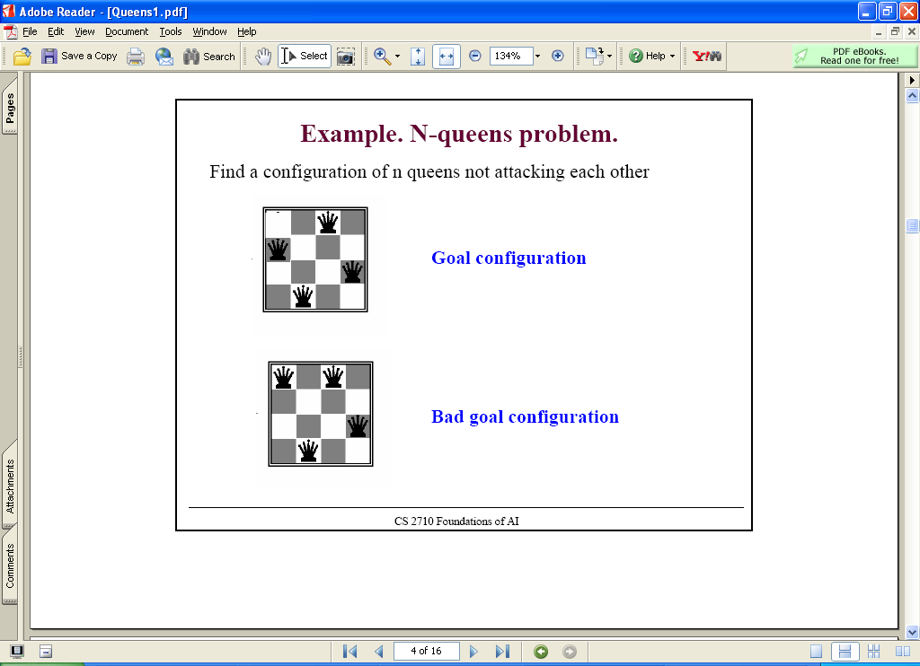
N-queens problem
Find a configuration of n queens not attacking each other

Slide 5
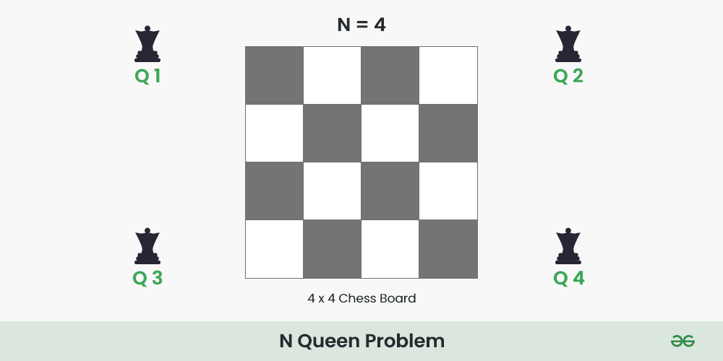
Backtracking
Backtracking is a general algorithmic technique for solving problems incrementally, one piece at a time, and removing solutions that fail
place a queen in the top row, then note the column and diagonals it occupies.
then place a queen in the next row down, taking care not to place it in the same column or diagonal. Keep track of the occupied columns and diagonals and move on to the next row.
If no position is open in the next row, we back track to the previous row and move the queen over to the next available spot in its row and the process starts over again.

Slide 6
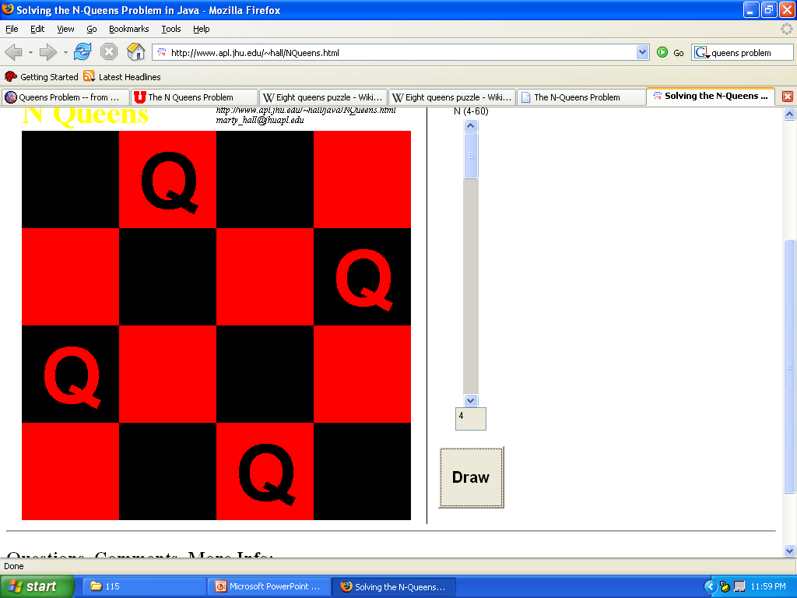
Problems N < 4
N < 4
Cannot use N Queens
3
2
1

Slide 7
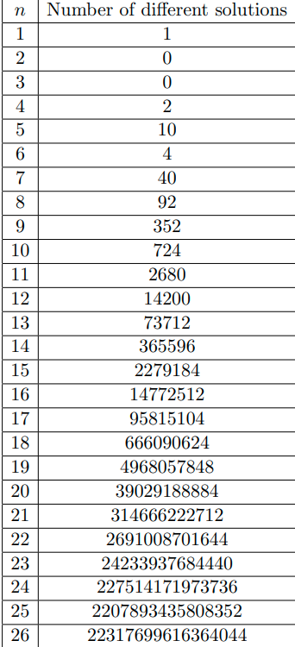
n | n!
1 | 1
2 | 2
3 | 6
4 | 24
5 | 120
6 | 720
7 | 5040
8 | 40 320
9 | 3 62 880
10 | 36 28 800
11 | 39916800
12 | 479001600
13 | 6227020800
14 | 87178291200
15 | 1307674368000
16 | 20922789888000
17 | 355687428096000
18 | 6402373705728000
19 | 121645100408832000
20 | 2432902008176640000
21 | 51090942171709440000
22 | 1124000727777607680000
23 | 25852016738884976640000
24 | 620448401733239439360000
25 | 15511210043330985984000000
26 | 403291461126605635584000000

Slide 8
Why n<=26 only?
27!=10,888,869,450,418,352,160,768,000,000.
Single-threaded Exploration: If one permutation can be processed in 1μs1 \mu s1μs (microsecond), processing all permutations would 27!×10−6 seconds≈3.449×1014 seconds≈10.9 million years
Distributed System (1 million processors): Even with one million processors working in parallel, it would still take: 10.9

Slide 9
8-Queens Problem
There are 92 distinct solutions
There are 12 unique solutions discounting symmetrical answers
How many solutions for 4-Queens? N-Queens?

Slide 10
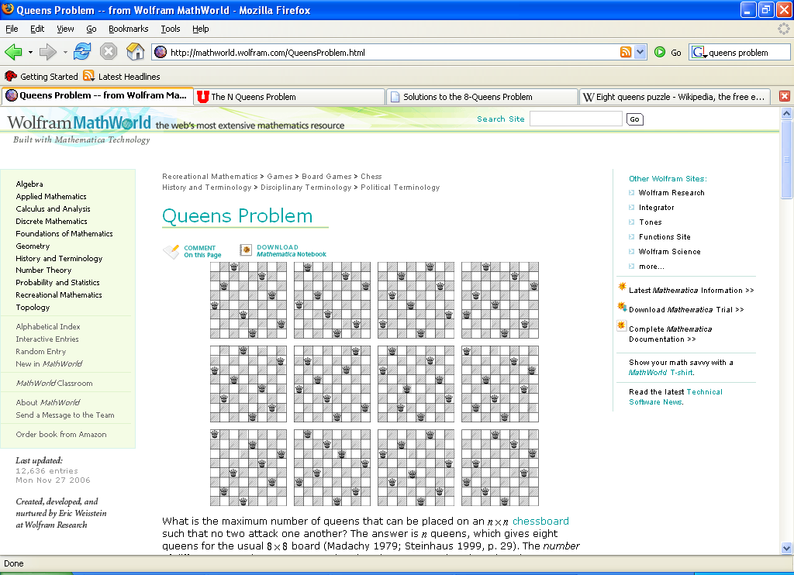
12 Unique Solutions 8-Queens Problem

Slide 11
CODE
My program efficiently tackles the n queens problem using a backtracking algorithm. Unlike basic implementations that flood the screen with every possible board configuration, our solution meticulously sifts through permutations to highlight only distinct solutions—where each queen is placed on the chessboard without threatening another. This approach not only ensures clarity but also showcases the elegance of our algorithmic design. With each valid configuration found, our program dynamically updates the board display, offering a clear visualization of each unique solution as it emerges. This feature not only demonstrates the power of backtracking in problem-solving but also enhances user understanding by focusing on meaningful outcomes rather than exhaustive possibilities.

Slide 12
THANK YOU!

