Slide 1
Title Slide
Inference on CPU and Fine-Tuning of LLM Model to Create a Custom Chatbot
An Innovative Approach for Efficient AI Deployment
Prepared by: Bugata Chanakya Sri Vinayaka
Date: 15 July 2024

Slide 2
Problem Statement
The need for efficient inference of large language models (LLMs) on CPUs due to the high cost and limited availability of GPUs.
The requirement for fine-tuning pre-trained LLMs to create custom chatbots tailored to specific domains and use cases.
Ensuring the chatbot can perform well in real-time applications with the computational constraints of CPUs.

Slide 3
Unique Idea Brief (Solution)
Leverage optimized inference techniques to deploy LLMs on CPUs.
Fine-tune a pre-trained LLM on domain-specific data to create a custom chatbot.
Implement techniques such as quantization and model pruning to reduce model size and increase inference speed.
Use knowledge distillation to transfer the capabilities of larger models to smaller, more efficient ones suitable for CPU deployment.

Slide 4
Features Offered
Optimized Inference on CPUs: Efficiently run LLMs without the need for GPUs.
Custom Fine-Tuning: Tailor the chatbot to specific industry needs and user requirements.
Reduced Latency: Real-time performance improvements through model optimization techniques.
Scalability: Easily scalable to different environments and use cases.

Slide 5
Process Flow
Data Collection: Gather domain-specific data for fine-tuning.
Pre-processing: Clean and prepare the data for training.
Fine-Tuning: Adapt the pre-trained LLM using the domain-specific data.
Model Optimization: Apply techniques like quantization, pruning, and distillation.
Deployment: Deploy the optimized model on CPU infrastructure.
Monitoring and Evaluation: Continuously monitor performance and make necessary adjustments.

Slide 6
Architecture Diagram
Data collection and pre-processing pipeline.
Fine-tuning process on pre-trained LLM.
Model optimization steps.
Deployment framework for CPU inference.
Monitoring and feedback loop.

Slide 7
Data Collection & Pre- Processing Pipeline
Monitoring & Feedback Loop
Fine-Tunning Process on Pre Trained LLM
Deployment Framework For CPU Inference
Model Optimization Steps

Slide 8
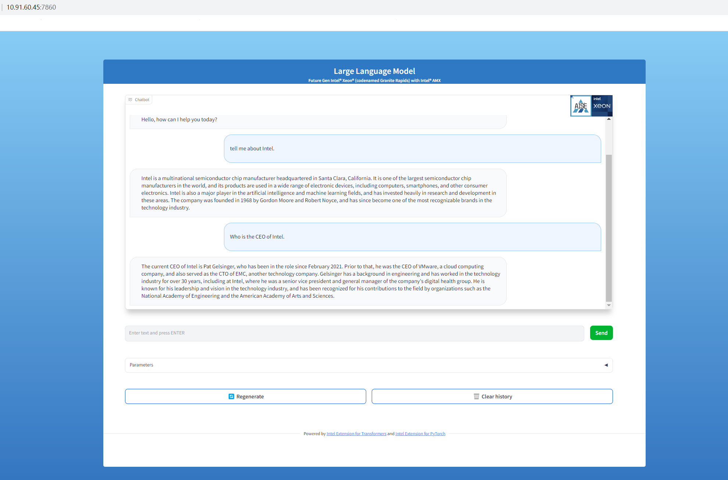
Technologies Used
Programming Languages: Python
Libraries and Frameworks: Hugging Face Transformers
Optimization Tools: Intel Neural Compressor

Slide 9
Team Members and Contribution
Chanakya : Project Lead and AI
The proposed solution addresses the challenge of running LLMs efficiently on CPUs while providing a customizable and scalable chatbot solution.
By leveraging model optimization techniques, the solution ensures real-time performance and cost-effectiveness.
The project has the potential to democratize access to advanced AI capabilities by making them more accessible and deployable on widely available hardware.
Conclusion

