Slide 1





Slide 2

Analysis on Television
CH.ANAND
Qualification : B.TECH(ECE)

Slide 3
Introduction of Television
Television is a system for transmitting visual images and sound that are reproduced on screens, chiefly used to broadcast programs for entertainment, information, and education.
The television set has become a common place in many households, businesses, and institutions.

Slide 4
Keys:
Website used for Analysis on Television is (Flipkart)
Features
Data Frame for web scrapping by using class
Data Cleaning
Visualization
Conclusion

Slide 5
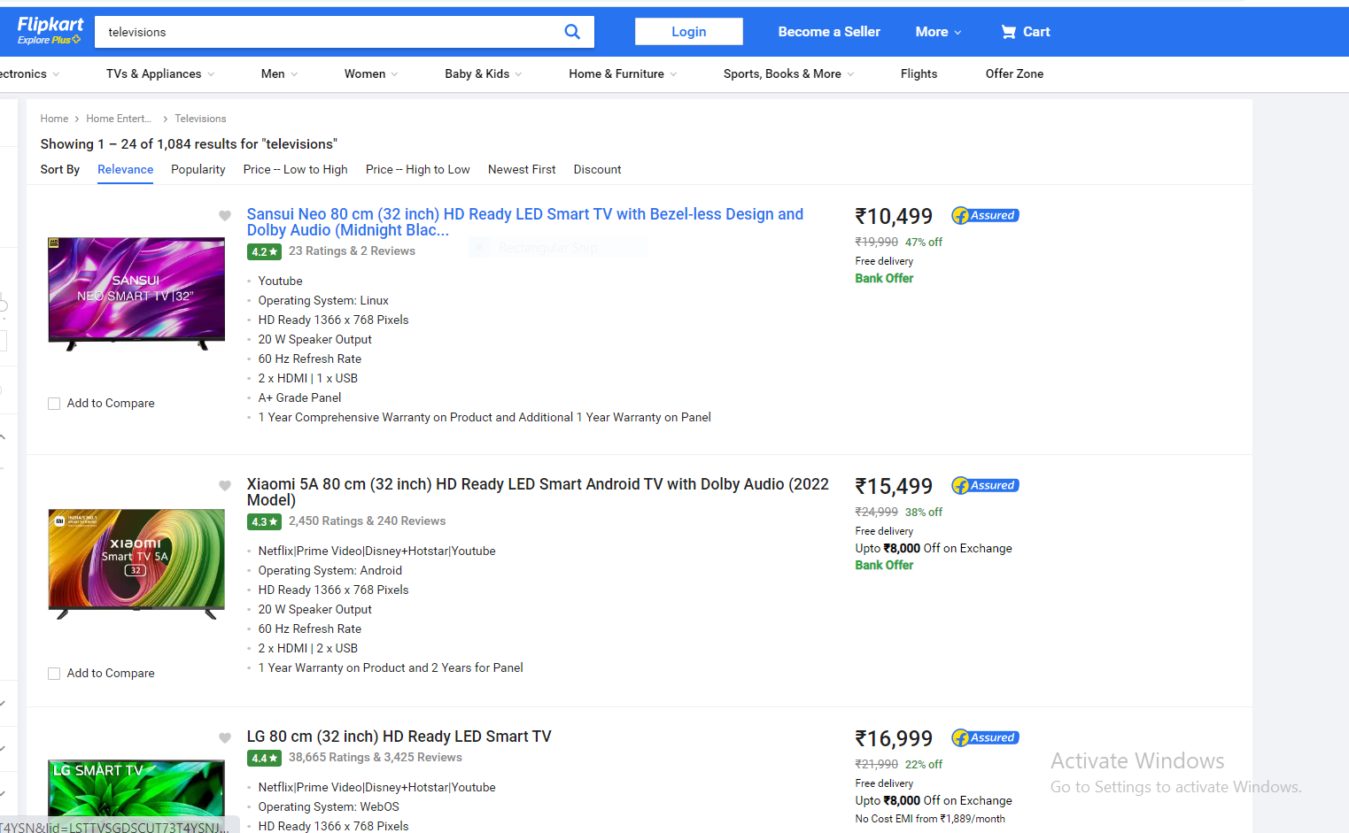
Website used for Analysis is Flip kart

Slide 6
Features of Analysis on Television
Model
Prices
Inch
Operating
Speaker
Ultra HD
Percentage

Slide 7
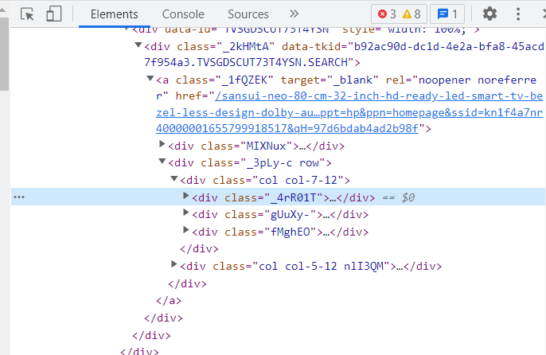
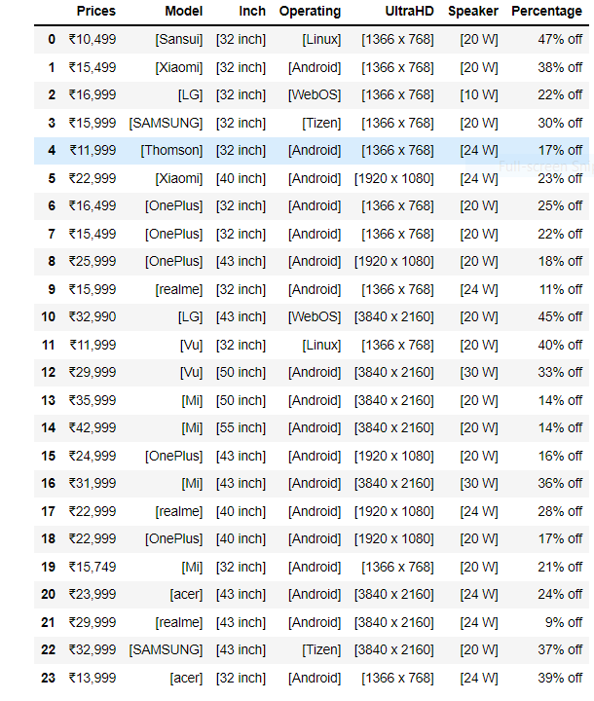
Web scrapping for Data Frame by using class for different features
Web scrapping for data frame which we collect the information by using different class from (Flip kart) for different features.

Slide 8
Data Cleaning
Analysing the null values and missing values.
Fill the missing and null values by (Nan).
In data frame removing the square brackets, commas , symbols etc…

Slide 9
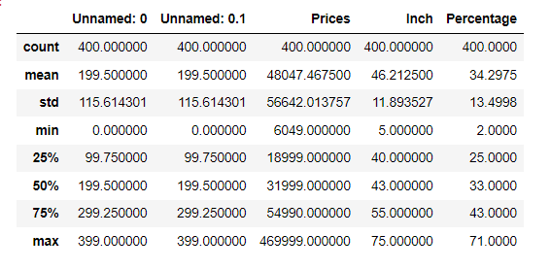
Statistics of Data Frame

Slide 10
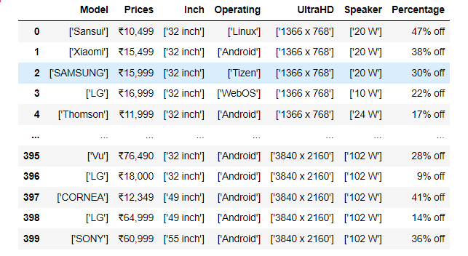
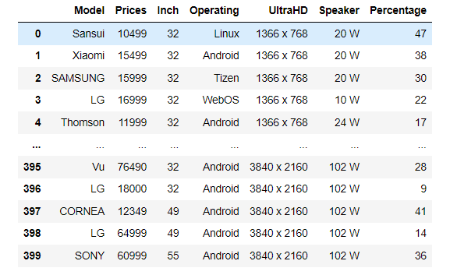
Comparision between before & after cleaning

Slide 11
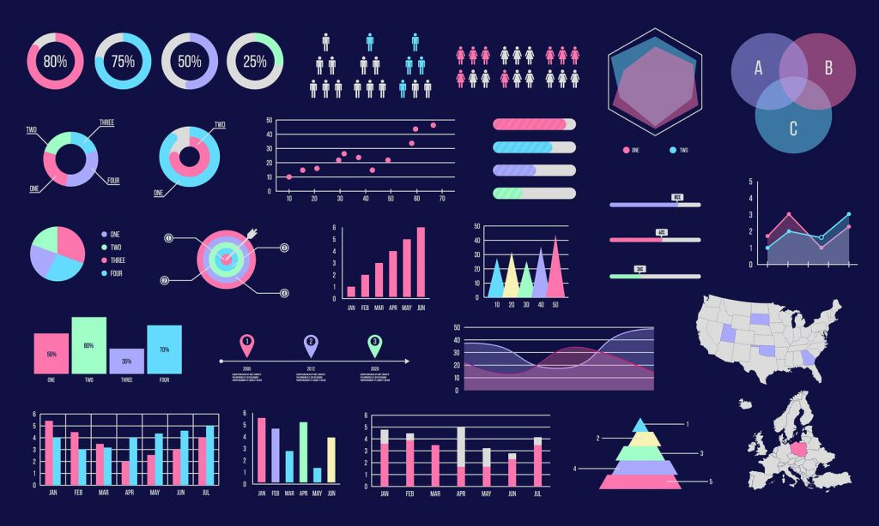
Data Visualization

Slide 12
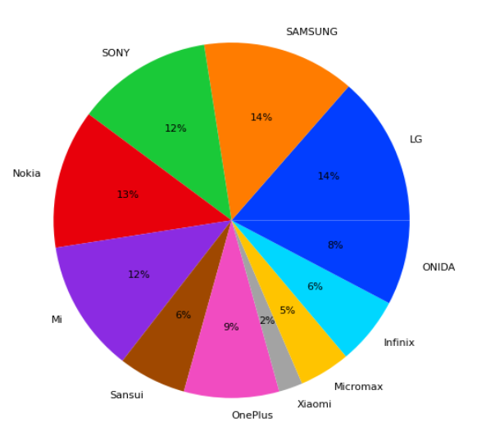
Pie Chart for Model

Slide 13
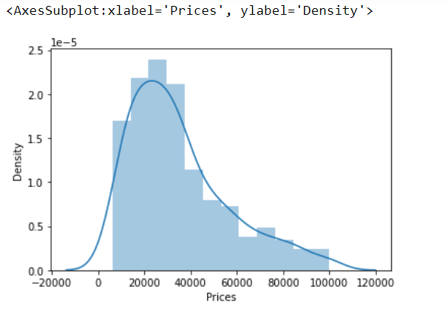
Distplot for Prices

Slide 14
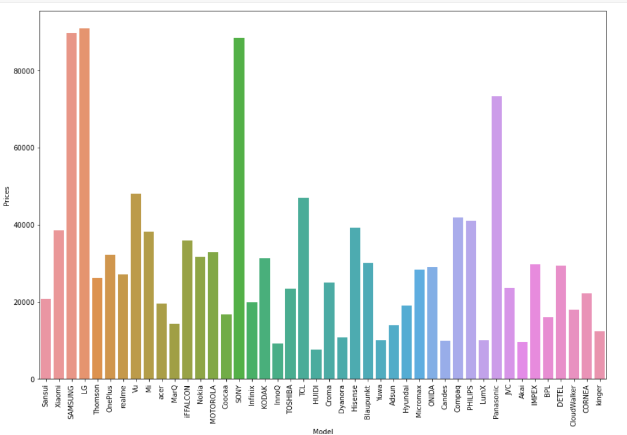
Barplot for Model & Prices

Slide 15
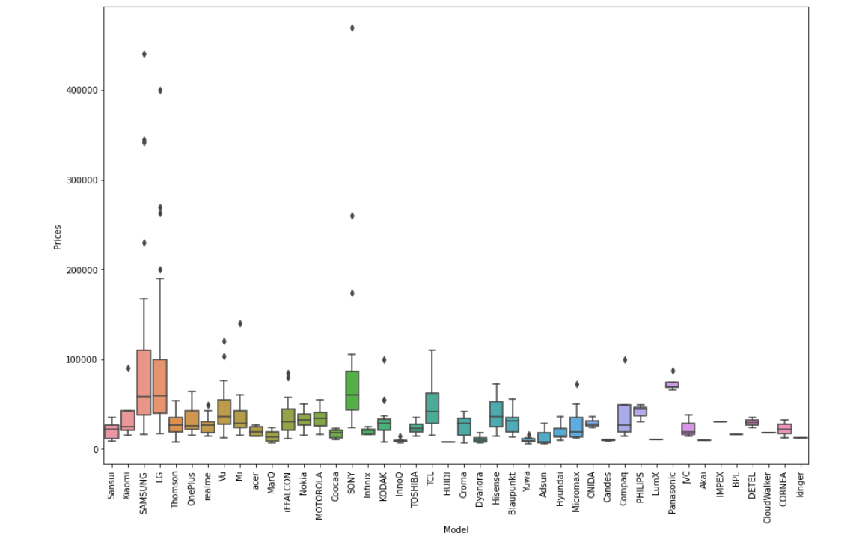
Boxplot of Model & Prices

Slide 16
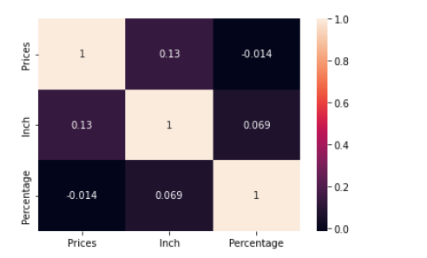
Heatmap

Slide 17
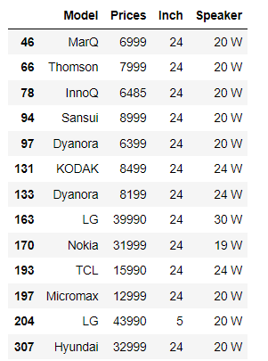
Conclusion
One of the customer ask for prices between 10,000 to 50,000 and Inch less than 24 which models are there.

Slide 18


