Slide 1
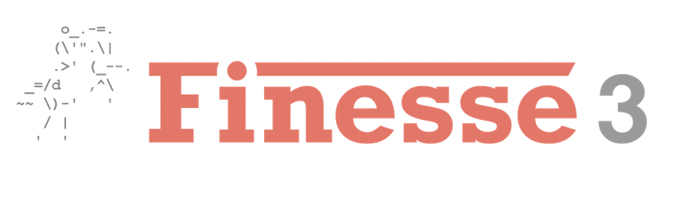
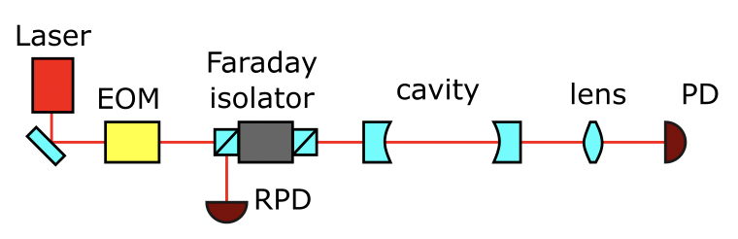
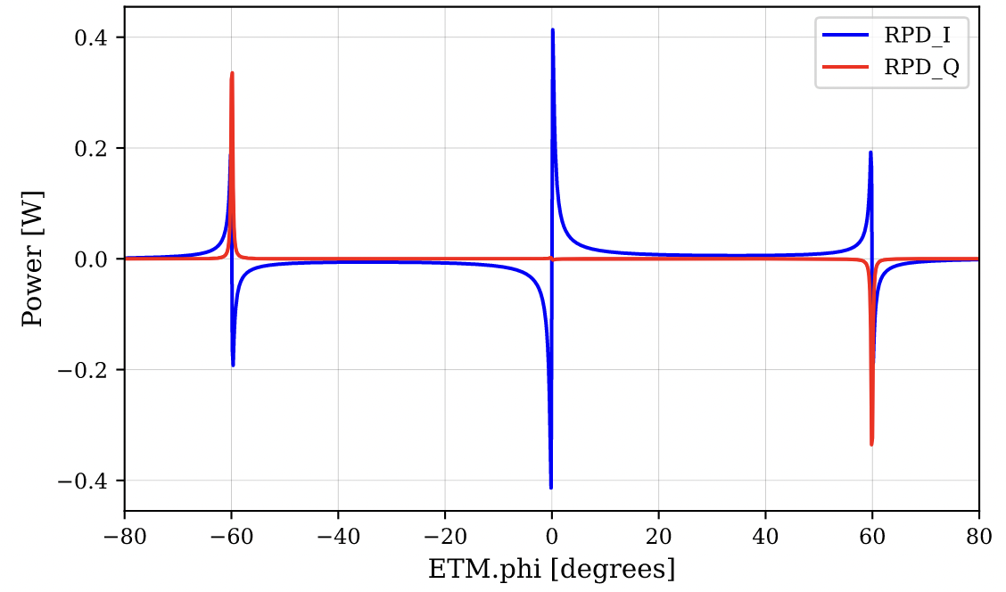
UF FINESSE 3 Workshop Summer 2025

Slide 2
UF FINESSE 3 Workshop Summer 2025
Introduction
What is FINESSE?
How does it work?
Typical use-cases for FINESSE (and when not to use it!)
Numerically solving a linear cavity
Using FINESSE to model a linear cavity
Quiz!!!!!

Slide 3
What is FINESSE?
Frequency domain INterferomEter Simulation SoftwarE
At a high level: Python-based package for simulation of arbitrary interferometer configurations in steady-state limit [1]
Underlying code is written in C, but we interface using a Python wrapper called Pykat [1]
Based originally on linear circuit simulation software LISO, which numerically solved system of linear equations defined by circuit elements (will sound familiar in a second) [2]

Slide 4
Why is FINESSE?
FINESSE is ubiquitous in LIGO/Virgo/CE collaborations as a tool for interferometer commissioning and design
Ongoing simulation of potential CE corner layouts has relied heavily on construction of realistic FINESSE models
Also an “optical-bench-in-a-box”
While FINESSE is a powerful tool, it’s important to note what it can’t do
Polarization-dependent effects (e.g birefringence of a mirror)
Time-dependent effects (FINESSE models are in steady-state)

Slide 5

How is FINESSE?
FINESSE relies on the computation of light-field amplitudes at every node (we’ll come back to this term!)
First, make a few assumptions [2]:
Interferometer is described via a set of linear equations derived from linear couplings of light-field amplitudes
No polarization/no polarizing components
Frequency of any individual light-field does not change
Use the linear couplings between optical components to construct a set of linear equations (the interferometer matrix) and solve:

Slide 6
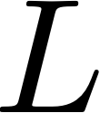







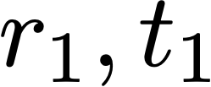
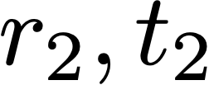



The basic optical cavity
We can solve for the fields everywhere in terms of the input field by writing a set of simultaneous equations.
Propagation through the cavity is described as multiplying by
Transmission through a mirror is described as multiplying by
Reflection from a mirror is described as multiplying by

Slide 7
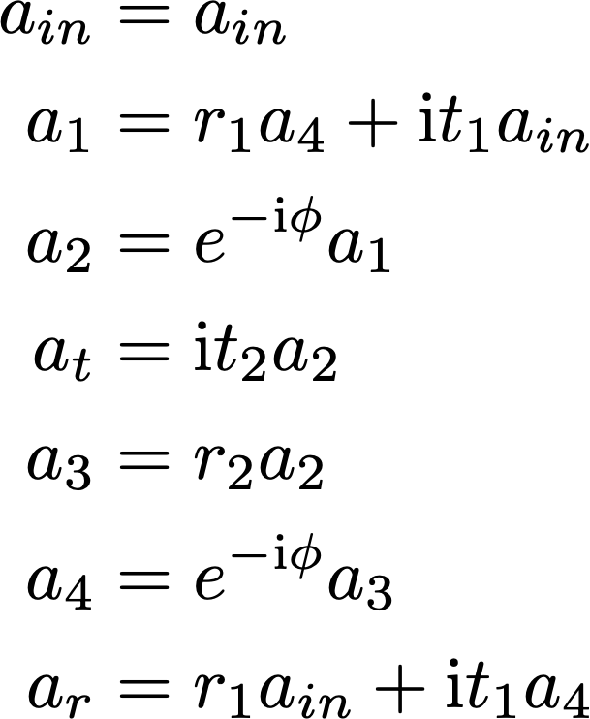
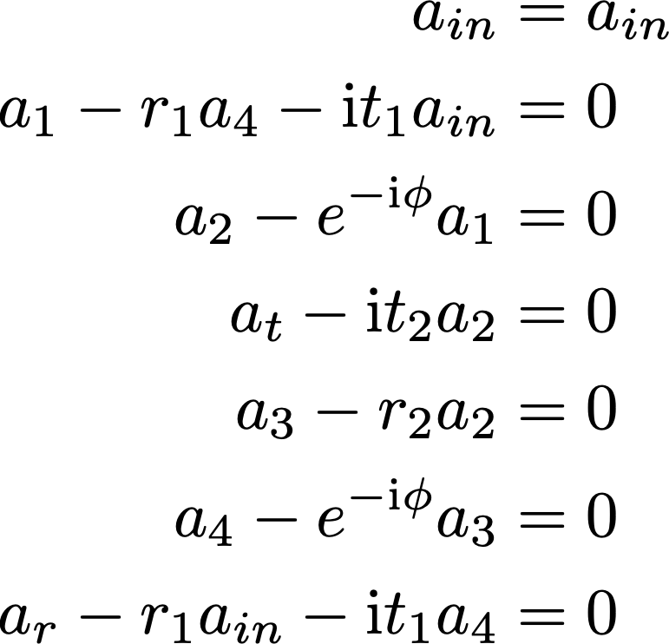

The basic optical cavity
Since we’re really dealing with a system of simultaneous equations, we can use matrix algebra to solve – really useful for numerically solving more complicated interferometers!
Rearrange to have RHS=0
(except for sources of field)
Thanks to Anna Green for LaTeX formulae, from her InterferometerMatrix.ipynb notebook!

Slide 8
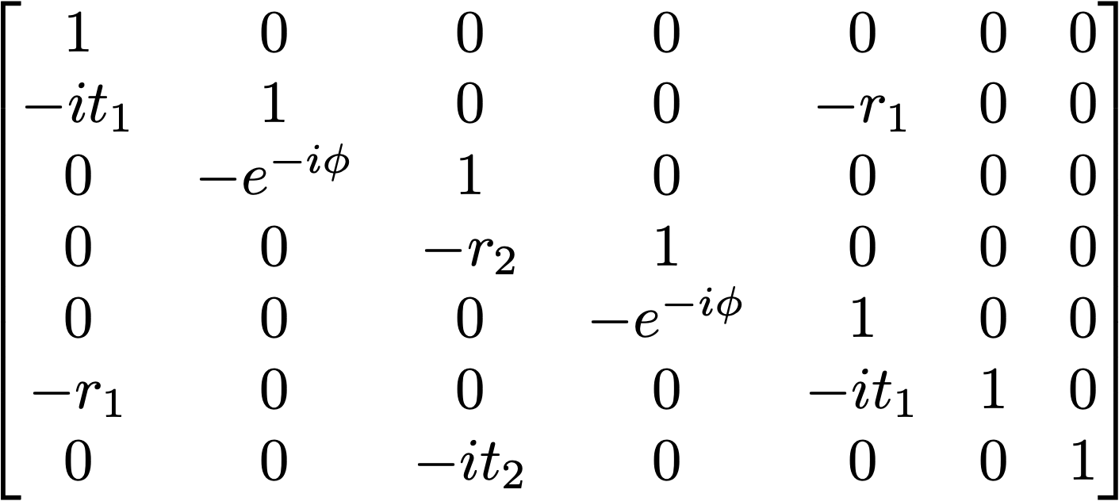
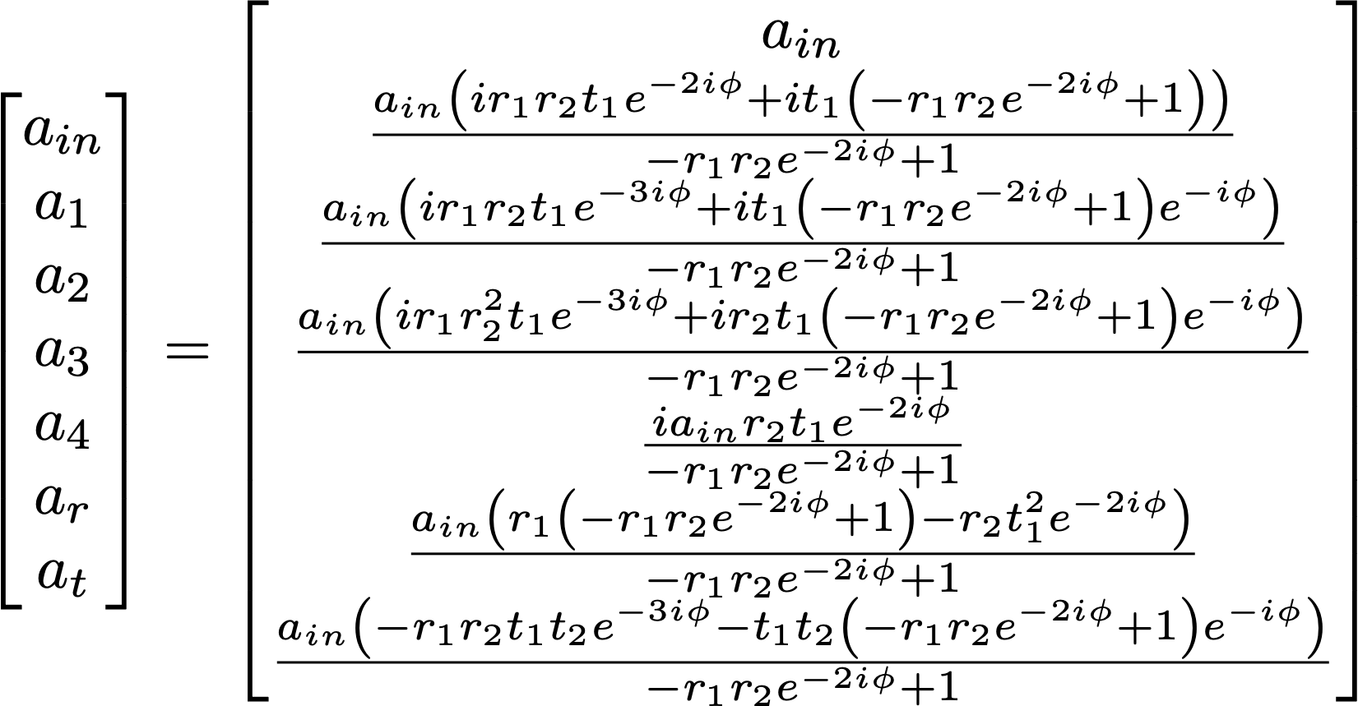
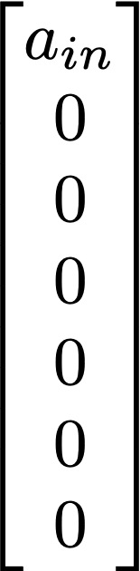


The basic optical cavity
Since we’re really dealing with a system of simultaneous equations, we can use matrix algebra to solve – really useful for numerically solving more complicated interferometers!
Write linear equations in matrix form
“Interferometer matrix” of coefficients
Solved fields
Input fields
Thanks to Anna Green for LaTeX formulae, from her InterferometerMatrix.ipynb notebook!

Slide 9
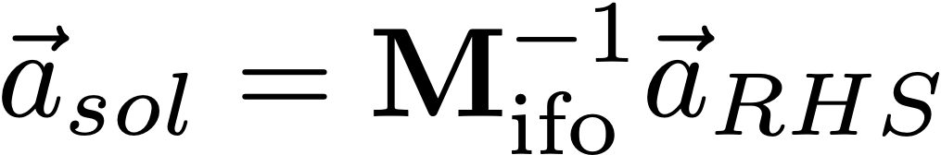
The basic optical cavity
The hard part here is inverting the interferometer matrix, but that can be done quite efficiently computationally, especially when sparse.
Then solve in the usual way:
Thanks to Anna Green for LaTeX formulae, from her InterferometerMatrix.ipynb notebook!

Slide 10
The basic optical cavity: numerical solution
R = 0.9
T = 0.1
R = 0.9
T = 0.1
If you wanted to solve for each of these fields numerically with the method shown, how could you do it?

Slide 11
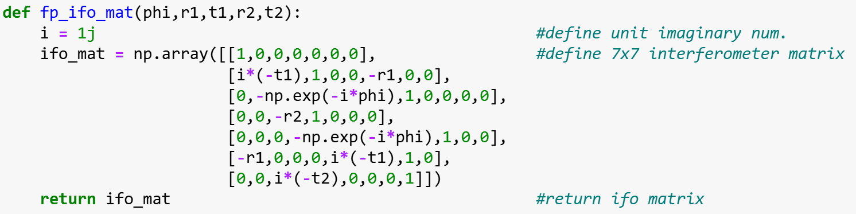
The basic optical cavity: numerical solution
We can begin by defining the interferometer matrix for our impedance matched linear cavity. You might do this in Python with the function:

Slide 12
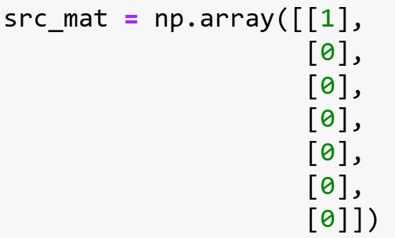
The basic optical cavity: numerical solution
Now we can define our source field. We’ll assume an input laser power of 1W

Slide 13
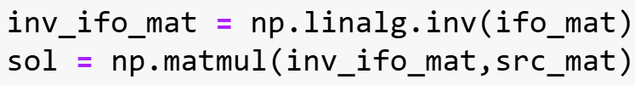
The basic optical cavity: numerical solution
We’re left to solve:
Which we can do with some in-built NumPy functions:

Slide 14
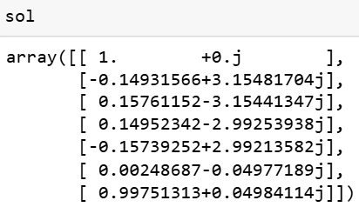
The basic optical cavity: numerical solution
So, finally, we find that our solution is:
Not super illuminating!

Slide 15
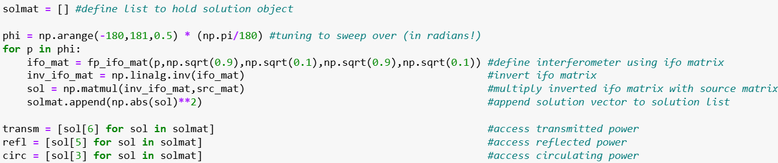
The basic optical cavity: numerical solution
Let’s plot the power for many different phi values (effectively changing the tuning of one of the mirrors).

Slide 16
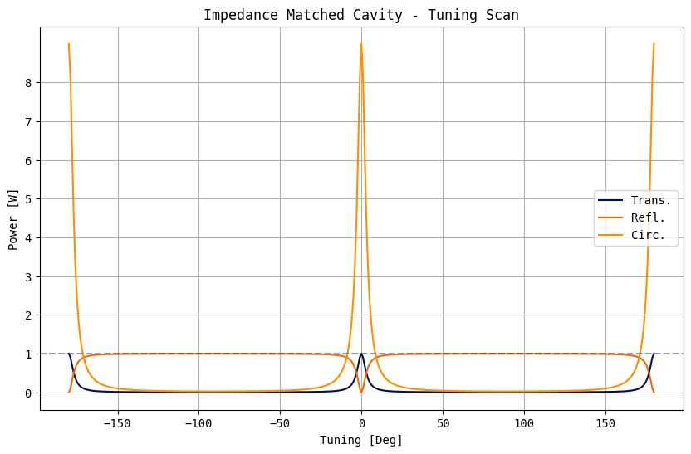
The basic optical cavity: numerical solution
And if we plot the circulating, transmitted, and reflected powers:

Slide 17
References
[1] Finesse — Finesse documentation. (n.d.). https://finesse.ifosim.org/docs/develop/index.html
[2] Freise, A., European Gravitational Observatory, Gerhard Heinzel, Keita Kawabe, & Gabriele Vajente. (n.d.). FINESSE 0.98. https://www.gwoptics.org/finesse/download/old/Finesse-0.98.pdf

