Slide 1
Filtering Motivations
CS 470
Chris Archibald
Brigham Young University

Slide 2
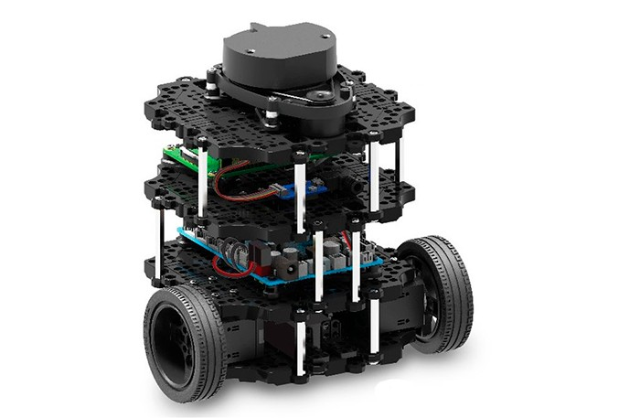
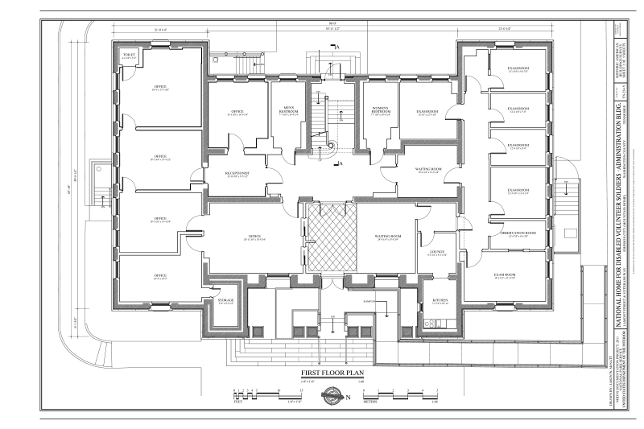
Example: Robots
Scenario: We have a robot that is delivering mail and food in a building. We have a map of the inside of the building. Our robot has some sensors.
How can the robot know where it is?
This is obviously important to carrying out its task
https://www.roscomponents.com/1326-big_default_2x/turtlebot-3.jpg

Slide 3


Idea: Dead-reckoning
Well, if we know where the robot starts, and we know how it drives, we should be able to just track it, right?
This is called Dead-reckoning
Doesn’t work too well
Real Path
Dead-reckoned Path

Slide 4
Why doesn’t this work?!?
different wheel diameters
ideal case
bump
carpet
and many more … sources of uncertainty

Slide 5
Uncertainty? Use probability
Ideal situation for Dynamic Bayesian Network
From last week: x is state (location of robot), z is observation (sensor reading)
New: u is the control (command sent to robot)

Slide 6
Filtering!
Filtering updates our beliefs about the robot’s location
Beliefs = probability distribution over robot poses
Pose = robot position + orientation
<x,y,θ> for ground robots

Slide 7
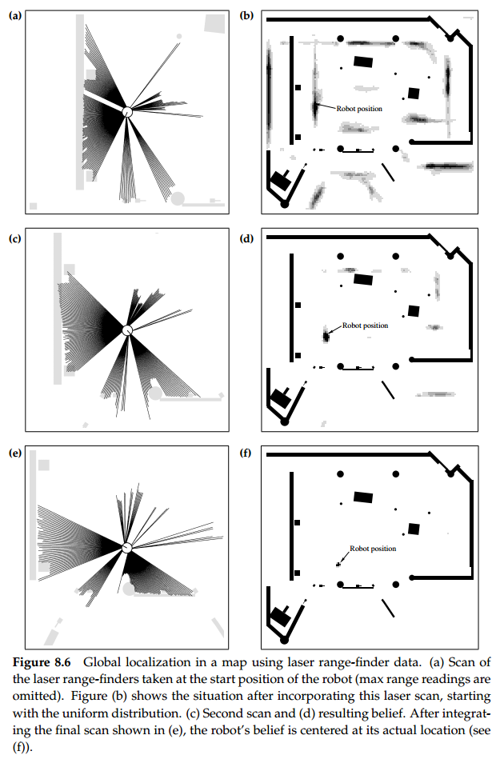
Filtering + Beliefs Example

Slide 8
Filtering + Beliefs Example

Slide 9
Filtering + Beliefs Example

Slide 10
This module:
Focus on robotics as an application
Algorithms work for other domains as well
Filtering algorithms
Other components
Programming assignment: you will code up a successful filter for a robot!

