Slide 1
Tools I use for this project:
Salary
Prediction
🔢 NumPy
🐼 Pandas
using Linear Regression
🤖 Sklearn
📊 Matplotlib
Made by Chanchal kushwah

Slide 2
Overview:
Basically, we want to find out —
if a company has a higher employee rating, do they also pay higher salaries?
To do this, we use a machine learning algorithm called Linear Regression. It draws the best straight line through our data so we can use it to predict salary from any given rating.
Our dataset is called eda_data.csv and it has two columns we care about:
Rating (1.0 to 5.0 stars) → this is our input
avg_salary (in dollars) → this is what we want to predict

Slide 3
Cell 1 — Importing the Libraries
What all this means:
# importing libraries
import pandas as pd
import numpy as np
import matplotlib.pyplot as plt
from sklearn.model_selection import train_test_split
from sklearn.linear_model import LinearRegression
from sklearn.metrics import mean_squared_error, r2_score
pandas helps us load and work with the data like a spreadsheet.
numpy is for math and arrays — sklearn needs it.
matplotlib is what draws the graph at the end.
train_test_split, LinearRegression and mean_squared_error are the actual machine learning tools we'll use.

Slide 4
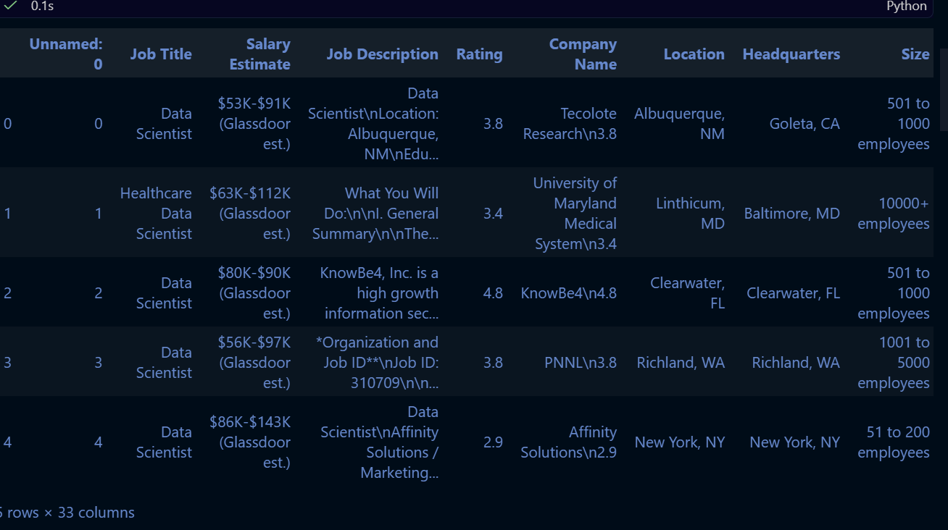
Cell 2 — Loading the Dataset
This reads our CSV file and saves it as a DataFrame called df. Then df.head() just shows us the first 5 rows so we can make sure the data loaded properly.
Df=pd.read_csv(r"C:\Users\dell\OneDrive\Desktop\new project\data.csv\eda_data.csv") df.head()
Data output:

Slide 5
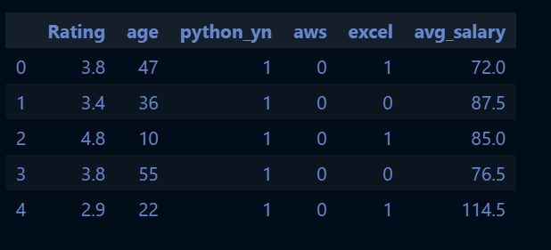
Cell 3 — Selecting Only What We Need
Our CSV has many columns but we only need two — Rating and avg_salary. The dropna() call removes any rows where either of those values is missing. If we skip this step, the model might crash or give bad results.
After this, data.head() shows us the clean version.
data = df[['Rating','age','python_yn','aws','excel','avg_salary']] data = data.dropna() data.head()
The data looks like this:

Slide 6
Cell 4 — Defining X and y
X = data[['Rating','age','python_yn','aws','excel’]] # Independent variable — the input
y = data['avg_salary’] # Dependent variable — the output
X is the input we give to the model — the company rating. y is the answer we want the model to learn to predict — the average salary. We use double brackets for X so it stays as a 2D table, which is what sklearn requires.
Cell 5 — Splitting the Data
X_train, X_test, y_train, y_test = train_test_split(
X, y, test_size=0.2, random_state=42)
We split our 200 rows into two parts. 80% goes into training — the model learns from this. The remaining 20% is set aside for testing — we'll use it later to check if the model actually learned correctly. The random_state=42 just means we get the same split every time we run the code, so our results are consistent.

Slide 7
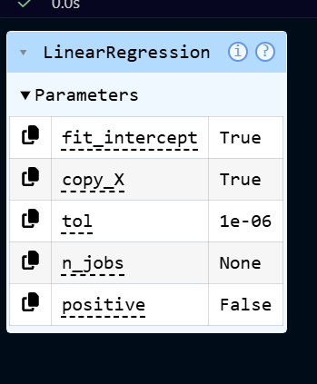
Cell 6 — Training the Model
model = LinearRegression() model.fit(X_train, y_train)
This is where the actual machine learning happens — and it's just two lines of code!
The first line creates a blank Linear Regression model. The second line — model.fit() — feeds it the training data and tells it to find the best straight line that fits through all those points. After this runs, the model has learned two things:

Slide 8
Cell 7 — Making Predictions & Checking Accuracy
y_pred = model.predict(X_test)
print("Model Coefficients:", model.coef_)
print("Model Intercept:", model.intercept_)
print("Mean Squared Error:", mean_squared_error(y_test, y_pred))
print("R2 Score:", r2_score(y_test, y_pred))
Output:
Model Coefficients: [-1.41680304 0.0509647 23.90179566 10.50994118 -2.75280588] Model Intercept: 89.43769162289092 Mean Squared Error: 1440.4587992795266 R2 Score: 0.11872197310029198
What do these numbers mean?
The model has multiple coefficients: [-1.41680304, 0.0589647, 23.90179566, 10.50994118, -2.75280588], each representing how much salary changes per unit increase in the corresponding feature. The intercept is 89.44, which is where the line starts when all features are zero. Together they form our prediction formula.
The Mean Squared Error (MSE) measures how far off our predictions are on average. Our MSE of approximately 1,440 means we're off by about ±$37.95 on average — which is actually pretty decent for a beginner project.
The R2 Score of 0.1187 tells us that the model explains about 11.87% of the variance in the data. This is relatively low, suggesting there may be other important features not yet included in the model that could improve predictions.

Slide 9
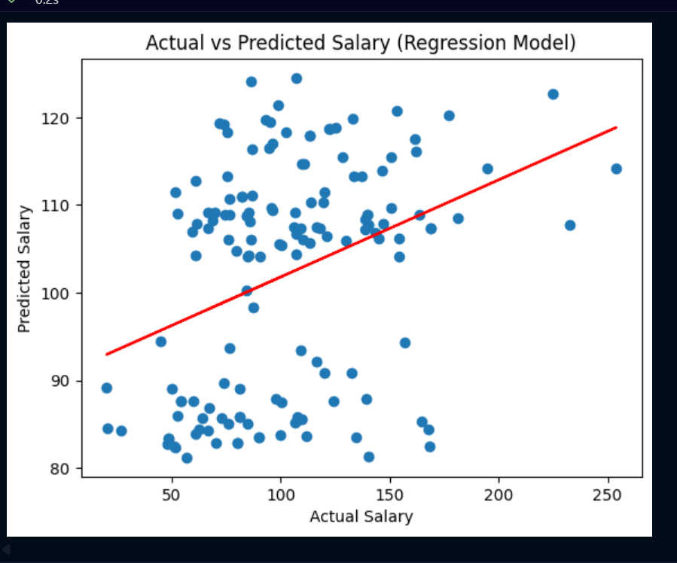
Cell 8 — Plotting the Graph
plt.scatter(y_test, y_pred)
plt.xlabel("Actual Salary")
plt.ylabel("Predicted Salary")
plt.title("Actual vs Predicted Salary (Regression Model)") m, b = np.polyfit(y_test, y_pred, 1)
plt.plot(y_test, m*y_test + b, color='red')
plt.plot()
plt.show()
plt.scatter() draws all the data points, plotting the actual salary on the x-axis against the predicted salary on the y-axis. plt.plot() draws the red regression line through them. The upward slope clearly shows that as actual salary increases, the predicted salary increases too.

Slide 10
Cell 9 — Testing with a New Value
sample = np.array([[4,20,1,1,1]]) prediction = model.predict(sample) print("Predicted Salary:", prediction)
Output:Predicted Salary: [116.44870434]
We pass rating 4.0 as a 2D array because sklearn always expects the input in table format. The model then applies what it learned and gives us the prediction.
We can verify this manually: 15,204 × 4.0 + 19,922 = $80,738 ✅
The model's answer matches the formula exactly, which means it learned correctly. This is our model working in the real world

Slide 11
Thank You!
Chanchal Kushwah
IBM PBEL AI Batch 8 | Salary Prediction Using Regression

