Slide 1
MASG
Chanchal Kumar

Slide 2
Contents
What is MASG ?
How to use ?
Requirements
Future Updates
About Developer

Slide 3
What is MASG ?
MASG application is developed for student of Computer Organization to understand how multiplication and division is done in computer internally by processor. How many registers are required ? What type of registers are required ? And Step-by-Step detail of How it becomes easier by using different multiplication and division Algorithms.

Slide 4
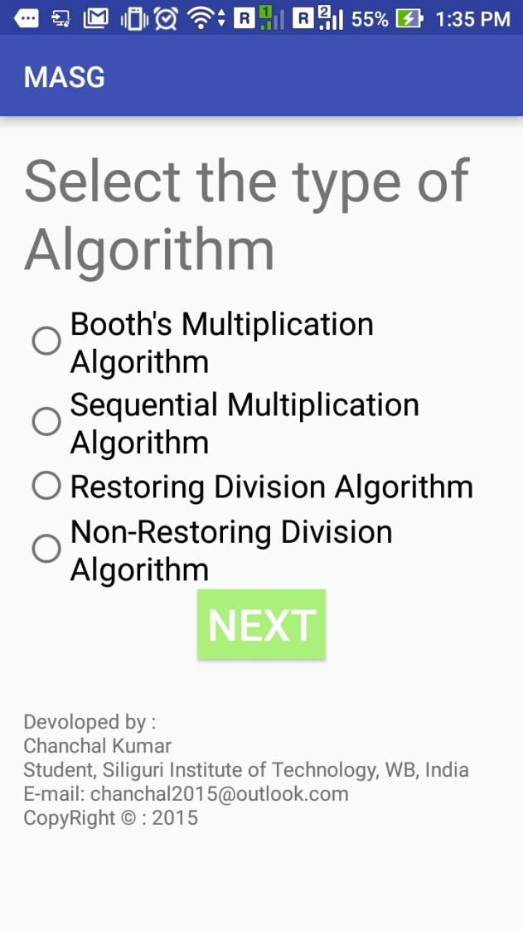
How to use ?
Open the app and select which type of algorithm you want to test.

Slide 5
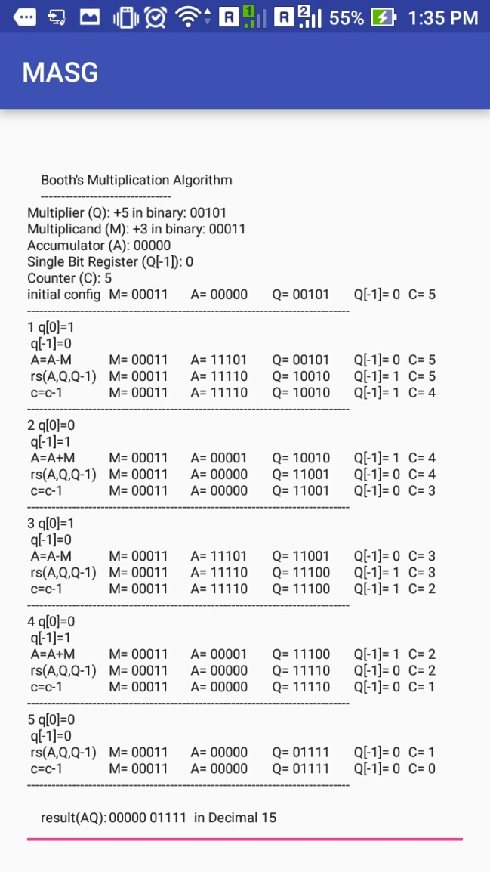
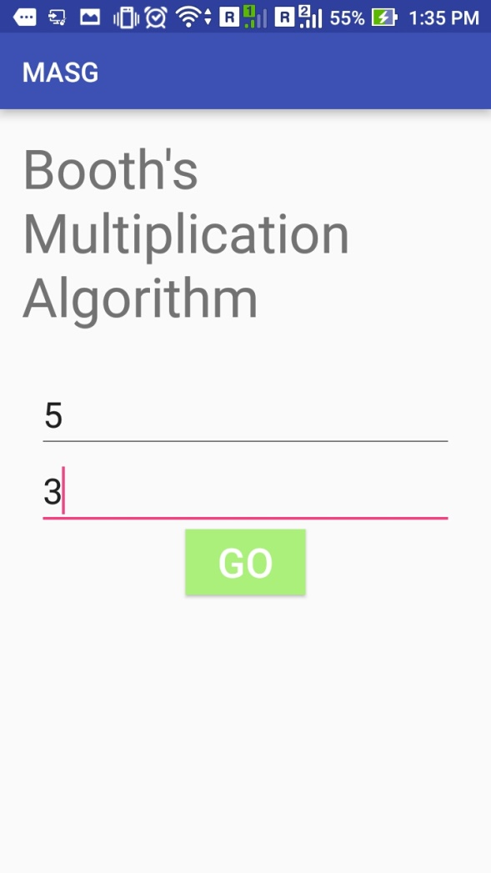
For ex. If you selected Booth Multiplication Algorithm.
Enter operands ( can be any integer ) and touch on “GO”.
<< Here is the result.

Slide 6
Detail of Result Activity
First section is what type of registers used.
Second section is Step-By-Step Processes.
Third section Final is Output in decimal and in binary.
Types of Registers used:
Step-By_Step Detail
Final Output

Slide 7
Some other snapshots to understand it
How to use ?

Slide 8
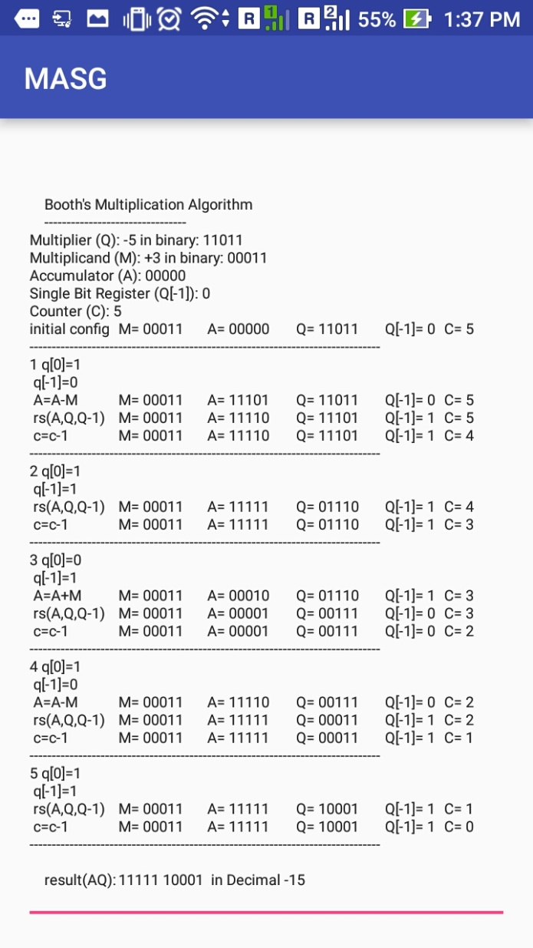
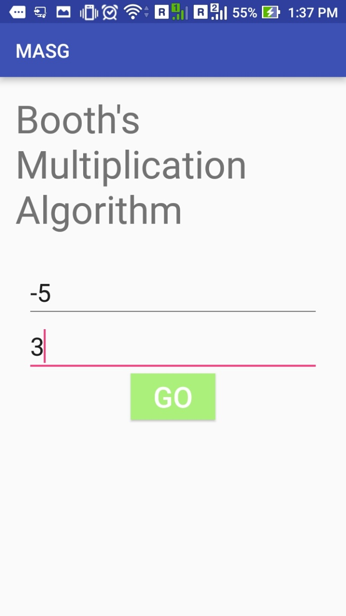

Slide 9
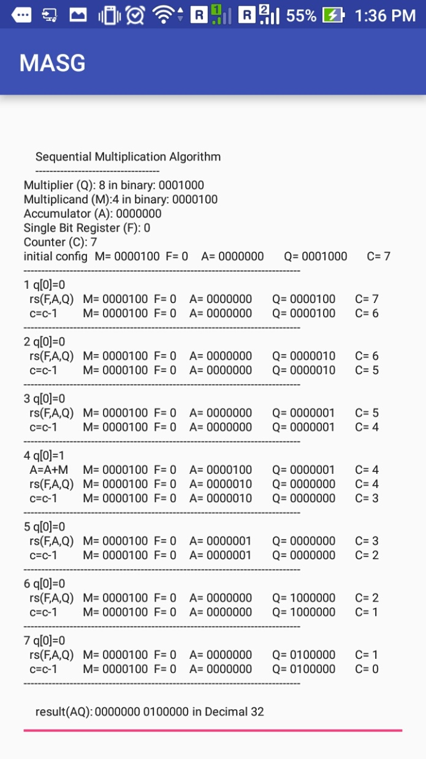
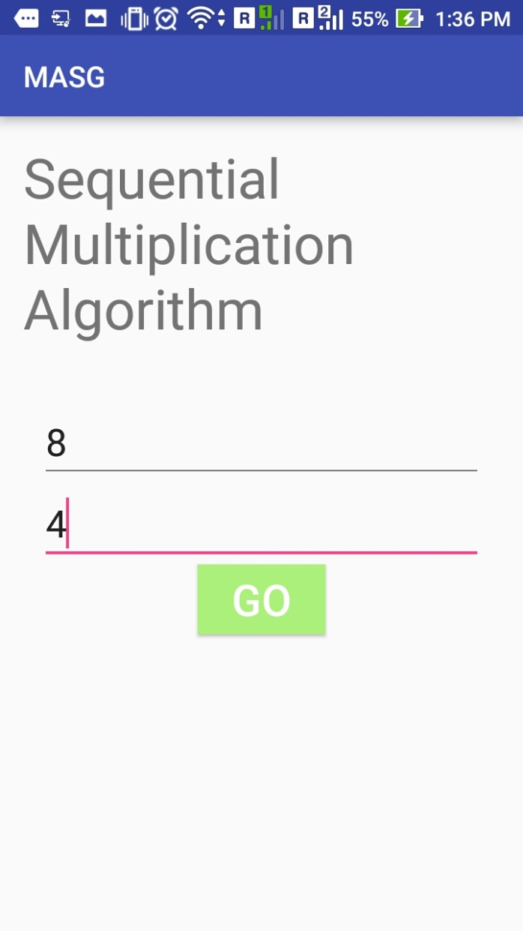

Slide 10
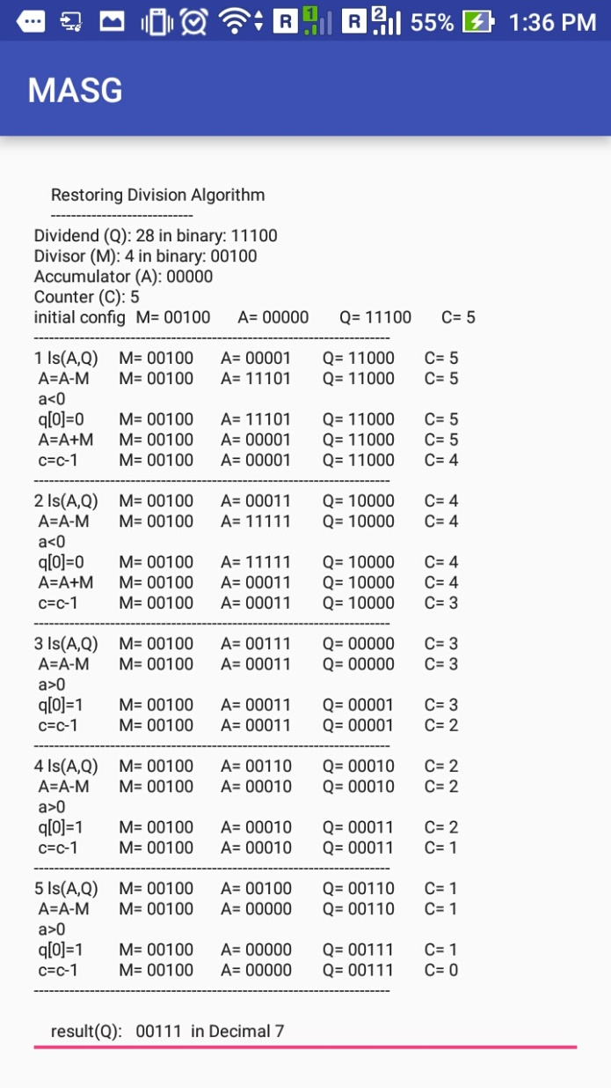
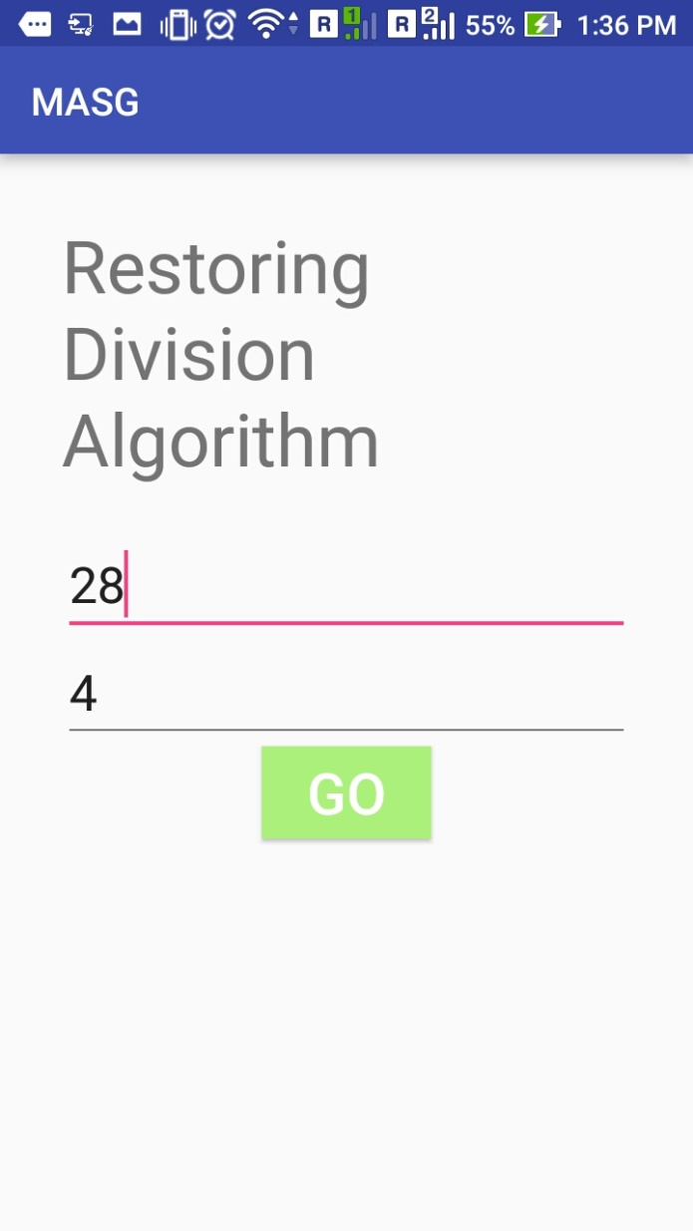

Slide 11
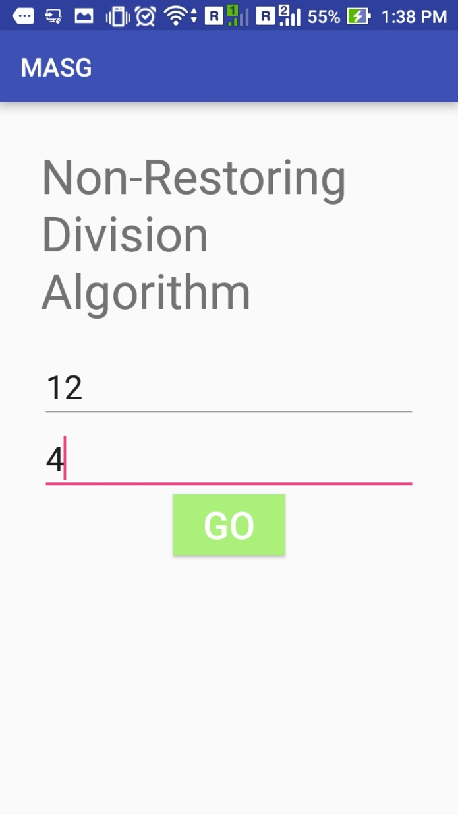
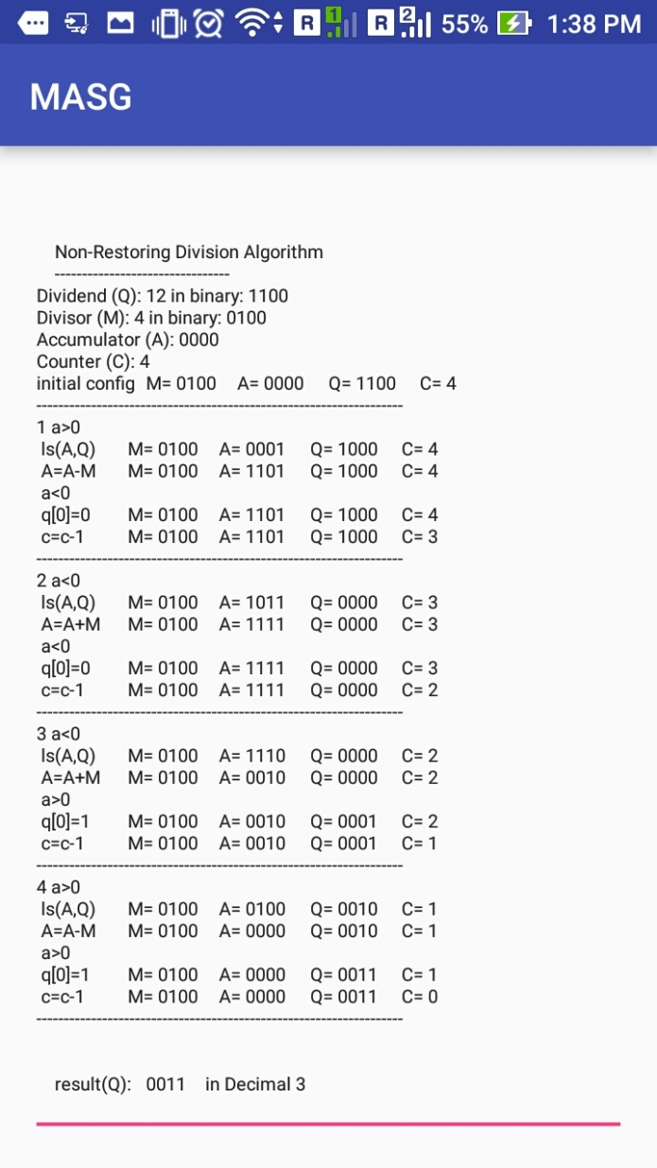

Slide 12
Requirements
Android Operating System
Tested in Android 4.0, 4.4, 5.0, 5.1 & 6.0
Memory space – 20 MB (approx.)
NOTE: memory space requirement depends upon system architecture.

Slide 13
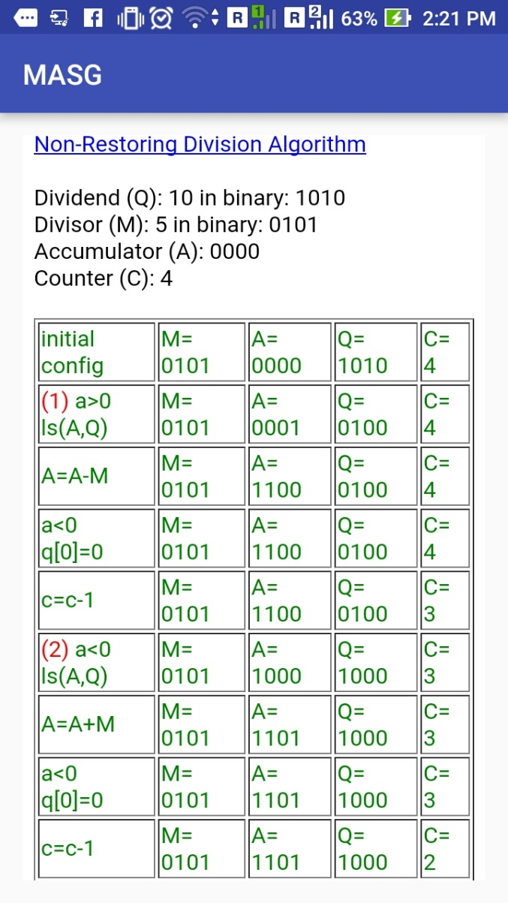
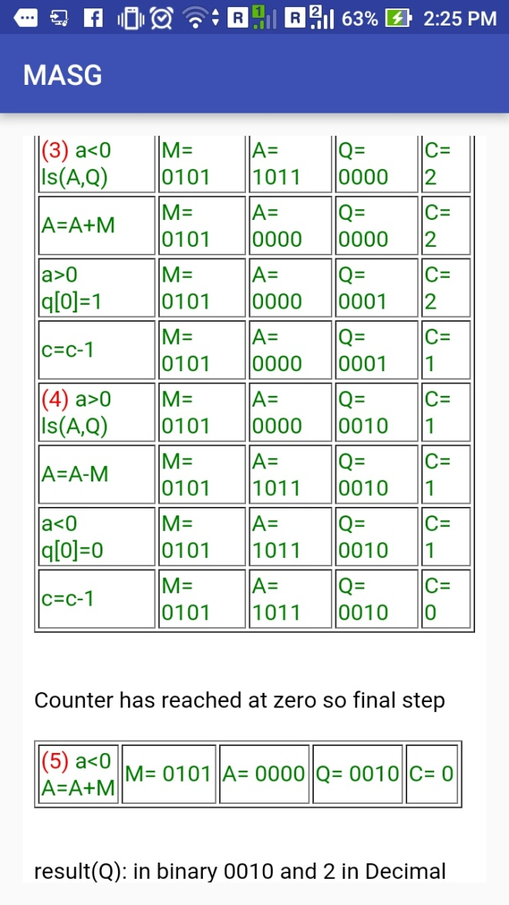
Future Updates
Will support more arithmetic algorithms.
Result Window will be more easier to understand.
These are some snapshots related to future updates.

Slide 14
About DEVELOPER
Chanchal Kumar
Persuing Bachelor of Technology at Siliguri Institute of Technology , District- Darjeeling, WB, India
Email - rrabshrivastava@gmail.com

