Slide 1


-Satyapriya Chaudhari
-Chanchal Kedia
-Akshayajith Radhakrishnan
-Harshit Kanodia

Slide 2
About Haptik
Haptik is India’s first Conversational Commerce platform that is powered by both AI and real humans and we aim to redefine the way people get their everyday jobs done using chat as the underlying interface.
A combination of Artificial Intelligence, Natural Language Process & Machine Learning has helped Haptik create technology that assists their assistants work a lot faster; while the bot learns every time a new query is answered.

Slide 3

Problem Statement
A dataset containing user queries is provided. Each query is tagged by humans with single/multiple (all the applicable domains) domains. The task is to build a multi-label classifier using this training data. The classifier should tag all the possible domains for each query.
Classes: Flights, Trains, Cabs, Reminders, Recharge, Nearby.

Slide 4
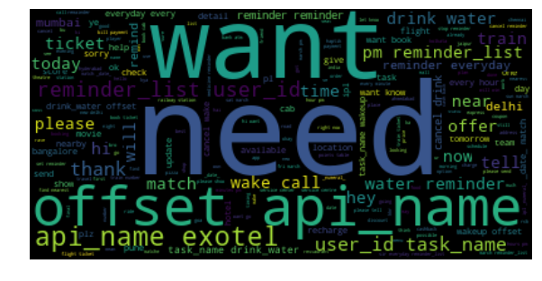
EDA
Word Cloud Before Pre Processing.

Slide 5
Data Cleaning
Total No. of comments: 55402
535 Comments dropped because as No Text Found.

Slide 6
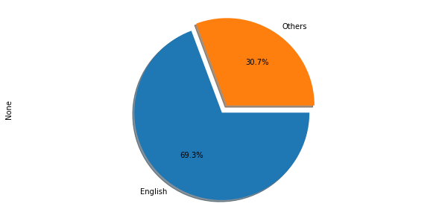
Language Proportion
Data Present in Multiple Languages.
Data Sorting based on Language Proportion.
No. of comments English: 38042

Slide 7
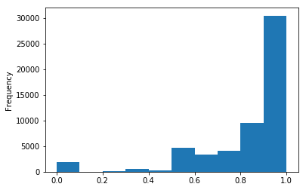
Valid words distribution before processing

Slide 8
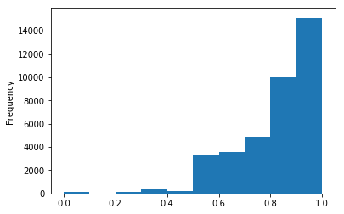
Valid words distribution after processing

Slide 9
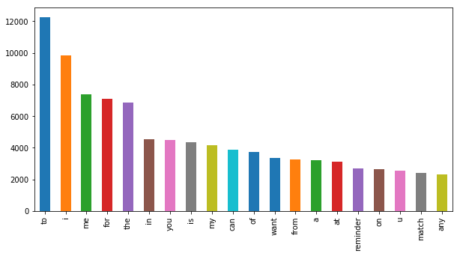
20 Most Frequent Words Before Preprocessing

Slide 10
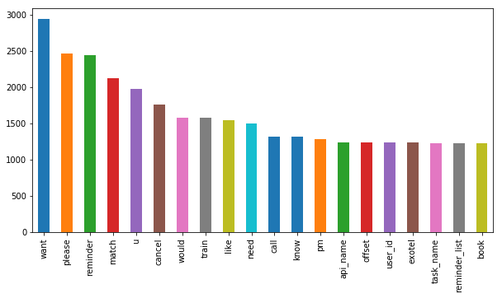
20 Most Frequent Words After Preprocessing

Slide 11
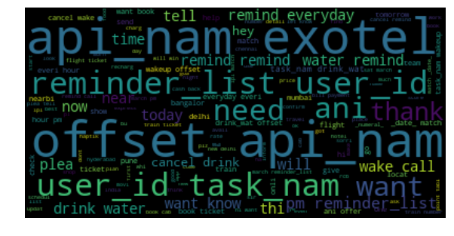
Word cloud after processing

Slide 12
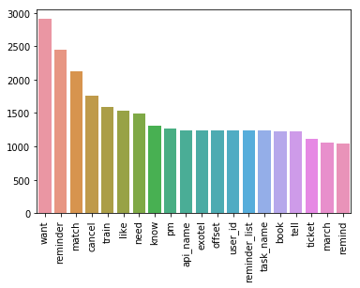
Count Vectorizer

Slide 13
Categorization Constraints

Slide 14
Reminder:
Constraint : Tagged as reminder if the sentence contains the words 'remind', 'alarm', 'offset', ‘meet' or 'wake up’ anywhere.
Examples:
stop reminding
could you please show up my reminders once again ?
"i would like to cancel my drink water reminder reminder for everyday at every 30 minutes from 10:00 am to 8:00 pm. { reminder_list: 721696, user_id: 1985513, task_name: drink_water, offset: 0, api_name: exotel }"

Slide 15
Nearby:
Constraint : Tagged as a ‘Nearby’ sentence if contains either 'near','around','close to’,’far’
Examples:
where is subway near my location
ok then which is the nearest open mcd from my location?il go myself
i need the nearest bbq restaurant
hotels around forti malar hospital, chennai
Can you find me a hotel in delhi for 2nd December to 5 December for 2 adults close to hauz khaz village
not at all. it shows 1.5 km far

Slide 16
Trains:
Constraint: Tagged as a Train related sentence if contains either of 'train', 'rail', 'pnr', 'platform', 'berth', 'express', 'tatkal‘
Examples:
I need to book a train ticket
pnr status please
Please book for bhopal express now
cst railway station
Information about tatkal tiket
can you check on which platform train no. 12248 will come?
"thanjavur to chennai egmore 05/03/17 night one berth"

Slide 17
Recharge:
Constraint : Tagged as a recharge if either of the conditions is satisfied:
matches regex ‘\s((\d+?\s?[Rr]s)|([Rr]s\s?\d+))\s’ (basically finds Rs. ,rs., rs or Rs)
or if contains any of these words ‘recharge','₹','airtel','vodafone','jio','reliance','idea','docomo','bsnl','mtnl','dth‘
Examples:
Can i know about airtel 53 rs 1g net pack
there is no recharge of rs 99
i meed recharge on discount
to is paise recharge kar sakte h na
recharge my jio

Slide 18
Flights:
Constraint : Tagged as Flight if contains either of 'flight', 'plane', 'airway', 'ticket'
Examples:
How much is d ticket cosr
Would like to get reminded to call jetairways this evening at 8-15 pm.
MakeMyTrip coupon code for flight tickets
no i got another plane ..any other way?

Slide 19
Cabs:
Constraint : Tagged as Flight if contains either of 'cab', 'taxi', 'auto', 'rick'
Examples:
any offer available on cab.?
need taxi or cab for 13 people from udaipur to mountabu
hey. can you please book me a ola auto

Slide 20
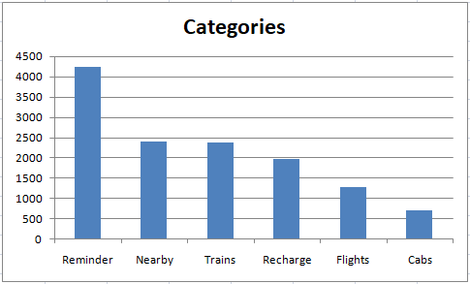
Feature Engineering

Slide 21
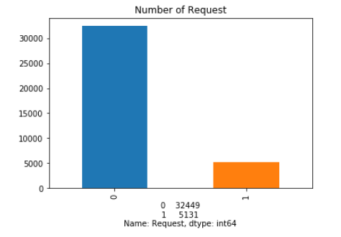
No. of Request identified in Dataset

Slide 22
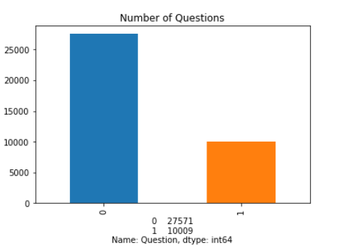
No. of Question identified in Dataset

Slide 23
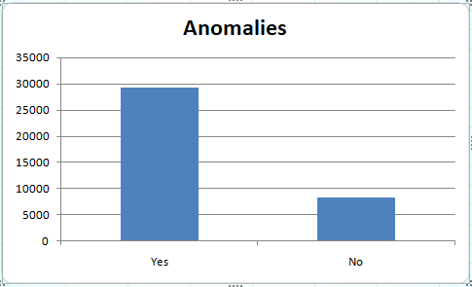
Anomalies Labeled in train data

Slide 24
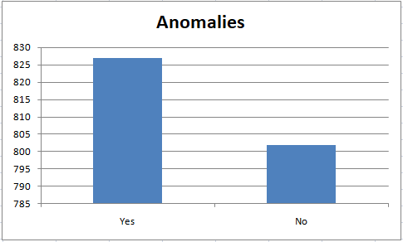
Distribution of Anomalies in evaluation data

Slide 25
Classifiers

Slide 26
Count Vectorizer and MultinomialNB
Used Unigram and Bigram
Accuracy on Test Data – 93.97%
Accuracy on Evaluation Data- 61.59%

Slide 27
OneVsRest Classifier
With Linear SVC
Accuracy on Evaluation Data - 61.59%
label | Precision | Recall | F1 Score
0 | 0.87 | 0.2 | 0.32
1 | 0.56 | 0.97 | 0.71
Avg | 0.71 | 0.59 | 0.52

Slide 28
Decision Tree Classifier
Accuracy on Evaluation Data - 61.59%
label | Precision | Recall | F1 Score
0 | 0.87 | 0.2 | 0.32
1 | 0.56 | 0.97 | 0.71
Avg | 0.71 | 0.59 | 0.52

Slide 29
Random Forest Classifier
Accuracy on Evaluation Data - 61.59%
label | Precision | Recall | F1 Score
0 | 0.88 | 0.2 | 0.32
1 | 0.56 | 0.97 | 0.71
Avg | 0.72 | 0.59 | 0.52

Slide 30
Further Steps:
Using Better Classification Models.
Named Entity Recognition.
Improving individual Labeling.

Slide 31
Thank You!!

