Slide 1
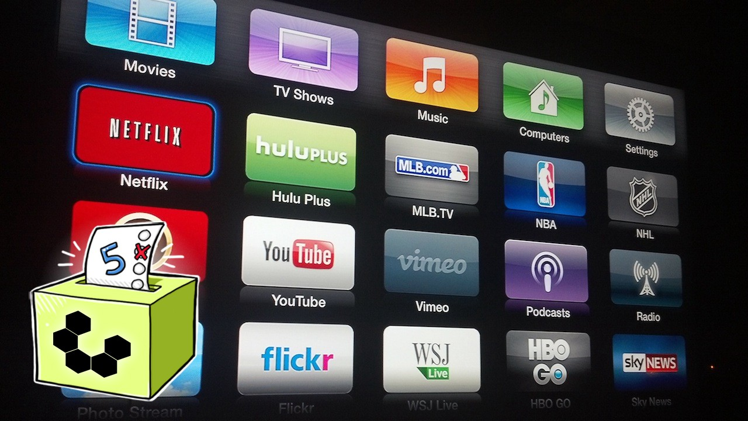
Clever Tap
CleverTap

Slide 2

What CleverTap Does?
Clever Tap helps business grow faster.
It helps building long term valuable customers relationships.
By:
-Giving access to behavioural analytics info. -Provides an engagement platform that helps business to reach its customer.
Capstone Project Members:
-Chanchal kedia
-Satyapriya Chaudhari
-Akshata Howal
-Renuka Srivastava

Slide 3
Problem Statement
To identify the propensity for a video app.
To know the how many users are going to watch the video in next 2 days.
Segmenting the audience based on their engagement with the app.

Slide 4

Pipeline
Obtaining the data
Scrubbing or cleaning the data
Exploring the Data
Modelling the data
Interpreting the data

Slide 5
The Data..
Unsupervised Dataset based on events: Registered, AppLaunched, AppUninstalled, UTMVisited, VideoStarted, VideoDetails
Features:
Discrete [ UserId, Date, VideoId]
Continous [ Minute_Of_Day, Second]
Categorical [Country, State, OS, Device, Genre, ProgramType, Category, Status]
There are no null values in the datasets in the columns

Slide 6
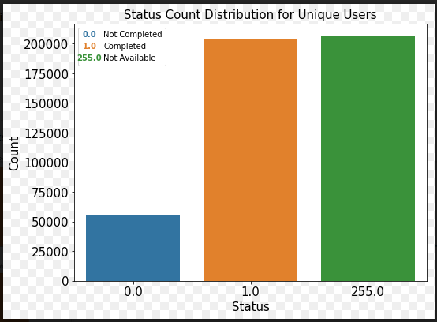
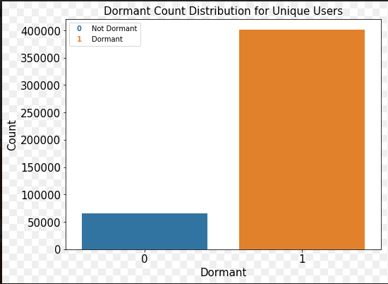
EDA

Slide 7
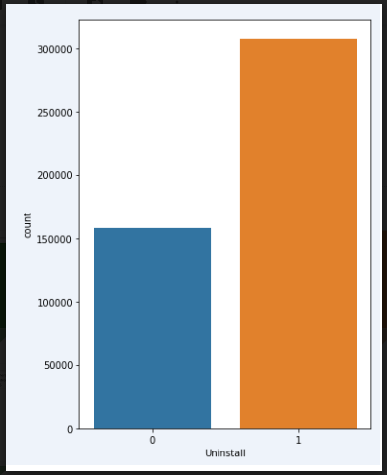

Slide 10
The Users who has interacted with App through Ad Campaign

Slide 11
Master Data..
Discrete
[UserId, Last_Date, Frist_Date, VideosWatched_in_diff_Quarters, Activity_in_diff_Quarters, No_Of_Uninstalled, Reinstall, Uniques Genre(54), Uniques ProgramType(4), Unique Genre Proportion, Unique ProgramType Proportion]
Continous
[Second_Of_Day, NumberOfAdCampaignInteracted, NumberOfAppLaunches, Avg_time_bw_visits, Count_of_Visits, ]
Categorical [Status, Country, State, OS, Device, Uninstall, Dormant,]
Null Values
Categorical features by int 255
Discrete & Continous features by 0
Unique Users
466124
Features:
145

Slide 12
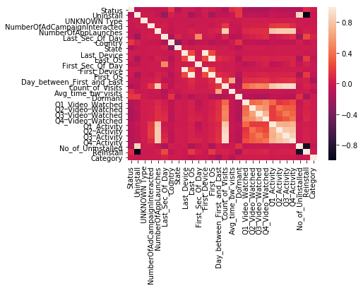
EDA On
Master Data..
Columns Dropped:
Genre
ProgramType
Activity_in_diff_Quarters
Uninstall
Reinstall
Country
Count_Of_Visit
First_Device
First_OS

Slide 13
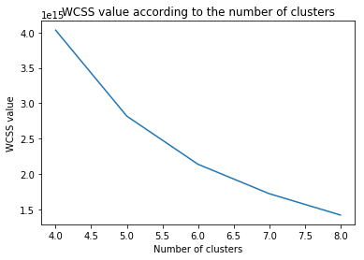
Unsupervised Data
Identifying No Clusters Using Elbow Method

Slide 14
Identifying Clusters
KMeans - 5 distinct clusters
0 - 'Dormant',
1 - 'Hyper Active User',
2 - 'Active User',
3 - 'Hyper Active Guest',
4 - 'Active Guest'
Target Variable created through these cluster labels.

Slide 15
Algorithm and Methodology
PCA was done to reduce the dimension to 2 features.
train-val-test: 70-10-20
Multi class Classification problem
Logistic Regression
Support Vector Machine

Slide 16
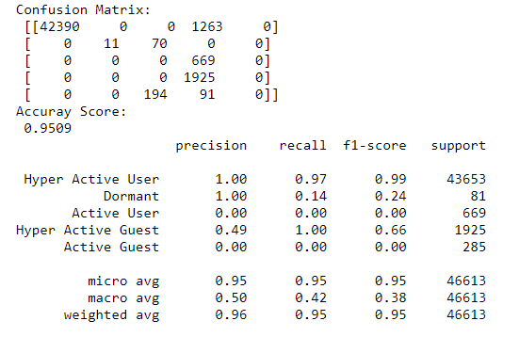
ML Models
Logistic Regression (Validation Data) :

Slide 17
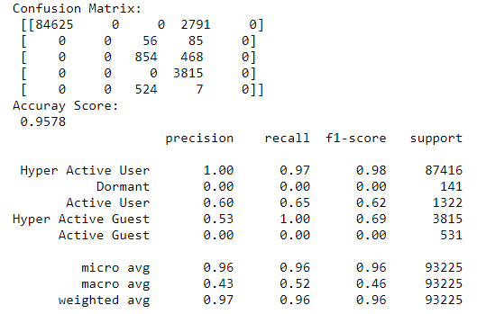
ML Models
Logistic Regression with Bagging Classifier: (Validation Data)

Slide 18
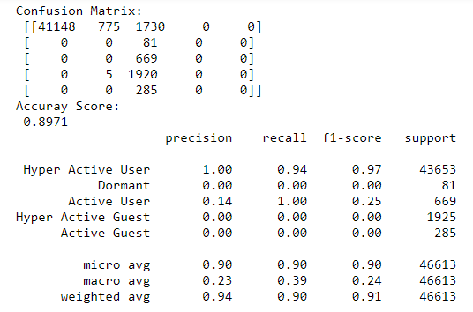
ML Models
SVM (Validation Data):

Slide 19
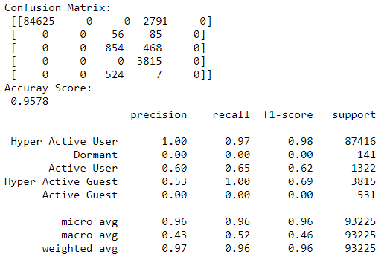
Model Selection
Logistic Regression With Bagging Classifier (Test Data)
Logistic Regression With Bagging Classifier with Best Recall Score so that most of the active users are identified.

Slide 20
Future Works
More Insights into Data
Distinct Clusters
Better Understanding and application of TSNE

