Slide 1
Chap 10. Index

Slide 2
Indexing
Goals:
  Store large files
  Support multiple search keys
  Support efficient insert, delete, and range queries

Slide 3
Terms(1)
Entry sequenced file: Order records by time of insertion.
  Search with sequential search
Index file: Organized, stores pointers to actual records.
  Could be organized with a tree or other data structure.
Notes:
Entry sequenced files are not practical as an organization for large databases

Slide 4
Terms(2)
Primary Key: A unique identifier for records. May be inconvenient for search.
Secondary Key: An alternate search key, often not unique for each record. Often used for search key.

Slide 5
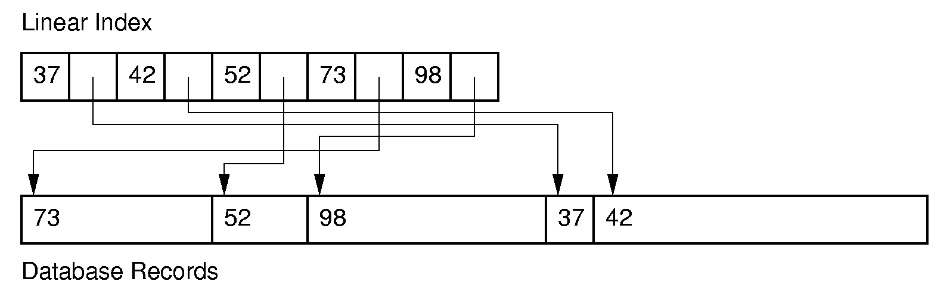
Linear Indexing
Linear index: Index file organized as a simple sequence of key/record pointer pairs with key values are in sorted order.
Linear indexing is good for searching variable-length records.
Notes:
A linear index is good for indexing an entry sequenced file.

Slide 6
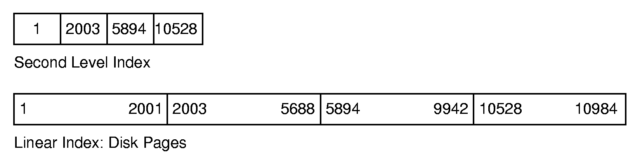
Linear Indexing (2)
If the index is too large to fit in main memory, a second-level index might be used.
Notes:
Second level index stores the first key for each disk page.

Slide 7
Tree Indexing (1)
Linear index is poor for insertion/deletion.
Tree index can efficiently support all desired operations:
  Insert/delete
  Multiple search keys (multiple indices)
  Key range search

Slide 8
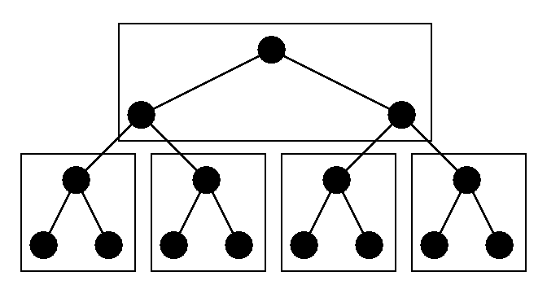
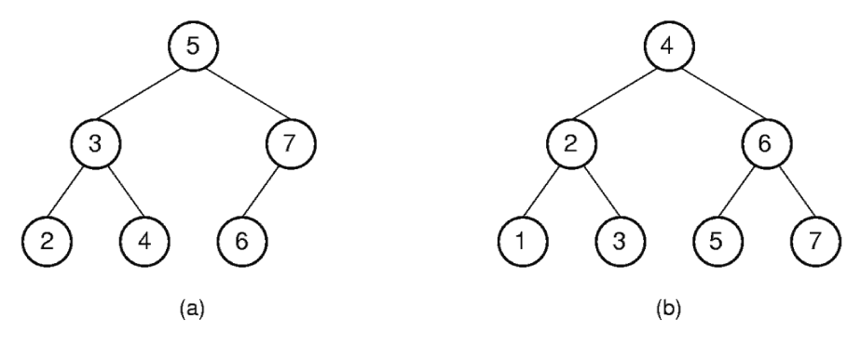
Tree Indexing (2)
Difficulties when storing tree index on disk:
  Tree must be balanced.
  Each path from root to leaf should cover few disk pages.
Notes:
Second figure illustrates how difficult it can be to keep a tree balanced. In this case, rebalancing the BST to maintain the complete tree shape requires that all nodes be moved. This is too expensive to be practical.

Slide 9

补充：二叉平衡树
（AVL树）
The AVL tree is named after its two inventors, G.M. Adelson-Velskii and E.M. Landis, who published it in their 1962 paper "An algorithm for the organization of information."

Slide 10
一棵AVL树或者是空树，或者是具有下列性质的二叉搜索树：它的左子树和右子树都是AVL树，且左子树和右子树的高度之差的绝对值不超过1。
A
C
B
A
D
C
D
E
B
E
不平衡
平衡

Slide 11
结点的平衡因子
(balance factor)
每个结点附加一个数字, 给出该结点右子树的高度减去左子树的高度所得的高度差, 这个数字即为结点的平衡因子。
AVL树任一结点平衡因子只能取
-1, 0, 1

Slide 12
如果一个结点的平衡因子的绝对值大于1, 则这棵二叉搜索树就失去了平衡, 不再是AVL树
如果一棵二叉搜索树是平衡的,
且有 n个结点，其高度可保持在
O(log₂n),平均搜索长度也可保持在O(log₂n)。

Slide 13
5
5
4
8
4
8
2
2
是平衡树
1
不是平衡树

Slide 14
平衡化旋转
如果在一棵平衡的二叉搜索树中插入一个新结点，造成了不平衡。此时必须调整树的结构，使之平衡化。
平衡化旋转有两类：
  单旋转 (左旋和右旋)
  双旋转 (左旋加右旋和右旋加左旋)

Slide 15
每插入一个新结点时，AVL树中相关结点的平衡状态会发生改变。因此，在插入一个新结点后，需要从插入位置沿通向根的路径回溯，检查各结点的平衡因子。
如果在某一结点发现高度不平衡，停止回溯。从发生不平衡的结点起，沿回溯的路径取直接下两层的结点。

Slide 16
如果这三个结点处于一条直线上，则采用单旋转进行平衡化 单旋转可按其方向分为左单旋转和右单旋转, 其中一个是另一个的镜像,其方向与不平衡的形状相关；
右单旋转
LL型
左单旋转
RR型

Slide 17
如果这三个结点处于一条折线上，则采用双旋转进行平衡化 双旋转分为先左后右和先右后左两类。
左右双旋转
LR型
右左双旋转
RL型

Slide 18
左单旋转
(RotateLeft)

Slide 19
+1
A
+2
A
C
0
B
0
C
B
+1
C
A
0
E
h
D
E
h
D
E
B
D
h
+
1
h
h
h
h
+
1
h
h
在子树E中插入新结点，该子树高度增1导致结点A的平衡因子变成+2，产生不平衡。
以结点C为旋转轴，反时针旋转。

Slide 20
右单旋转
( RotateRight)

Slide 21
A
-1
A
-2
-1
C
0
B
B
0
C
B
D
0
A
D
E
h
D
E
h
h
+
1
E
C
h
h
h
+
1
h
h
h
在子树D中插入新结点, 该子树高度增 1导致结点 A的平衡因子变成 -2，产生不平衡。
以结点B为旋转轴，顺时针旋转。

Slide 22
先左后右双旋转
(RotationLeftRight)

Slide 23
在F或G中插入新结点，该子树高度增1导致A的平衡因子变成-2。
A
A
-2
-1
0
+1
B
0
C
B
C
0
-1
E
h
D
E
h
D
F
G
h
F
G
h
h-1
h-1
h
h-1
左单
旋转
插入
首先以结点E为旋转轴，将结点B反时针旋转，以E代替原来B的位置，做左单旋转

Slide 24
右单
旋转
A
-2
0
E
-2
0
+1
E
0
C
B
A
0
G
B
h
D
F
G
C
h-1
D
F
h
h
h-1
h
h
h
再以结点E为旋转轴，将结点A顺时针旋转，做右单旋转。

Slide 25
先右后左双旋转
(RotationRightLeft)

Slide 26
在子树F或G中插入新结点，该子树高度增1 导致A的平衡因子变成2，产生不平衡。
+1
A
A
0
-1
B
0
C
0
右
单
旋
转
B
C
0
1
h
D
0
D
E
h
0
E
F
G
F
G
h
h
h-1
h-1
h-1
h
插入
首先以D为旋转轴，将C顺时针旋转，以D代替原C的位置,做右单旋转

Slide 27
+2
A
左单
旋转
D
0
+2
-1
0
B
D
A
C
h
0
0
F
C
B
F
G
E
h-1
G
E
h
h
h-1
h
h
h
再以结点D为旋转轴，将结点A反时针旋转，做左单旋转

Slide 28
构造二叉平衡（搜索）树的方法
在插入过程中，采用平衡旋转技术
依次插入的关键字为5, 4, 2, 8, 6, 9
5
4
4
4
2
5
2
6
2
5
8
8
向右旋
转一次
先向右旋转
再向左旋转
6

Slide 29
向左旋转一次
4
2
6
5
8
9
6
4
8
继续插入关键字 9
2
5
9

Slide 30
输入关键码序列为 { 16, 3, 7, 11, 9, 26, 18, 14, 15 } 插入和调整过程如下
-2
-1
0
0
1
16
16
1
7
16
0
0
0
7
-1
3
3
0
左右
双旋
3
16
3
16
0
7
2
11
7
-2
2
1
7
7
1
3
16
0
-1
3
11
3
11
1
0
11
右单旋
0
0
9
16
9
16
0
9
26

Slide 31
1
0
11
左单旋
11
2
0
1
右左
双旋
7
16
7
16
-1
3
9
26
3
9
26
0
18
1
0
11
-1
11
0
7
18
7
18
-1
0
0
3
9
16
26
3
9
16
26
0
14

Slide 32
2
1
11
-2
左右双旋
11
-1
7
-2
18
7
18
0
3
9
16
26
3
9
15
26
1
0
0
14
0
14
16
15

Slide 33
2-3 Tree (1)
A 2-3 Tree has the following properties:
  A node contains one or two keys
  Every internal node has either two children (if it contains one key) or three children (if it contains two keys).
  All leaves are at the same level in the tree, so the tree is always height balanced.
The 2-3 Tree has a search tree property analogous to the BST.

Slide 34
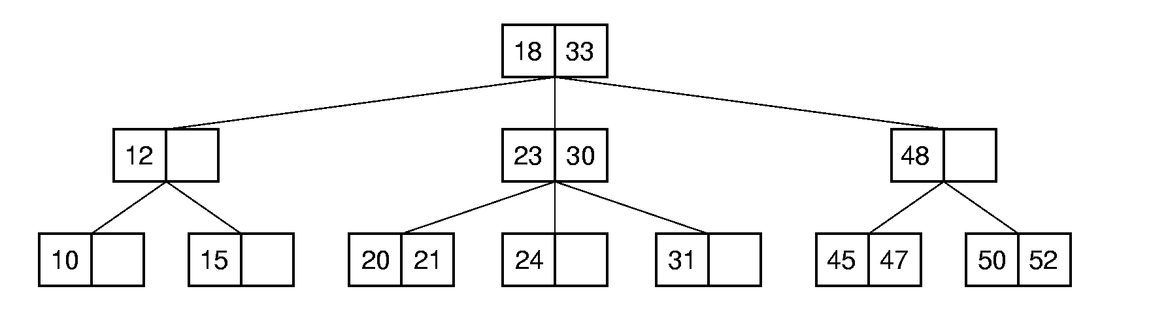
2-3 Tree (2)
The advantage of the 2-3 Tree over the BST is that it can be updated at low cost.

Slide 35
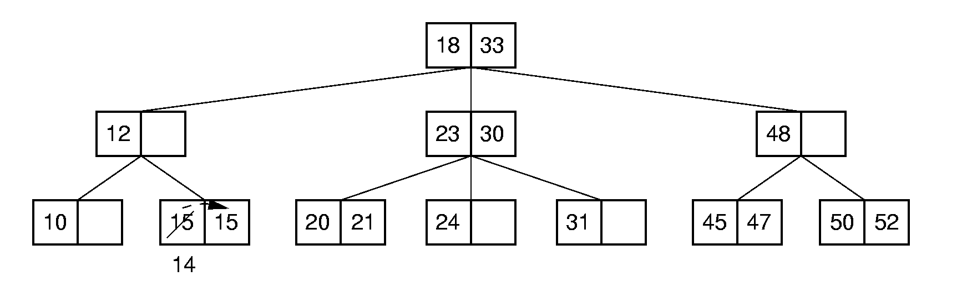
2-3 Tree Insertion (1)

Slide 36
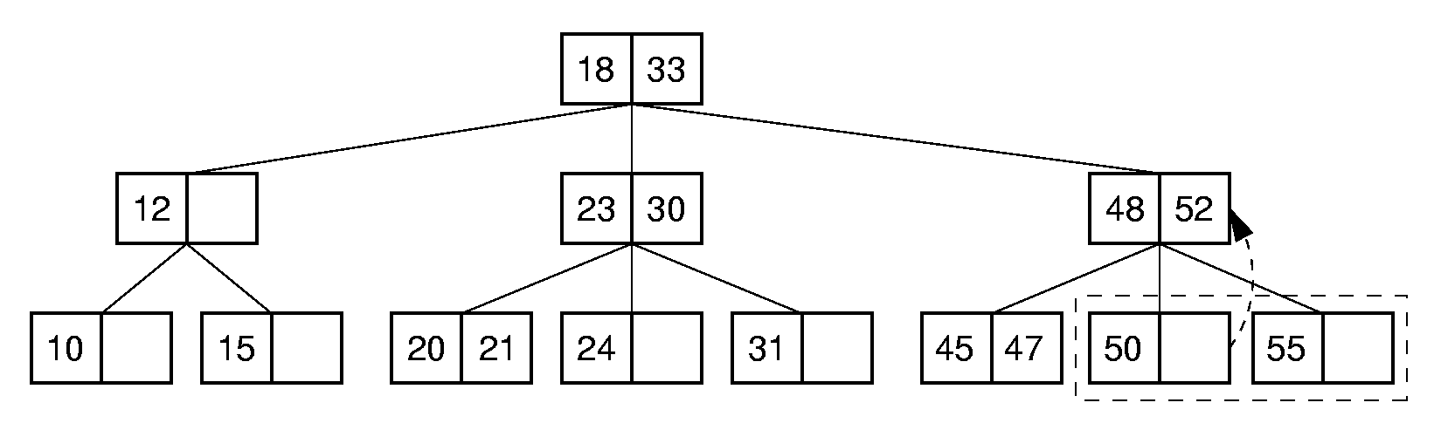
2-3 Tree Insertion (2)

Slide 37
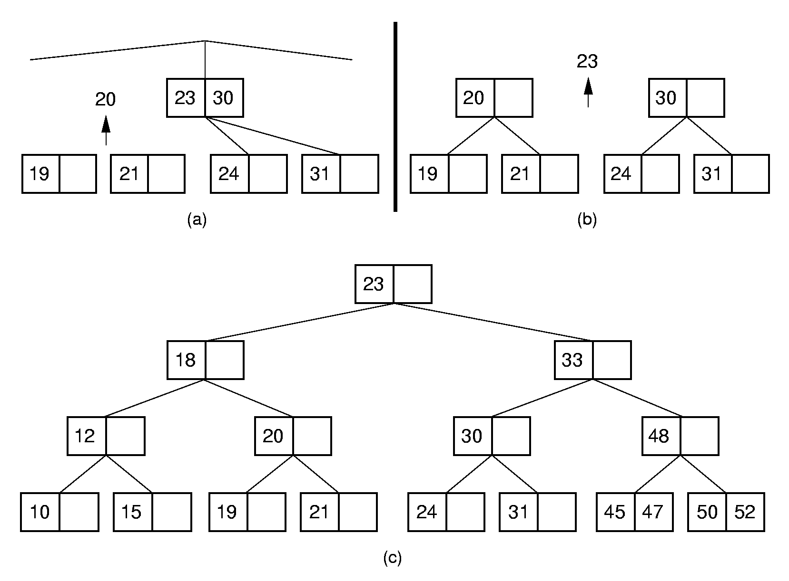
2-3 Tree Insertion (3)

Slide 38
B-Trees (1)
The B-Tree is an extension of the 2-3 Tree.
The B-Tree is now the standard file organization for applications requiring insertion, deletion, and key range searches.

Slide 39
B-Trees (2)
B-Trees are always balanced.
B-Trees keep similar-valued records together on a disk page, which takes advantage of locality of reference.
B-Trees guarantee that every node in the tree will be full at least to a certain minimum percentage. This improves space efficiency while reducing the typical number of disk fetches necessary during a search or update operation.

Slide 40
B-Tree Definition
A B-Tree of order m has these properties:
  The root is either a leaf or has at least two children.
  Each node, except for the root and the leaves, has between ⎡m/2⎤ and m children.
  All leaves are at the same level in the tree, so the tree is always height balanced.
A B-Tree node is usually selected to match the size of a disk block.
  A B-Tree node could have hundreds of children.

Slide 41
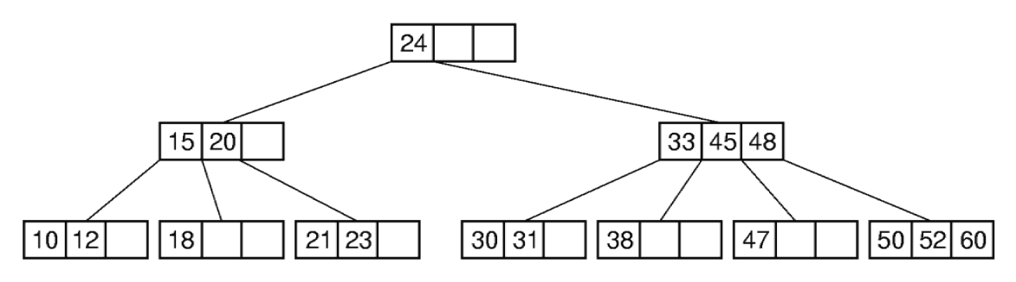
B-Tree Search (1)
Search in a B-Tree is a generalization of search in a 2-3 Tree.
  Do binary search on keys in current node. If search key is found, then return record. If current node is a leaf node and key is not found, then report an unsuccessful search.
  Otherwise, follow the proper branch and repeat the process.

Slide 42
B⁺-Trees
The most commonly implemented form of the B-Tree is the B⁺-Tree.
Internal nodes of the B⁺-Tree do not store record -- only key values to guild the search.
Leaf nodes store records or pointers to records.
A leaf node may store more or less records than an internal node stores keys.

Slide 43
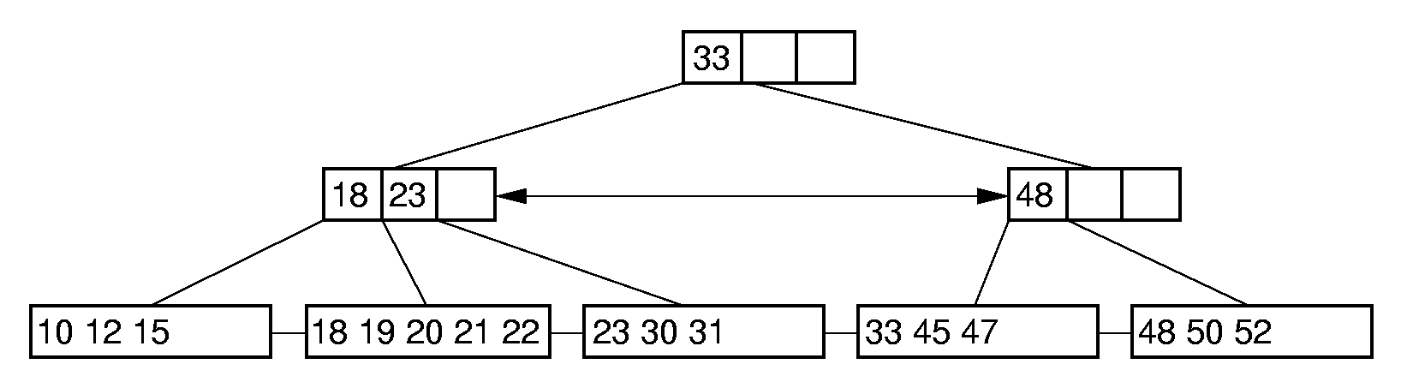
B⁺-Tree Example

Slide 44
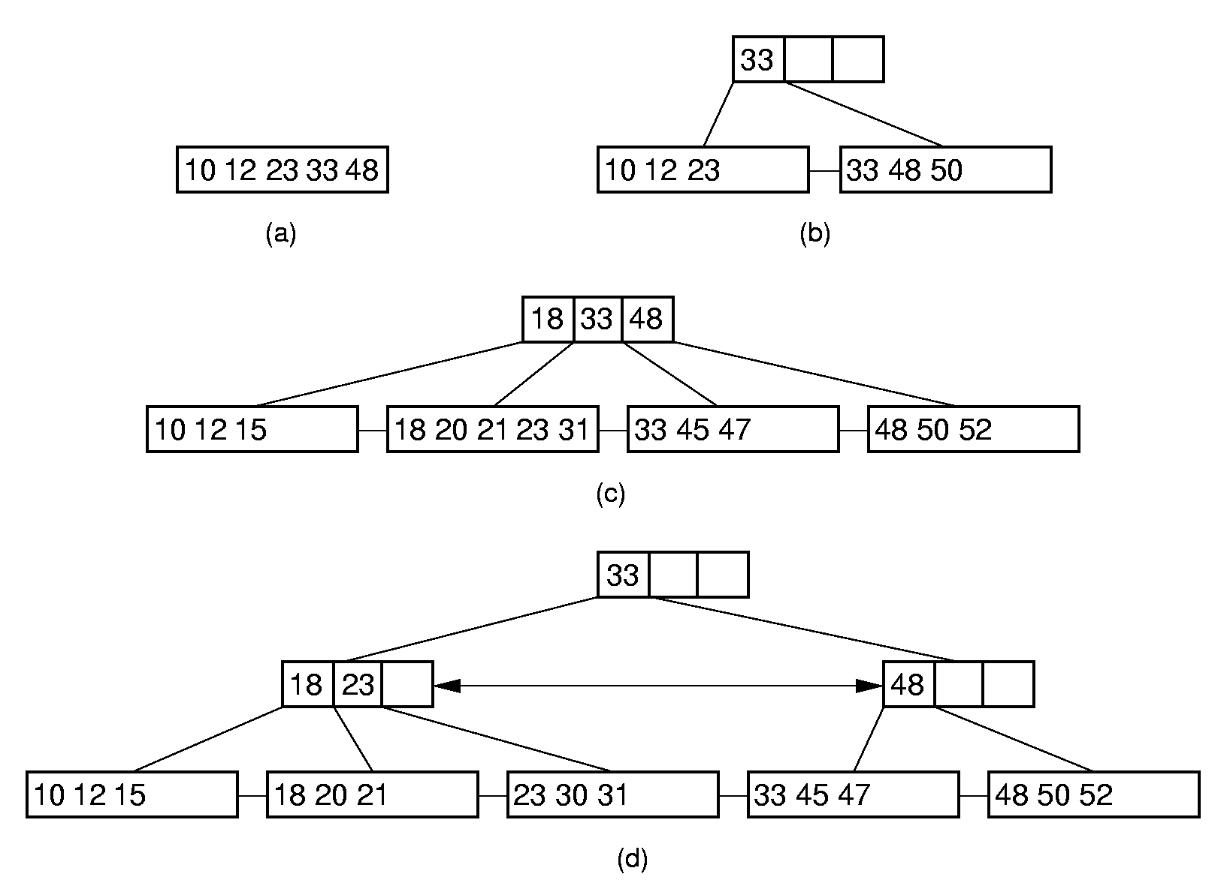
B⁺-Tree Insertion

Slide 45
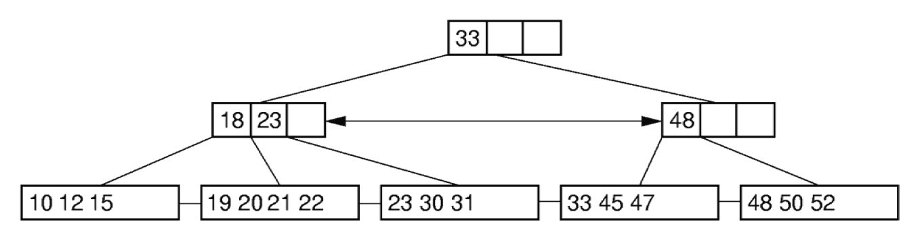
B⁺-Tree Deletion (1)
Notes:
Delete 18

Slide 46
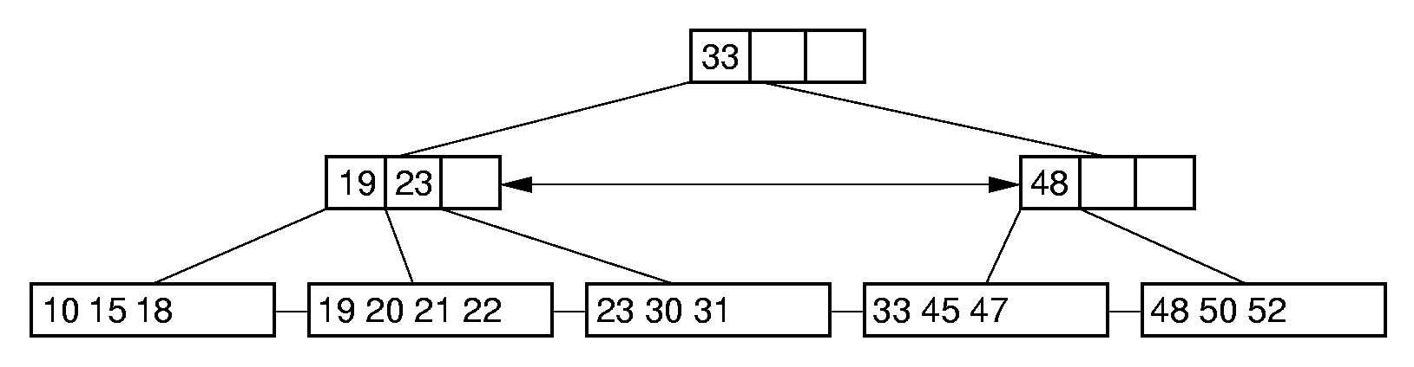
B⁺-Tree Deletion (2)
Notes:
Delete 12. Borrow 18 from the second child.

Slide 47
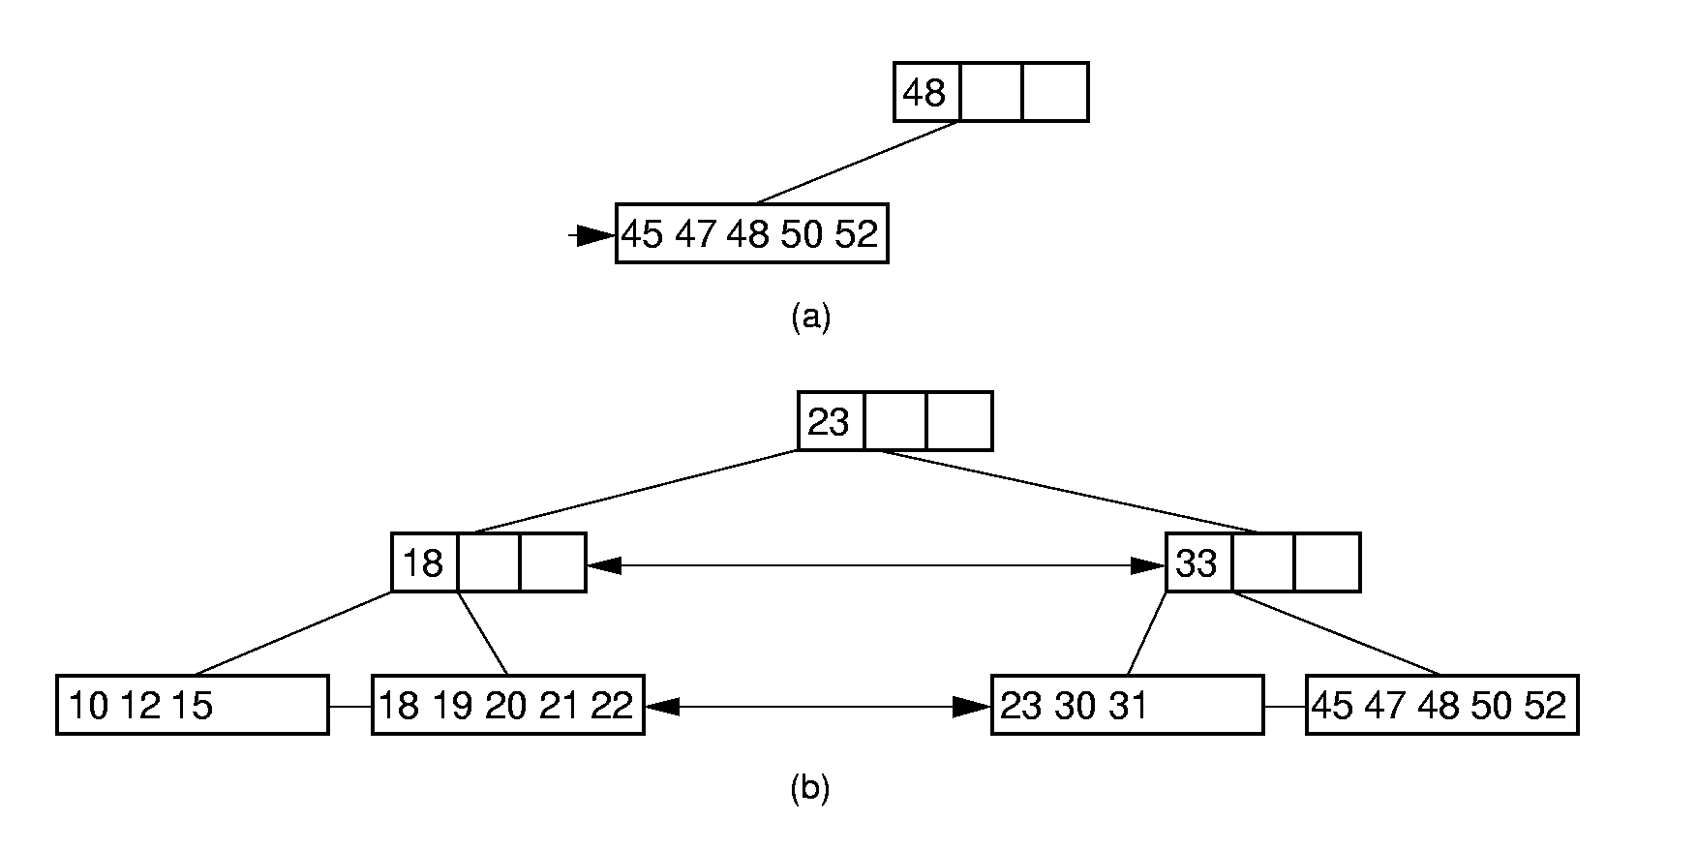
B⁺-Tree Deletion (3)
Notes:
Delete 33

Slide 48
B-Tree Space Analysis (1)
B⁺-Trees nodes are always at least half full.
The B*-Tree splits two pages for three, and combines three pages into two. In this way, nodes are always 2/3 full.
Asymptotic cost of search, insertion, and deletion of nodes from B-Trees is Θ(log n).
  Base of the log is the (average) branching factor of the tree.

Slide 49
B-Tree Space Analysis (2)
Example: Consider a B+-Tree of order 100 with leaf nodes containing 100 records.
  1 level B+-tree:
  2 level B+-tree:
  3 level B+-tree:
  4 level B+-tree:
Ways to reduce the number of disk fetches:
  Keep the upper levels in memory.
  Manage B+-Tree pages with a buffer pool.
Notes:
1 level: Min 0, Max 100
2 level: Min: 2 leaves of 50 for 100 records. Max: 100 leaves with 100 for 10,000 records.
3 level: Min 2 x 50 nodes of leaves, for 5000 records. Max: 100³ = 1,000,000 records.
4 level: Min: 250,00 records (2 * 50 * 50 * 50). Max: 100⁴ = 100 million records.

Slide 50
B 树
B 树
B + 树

Slide 51
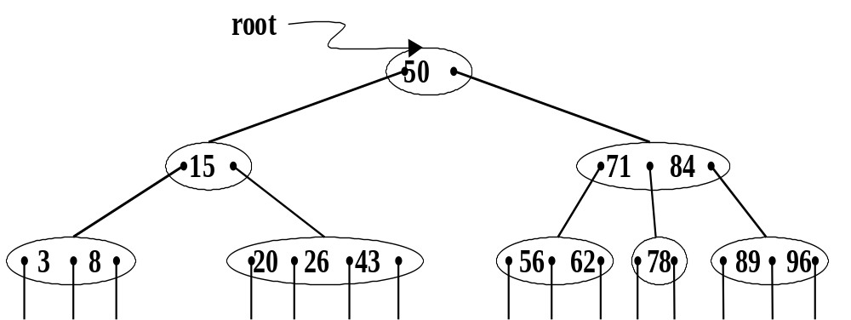
B树是一种平衡的 多路搜索 树

Slide 52
在 m 阶的B-树上，每个非终端结点可能含有：
n 个关键字 K_{i}（1≤ i≤n） n<m
n 个指向记录的指针 D_{i}（1≤i≤n）
n+1 个指向子树的指针 A_{i}（0≤i≤n）
多叉树的特性

Slide 53
非叶结点中的多个关键字均自小至大有序排列，即：K₁< K₂ < … < K_{n}
A_{i-1} 所指子树上所有关键字均小于K_{i}
A_{i} 所指子树上所有关键字均大于K_{i}
搜索树的特性

Slide 54
树中所有叶子结点均不带信息，且在树中的同一层次上
根结点或为叶子结点，或至少含有两棵子树
其余所有非叶结点均至少含有⎡m/2⎤棵子树，至多含有 m 棵子树
平衡树的特性

Slide 55
查找过程
从根结点出发，沿指针搜索结点和在结点内进行顺序（或折半）查找 两个过程交叉进行。

Slide 56
若查找成功，则返回指向被查关键字所在结点的指针和关键字在结点中的位置；
若查找不成功，则返回插入位置。

Slide 57
插 入
在查找不成功之后，需进行插入
显然，关键字插入的位置必定在最下层的非叶结点，有下列几种情况

Slide 58
插入后，该结点的关键字个数n<m， 不修改指针

Slide 59
插入后，该结点的关键字个数 n=m，
则需进行“结点分裂”，令 s = ⎡m/2⎤，
在原结点中保留
（A₀，K₁，…… ， K_{s-1}，A_{s-1}）；
建新结点
（A_{s}，K_{s+1}，…… ，K_{n}，A_{n}）；
将（K_{s}，p）插入双亲结点

Slide 60
若双亲为空，则建新的根结点

Slide 61
下列为 3 阶B-树
50
50 80
30 50 80
30
80
50
∧ 20 ∧ 40 ∧
∧ 20 ∧
∧ 40 ∧
∧ 80 ∧
∧ 60 ∧ 80 ∧
∧60∧80∧90∧
∧60∧
∧90∧
插入关键字 = 60
, 90
, 30

Slide 62
删 除
和插入的考虑相反，首先必须找到待删关键字所在结点，并且要求删除之后，结点中关键字的个数不能小于⎡m/2⎤-1，否则，要从其左(或右)兄弟结点“借调”关键字，若其左和右兄弟结点均无关键字可借(结点中只有最少量的关键字)，则必须进行结点的“合并”

Slide 63
查找性能
在含 N 个关键字的 B-树上进行一次查找，需访问的结点个数不超过
log_{⎡m/2⎤}((N+1)/2)+1

Slide 64
B⁺树
是B-树的一种变型

Slide 65
※ 每个叶子结点中含有 n 个关键字和 n 个指向记录的指针；并且，所有叶子结点彼此相链接构成一个有序链表，其头指针指向含最小关键字的结点

Slide 66
※ 每个非叶结点中的关键字 K_{i} 即为其相应指针 A_{i} 所指子树中关键字的最大值
※ 所有叶子结点都处在同一层次上，每个叶子结点中关键字的个数均介于 ⎡m/2⎤和 m 之间

Slide 67
查找过程
※ 在 B⁺ 树上，既可以进行缩小范围的查找，也可以进行顺序查找
※ 在进行缩小范围的查找时，不管成功与否，都必须查到叶子结点才能结束
※若在结点内查找时，给定值≤K_{i}， 则应继续在 A_{i} 所指子树中进行查找

Slide 68
插入和删除
类似于B-树进行，即必要时，也需要进行结点的“分裂”或“归并”

Slide 69
root
50 96
15 50
62 78 96
sq
3 8 15
20 26 43 50
56 62
71 78
84 89 96

