Slide 1
9.8 外 部 排 序

Slide 2
外部排序定义
当待排序的对象数目特别多时，在内存中不能一次处理。必须把它们以文件的形式存放于外存，排序时再把它们一部分一部分调入内存进行处理。这样，在排序过程中必须不断地在内存与外存之间传送数据。这种基于外部存储设备（或文件）的排序技术就是外排序。

Slide 3
外部排序的基本过程
当对象以文件形式存放于磁盘上的时候，通常是按物理块存储的。
物理块也叫做页块，是磁盘存取的基本单位。
每个页块可以存放几个对象。操作系统按页块对磁盘上的信息进行读写。
本节所指的磁盘是由若干片磁盘组成的磁盘组，各个盘片安装在同一主轴上高速旋转。各个盘面上半径相同的磁道构成了柱面。各盘面设置一个读写磁头，它们装在同一移动臂上，可以径向从一个柱面移到另一个柱面上。

Slide 4
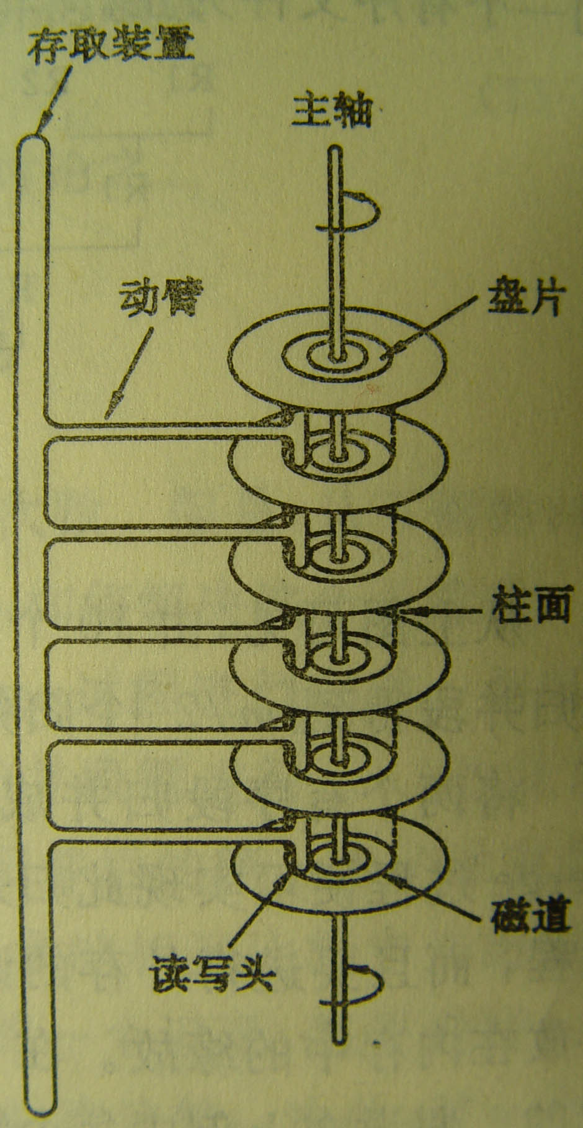

Slide 5
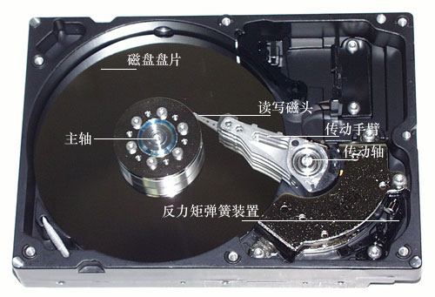

Slide 6

Working of Hard Disk

Slide 7
为了访问某一页块，先寻找柱面，移动臂使读写磁头移到指定柱面上：寻查(seek)； 再根据磁道号(盘面号)选择相应读写磁头，等待指定页块转到读写磁头下：等待(latency)。因此, 在磁盘组上存取一个页块的时间：
t_{io}＝t_{seek}＋t_{latency}＋t_{rw}

Slide 8
Golden Rule of File Processing
Minimize the number of disk accesses!
  1. Arrange information so that you get what you want with few disk accesses.
  2. Arrange information to minimize future disk accesses.
An organization for data on disk is often called a file structure.
Disk-based space/time tradeoff: Compress information to save processing time by reducing disk accesses.

Slide 9
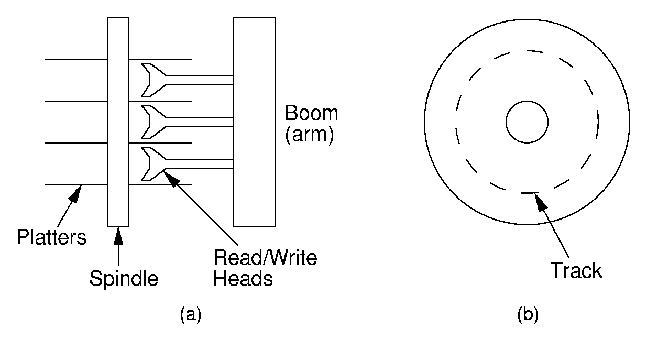
Disk Drives

Slide 10
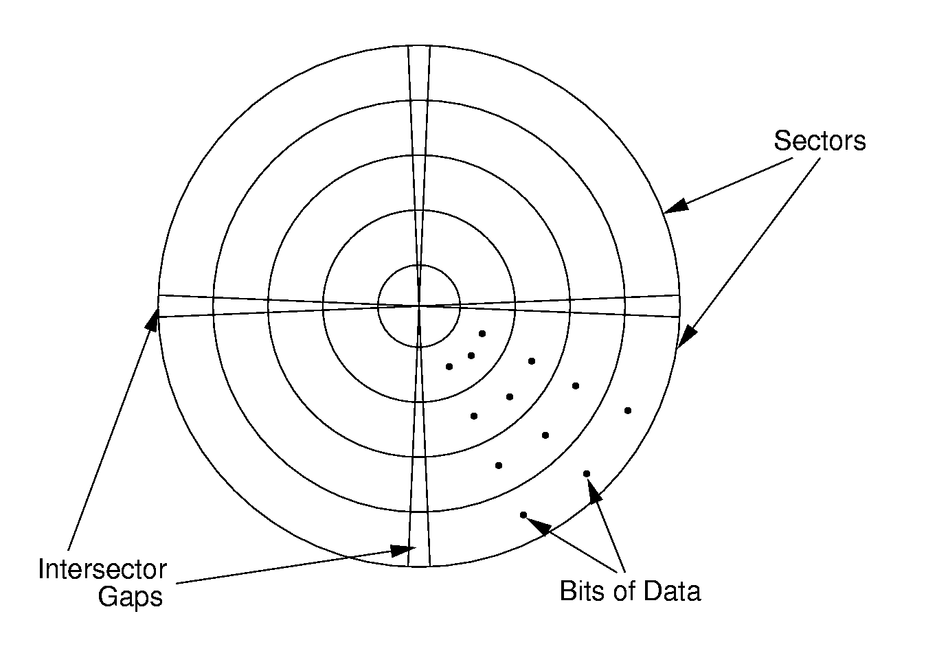
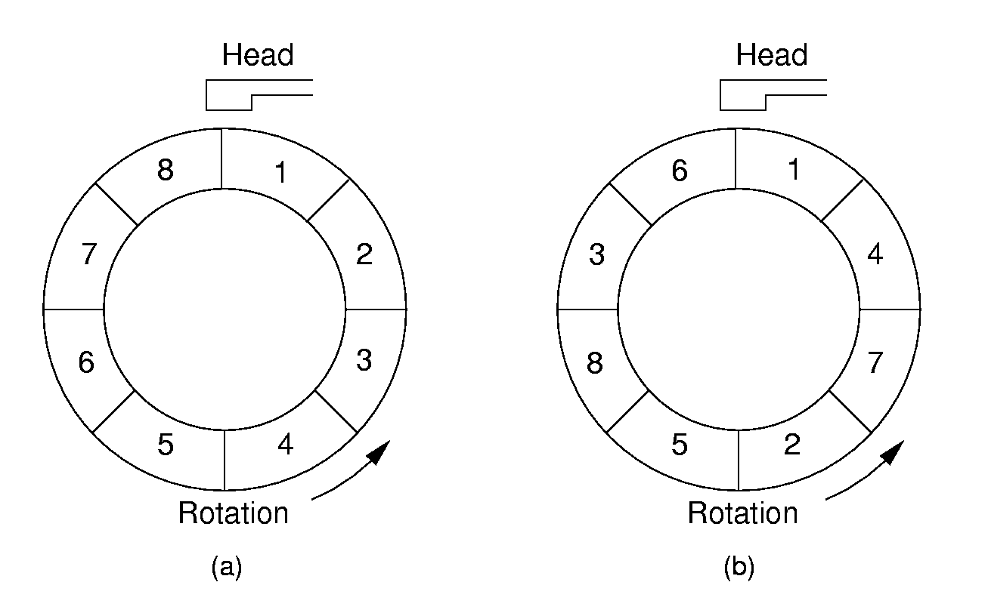
Sectors
A sector is the basic unit of I/O.
Interleaving factor: Physical distance between logically adjacent sectors on a track.

Slide 11
Terms
Locality of Reference(引用的局部性): When record is read from disk, next request is likely to come from near the same place in the file.
Cluster(簇): Smallest unit of file allocation, usually several sectors.
Extent(范围): A group of physically contiguous clusters.
Internal fragmentation(内部碎片): Wasted space within sector if record size does not match sector size; wasted space within cluster if file size is not a multiple of cluster size.

Slide 12
Seek Time
Seek time: Time for I/O head to reach desired track. Largely determined by distance between I/O head and desired track.
Track-to-track time: Minimum time to move from one track to an adjacent track.
Average Seek time: Average time to reach a track for random access.

Slide 13
Other Factors
Rotational Delay or Latency: Time for data to rotate under I/O head.
  One half of a rotation on average.
  At 7200 rpm, this is 8.3/2 = 4.2ms.
Transfer time: Time for data to move under the I/O head.
  At 7200 rpm:
    Number of sectors read/Number of sectors per track * 8.3ms.<number>

Slide 14
Disk Spec Example
16.8 GB disk on 10 platters = 1.68GB/platter
13,085 tracks/platter
256 sectors/track
512 bytes/sector
Track-to-track seek time: 2.2 ms
Average seek time: 9.5ms
4KB clusters, 32 clusters/track.
Interleaving factor of 3.
5400RPM

Slide 15
Disk Access Cost Example (1)
Read a 1MB file divided into 2048 records of 512 bytes (1 sector) each.
Assume all records are on 8 contiguous tracks.
First track: 9.5 + 11.1/2 + 3 x 11.1 = 48.4 ms
Remaining 7 tracks: 2.2 + 11.1/2 + 3 x 11.1 = 41.1 ms.
Total: 48.4 + 7 * 41.1 = 335.7ms

Slide 16
Disk Access Cost Example (2)
Read a 1MB file divided into 2048 records of 512 bytes (1 sector) each.
Assume all file clusters are randomly spread across the disk.
256 clusters. Cluster read time is
(3 x 8)/256 of a rotation for about 1 ms.
256(9.5 + 11.1/2 + (3 x 8)/256) is about 3877 ms. or nearly 4 seconds.
Notes:
This is MUCH worse than the previous example.

Slide 17
How Much to Read?
Read time for one track:
  9.5 + 11.1/2 + 3 x 11.1 = 48.4ms.
Read time for one sector:
  9.5 + 11.1/2 + (1/256)11.1 = 15.1ms.
Read time for one byte:
  9.5 + 11.1/2 = 15.05 ms.
Nearly all disk drives read/write one sector at every I/O access.
  Also referred to as a page.

Slide 18
Buffers
The information in a sector is stored in a buffer or cache.
If the next I/O access is to the same buffer, then no need to go to disk.
There are usually one or more input buffers and one or more output buffers.

Slide 19
Buffer Pools
A series of buffers used by an application to cache disk data is called a buffer pool.
Virtual memory uses a buffer pool to imitate greater RAM memory by actually storing information on disk and “swapping” between disk and RAM.

Slide 20
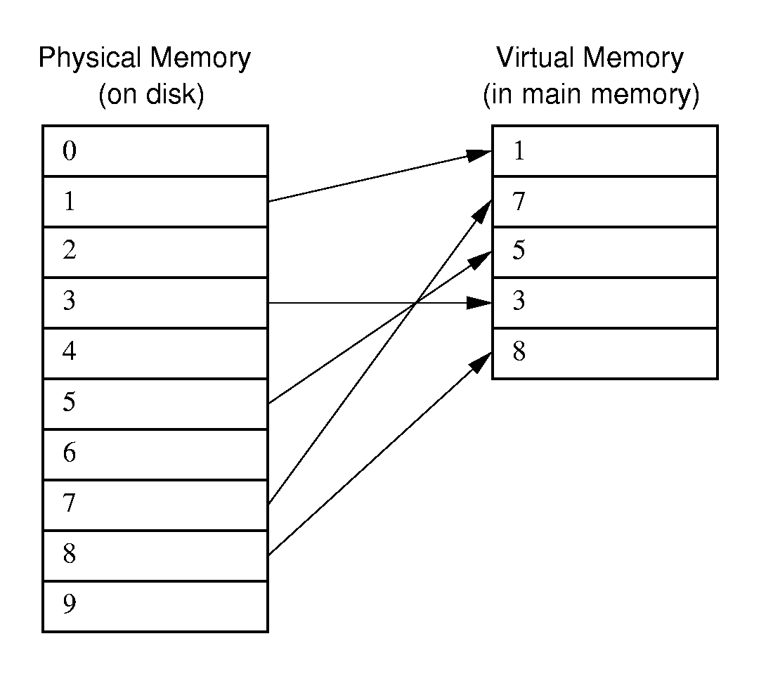
Buffer Pools

Slide 21
Organizing Buffer Pools
Which buffer should be replaced when new data must be read?
First-in, First-out: Use the first one on the queue.
Least Frequently Used (LFU): Count buffer accesses, reuse the least used.
Least Recently used (LRU): Keep buffers on a linked list. When buffer is accessed, bring it to front. Reuse the one at end.

Slide 22
Programmer’s View of Files
Logical view of files:
  An a array of bytes.
  A file pointer marks the current position.
Three fundamental operations:
  Read bytes from current position (move file pointer)
  Write bytes to current position (move file pointer)
  Set file pointer to specified byte position.

Slide 23
Simple External Mergesort (1)
Quicksort requires random access to the entire set of records.
Better: Modified Mergesort algorithm.
  Process n elements in Θ(log n) passes.
A group of sorted records is called a run.
Notes:
Usually the records are not rewritten in sorted order.
(1) It is expensive (random access to all records).
(2) If there are multiple keys, there is no single “correct” order.

Slide 24
Simple External Mergesort (2)
Split the file into two files.
Read in a block from each file.
Take first record from each block, output them in sorted order.
Take next record from each block, output them to a second file in sorted order.
Repeat until finished, alternating between output files. Read new input blocks as needed.
Repeat steps 2-5, except this time input files have runs of two sorted records that are merged together.
Each pass through the files provides larger runs.
Notes:
Usually the records are not rewritten in sorted order.
(1) It is expensive (random access to all records).
(2) If there are multiple keys, there is no single “correct” order.

Slide 25
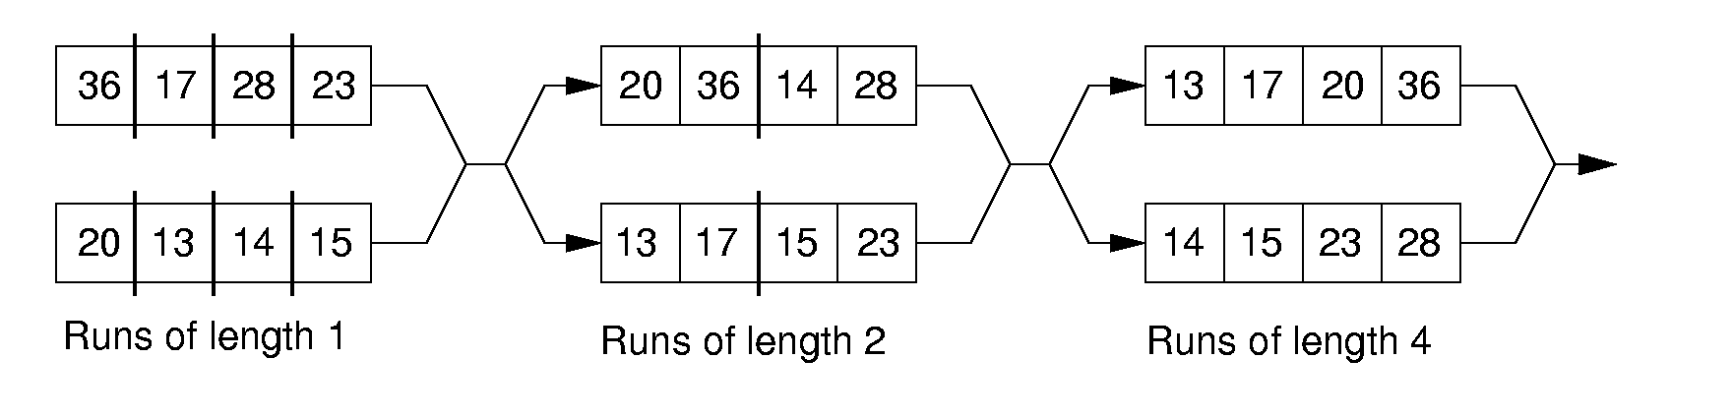
Simple External Mergesort (3)
Notes:
Usually the records are not rewritten in sorted order.
(1) It is expensive (random access to all records).
(2) If there are multiple keys, there is no single “correct” order.

Slide 26
Problems with Simple Mergesort
Is each pass through input and output files sequential?
What happens if all work is done on a single disk drive?
How can we reduce the number of Mergesort passes?
In general, external sorting consists of two phases:
  Break the files into initial runs
  Merge the runs together into a single run.
Notes:
The passes are sequential. But, on a single disk drive, competition for the I/O head eliminates this advantage.
But, we can get a massive improvement by reading in a block, or several blocks, and using an in-memory sort to create the initial runs.

Slide 27
Breaking a File into Runs
General approach:
  Read as much of the file into memory as possible.
  Perform an in-memory sort.
  Output this group of records as a single run.

Slide 28
Replacement Selection (1)
Break available memory into an array for the heap, an input buffer, and an output buffer.
Fill the array from disk.
Make a min-heap.
Send the smallest value (root) to the output buffer.

Slide 29
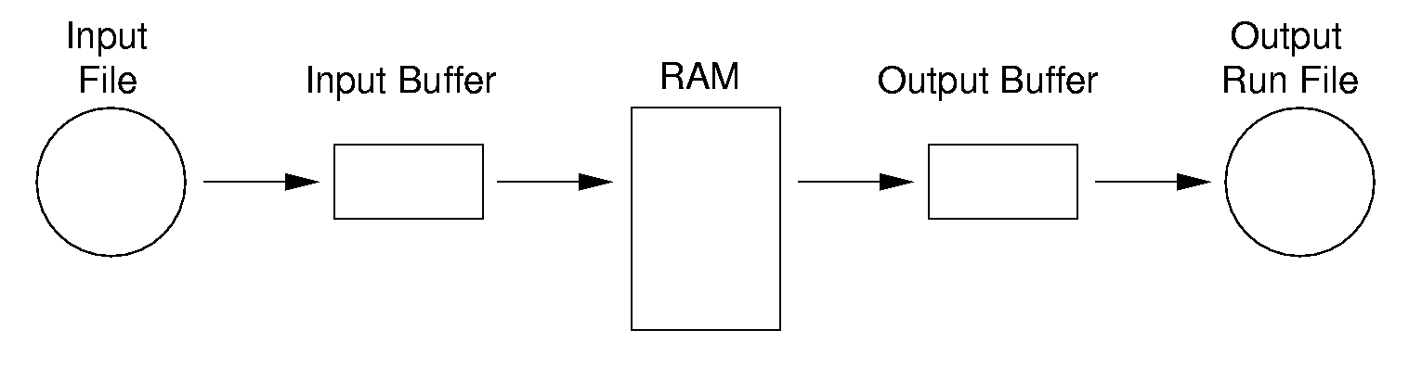
Replacement Selection (2)
If the next key in the file is greater than the last value output, then
  Replace the root with this key
  else
  Replace the root with the last key in the array
  Add the next record in the file to a new heap (actually, stick it at the end of the array).

Slide 30
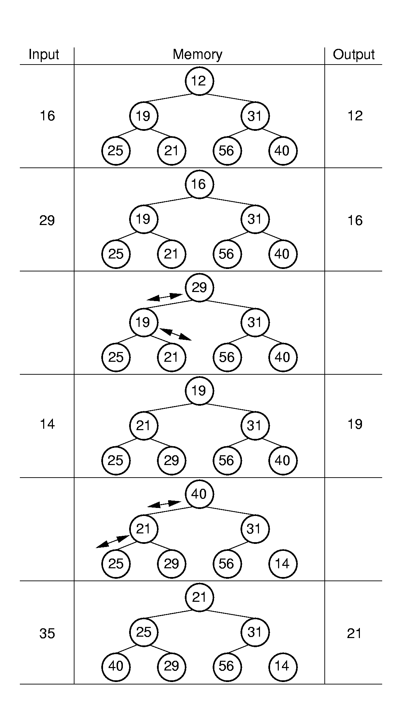
RS Example

Slide 31
Problems with Simple Merge
Simple mergesort: Place runs into two files.
  Merge the first two runs to output file, then next two runs, etc.
Repeat process until only one run remains.
  How many passes for r initial runs?
Is there benefit from sequential reading?
Is working memory well used?
Need a way to reduce the number of passes.
Notes:
For r initial runs, need log r passes.
We get NO benefit from sequential reading if only one disk drive is used.
Working memory is poorly used because only 2 blocks are really needed. So, we would like a way to use memory better.

Slide 32
Multiway Merge (1)
With replacement selection, each initial run is several blocks long.
Assume each run is placed in separate file.
Read the first block from each file into memory and perform an r-way merge.
When a buffer becomes empty, read a block from the appropriate run file.
Each record is read only once from disk during the merge process.

Slide 33
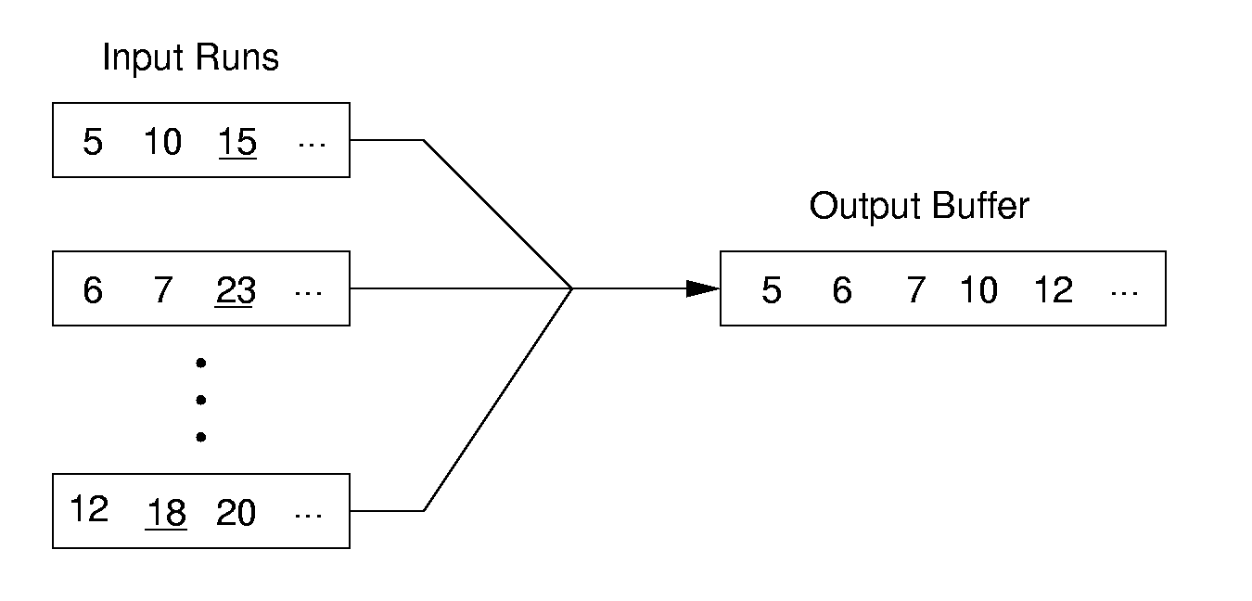
Multiway Merge (2)
In practice, use only one file and seek to appropriate block.

Slide 34
外部排序多使用归并排序方法。其排序过程主要分为两个阶段：
  1. 建立内存缓冲区。根据其大小将输入文件划分为若干段，用某种内排序方法对各段进行排序。经过排序的段叫做初始归并段(Run)。当它们生成后就被写到外存中去。
  2. 仿照内排序中的归并排序方法，把初始归并段加以归并，逐步扩大归并段，直到最后归并成一个大归并段(有序文件)为止。

Slide 35
示例：输入文件包含4500个对象。计算机内存至多可容纳750个对象。磁盘每个页块可容纳250个对象，这样全部对象可存储在 4500/250＝18 个页块中。输出文件也放在磁盘上，用以存放归并结果。
内存中恰好能存3个页块的对象。
开始时，把18块对象，每3块一组，读入内存。进行内部排序, 形成初始归并段, 再写回外存。总共可得到6个初始归并段。然后一趟一趟进行归并排序。

Slide 36
两路归并排序的归并树
R1:750 R2:750 R3:750 R4:750 R5:750 R6:750
初始
归并段
R12:1500 R34:1500 R56:1500
第一趟
归并结果
R1234 : 3000
第二趟
归并结果
R123456: 4500
第三趟
归并结果

Slide 37
若把内存等分为 3 个缓冲区。其中的两个为输入缓冲区，一个为输出缓冲区，可以在内存中利用函数 merge 实现 2 路归并。
输入缓冲区1
输出缓冲区
输入缓冲区2
首先, 从归并段 R₁ 和 R₂ 中分别读入一块，放在输入缓冲区1 和2 中。然后，在内存中进行2路归并，归并出来的对象存放到输出缓冲区中。

Slide 38
一般地，若对象个数为 n，每个页块可容纳 b 个对象，内存可容纳 i 个页块，则每个初始归并段长度为 len = i * b，可生成 m = ⎡n/len⎤ 个等长的初始归并段。
2路归并排序时，总归并趟数为 ⎡log₂m⎤。
2 路归并排序时间 t_{ES} 的上界为：
t_{ES} = m*t_{IS} + d*t_{IO} + S*u*t_{mg}

Slide 39
想要提高外排序的速度，应减少d。
对相同数目的对象，在同样页块大小的情况下做k路归并(当然, 内存缓冲区的数目也要变化)，则可大致比较：
归并路数 k 总读写磁盘次数 d 归并趟数 S
2 132 3
3 108 2
6 72 1
因此，增大归并路数，可减少归并趟数，从而减少总读写磁盘次数d。

Slide 40
一般, 对 m 个初始归并段, 做 k 路平衡归并, 归并树可用正则 k 叉树(即只有度为k 与度为0的结点的 k 叉树)来表示。
树的高度＝ ⎡log_{k}m⎤ ＝ 归并趟数S。
增大归并路数 k，或减少初始归并段个数 m，都能减少归并趟数 S，以减少读写磁盘次数 d，达到提高外排序速度的目的。

