Slide 1
Stage A
CAPTCHA, OCR
Shiyu Yi

Slide 2
Language & Framework
Python and cpp—basic language .
Opencv —try some preprocessing like denoising.
Pytorch—model create, training and test.

Slide 3





Workflow
Stage 1:
Data Preprocessing
Stage 2:
Model Creation
Stage 3:
Training
Evaluation

Slide 4
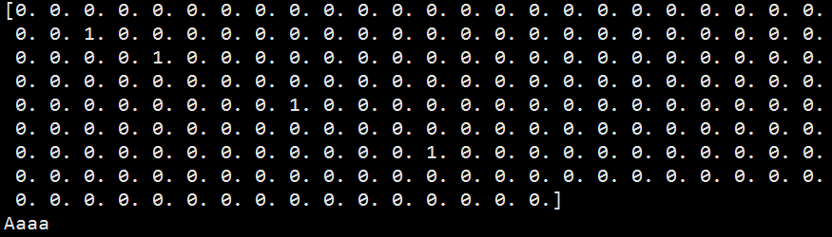
Data Preprocessing
Firstly, assemble image id and label from json files;
Secondly, make labels to one-hot encoding;
Thirdly, split datasets to train/val/test sets;
Then, we are going to do some observation of the image, and find out some intuition.
Such as noising, blurring, artifacts…

Slide 5


Observation
Intuitively, most of the images are blurring, noising, and the resolution is low…
Good thing is, the location of every target is fixed, which could save our time for segmentation.

Slide 6
Denoising or not?
We tried out simple Gaussian filter, OM3D, Wiener filter…
And sorts of deblurring methods…
But we find that simple Resnet can perform very well without these process.
Especially, simple denoising and deblurring methods may have some damage to the target area.
Thus, we find these two process are not integral.

Slide 7
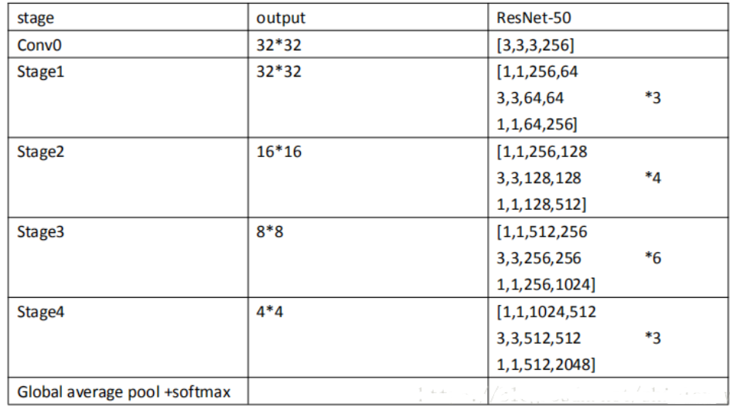
Model
Simply, we select Resnet50 after trying many networks (without pretrained).

Slide 8
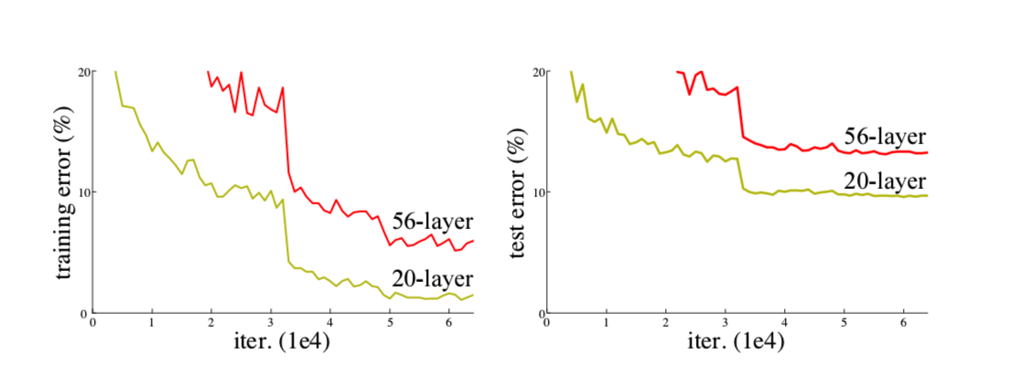
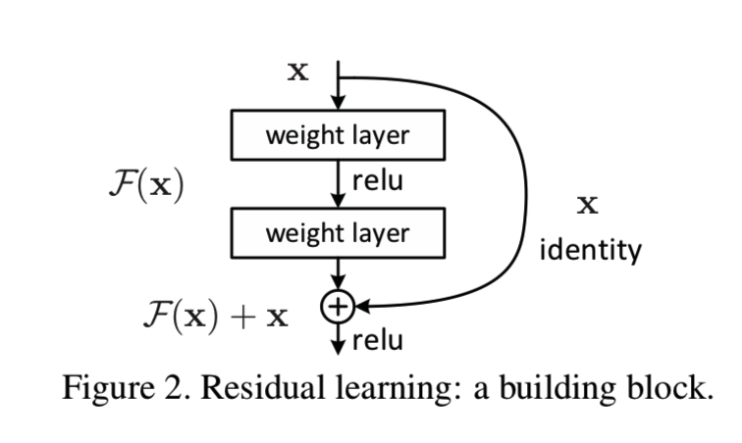
About Resnet

Slide 9
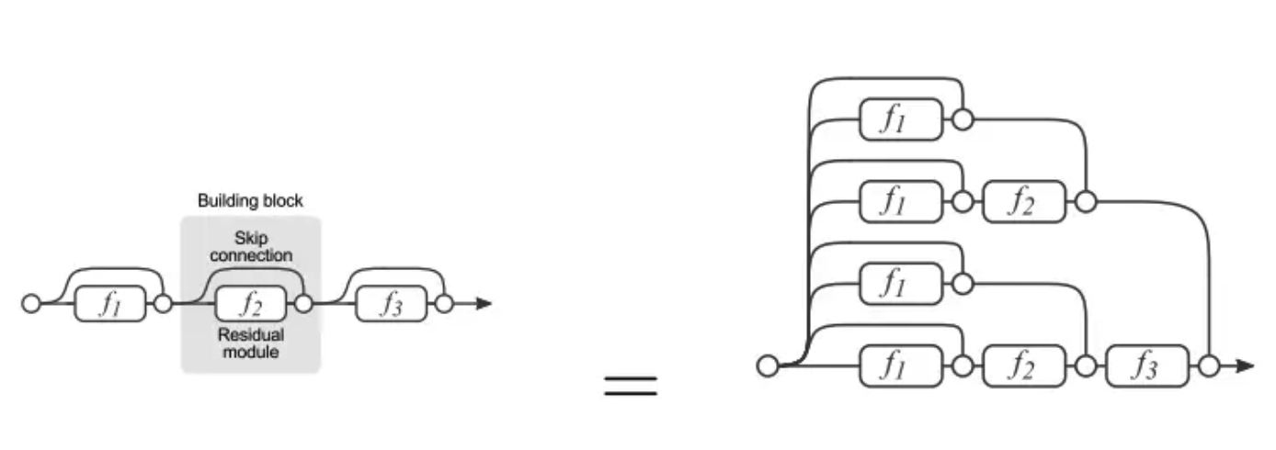

Slide 10
Training
Loss: MultiLabelSoftMarginLoss.
Optimizer: Adam with default.
Learning rate: 0.001 with reducing by 0.1 every 30 steps.
Other params: batch size 64, training epoch 100.
Earlystop: Best model selection with loss value.
Model save: As pkl file.
Hardware: Single NVIDIA 1080 Ti.
Note: Except for resizing image to 224x224 for input, we didn’t do any other augmentation.

Slide 11
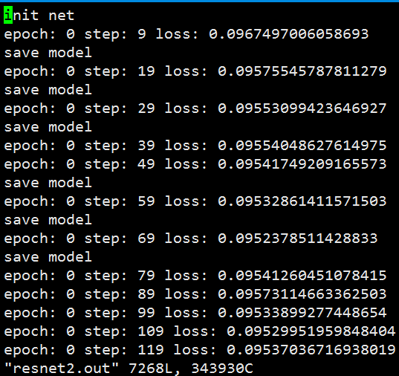
Training
Start

Slide 12
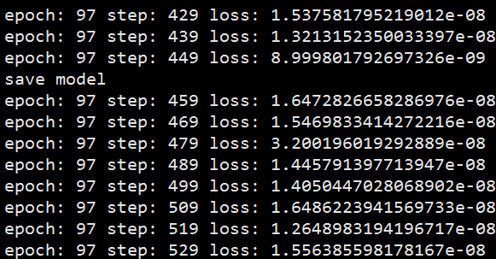
Training
Here is the best model to be saved.

Slide 13
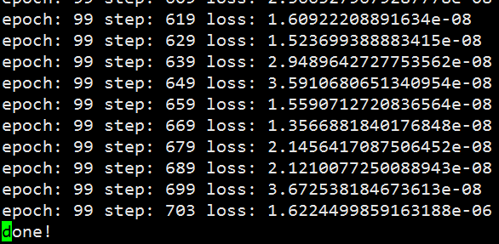
Training
End

Slide 14
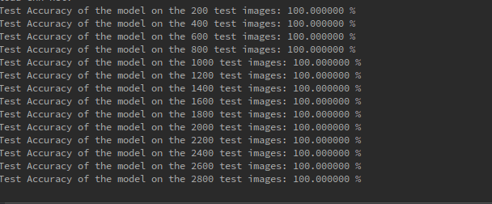
Evaluation
Without any process, the result on validation datasets is up to 100% and final submission score is 0.9998.
Then, use saved model to do prediction on test set and commit.

Slide 15
Stage B and C
Natural language process

Slide 16
Steps
Preprocess
Feature Generation
Normalization
Train model
Test
Predict

Slide 17
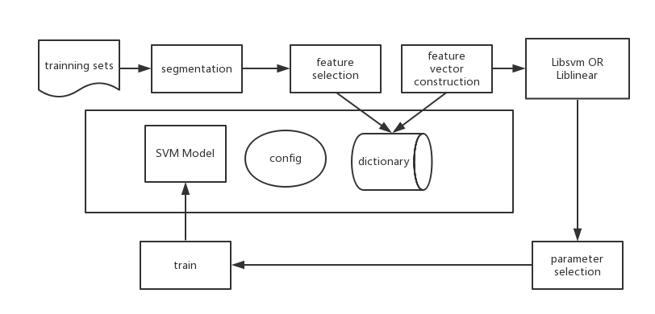

Slide 18
Preprocess
Chinese word segmentation(jieba)
Stopwords(SCU machine lab stopwords.txt)
Build Dictionary

Slide 19
Feature Generation
N-gram
Using unigram and bigram
Write in .svm file(sparse matrix)

Slide 20
Deep learning?
BERT
CNNInception
CNNKim
TextCNN
LSTM
BiLSTM
RCNN
Transformer

Slide 21
Liblinear vs Libsvm
The best method for short text classification is SVM

Slide 22
BUT

Slide 23
What is liblinear
LIBLINEAR is an open source library for large-scale linear classification. It supports logistic regression and linear support vector machines. We provide easy-to-use command-line tools and library calls for users and developers. Experiments demonstrate that LIBLINEAR is very efficient on large sparse data sets.

Slide 24
Why liblinear
It runs really faster than libsvm because it doesn’t have to compute the kernel for any two points
It can be able to handle large scaled dataset
It performs better in sparse matrix(High dimensional feature)
Libsvm use one-against-one,so it has k*(k-1)/2 binary classifiers, liblinear use one-against-rest which has k binary classifiers.

Slide 25
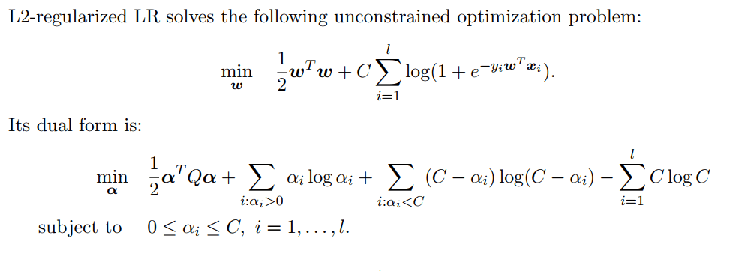
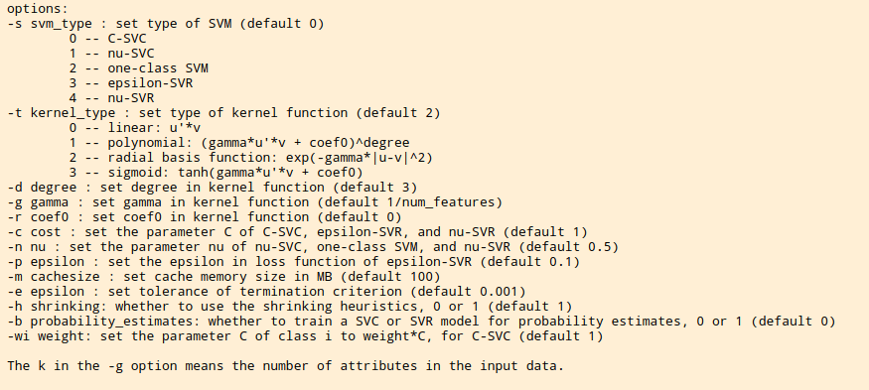
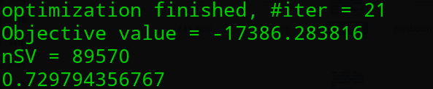

Slide 26
Thank you!!!

