Slide 1
Compiler: Lexical Analysis
Shiyu Yi

Slide 2
Introduction
Programming language: c++
Platform: Linux ubuntu 16.04 && macOS
Apple LLVM version 10.0.1 (clang-1001.0.46.4)
Method: Implementation in code II in slides

Slide 3
Project Structure
.
├── CMakeLists.txt
├── LICENSE
├── README.md
├── include
│ ├── lexier.hpp
│ ├── token.hpp
│ └── tokenType.hpp
├── src
│ ├── CMakeLists.txt
│ ├── lexier.cpp
│ ├── main.cpp
│ └── token.cpp
└── test
├── CMakeLists.txt
├── test_data
└── test_lexier.cpp

Slide 4
Overview(List some important elements)
class Token
Description: Encapsulate the attributes of token
Attribute:string text, TokenType type, int line_number,
static const unordered_map<TokenType, string> tagLexemeMap_;
enum TokenType
Description: The type of tokens

Slide 5
Overview(List some important elements)
class Lexier:
Description: Encapsulate the methods of identifying tokens and state transition
enum Dfstate
void handle(const std::string& src);
void handleState(const char c);
void initToken(const char c);

Slide 6
Overview(List some important elements)
Open the source file: ifstream& getInput()
Input the source stream into handle function: void handle(const std::string& src)
We read every character from the stream to process:handleState(src[i]);
Every time we meet the new token we init start state:initToken(const char c)

Slide 7
Keywords
We choose a subset keywords of c11 including:
int, if, while, else, float, return, break, main
We choose an example ‘if’ to illustrate how to recognize a keyword.

Slide 8
Keywords: DFA of ‘if’
[a-zA-Z0-9_]
DFA:
[a-hj-zA-Z]
Other
0
1
2
i
3
……
f
4
……

Slide 9
Keywords: simplified code of ‘if’
// InitToken():
if (isAlpha(c) || c == ‘_’) { // The first charcter is alpha or underline
if(c == ‘i’){ // The first charcter is ‘i’
state = Dfstate::Id_int_if1; // Then we set the state Id_int_if1
}else if ….

Slide 10
Keywords: simplified code of ‘if’
// handlestate()
case Dfstate::Id_int_if1: // i
if (c == 'f'){ // if
state = Dfstate::Id_if2;
tokenText.push_back(c);
}else if (isDigital(c) || isAlpha(c)) {
state = Dfstate::Id; // get back to Id state
tokenText.push_back(c);
} else {
initToken(c);
}
break;

Slide 11
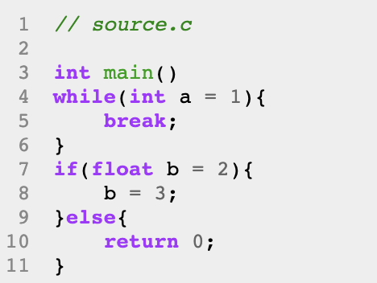
Test Keywords

Slide 12
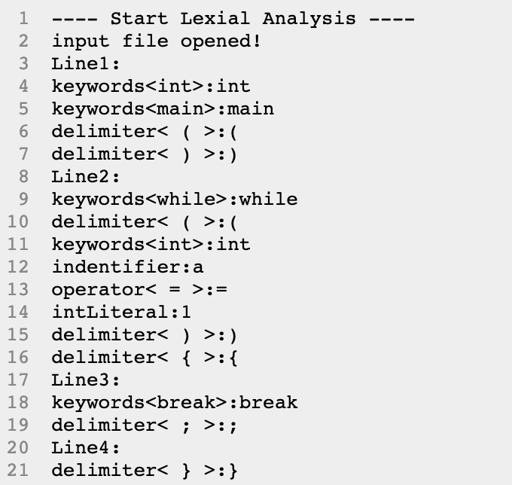
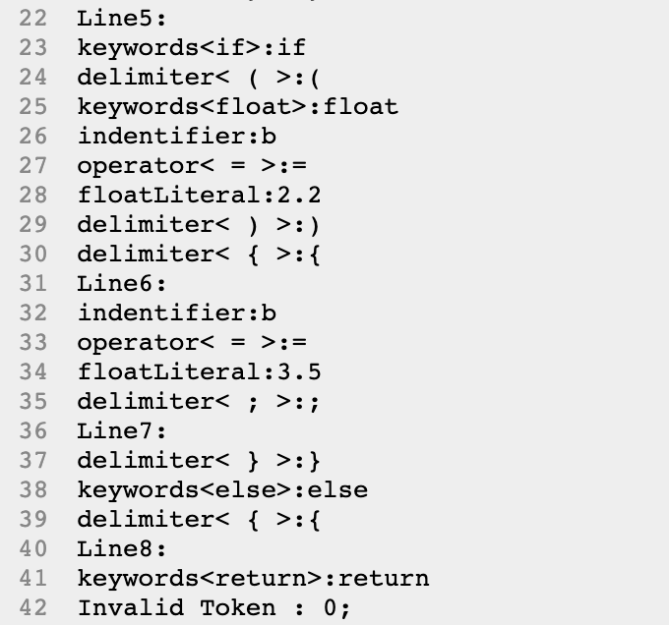
Test output

Slide 13
Error Detection
There are a lot of kinds of error need to detect in the part of lexical analysis, but we only give an traditional example like detecting 2x.
digit
start
0
digit
1
Non-digit
2
error

Slide 14
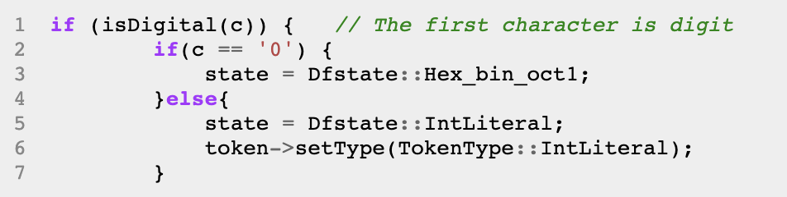
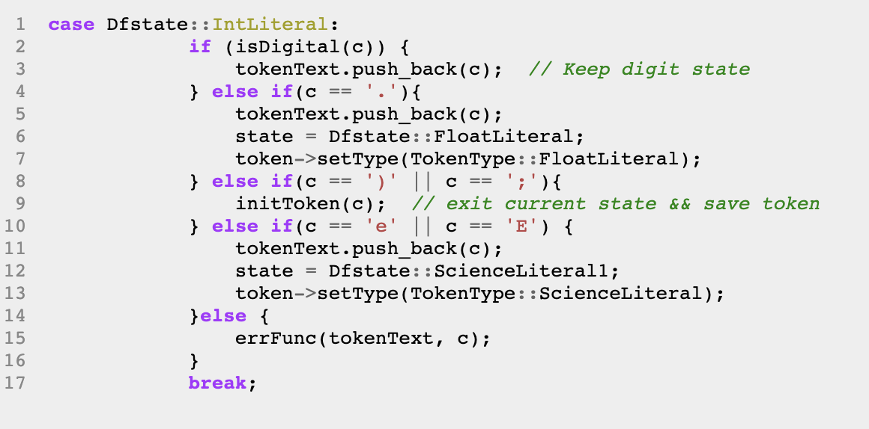
Error Detection

Slide 15
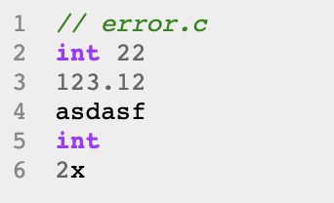
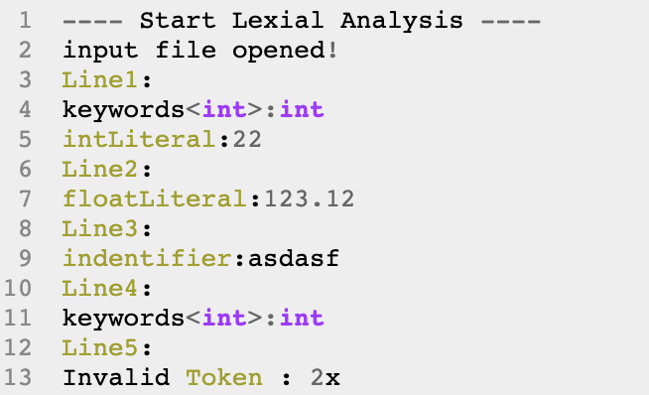
Error Detection: Test

Slide 16
Floating number
digit
digit
start
0
digit
1
[.]
2
float

Slide 17
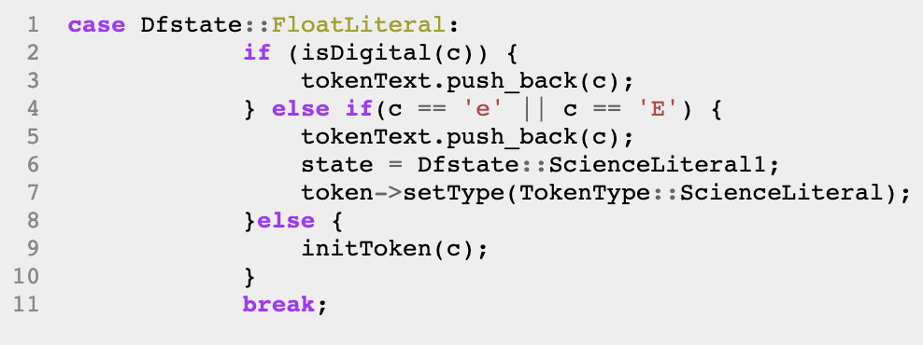
Floating number: code implement

Slide 18
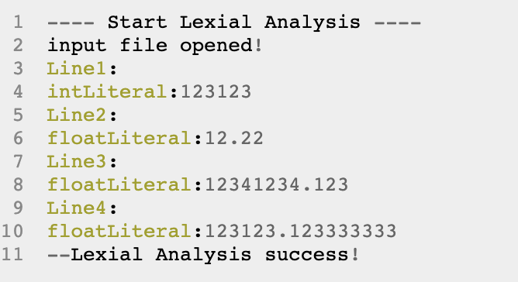
Floating number: Test

Slide 19
Scientific notation
digit
digit
start
0
digit
1
[.]
2
float
digit
[e,E]
[e,E]
3
[+,-,digit]
4

Slide 20
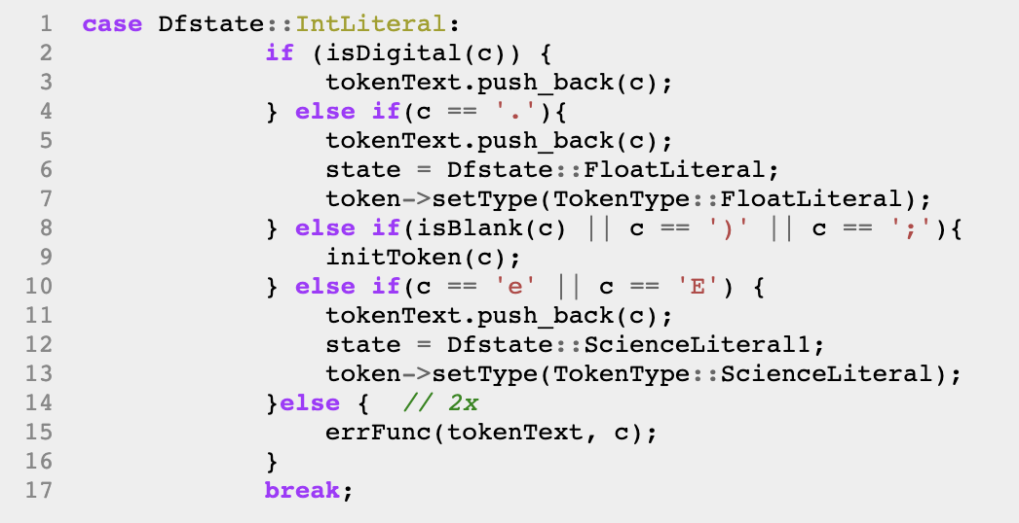
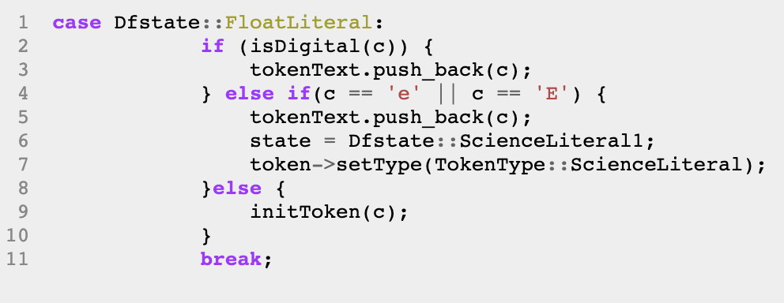
Scientific notation

Slide 21
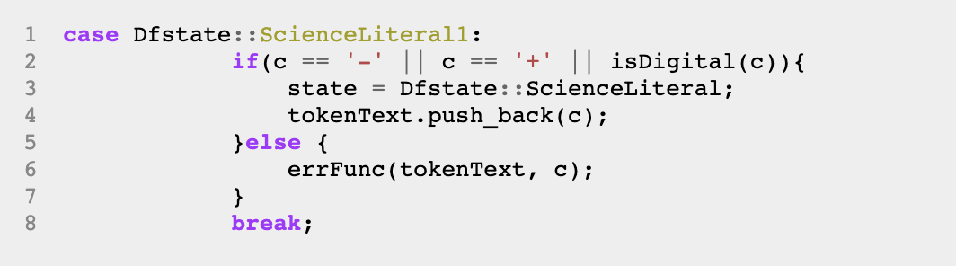
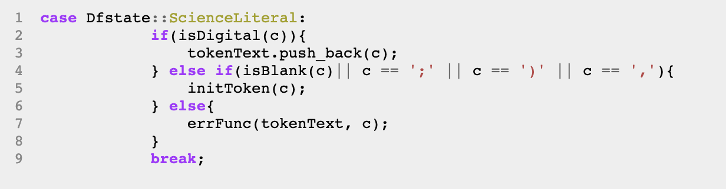
Scientific notation

Slide 22
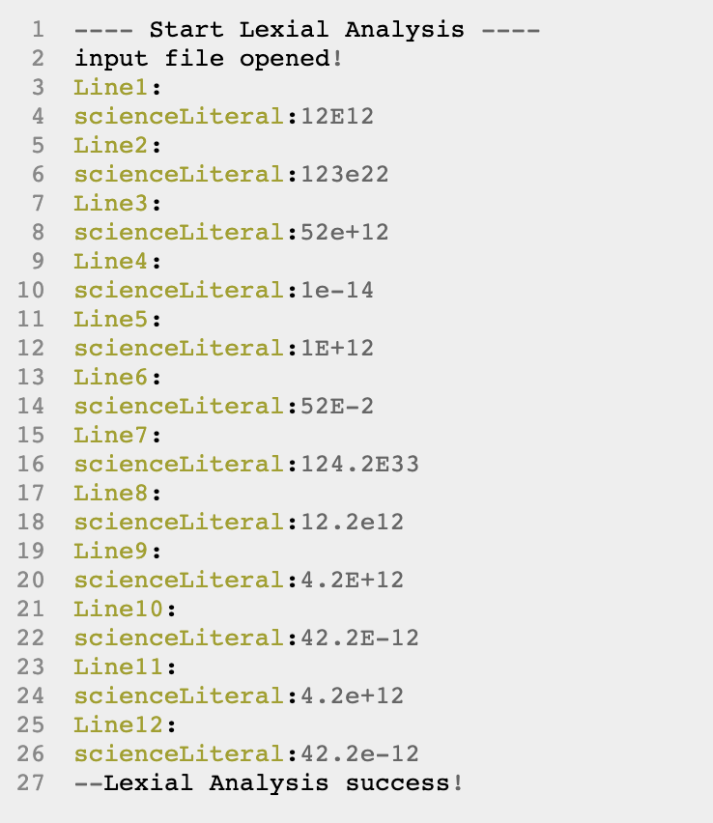
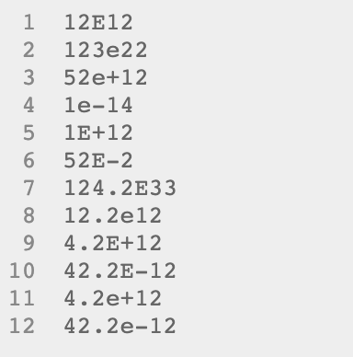
Scientific notation:Test

Slide 23
Bin && Hex && Oct
Oct
4
[0-7]
[0-7]
[0,1]
start
0
0
1
[b,B]
2
[0,1]
3
Bin
Oct
[x,X]
5
[0-9a-fA-F]
6
[0-9a-fA-F]
Hex

Slide 24
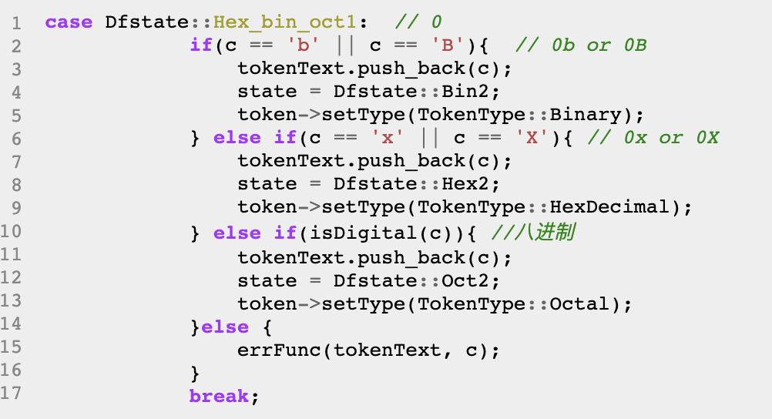
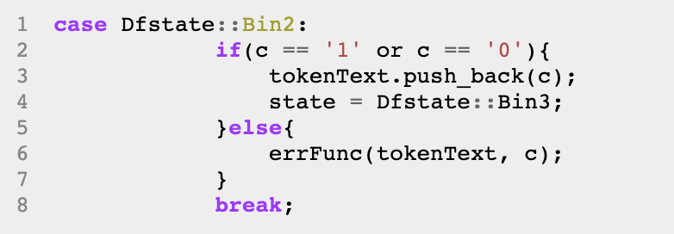
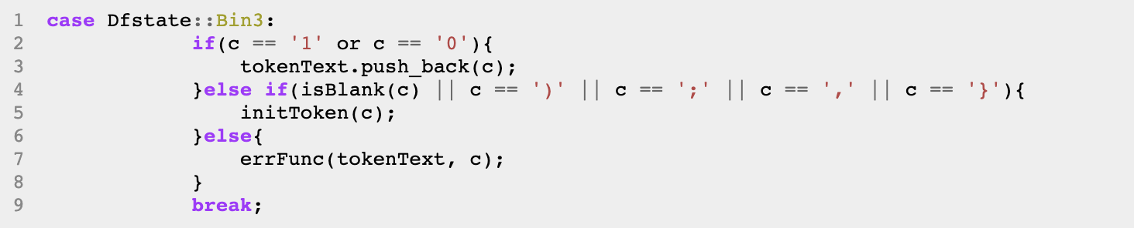
Bin && Hex && Oct: example of Hex

Slide 25
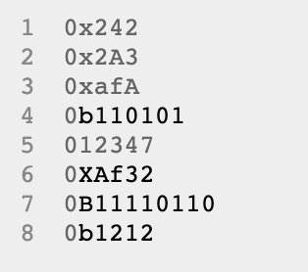
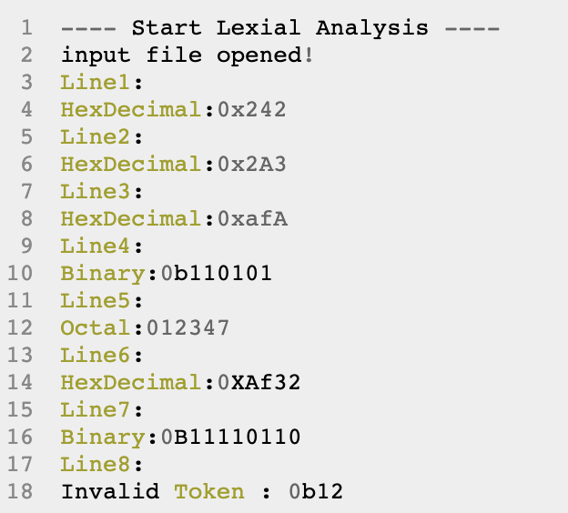
Bin && Hex && Oct: Test

Slide 26
Char Literal
4
[t,b,\,’,”,n]
\
start
0
‘
1
other
5
\n
‘
‘
3
2
error

Slide 27
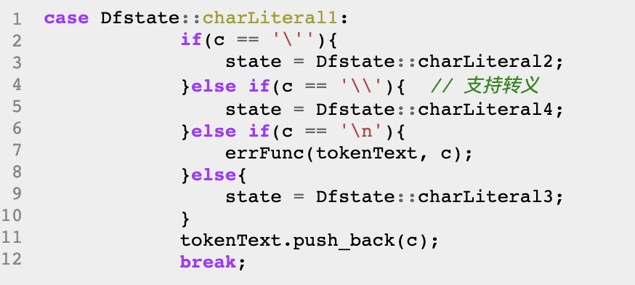
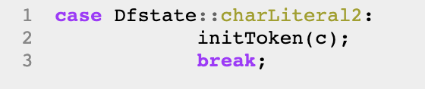
Char Literal

Slide 28
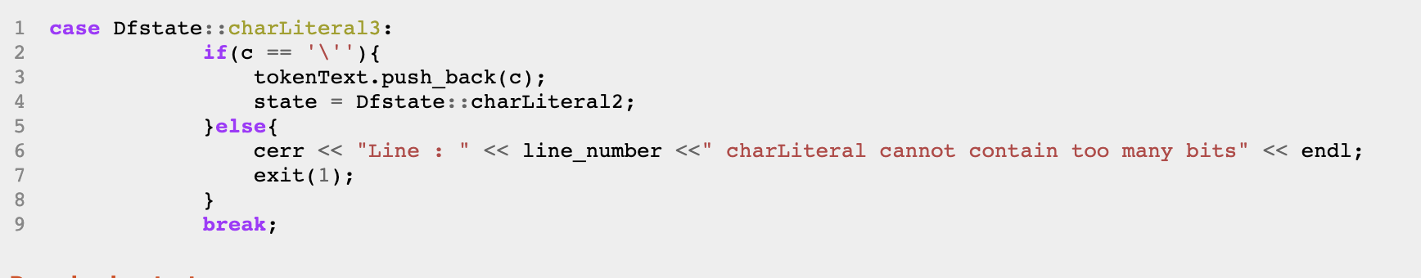
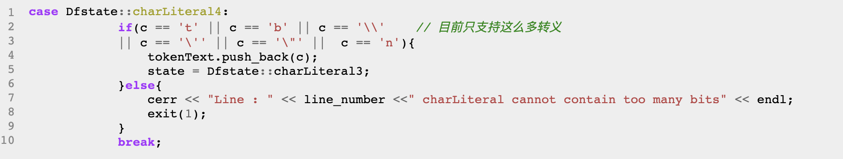
Char Literal

Slide 29
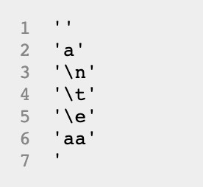
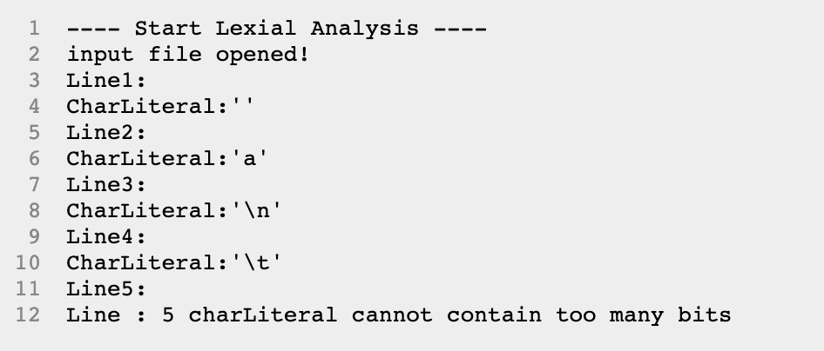
Char Literal:Test

Slide 30
String Literal
3
“
“
start
0
“
1
other
2
\n
other
4
error

Slide 31
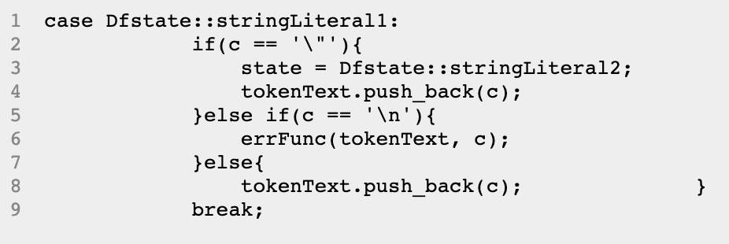
String Literal

Slide 32
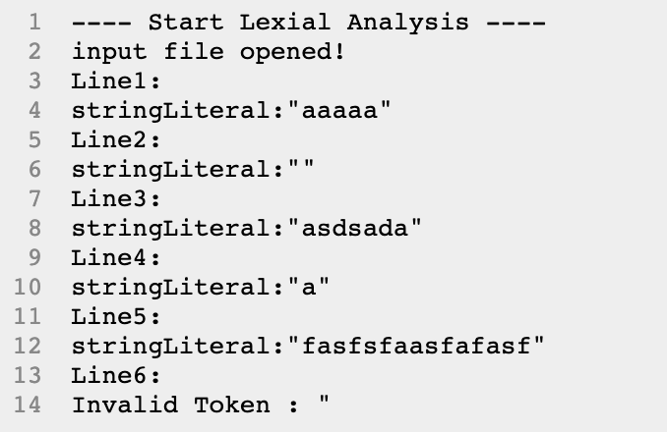
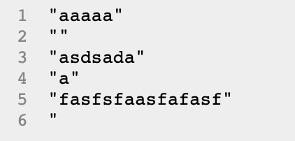
String Literal: Test

