Slide 1
battleship
Chan Choi
github.com/chanchoi829/battleship_cplusplus

Slide 2
Table of contents
Demo
Program spec

Slide 3
Demo
1. Computer and player’s ships are placed automatically.
2. Player attacks a point.
3. Computer automatically attacks a point.
Repeat 2 and 3 until someone’s ships have all sunk.

Slide 4
Table of contents
Demo
Program spec

Slide 5
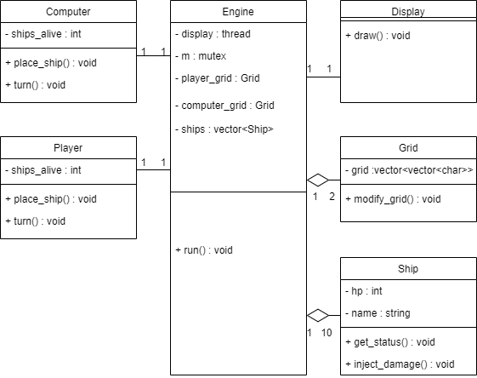
Program spec
2. Class Diagram
1. Key Functions
Engine::run() Start the game
Display::draw() Draw grids every 50ms
Computer::place_ship() Place computer's ship
Computer::turn() Simulate computer's turn
Player::place_ship() Place player's ship
Player::turn() Simulate player's turn

Slide 6
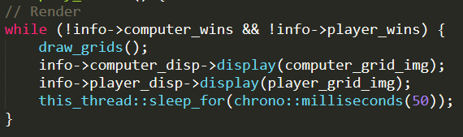
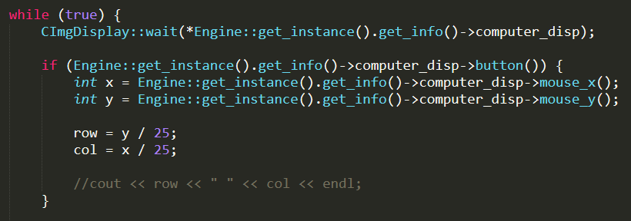
3. Key Concepts
Display thread
Reading inputs
std::shared_ptr

