Slide 1
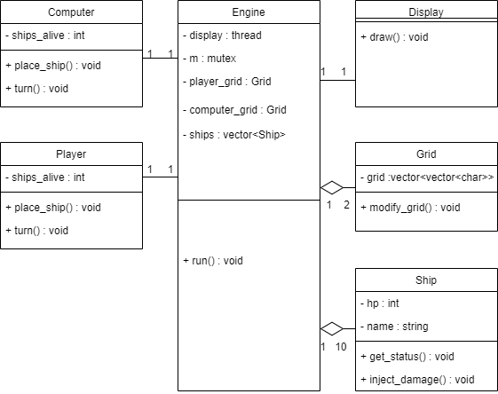
1. Objective
Defeat the computer by attacking its ships
2. Class Diagram
3. Key Functions
Engine::run() Start the game
Display::draw() Draw grids every 30ms
Computer::place_ship() Place computer's ship
Computer::turn() Simulate computer's turn
Player::place_ship() Place player's ship
Player::turn() Simulate player's turn

