Slide 1
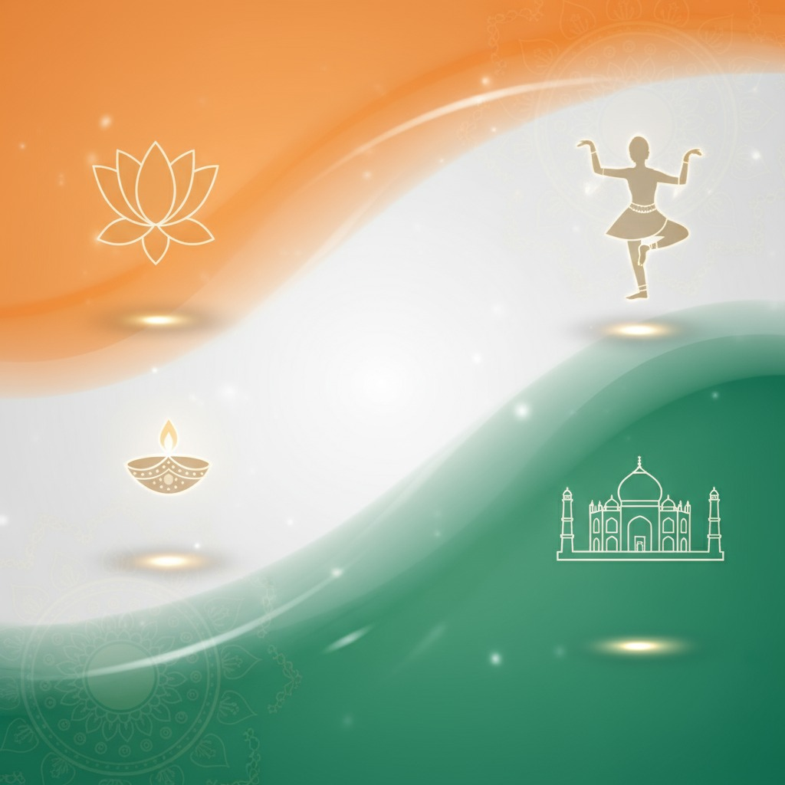
BHARATH HERITAGE
PROBLEM STATEMENT:
Designed a webapp with interactive challenges that showcase India’s varied traditions and state heritage, celebrating regional uniqueness. Launch an AR companion for 3D, immersive exploration of cultural landmarks and stories.
Team Shouryanga:
S.Pranathi
P.Chandini

Slide 2
ABSTRACT
Our web app makes learning India’s diverse traditions and state heritage interactive, engaging, and accessible—filling the gap left by traditional education. With gamified challenges and immersive AR, users explore, appreciate, and remember cultural landmarks and stories in a modern, visually rich way.
Problem: No single interactive, immersive platform for learning India’s cultures and state heritage.
Solution: Web app offers gamified challenges and interactive content, plus AR for immersive 3D site and story exploration.
Tech: Built with modern web and AR technologies.
Users: Students, heritage enthusiasts, domestic & international visitors.
Unique Value: Regional focus, accessibility, privacy, minimal data.
Impact: Enhanced, memorable learning and deeper cultural appreciation for all users.

Slide 3
INTRODUCTION:
India’s cultural heritage is among the world’s richest, spanning thousands of years, countless traditions, and vibrant regional diversity. However, traditional education systems and existing digital platforms often fail to convey this depth and variety in an engaging, accessible way—resulting in a growing disconnect between young Indians and their heritage, and leaving both domestic and international audiences without meaningful avenues for immersive exploration

Slide 4
Existing System:
Current approaches to Indian cultural heritage education rely on school curricula, government websites, and a few digital platforms offering mainly text, images, and basic videos. Content is fragmented, often limited to major national sites, and rarely available in regional languages.
Non-interactive :
Learning is mostly passive, with few quizzes, games, or hands-on activities .Fragmented: Information is scattered across many sources, making comprehensive learning difficult .No modern tech: Little use of AR/VR or other immersive technologies .Accessibility issues: Limited digital access and language options, especially in rural or non-English-speaking areas .No personalization: Resources do not adapt to different age groups or learning styles.

Slide 5
ARCHITECTUR & FLOW CHART:
User Interface (UI):The front end built in HTML5, CSS3, and JavaScript, possibly enhanced with frameworks like React or Angular for interactivity. Includes the homepage, interactive challenges, AR access points, event calendar, and language options.
Backend Server: Manages content delivery, user authentication, quiz engine logic, event/calendar updates, and AR data processing. Built with Node.js, Python, or a similar backend stack.
Database: Stores cultural articles, user profiles, event/calendar data, and AR model assets for virtual tours and fashion try-ons.
External APIs: Integrates map services, weather data, and AI/AR libraries to enrich the user experience with location-based features and intelligent recommendations.
AR Companion Module: Provides 3D reconstructions of heritage sites, virtual try-on for traditional attire, and immersive storytelling using device cameras and AR technology.

Slide 6
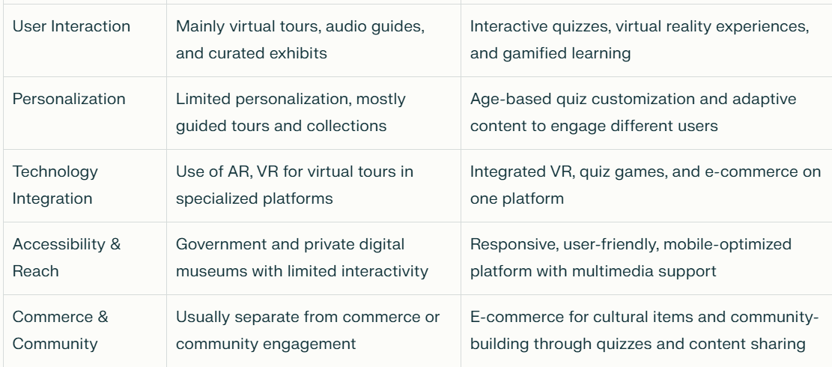
Proposed system VS Existing system

Slide 7
Advantages of system:
Cultural Identity: Helps users connect with their roots and understand the diversity that defines India as a nation.
Interactive Learning: Gamified quizzes, challenges, and AR experiences make cultural education engaging for all ages.
Personalized Access: AI recommendations and age-based content ensure experiences are relevant to each user.
No App Required: Users access 3D/AR experiences directly in the browser—no downloads, easy for all ages.
Regional Focus: Highlights the unique traditions, languages, cuisines, and arts of each Indian state, fostering pride and awareness of local heritage.

Slide 8
Technology TAGS:
Layer | Function | Technologies
UI | Content browsing, interactive challenges, AR access, event calendar, language switch | HTML5, CSS3, JS, React/Angular
Backend | Content/user/quiz/event management, AR processing | Node.js, Python/Express/Django
Database | Stores articles, profiles, events, AR models | MongoDB, PostgreSQL, Firebase
External APIs | Maps, weather, AI/AR services | Google Maps, OpenWeather, etc.
AR Companion | 3D/AR site tours, virtual try-on, immersive stories | AR.js, A-Frame, Three.js, WebXR

