Slide 1
HarperDB’s Cloud Hackathon
HarperDB Zapier Integration
Connect with 2000+ app in the Zapier platform to automate the workflow
Project GitHub Link
Presenter,
Team: noobDev
Chandan Kumar
GitHub profile
e-mail: chandan.kumar9503@gmail.com

Slide 2
OUTLINES
What is this Project?
INTRODUCTION
FEATURES
How the app will work?
FUTURE WORK

Slide 3
What is this Project?
The Project is a Zapier Integration of HarperDB, an app that can be published to Zapier app market and use its capability to connect with 2000+ app in the Zapier app market to automate various workflow.

Slide 4
INTRODUCTION
Zapier helps us to automate
Trigger
Action/
Search
More Action
A Zapier workflow
Zap : A Zap is an automated workflow that connects our apps and services together.
Each Zap consists of a trigger and one or more actions.
Trigger : A trigger is an event that starts a Zap.
Action : An action is an event a Zap performs after it is triggered. Action steps can find and/or
create items in apps. Search & Create are two actions
- Search can find data in apps and optionally create new items if the search returns no results.
- Create as its name implies make new items from the data received from trigger.

Slide 5
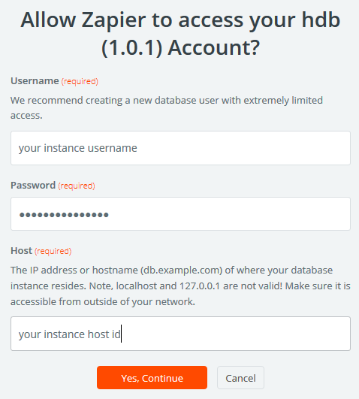
FEATURES
Authentication:
The app needs following instance’s detail:
HOST_ADDRESS
USERNAME
PASSWORD

Slide 6
FEATURES
Triggers:
Following are hidden triggers which are used by actions to fetch Schemas, Tables and Attributes.
Get All Schema: Fetch all the schemas from the db server.
Get All Tables: Fetch all the tables of the provided schema.
Get All Attributes: Fetch all the attributes of the provided table and schema.
Following are user facing triggers, not implemented and are for future scope.
Record Created & Record Updated :
These triggers need some subscription mechanism like Rest Hooks or Pub-Sub.
The cluster socket connection is not working in this case as after the subscription, the connection listens for new events that occur but in our case we need all the new event from our last listened offset like Pub-Sub.

Slide 7
FEATURES
Actions:
Following are Search Actions which are used to find data from the app:
Find A Record:
This will search record in the table via lookup Attribute.
Find Records via Custom Query:
This will search record in the table via custom query that user controls.
Find or Create A Record:
This will search record or alternatively create a new one if it does not exists.

Slide 8
FEATURES
Actions:
Following are Create Actions which are used to create records in the app using the data provided by the triggers:
Create A Record:
This will create a new record in the provided table and schema.
Update A Record:
This will update the existing record of the provided table and schema.
Update or Create A Record:
This will update an existing record or alternatively create a new one if it does not exist in the provided table and schema.

Slide 9

HOW THE APP WILL WORK?
Search/Select Our App
Select Trigger/Action(search or create)
Authenticate
Customize Row
Provide input details as required.
Test, review and done
Watch this video on How to Create Your First Zap in Zapier

Slide 10
FUTURE WORK
The app does not support any user facing triggers
Support for Record Created & Record Updated Triggers will be provided if some subscription mechanism like Rest Hooks or Pub-Sub is supported by the database.
The cluster socket connection is not working in this case as after the subscription, the connection listens for new events that occur but in our case we need all the new event from our last listened offset like Pub-Sub.
Support for more create actions can be given if the use case need it
Like Create a Table, Drop an Attribute, Drop Table etc.

Slide 11
THANK YOU

